Slide 1
Unit 9: What are you wearing?

Slide 2
Lesson Four: Phonics

Slide 3
1. Listen, point and repeat.

Slide 4
1. Listen, point and repeat.

Slide 5
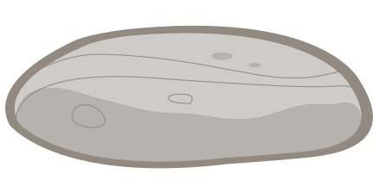
1. Listen, point and repeat.

Slide 6
1. Listen, point and repeat.

Slide 7
1. Listen, point and repeat.

Slide 8
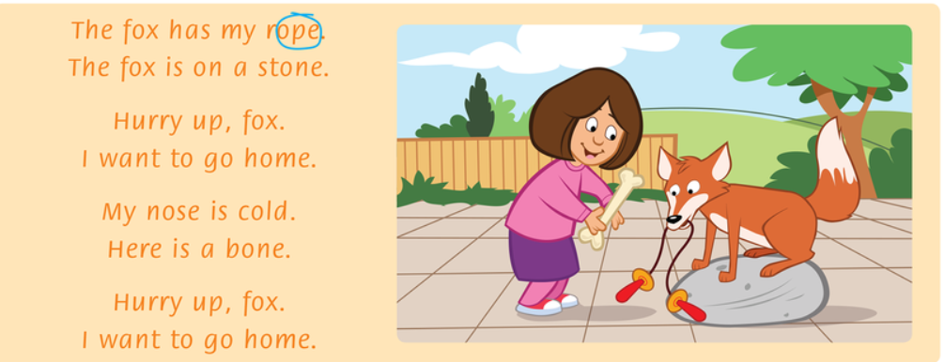
3. Read the chant

Slide 9
3. Read the chant again. Circle the sound o__e.

Slide 10
4. Listen and complete the words.
n s
st n
h m
b n

Slide 11
Lesson Five: Reading

Slide 12
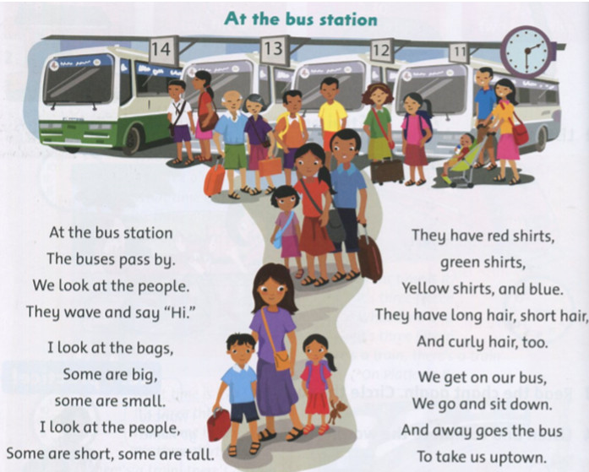
Look at the picture. What color is the bus? What time is it?

Slide 14
Read again

Slide 15
Read again.
Circle the false word and write the correct word.
1. They are at the train station. bus
2. The people say "Goodbye" . _____
3. Some bags are big. Some are short. ____
4. The shirts are red, green, orange, and blue. ____
“Hi”
small
yellow

Slide 16
Lesson Six: Listening
Page.65

Slide 17
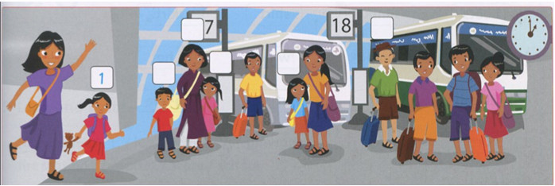
Listen and number.
3
4
2
6
5

Slide 18
Speaking
Point, ask, and answer.
+ What's she wearing? => She wearing …
+ He's wearing a red T-shirt. Who is it? => It's number …
3
4
2
6
5

Slide 19
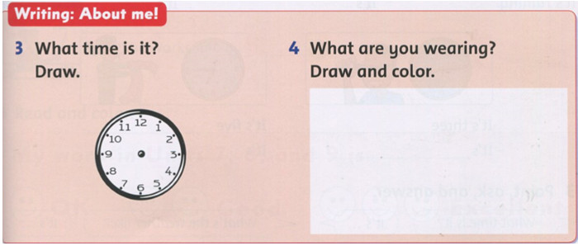
Writing

