Slide 1



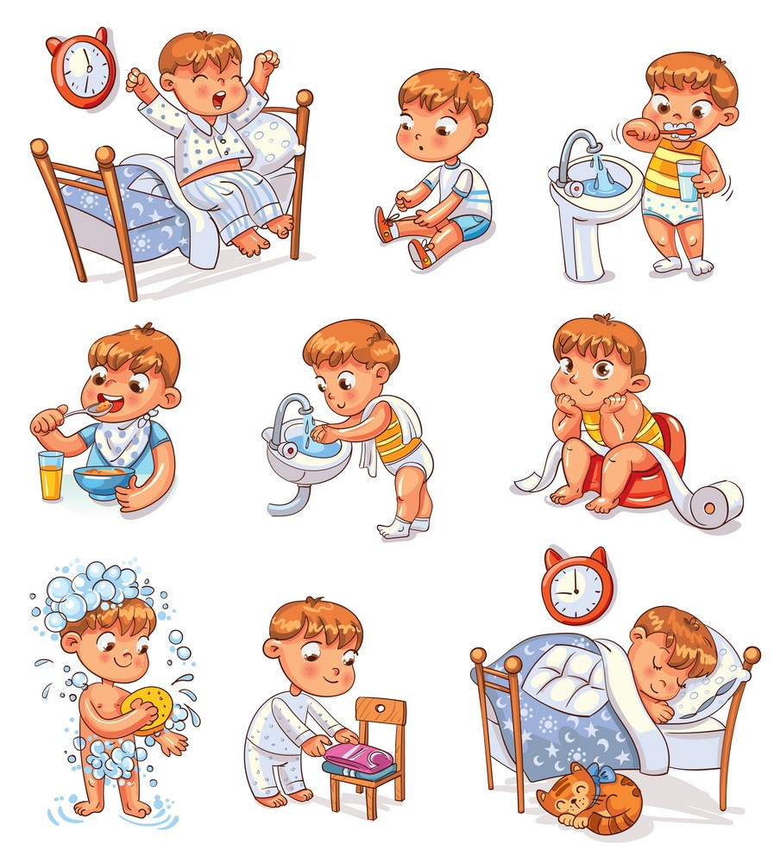
Family and Friend 4
Special Edition
UNIT 6
Jim’s day
Lesson 5
Teacher: Ms.Nuong
Grade 4
Week : 15

Slide 2

Monday, December 13th 2021
Unit 6 : Jim’s day
Lesson 5 : Skills time

Slide 3
WORDS

Slide 4


first

Slide 5

then

Slide 6

next

Slide 7

finally

Slide 8
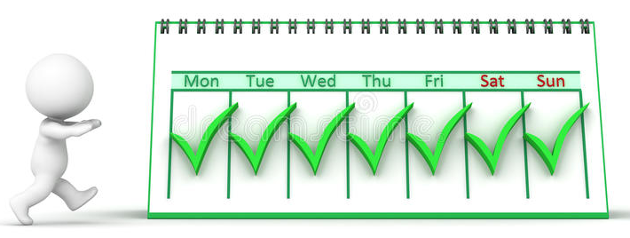
every day

Slide 9

LISTEN, POINT and REPEAT

Slide 10


Slide 11
Look at the text and answer:
Where does Thi live?

Slide 12
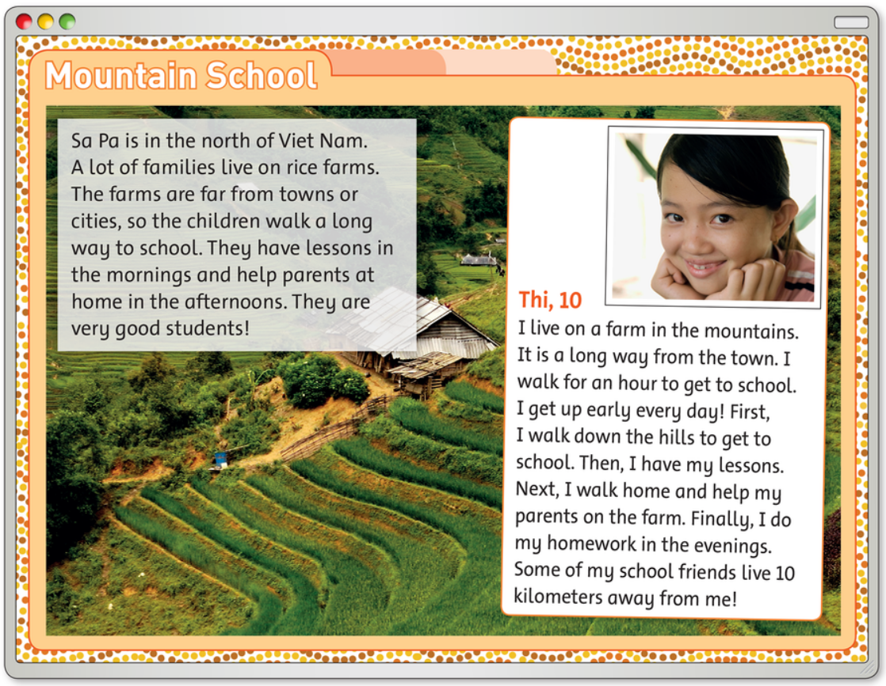

Slide 13
Task:
OPEN YOUR BOOK AND READ AGAIN

Slide 15
GAME TIME

Slide 16
READ and CHOOSE YES or NO.

Slide 17
Does Thi live in an apartment?
YES
NO

Slide 18
Is Sa Pa in the north of Vietnam?
YES
NO

Slide 19
Does Thi help her parents on the farm?
YES
NO

Slide 20
Does Thi get up late in the morning?
YES
NO

Slide 21
Does Thi catch a bus to school?
YES
NO

Slide 22

Does Thi live far away from some of her friends?
YES
NO

Slide 23
GOOD JOB!

Slide 24
TASK:
Read again and answer the question.
No, she doesn’t.
1. Does Thi live in a town? _________
2. Does Thi get up early? _________
3. Does Thi help her parents on the farm first?
________
4. Does Thi do homework in the evenings? ______
5. Does Thi go to school by motorcycle? ______
6. Does Thi live close to her friends? ______
Yes, she does.
No, she doesn’t.
Yes, she does.
No, she doesn’t.
No, she doesn’t.

Slide 25

HOMEWORK

Slide 26

Monday, December 13th 2021
Lesson 5: Skills time
first
next
then
finally
every day

Slide 27

Exercises in Workbook : Lesson 5 – P.44
- Preparing Unit 6 – Lesson 6 . Page 47

Slide 28




