Slide 1


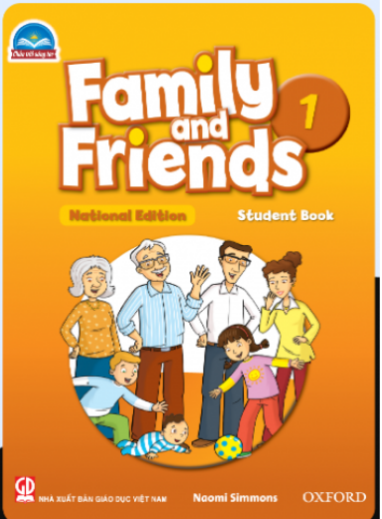

FAMILY and FRIENDS 1
National Edition
Teacher: Ms. Truc

Slide 2
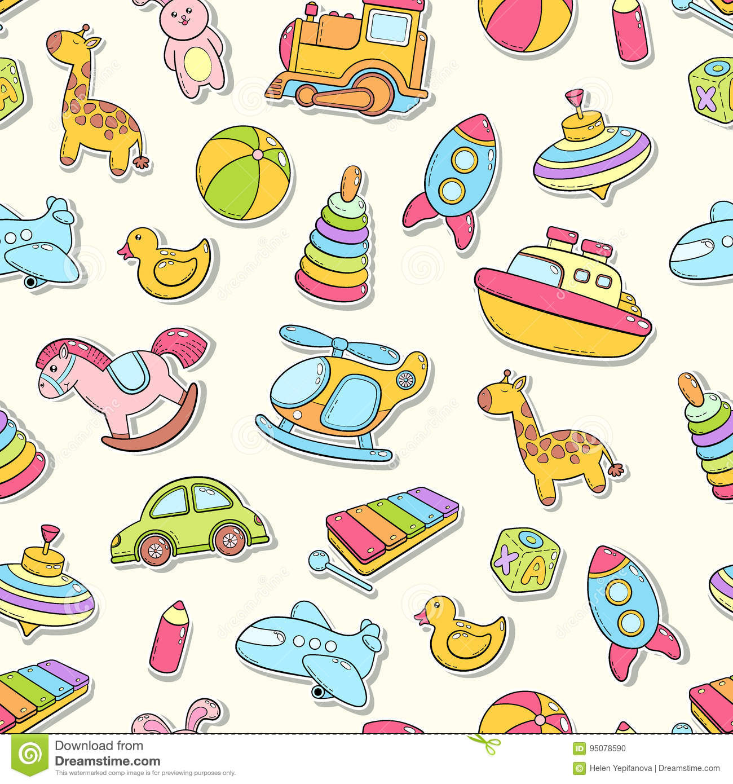
UNIT 3 : IS IT A PLANE ?
LESSON 2 : GRAMMAR AND SONG

Slide 3

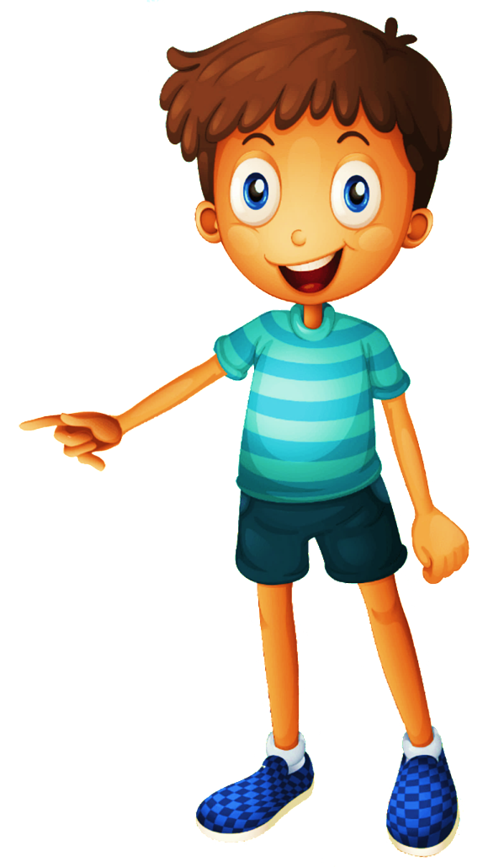


GUESSING GAME ON TOYS

Slide 4

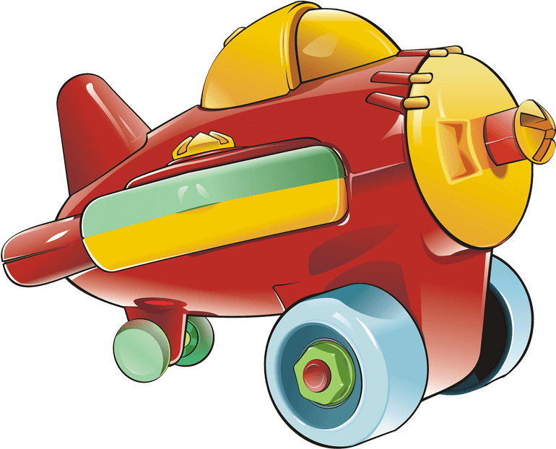

It’s a …
PLANE
Click here to guess what’s in the box

Slide 5
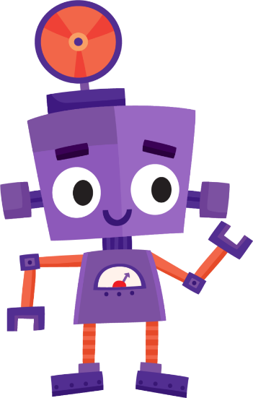
It’s a …
ROBOT
Click here to guess what’s in the box

Slide 6

It’s a …
BALLOON
Click here to guess what’s in the box

Slide 7
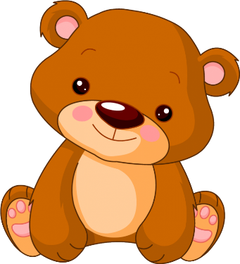
It’s a …
TEDDY BEAR
Click here to guess what’s in the box

Slide 8

It’s a …
PUPPET
Click here to guess what’s in the box

Slide 9

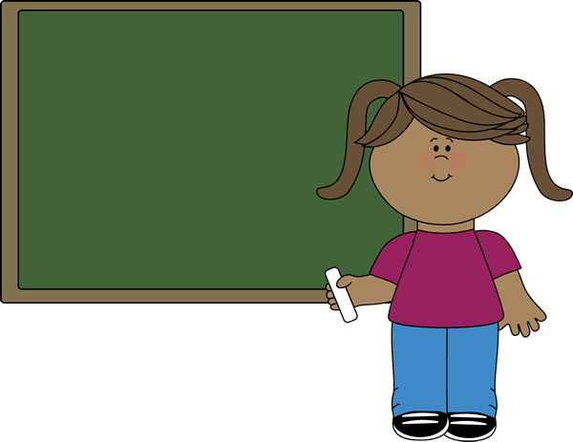



LISTEN and REPEAT
Yes , it is.
No , it isn’t.
Notes:
(One click for this slide.)
Listen and repeat track 39
- Play track 39, listen and point
- Play again, ask students to listen and point
- Play again, ask students to listen and repeat

Slide 10
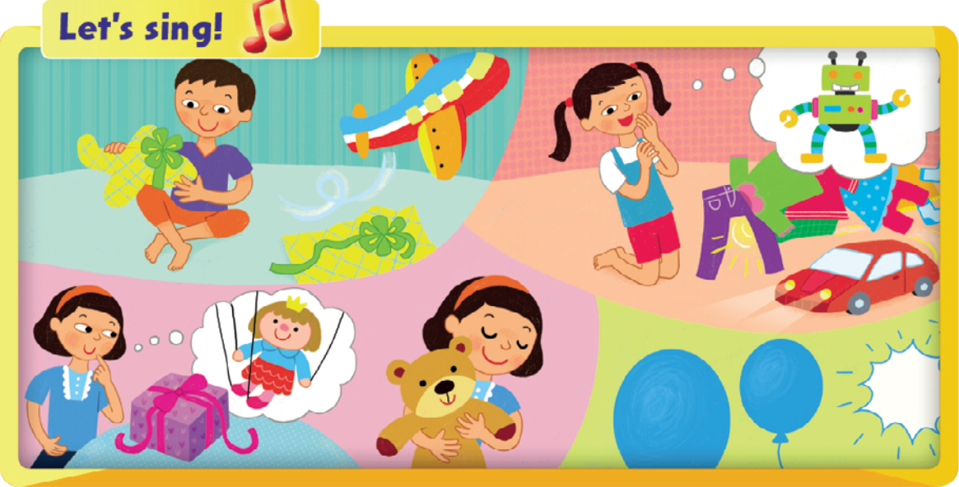

Notes:
Listen and sing. Track 40
Point to the picture and say: Is it a plane?
Elicit the answer: Yes, it is./ No, it isn’t.
Repeat with all toys with the whole class.

Slide 11



Who’s faster ?

Slide 12


Notes:
- Play the song.
- Demonstrate an action for each toy.
- Play the recording again and students listen and point to the toys as they hear the words.
- Practice several times singing and doing the actions.
• Below level:
- Divide the class into four groups and give each group a verse and an action of the song.
- Play the song again and encourage each group to sing their verse, and do their actions.
• At level: sing the song, do actions for all toys
• Above level:
- Practice the song and the actions.
- Pause after No or Yes, and elicit the rest of the line

Slide 13
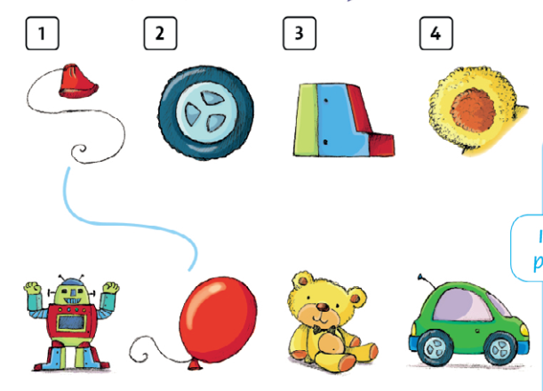

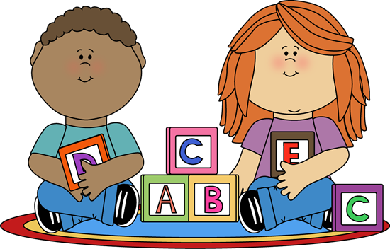
Match , ask ,and answer.
Notes:
Match, ask, and answer.
- Point to the two rows of pictures. Explain that the pictures on the top row are small parts of the toys below.
- Point to the top picture and say Is it a plane? Elicit No, it isn’t.
- Say Is it a teddy bear? and elicit the same answer.
- Ask Is it a balloon? Nod your head to encourage children to say Yes, it is. It’s a balloon.
- Repeat the same steps with the other pictures.

Slide 14

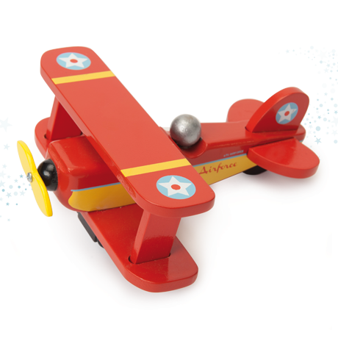
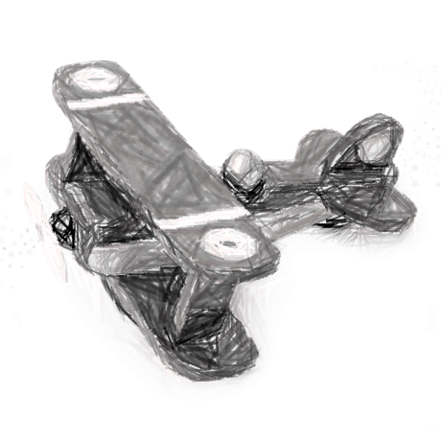

Let’s talk !
Is it a plane ?
Yes, it is.
No, it isn’t.
Notes:
- Have two students demonstrate the question in the speech bubble and the answer (No, it isn’t. It’s a teddy bear.).
- Have students work in pairs to ask and answer the question. Tell them to use other toy words on the page.

Slide 15
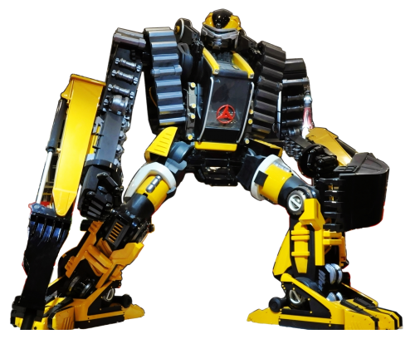
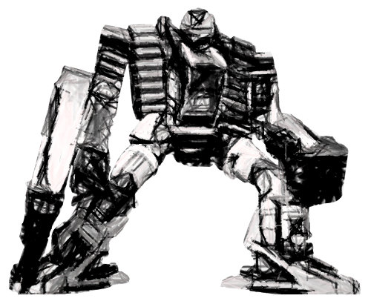
Let’s talk !
Is it a plane ?
Yes, it is.
No, it isn’t.

Slide 16
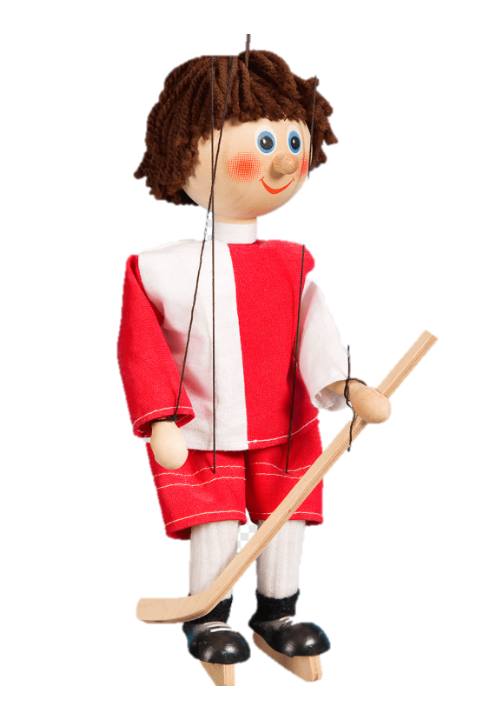
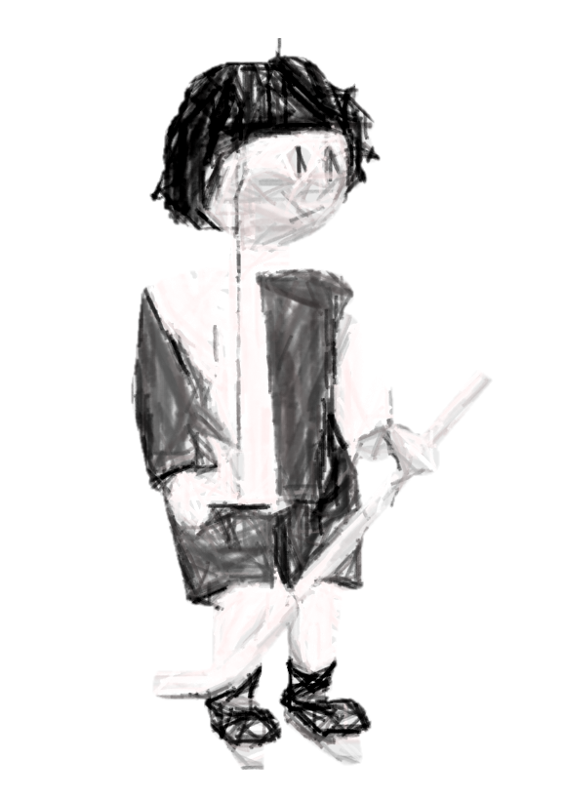
Let’s talk !
Is it a puppet ?
Yes, it is.
No, it isn’t.

Slide 17
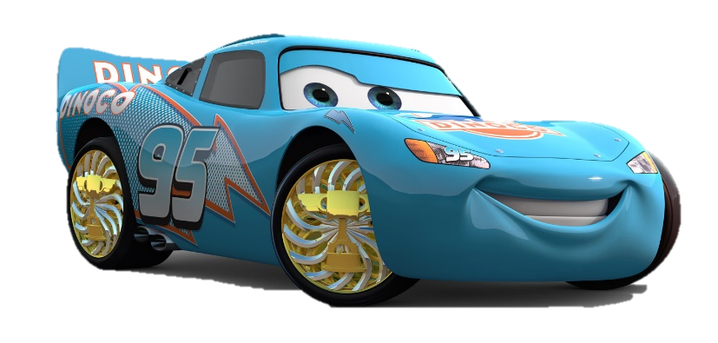
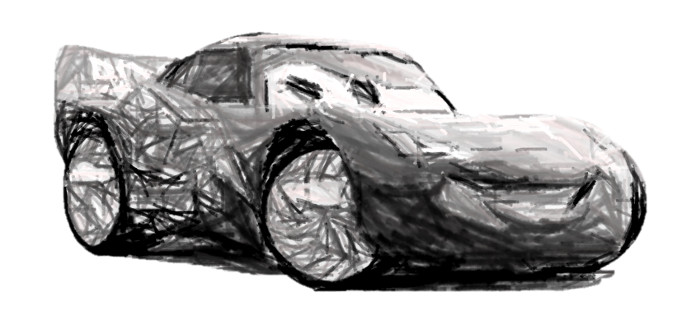
Let’s talk !
Is it a teddy bear ?
Yes, it is.
No, it isn’t.

Slide 18
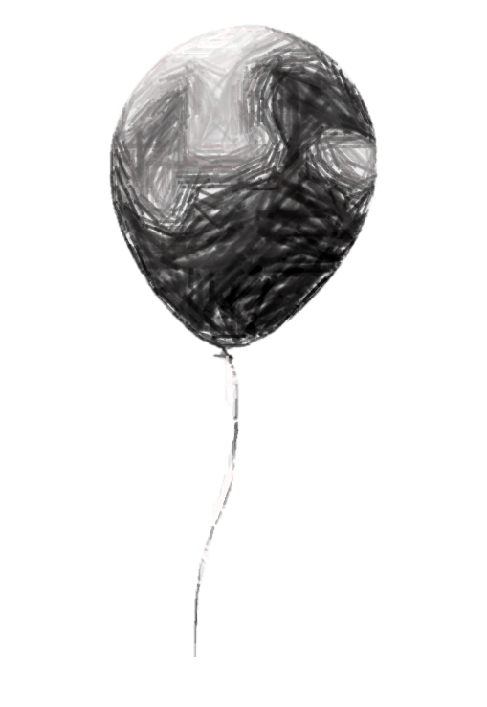

Let’s talk !
Is it a balloon?
Yes, it is.
No, it isn’t.

Slide 19
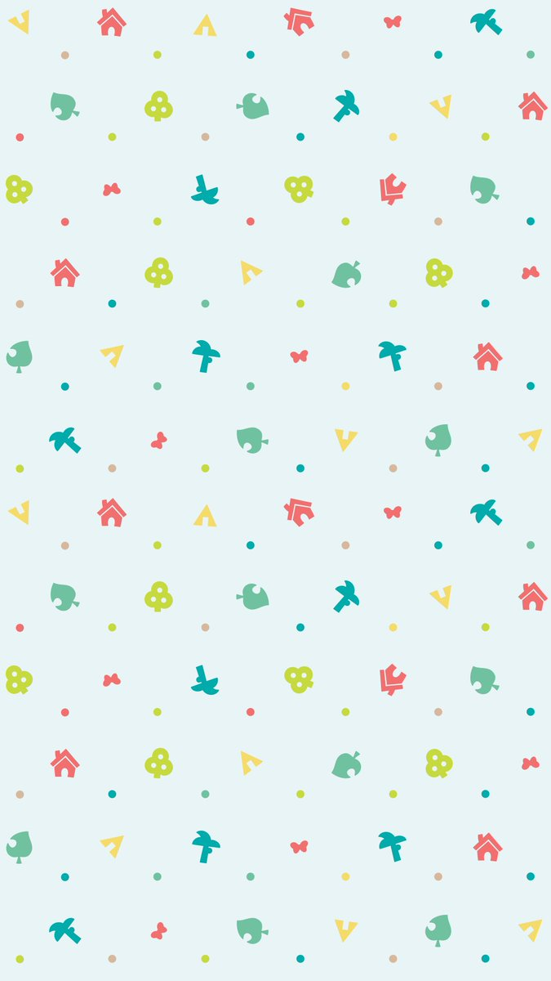

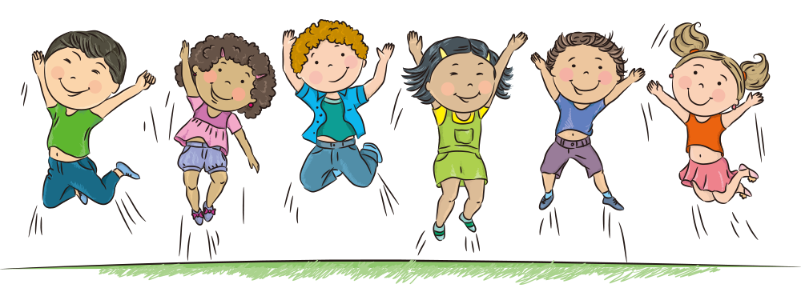
Goodbye!

