Slide 1




FAMILY and FRIENDS 1
National Edition
TEACHER: MS. TRUC

Slide 2

UNIT 3 : IS IT A PLANE ?
LESSON 5 : SOUNDS AND LETTERS

Slide 3

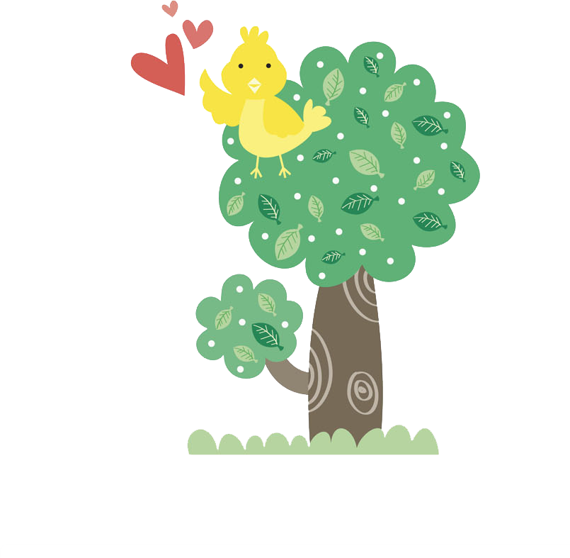




Notes:
- Show the uppercase H and lowercase h.
- Say the sound /h/
- Draw dotted outlines of the uppercase H and lowercase h on the board.
- Ask different students to come to the board and connect the dots.

Slide 4




h
Notes:
Listen, point, and repeat. Write. Track 45
- Play the first part of track 45, listen and point (for the letter h)
- Play again, ask students to listen and point
- Play again, ask students to listen and repeat
- Model the writing activity

Slide 5

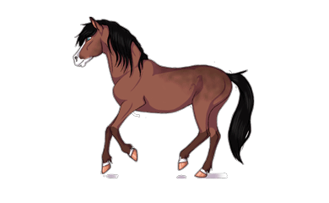


h

Slide 6
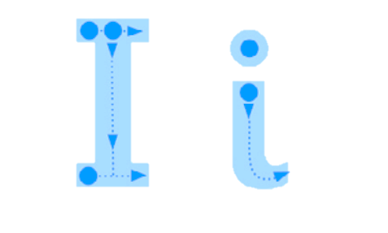
Notes:
- Show the uppercase I and lowercase i.
- Say the sound /i/
- Draw dotted outlines of the uppercase I and lowercase i on the board.
- Ask different students to come to the board and connect the dots.

Slide 7


Slide 8
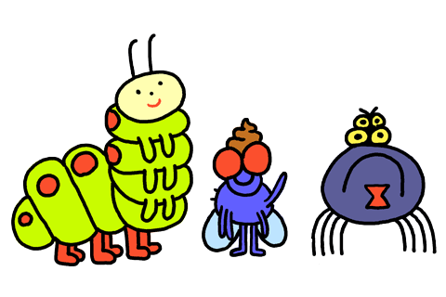

i
Notes:
Listen, point, and repeat. Write. Track 45
- Play the second part of track 45, listen and point (for the letter i)
- Play again, ask students to listen and point
- Play again, ask students to listen and repeat
- Model the writing activity

Slide 9




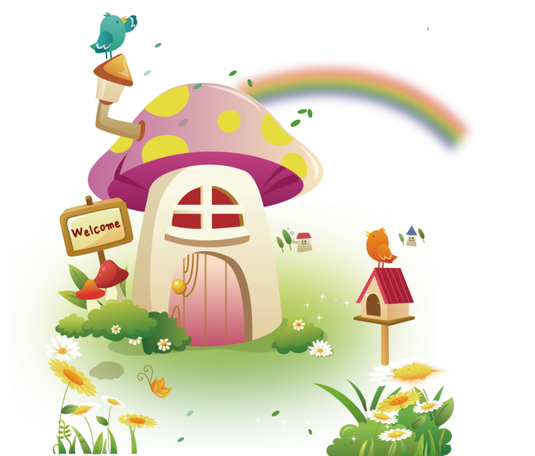
i

Slide 10


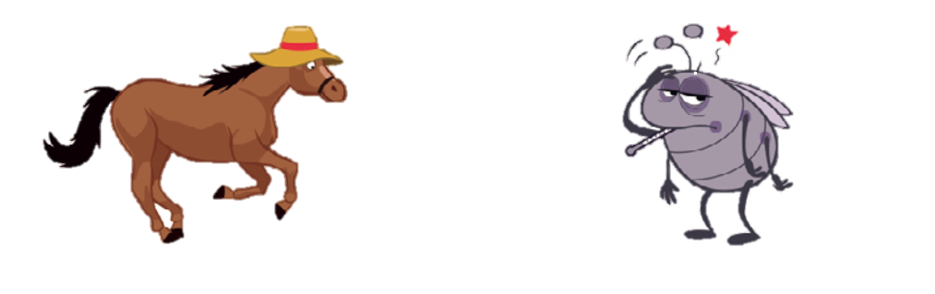

Notes:
Listen and chant: track 46
- Point to the picture and say: “A horse with a hat.”
- Point to the insect and say: “an insect… it’s ill.”
- Play the recording, ask students to listen to the chant.
- Put Phonics cards 15-18 on the board.
- Play the chant again
- Students point to the cards.
- Play the chant again, pause for students to repeat.
Below level: Ask four students to come to the front and give each child a phonics card (15–18). The child at the front jumps up when his/her word is said.
At level: Teach actions for each of the four words:
horse – raise your head and hands as if rearing,
hat – put a hand to your head,
insect – flap hands like wings,
ill – put hands to stomach and look unhappy.
- Divide the class into four groups and assign each group a word and action.
- Tell groups to do their action when they hear and say their word.
Above level: Practice the actions above with the whole class and encourage them to do all the actions when they say the chant.

Slide 11

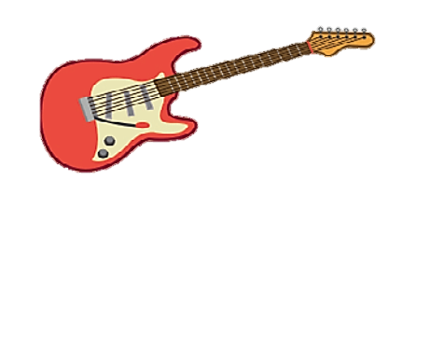
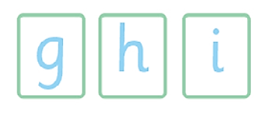


Notes:
Stick and say.
- Point to the pictures and elicit the words: guitar, horse, insect
- Point to the letters under the guitar and say /g/ – guitar. Then elicit the /h/ sound for the next picture and the /ɪ/ for the last picture.
- Say: Let’s stick! Hold up the g sticker. Say the sound /g/.
- Say Now your turn!
- Ask students to connect and say.

Slide 12





Slide 13

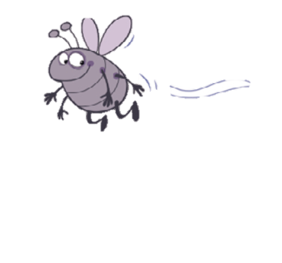


Slide 14

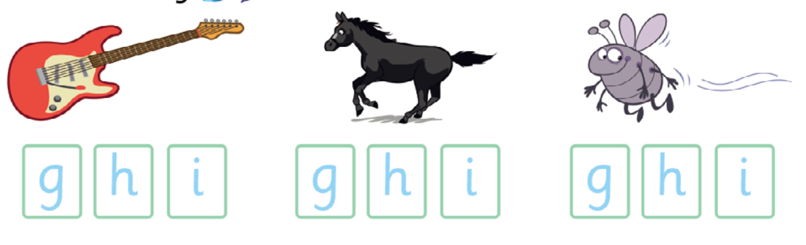

Slide 15

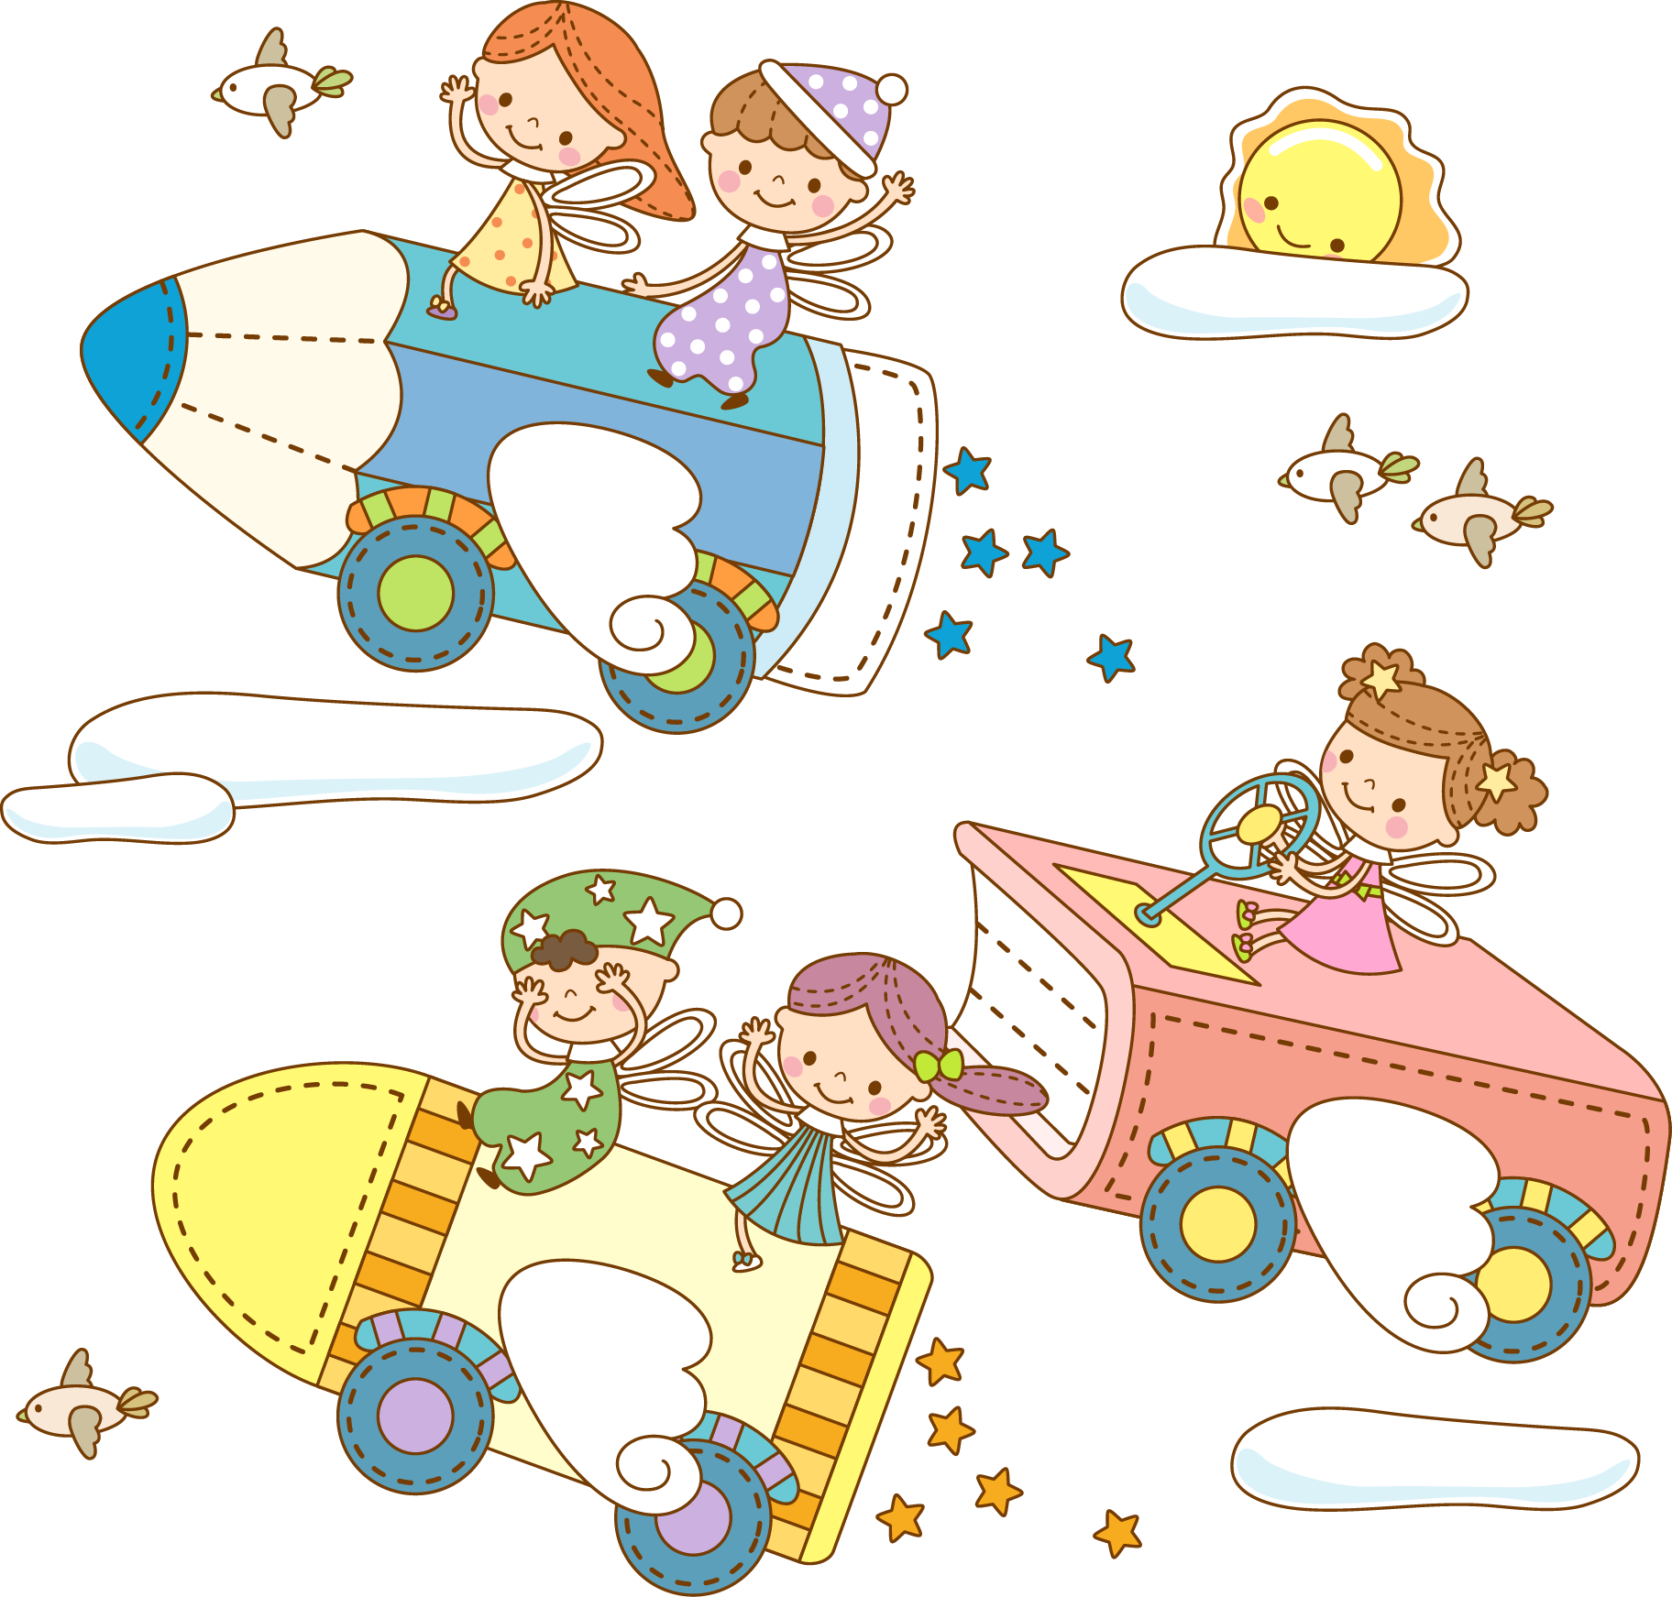

Goodbye !

