Slide 1
Grade 3
Teacher: Ms. Tuyen
Unit 8: IT’S HOT TODAY!
Lesson 1

Slide 2
NEW WORDS

Slide 4
WORDS
hot
raining
windy
sunny
snowing

Slide 5
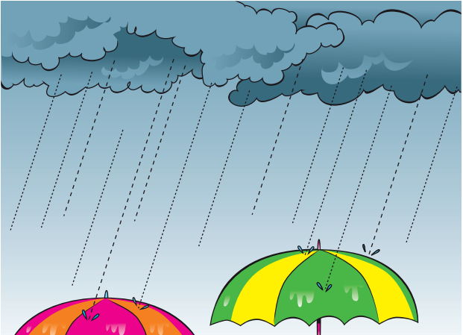
Listen and choose
A.
B.
C.

Slide 6
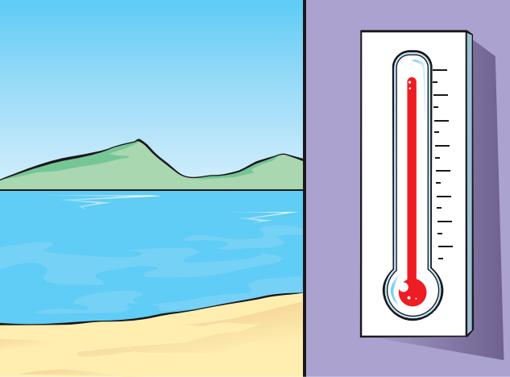
Listen and choose
A.
B.
C.

Slide 7
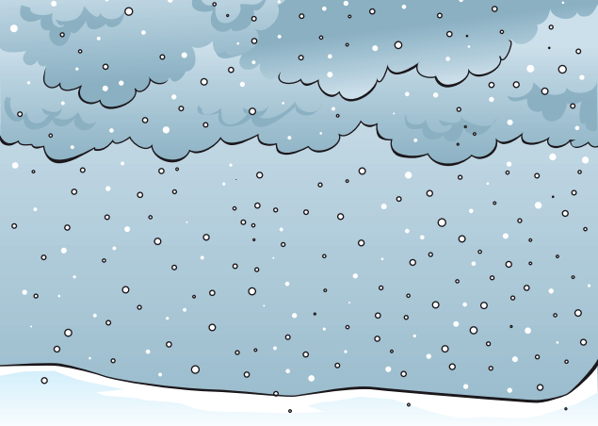
Listen and choose
A.
B.
C.

Slide 8
Listen and choose
A.
B.
C.

Slide 9
Listen and choose
A.
B.
C.

Slide 10
Story

Slide 11
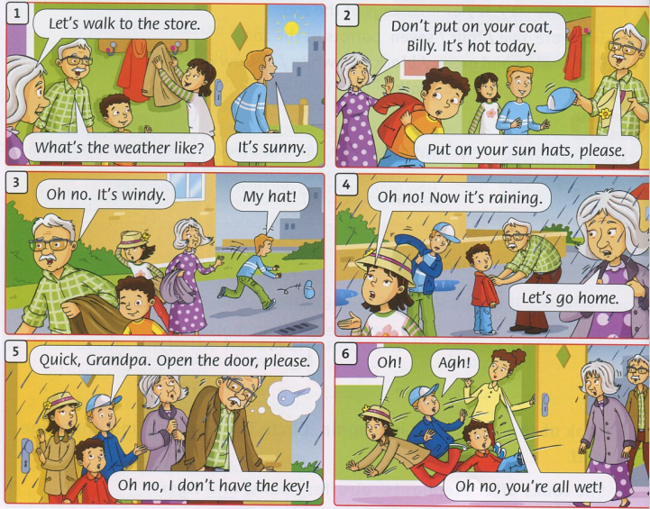
Listen and read

Slide 12
Goodbye~!

Slide 13
Monday, February 21st, 2022
Unit 8: It’s hot today!
Lesson 1 - Words
raining
raining
raining
raining
windy
windy
windy
windy
hot
hot
hot
hot
snowing
snowing
snowing
snowing
sunny
sunny
sunny
sunny

