Slide 1
Family and friends Grade 3
Unit 8: It’s hot today!
Lesson 3: Song

Slide 2
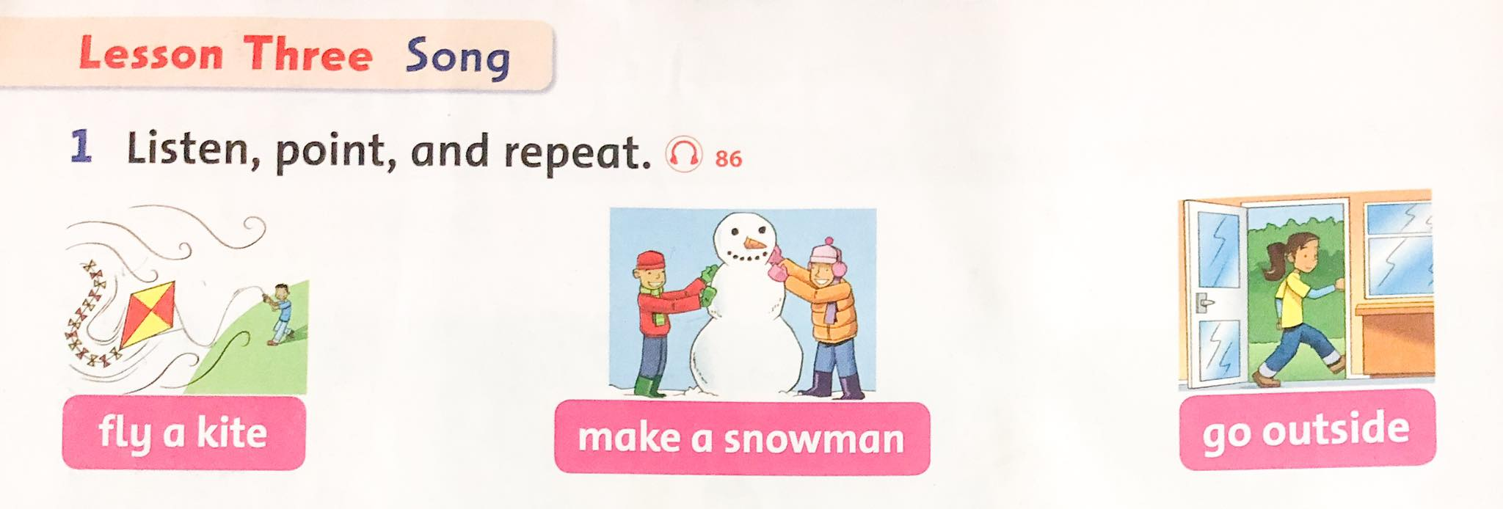

Slide 3
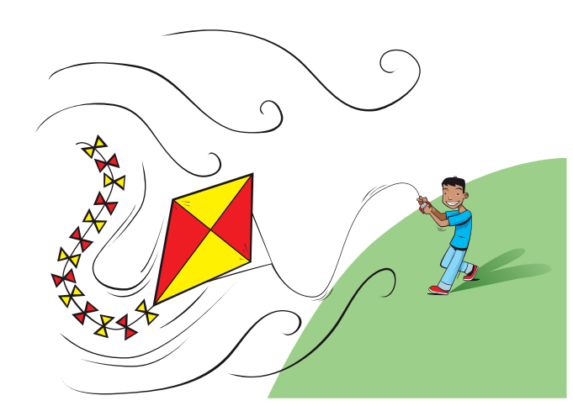
fly a kite
thả diều

Slide 4
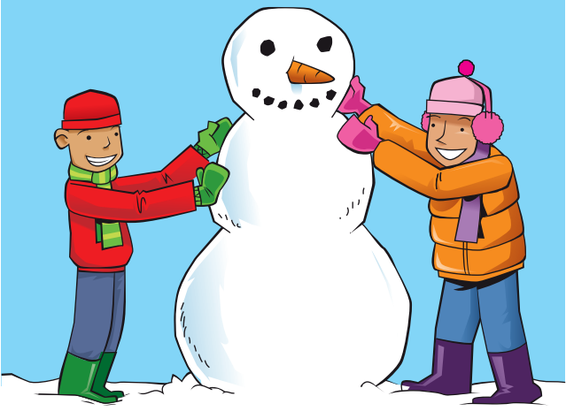
make a snowman
làm người tuyết

Slide 5
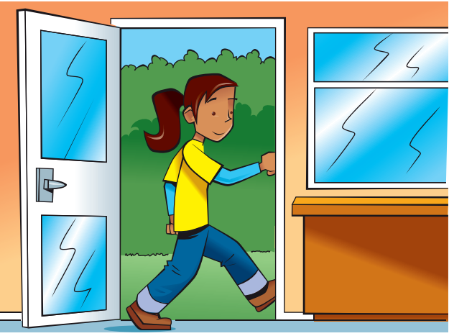
go outside
đi ra ngoài

Slide 6
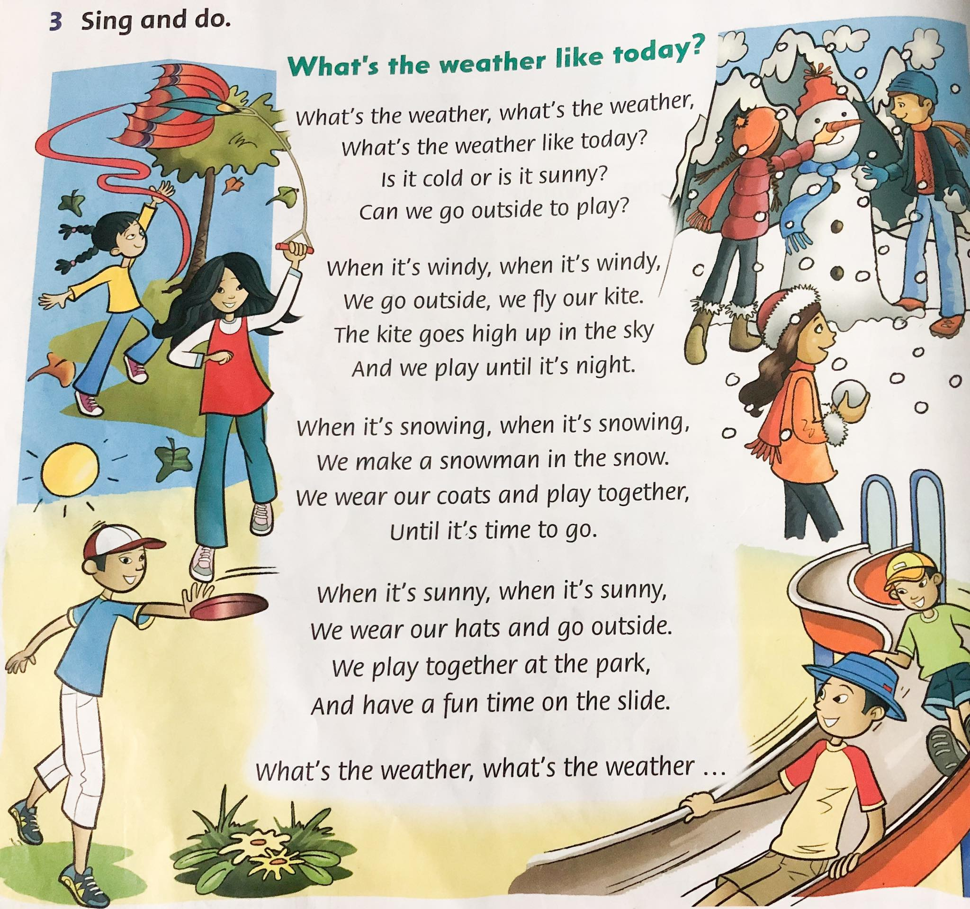

Slide 7
Exercise 1: Read and match
Don’t close
Put on
Don’t go
Don’t fly
Let’s make
Let’s
go home
outside
your kite
the door
a snowman
your hat

Slide 8
Exercise 2: Fill in the blanks
h_t
_unn_
w_n_y
sn_w_ng
r_in_ng
g_ o_tsi_e
m_k_ a s_owm_n
fl_ a k_t_

