Slide 1




PEOPLE’S COMMITTEE OF TAN BINH DISTRICT
CHI LANG PRIMARY SCHOOL
Grade: 2
UNIT 2: SHAPES
Teacher: Hoàng Thị Thanh Thảo

Slide 2
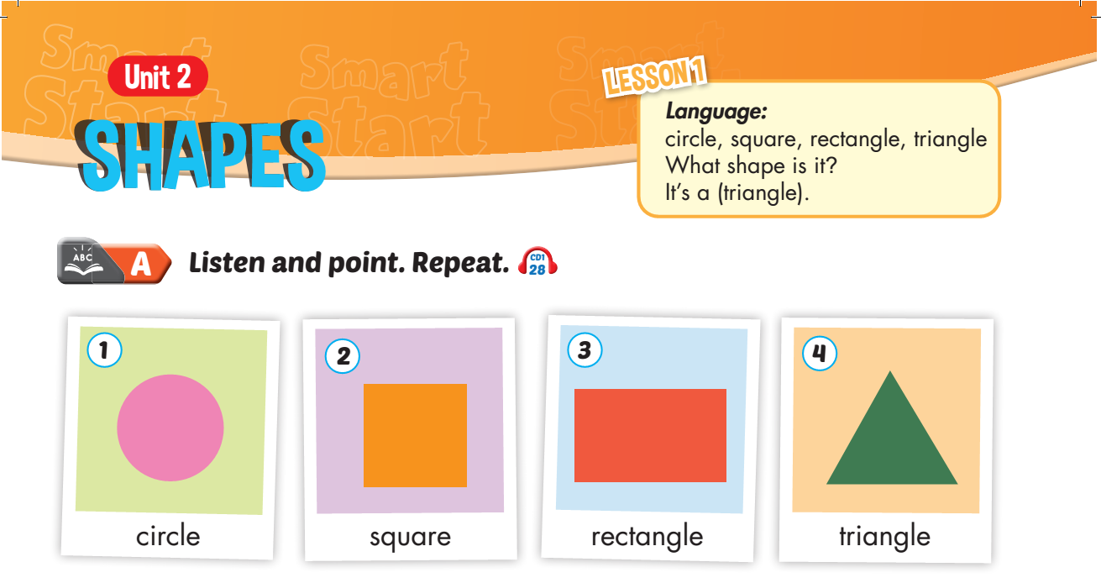


Slide 3
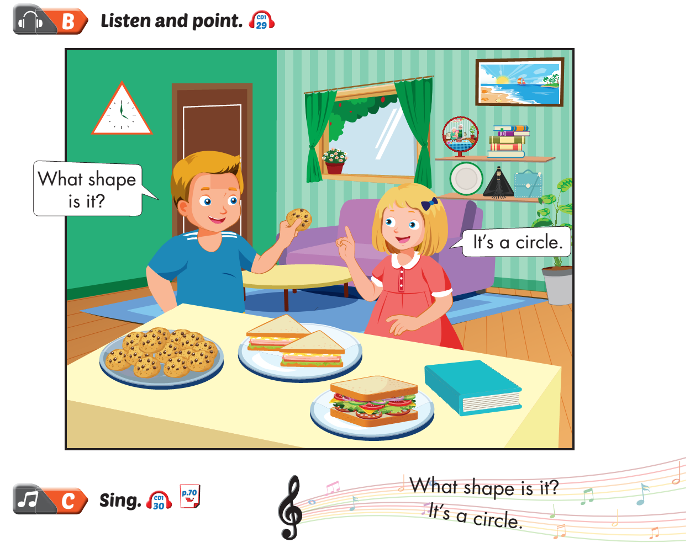
Lesson 1

Slide 4
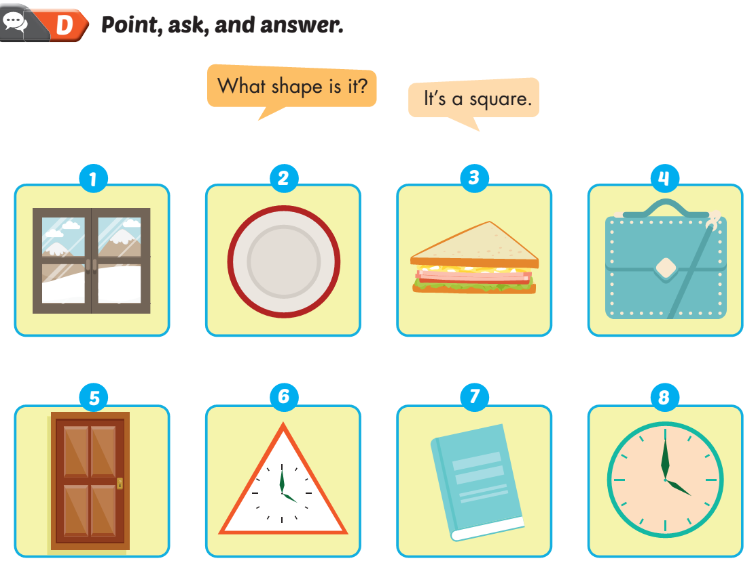
Lesson 1

Slide 5
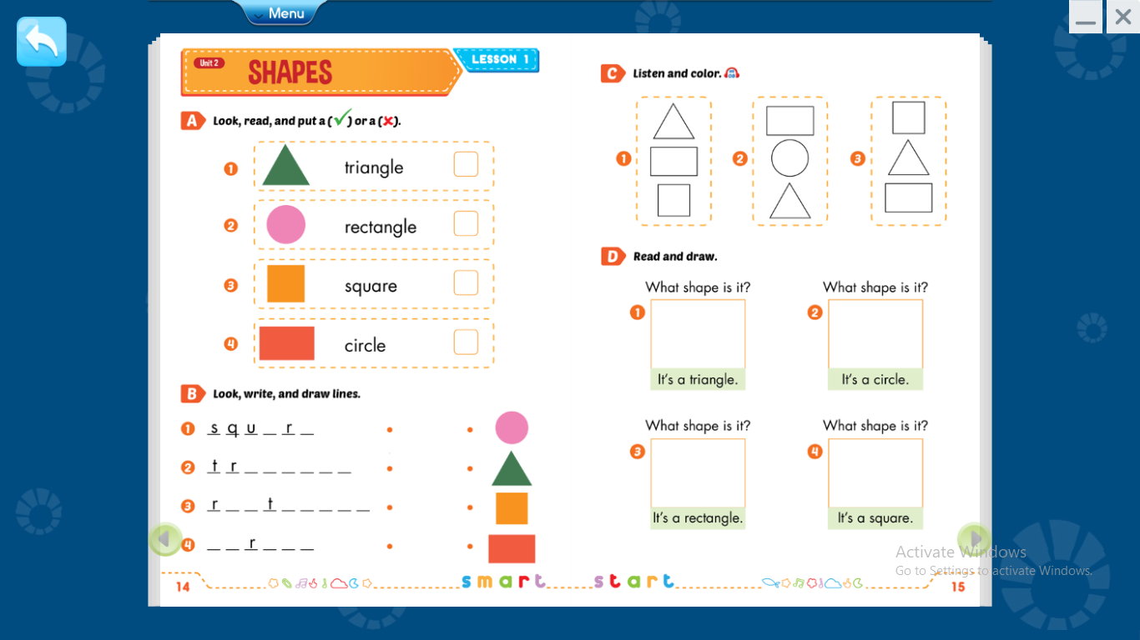



Slide 7
a e
i a n g l e
e c a n g l e
c i c l e

Slide 8






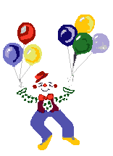
Thank you for enjoying
the lesson !

