Slide 1




PEOPLE’S COMMITTEE OF TAN BINH DISTRICT
CHI LANG PRIMARY SCHOOL
Grade: 2
UNIT 5: FREE TIME ACTIVITIES
Teacher: Hoàng Thị Thanh Thảo

Slide 2
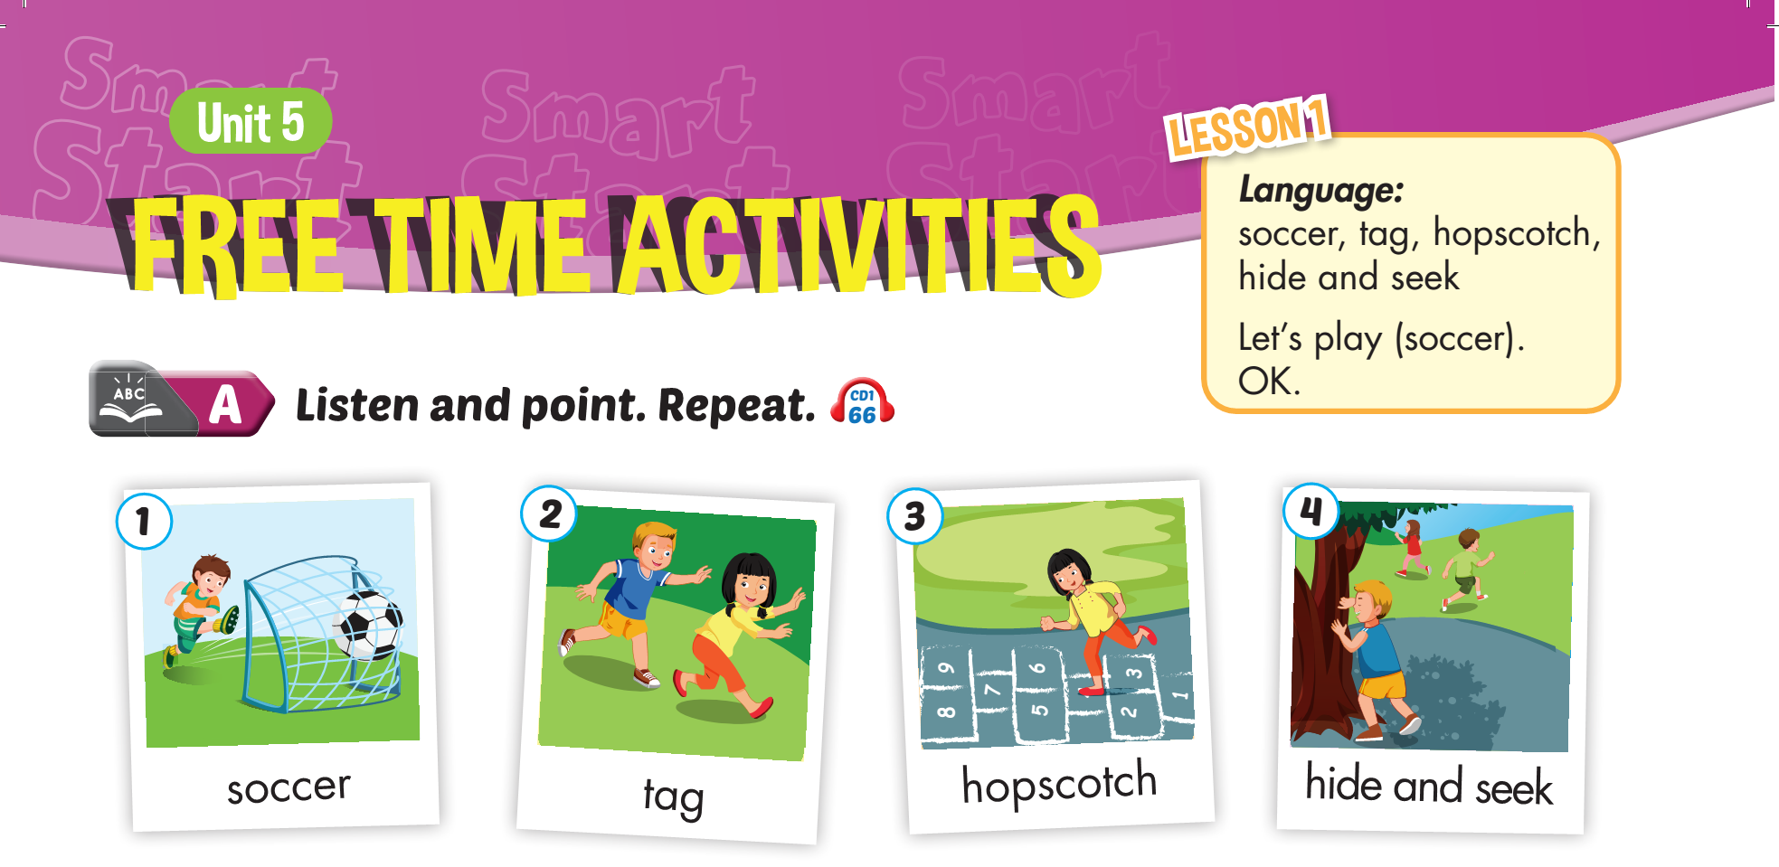


Slide 7
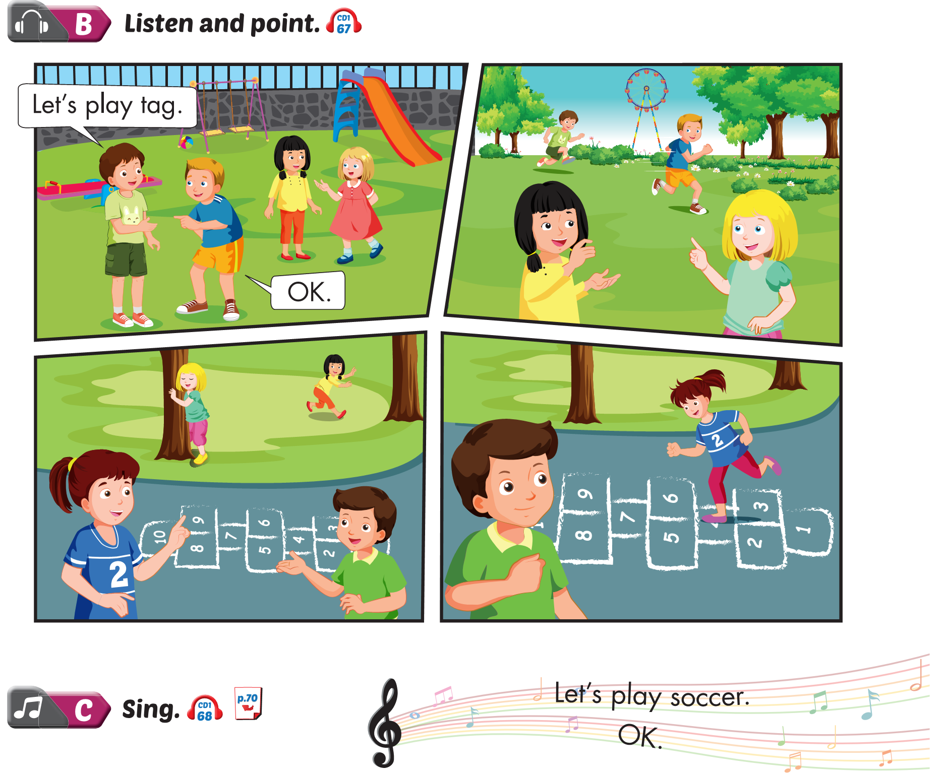
Lesson 1
tag.
Let’s play ……..
ok.

Slide 8
Let’s play

Slide 9
Let’s play

Slide 10
Let’s play

Slide 11
Let’s play

Slide 12
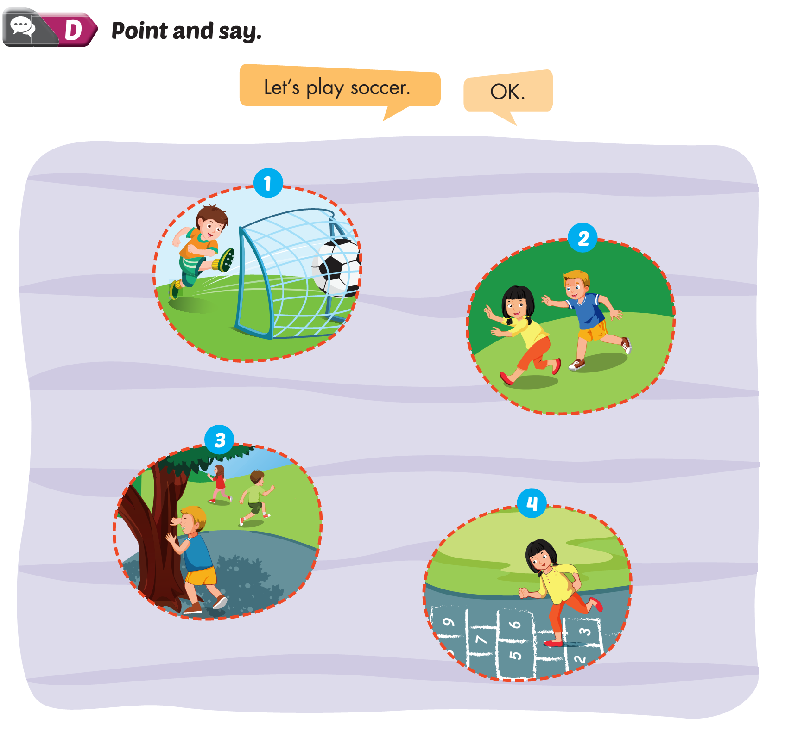
Lesson 1
soccer
1. Let’s play ……..
tag
2. Let’s play ……..
hide and seek
3. Let’s play ……..
hopscotch
4. Let’s play ……..

Slide 13
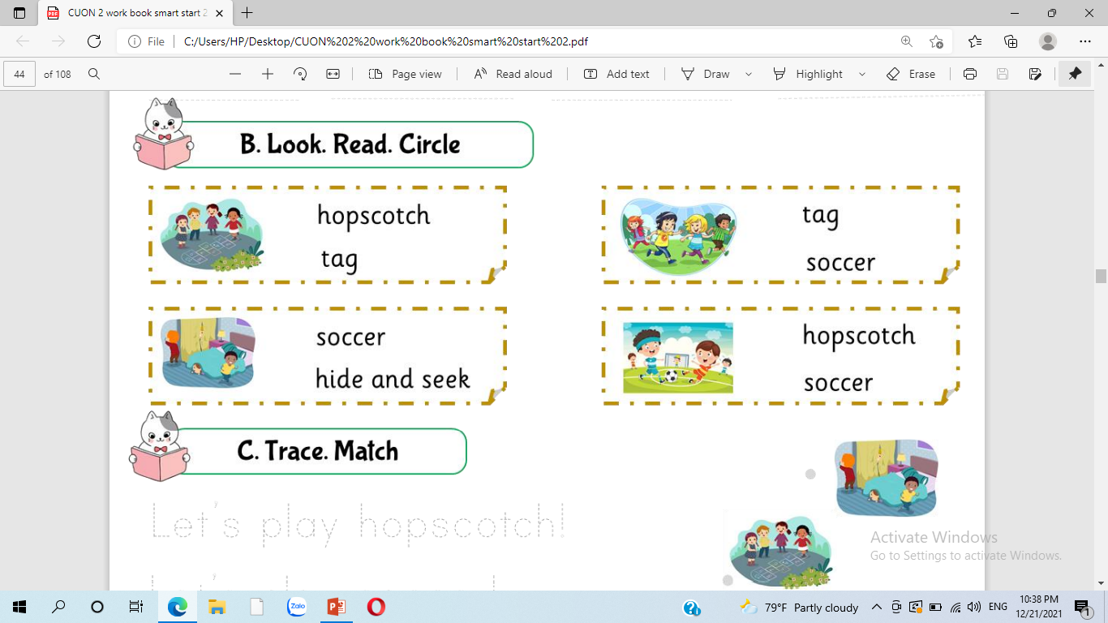

Slide 14
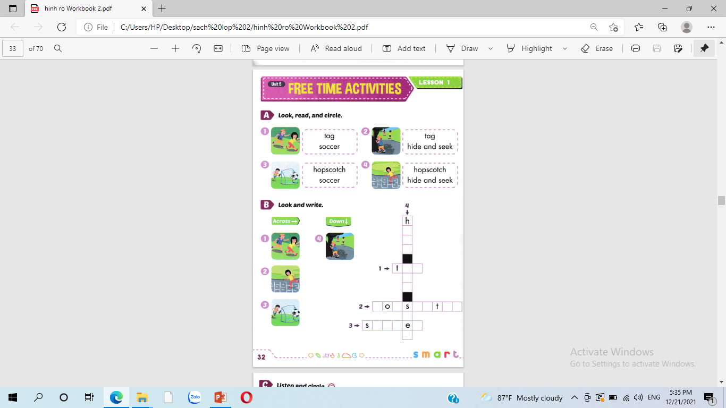

Slide 15
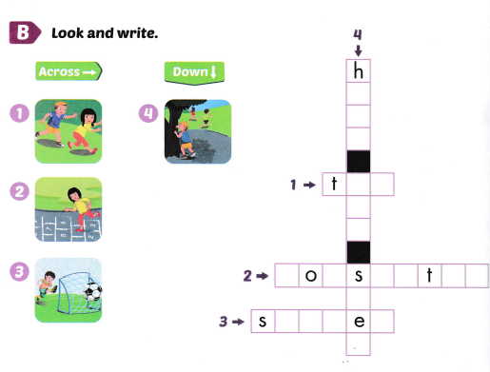
i
d
e
a g
n
d
h p c o c h
e
k
o c c r

Slide 16
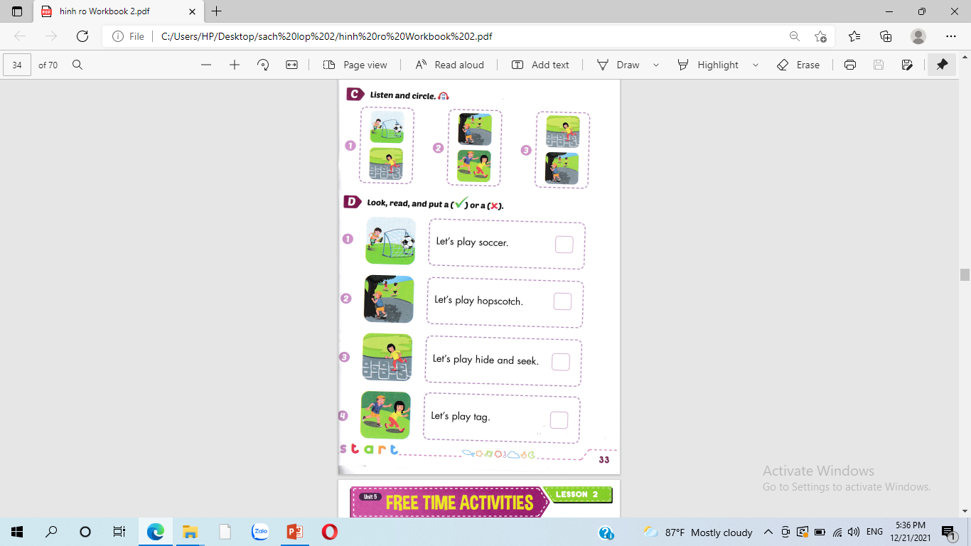



Slide 17






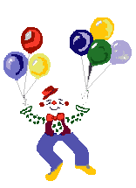
Thank you for enjoying
the lesson !

