Slide 1




PEOPLE’S COMMITTEE OF TAN BINH DISTRICT
CHI LANG PRIMARY SCHOOL
Grade: 2
UNIT 4: ANIMALS
Teacher: Hoàng Thị Thanh Thảo

Slide 2
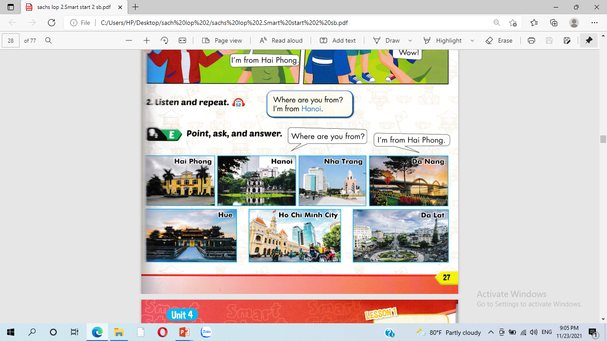
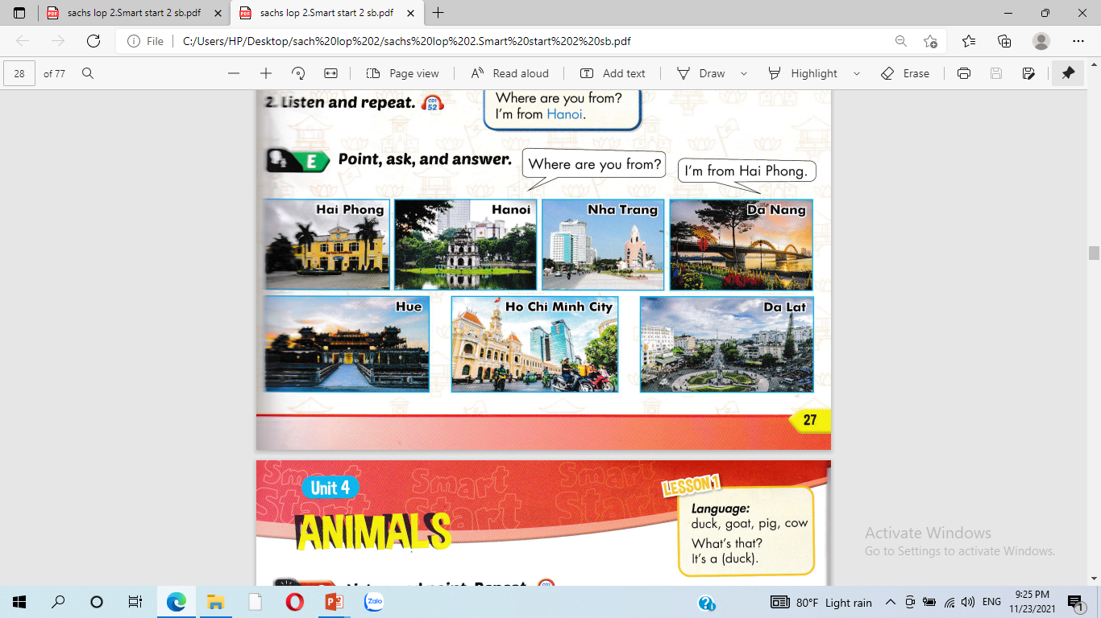
Where are you from?
I’m from Nha Trang.
Where are you from?
I’m from Ho Chi Minh City.

Slide 3
Ho Chi Minh City.

Slide 4
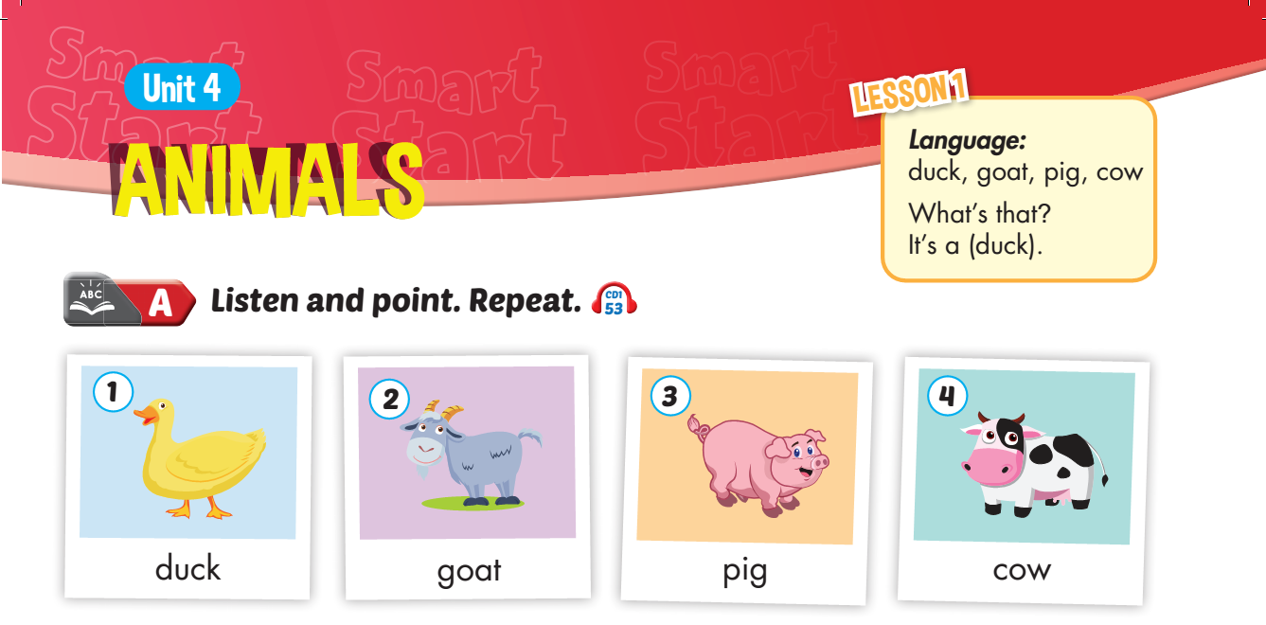


Slide 5
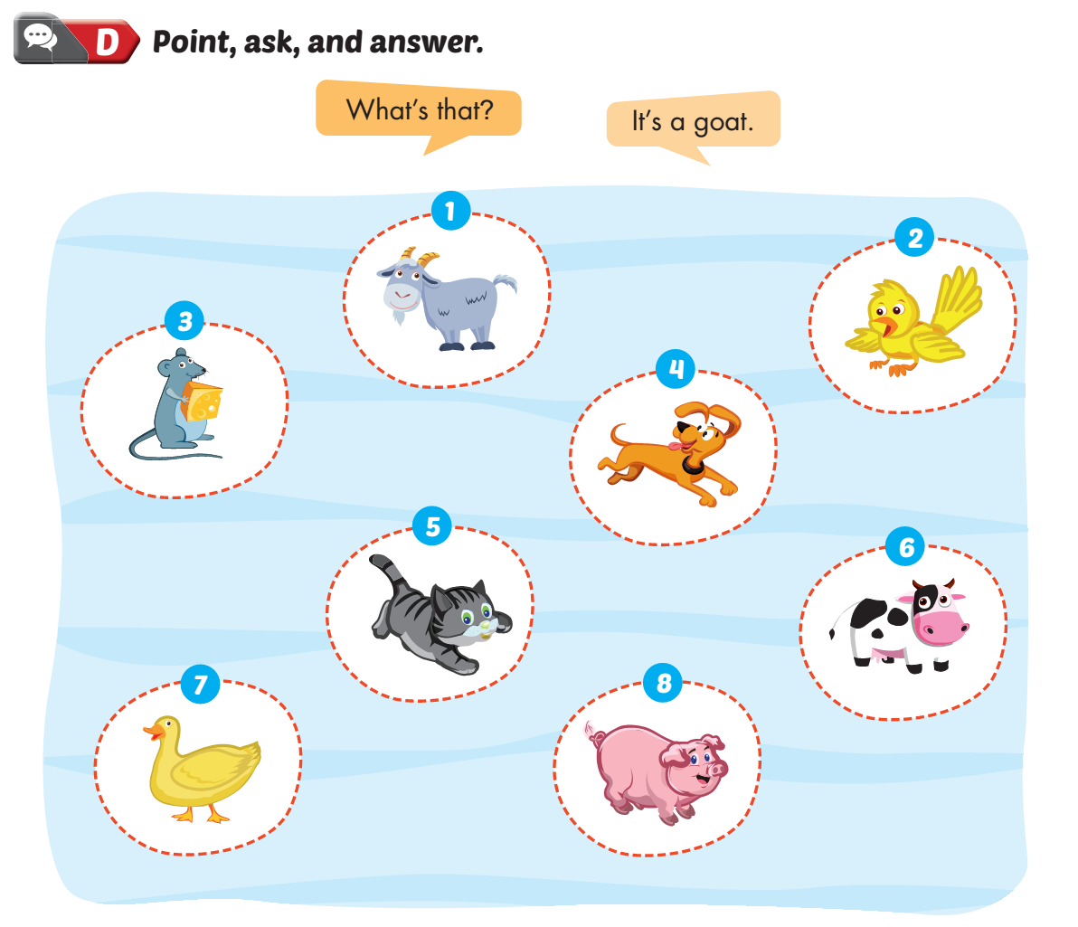
Lesson 1

Slide 6
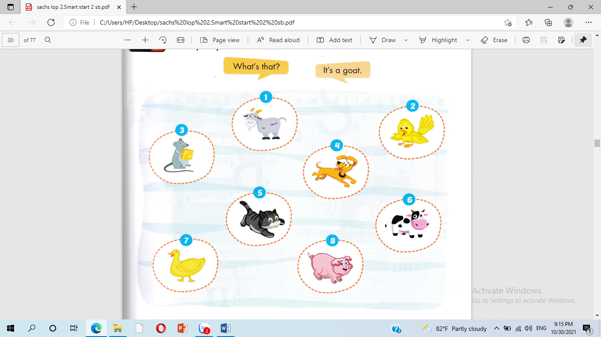
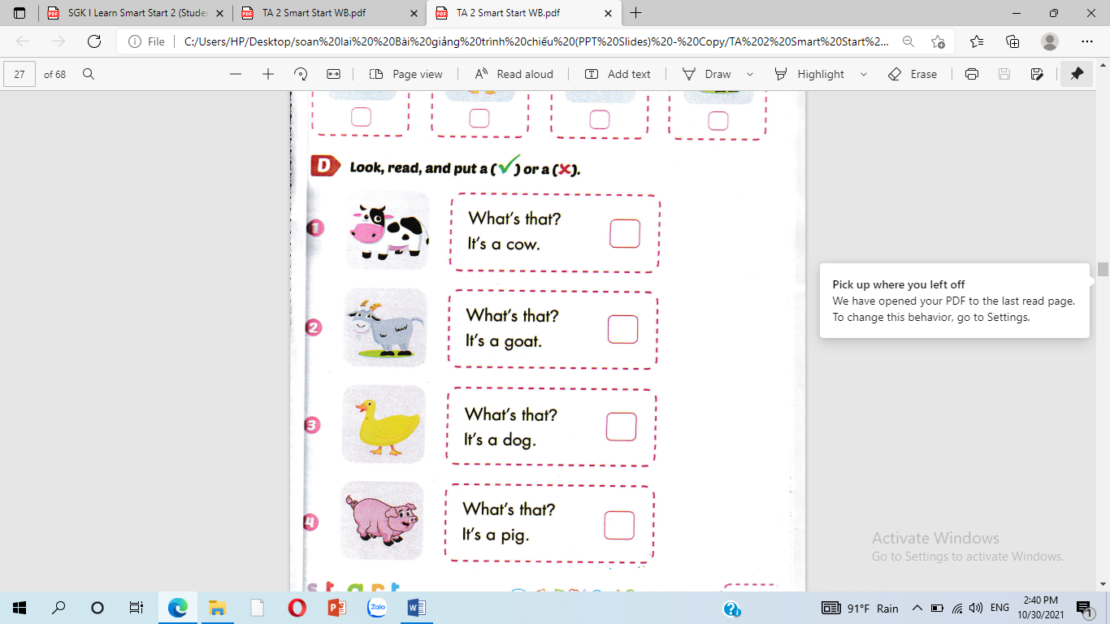
What’s that ?
It’s a ………….

Slide 7
What’s that ?
It’s a ………….

Slide 8
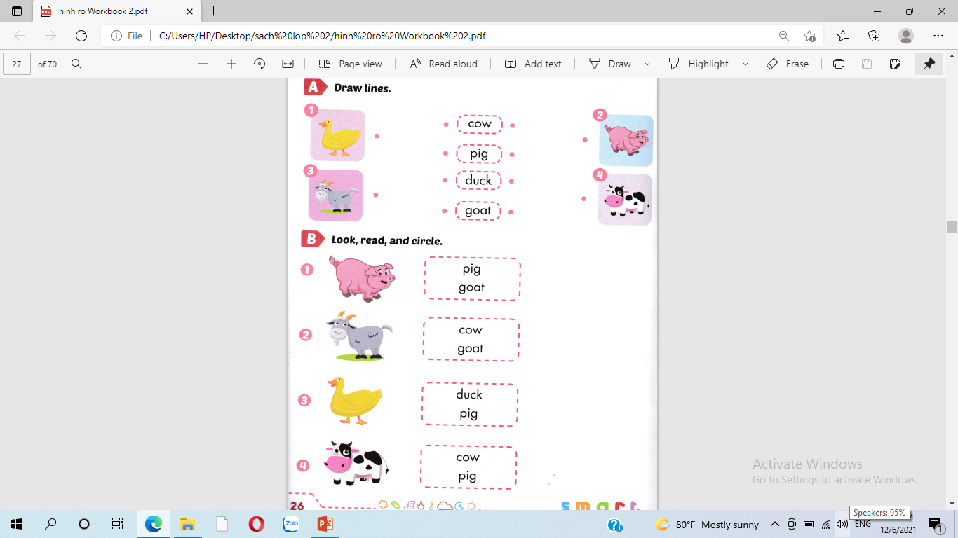

Slide 10
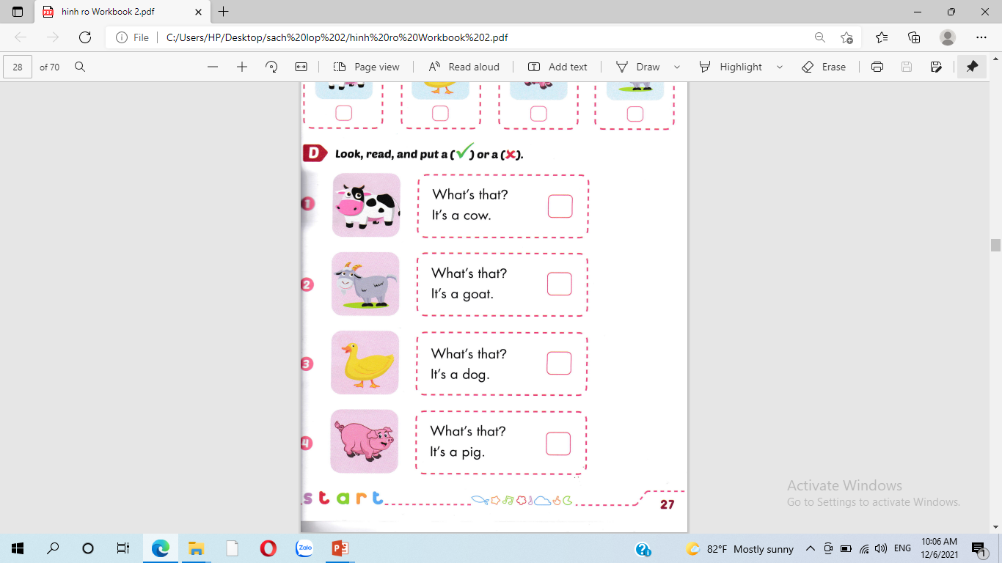



Slide 11






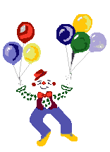
Thank you for enjoying
the lesson !

