Slide 1







PEOPLE’S COMMITTEE OF TAN BINH DISTRICT
CHI LANG PRIMARY SCHOOL
Grade: 5
Review (5)
Teacher: Hoàng Thị Thanh Thảo

Slide 2
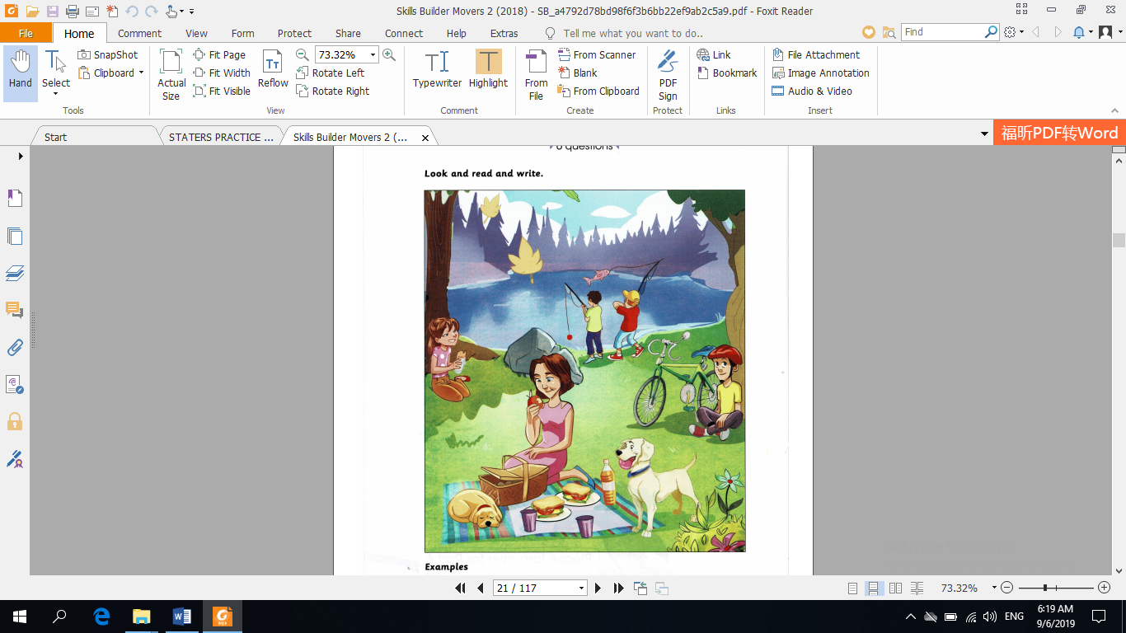
REVIEW (5)
Look and read. Write Yes or No. There are two examples.
Ex: There were two bottles of water near the girl. … No….
One of the boys by the lake caught a big fish. …Yes…
Questions
1. The boy sat under the tree wasn’t wearing a jacket. ……………
2. The bigger dog was sleeping next to the basket. ……………
3. Two boys wore backpacks and uniforms were fishing. ..…………..
Yes
No
No

Slide 3
REVIEW (5)
Read and write (T) or (F). There are two examples.
 |  | T | F
Ex | Fossils are parts of animals that died a very long time ago. | T
 | Fossils are parts of insects that died a very long time ago. |  | F
1 | All of fossils are more than 500 million years old.
2 | Fossils are important because they tell us about the past, help us learn about types of rocks and animals that lived a very long time ago.
3 | People can find fossils on mountains, in lakes, in rivers, on beaches but people can’t find fossils under the ground.
FOSSILS
What are fossils?
Fossils are parts of animals that died a very long time ago. You can find fossils in rocks. You can see the shape of the animal. Some fossils are more than 500 million years old.
Why are fossils important?
Fossils tell us about the past. We can learn about types of rocks and we can learn about animals that lived a very long time ago.
Where can you find fossils?
You can find fossils in many places. You can find them on mountains and in lakes. You can find them in rivers and on beaches. You can find them under the ground, too.
F
T
F

Slide 4
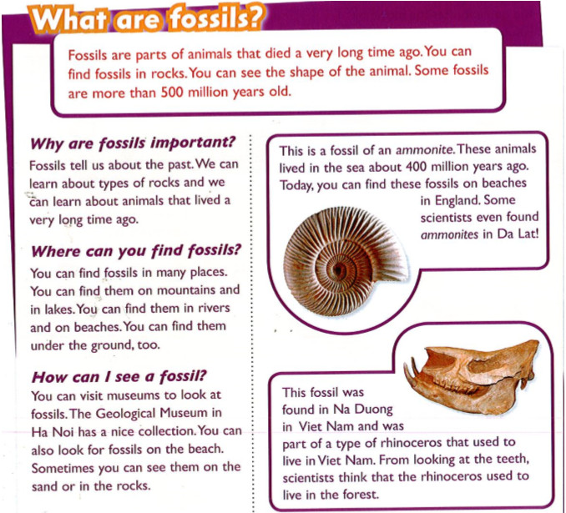
What do you know about fossil ?

Slide 5
What are fossils?
Fossils are parts of animals that died a very long time ago. You can find fossils in rocks. You can see the shape of the animal. Some fossils are more than 500 million years old.
Why are fossils important?
Fossils tell us about the past. We can learn about types of rocks and we can learn about animals that lived a very long time ago.
Where can you find fossils?
You can find fossils in many places. You can find them on mountains and in lakes. You can fine them in rivers and on beaches. You can find them under the ground, too.
How can I see a fossil?
You can visit museums to look at fossils. The Geological Museum in Ha Noi has a nice collection. You can also look for fossils on the beach. Sometimes you can see them on the sand or in the rocks.
This is a fossil of an ammonite. These animals lived in the sea about 400 million years ago. Today, you can find these fossils on beaches in England. Some scientists even found ammonites in Da Lat!
This fossil was found in Na Duong in Viet Nam and was part of type of rhinoceros that used to live in Viet Nam. From looking at the teeth, scientists think that the rhinoceros used to live in the forest.

Slide 6
Write T or F
1. Fossils are parts of animals that died a very long time ago.
2. We can learn about types of rocks and about animals that lived a very long time ago.
3. We can’t find fossils on beaches and under the ground.
4. Scientists couldn’t find ammonites in Da Lat.
5. Rhinoceros used to live in the forest.
T
T
F
F
T

Slide 7
3. Read again. Where did they find the fossils in the pictures?
They find the fossils on beaches in England, in Da Lat and Na Duong in Viet Nam.
4. Read again and answer.
What are fossils?
Fossils are parts of animals that died a very long time ago.
2. How old are some fossils?
Some fossils are more than 500 million years old.
3. What can we learn from fossils?
We can learn about types of rocks and about animals that lived a very long time ago.
4. Where can we find fossils?
We can find fossils on mountains, in lakes, in rivers, on beaches and under the ground.
5. Where did scientists find the ammonites in Viet Nam?
Some scientists found ammonites in Da Lat.
6. Where did the rhinoceros use to live?
Rhinoceros used to live in the forest.

Slide 8
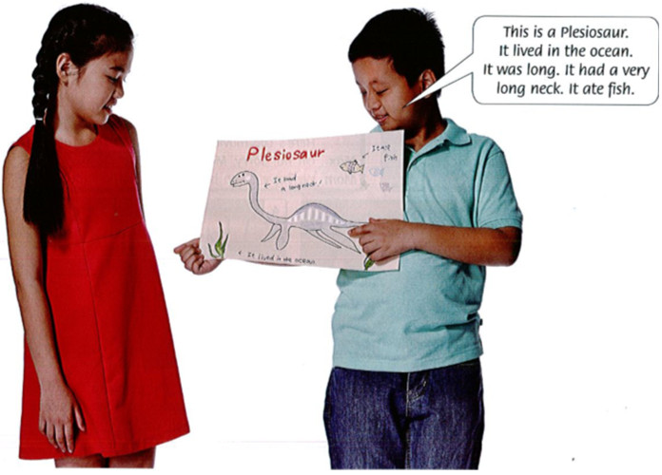
5. Ask and answer.
Would you like to find a fossil? Why?
Yes. Because I can learn about types of rocks and I can learn about animals that lived a very long time ago.
2. Do you like learning about the past? Why?
Yes, I do. Because I like learning about animals that lived a very long time ago.
6. Draw of find a picture of an animal that lived in the past. Talk about it.

Slide 9
Homework
Do exercises in your workbook .

