Slide 1




PEOPLE’S COMMITTEE OF TAN BINH DISTRICT
CHI LANG PRIMARY SCHOOL
Grade: 2
UNIT 6: AROUND TOWN
(REVIEW)
Teacher: Hoàng Thị Thanh Thảo

Slide 2
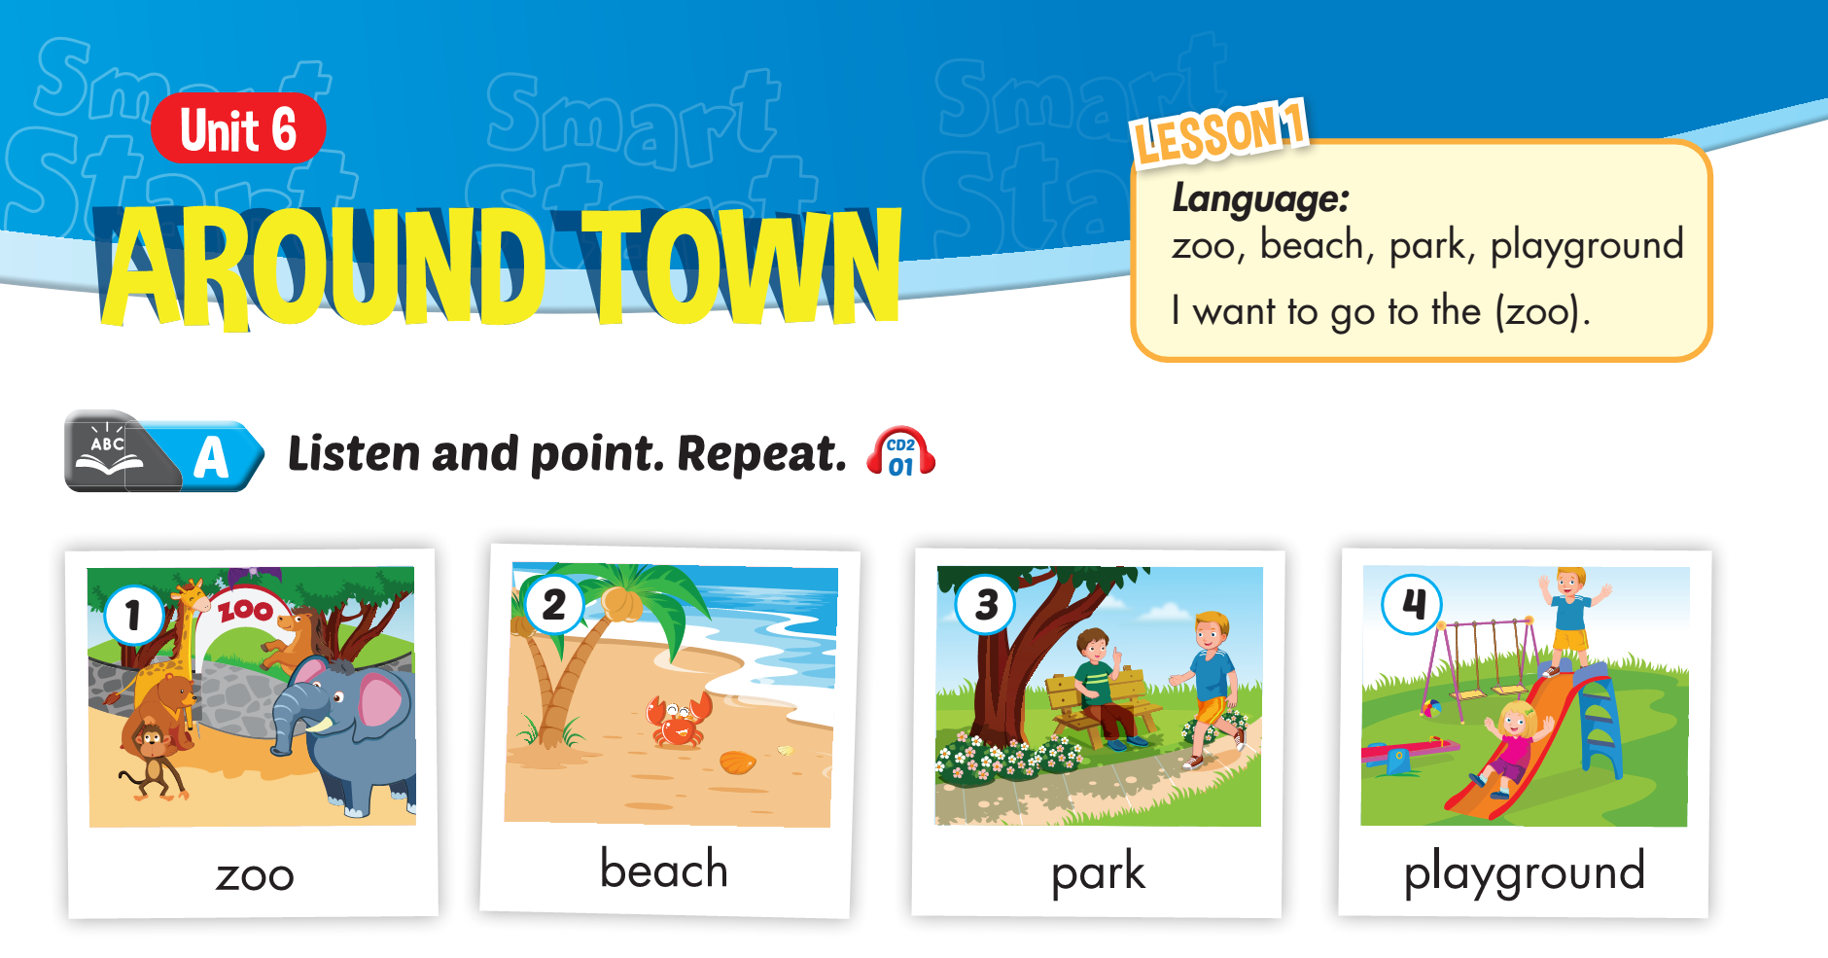


Slide 3
Lesson 1

Slide 4
Lesson 1

Slide 5
Lesson 1

Slide 6
Lesson 1

Slide 7
Lesson 1
I want to go to
the zoo.

Slide 8
Lesson 1
I want to go to the zoo.

Slide 9
Lesson 1
I want to go to the beach.

Slide 10
Lesson 1
I want to go to the park.

Slide 11
Lesson 1
I want to go to the playground.

Slide 12
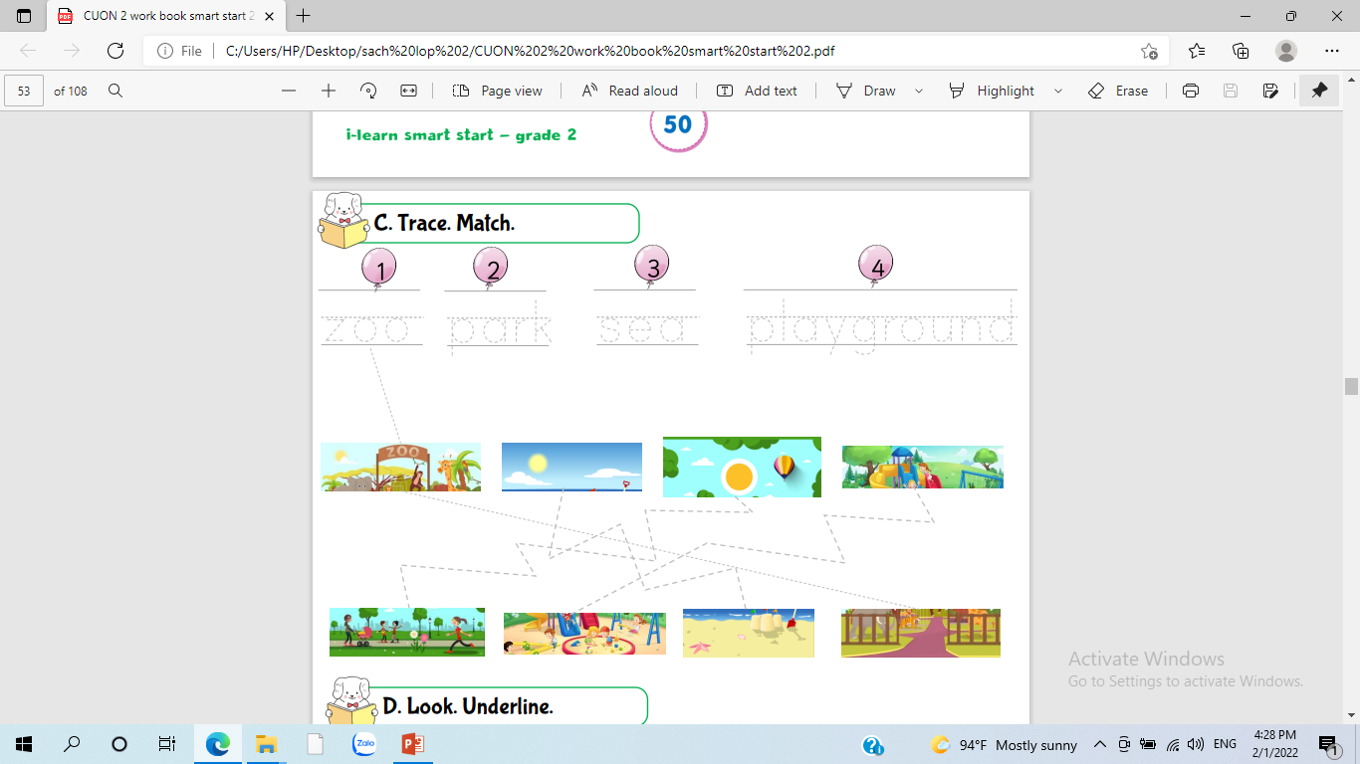

Slide 13
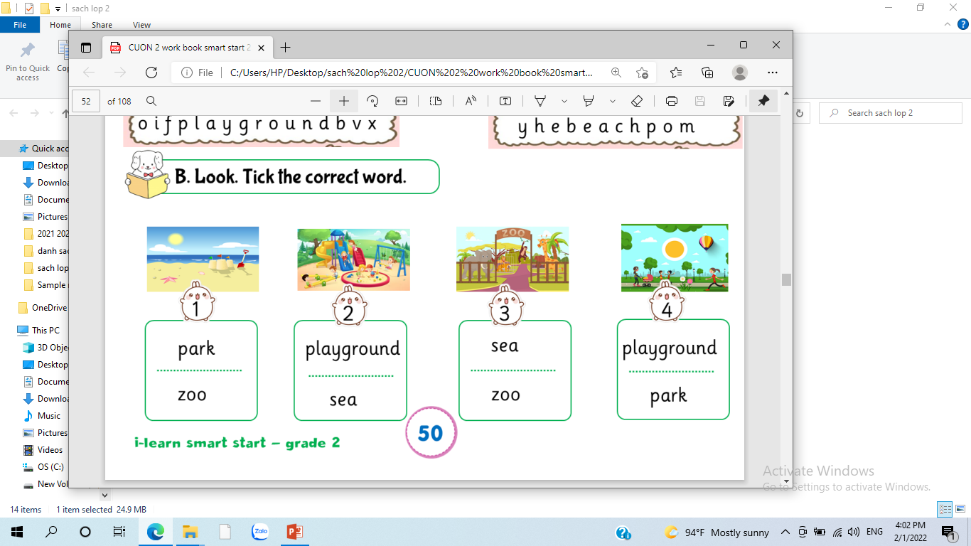

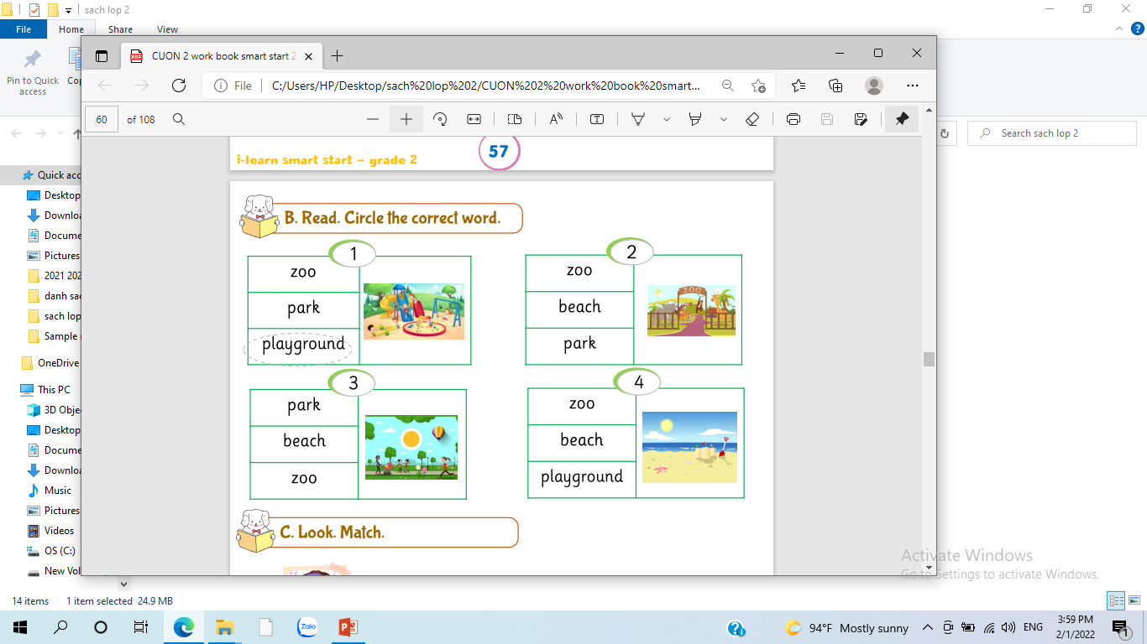

Slide 15
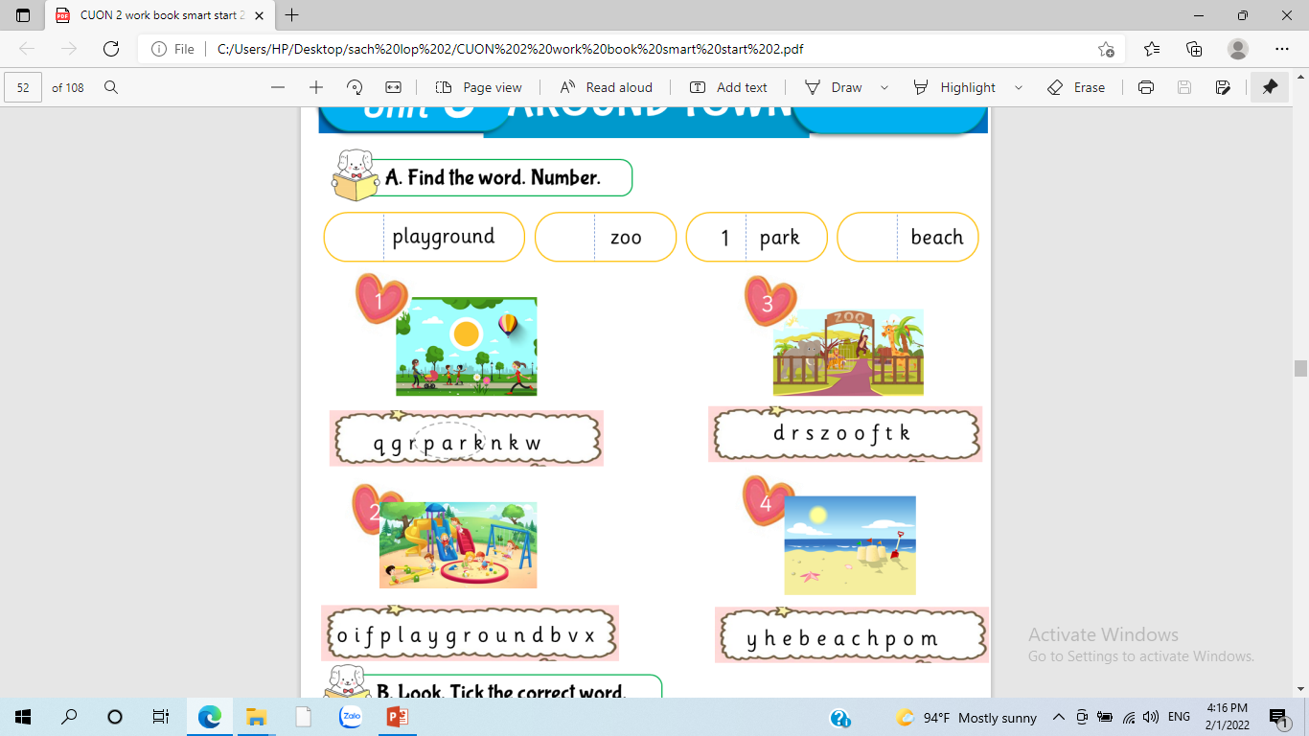
2
3
1
4

Slide 16
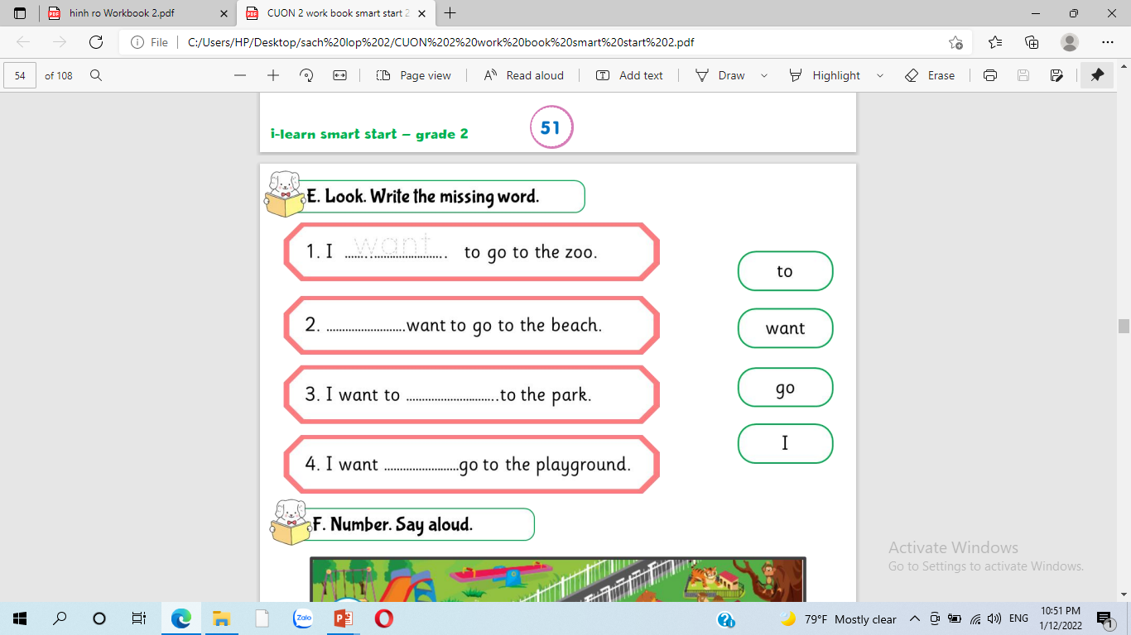
want
I
go
to

Slide 17
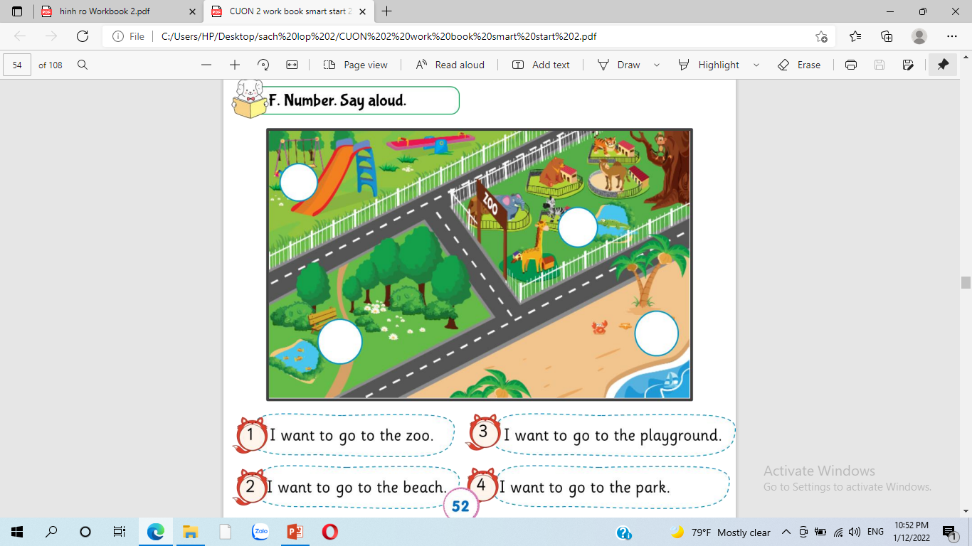
3
1
2
4

Slide 18
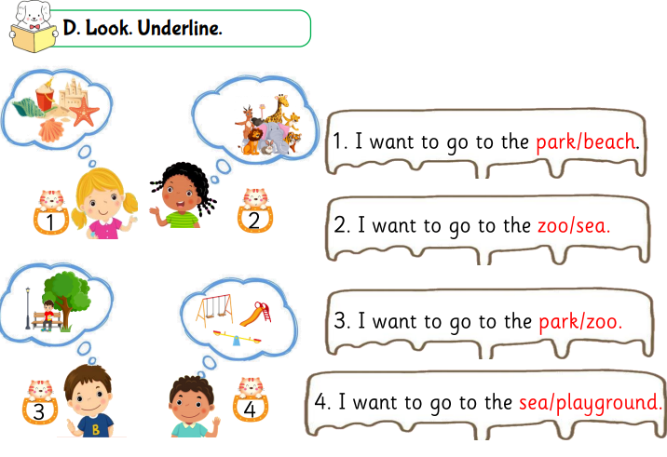

Slide 19






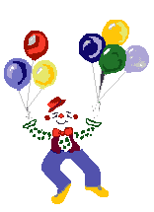
Thank you for enjoying
the lesson !

