Slide 1





THE COMMITTEE OF PEOPLE OF DISTRICT 12
DEPARTMENT OF EDUCATION AND TRAINING
WELCOME TO ENGLISH CLASS
NGUYEN THI MINH KHAI PRIMARY SCHOOL
Unit 1: Clean up!
Lesson 4: Phonics
Family and Friends
Special Edition
Grade 3
Teacher: Pham Thi Thanh Thao

Slide 2

Review

Slide 3


Listen and guess what sounds are they?

Slide 4
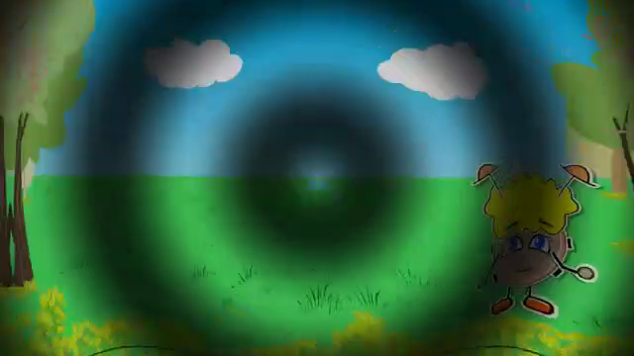

Slide 5

Lesson 4: Phonics
(Page 11)

Slide 6
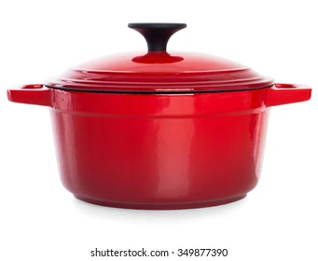





Listen and point
pot
fox
hop
rug
bug
sun

Slide 7

Listen and repeat
pot
fox
hop
fox
hop
pot
rug
bug
sun
bug
sun
rug

Slide 8

Game time

Slide 9


A. bug
B. sun
C. rug

Slide 10

A. hop
B. bug
C. fox

Slide 11
A. fox
B. bug
C. pot

Slide 12
A. fox
B. hop
C. pot

Slide 13

A. hop
B. sun
C. rug

Slide 14


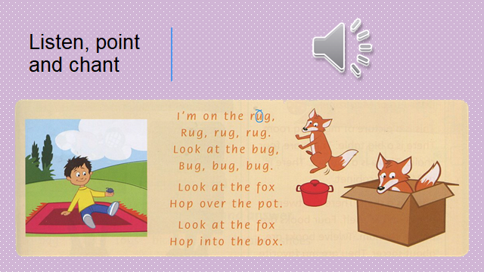
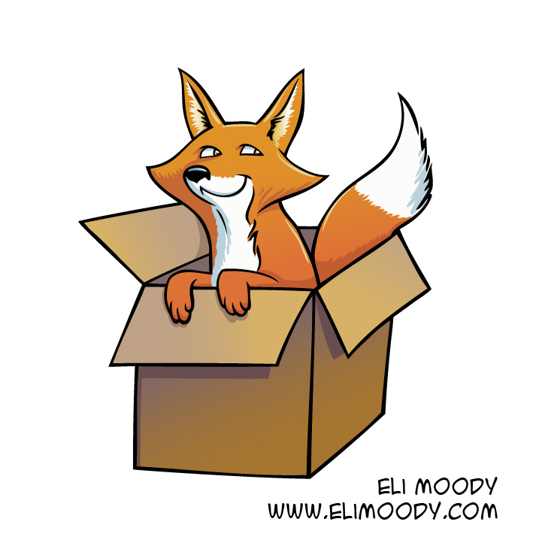
Listen and chant
I’m on the rug,
Rug, rug, rug.
Look at the bug,
Bug, bug, bug.
Look at the fox
Hop over the pot.
Look at the fox
Hop into the box.

Slide 15

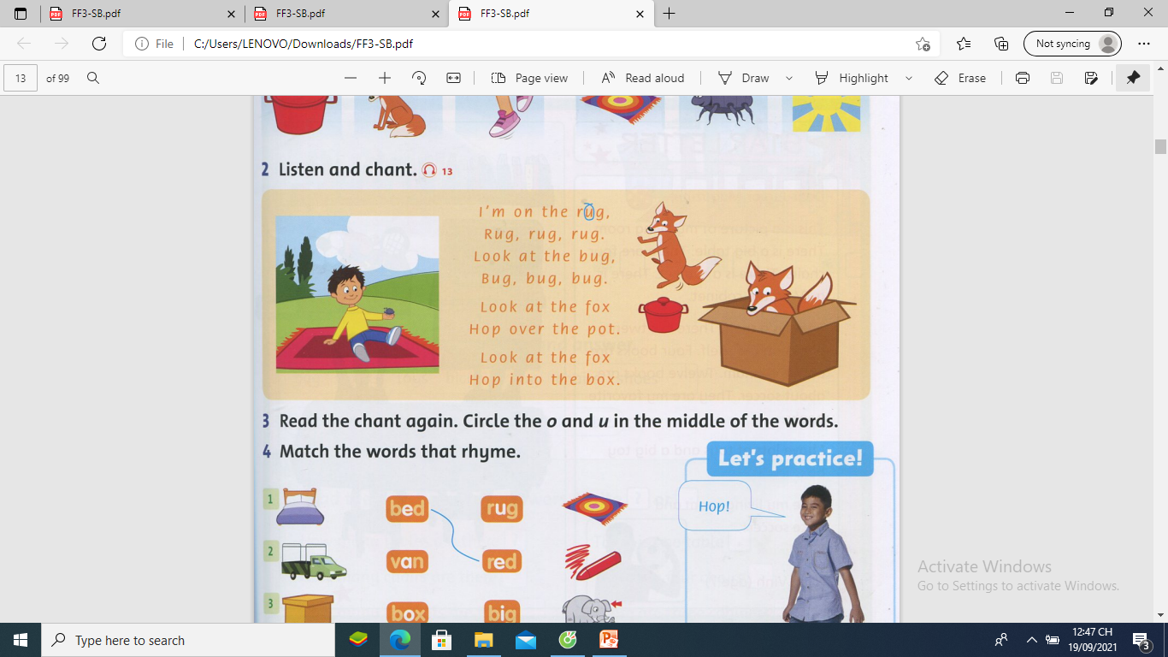
3. Read the chant again. Circle the o and u in the middle of the words. ( p.11 )
1
2
3
4
5
6
7
8
9
10

Slide 16
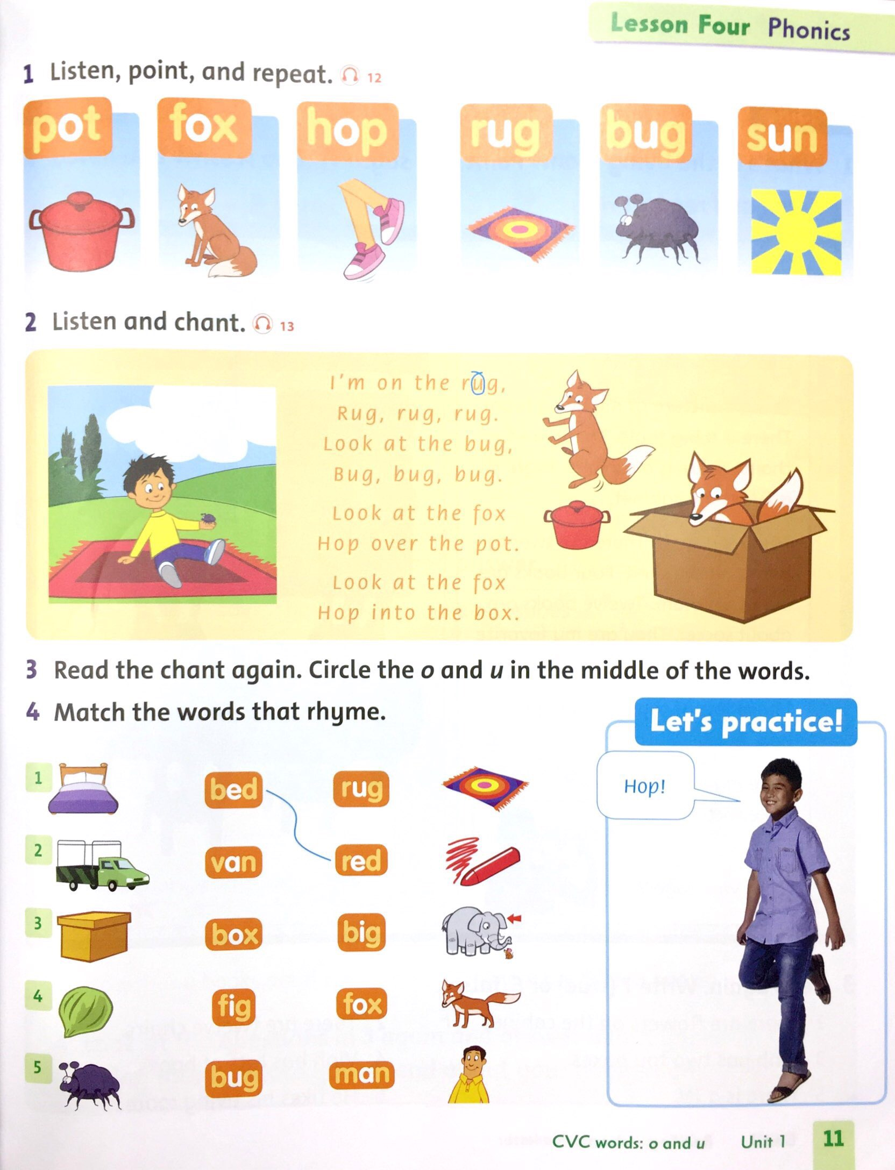
4.Match the words that rhyme ( p.11)
10
1
2
3
4
5
6
7
8
9

Slide 17
Review
pot
fox
hop
rug
bug
sun

Slide 18

Homework
Workbook / Page 11

