Slide 1
Where’s the ball?
Unit 5
Lesson 5

Slide 3
Listen and point

Slide 5
Listen and repeat

Slide 7
Listen and point

Slide 9
Listen and chant

Slide 11
Listen and repeat

Slide 15
Workbook time!!!

Slide 16
Where’s the ball?
Unit 5
Lesson 6

Slide 17
Watch a film

Slide 19
Listen and point

Slide 21
Read

Slide 22
Where’ ……………..?
the ball
The ball is on the slide.

Slide 23
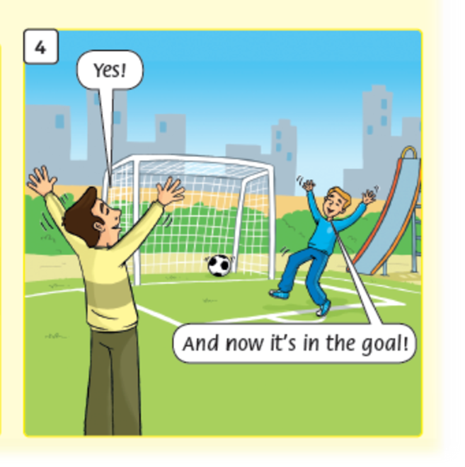
Where’ ……………..?
the ball
The ball is in the goal.

Slide 24
Listen and repeat

Slide 26
Workbook time!!!

