Slide 1

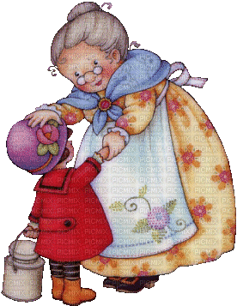
Unit 6
Where’s grandma?
Lesson 1

Slide 2


Slide 3

Listen and point

Slide 4
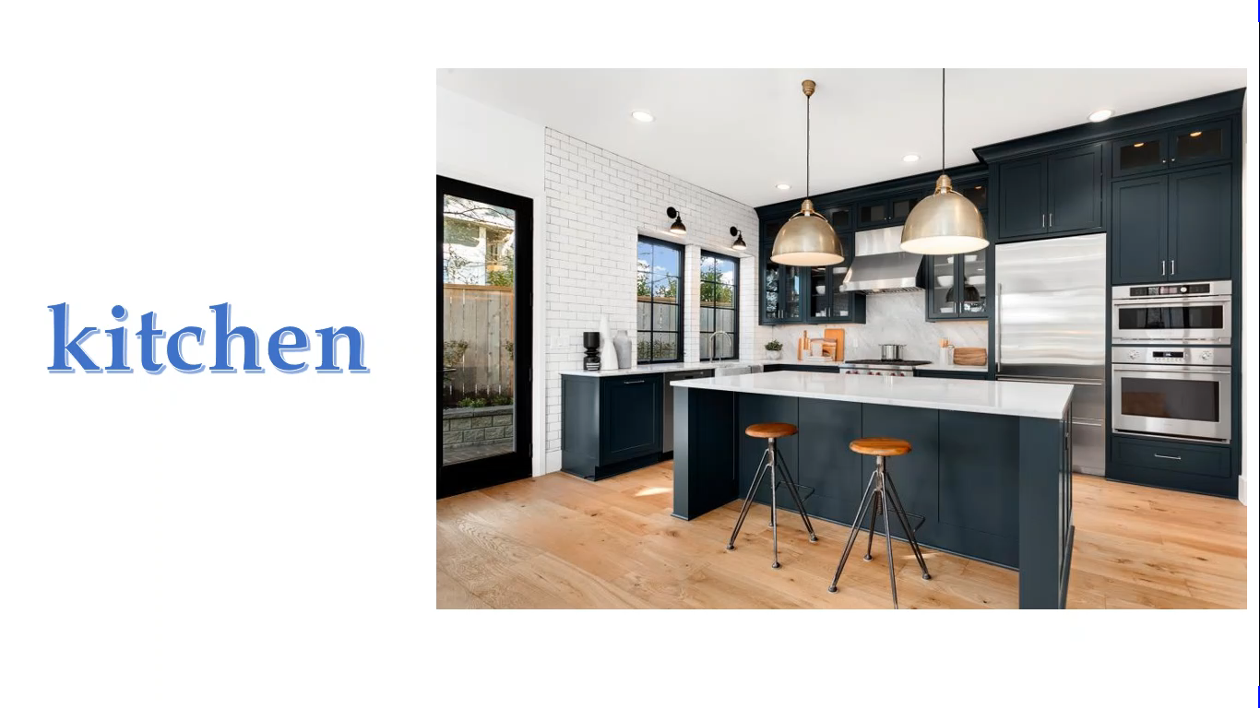

Slide 5

Listen and repeat

Slide 7
Listen and point

Slide 8


Slide 9

Listen and chant

Slide 11

Point and say!

Slide 13
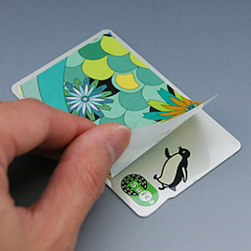
Let’s stick!

Slide 14
kitchen
bedroom
living room
bathroom
dining room

Slide 15
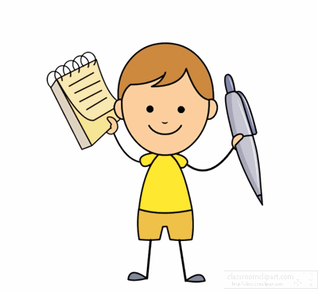
Workbook time!!!

Slide 16
1

Slide 17
Unit 6
Where’s grandma?
Lesson 2

Slide 18
Listen and repeat

Slide 19


Slide 20
Point and say!

Slide 21
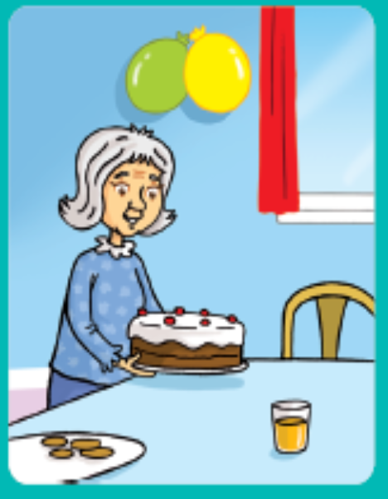
grandma
Where is……………….….?
She is in the living room.

Slide 22
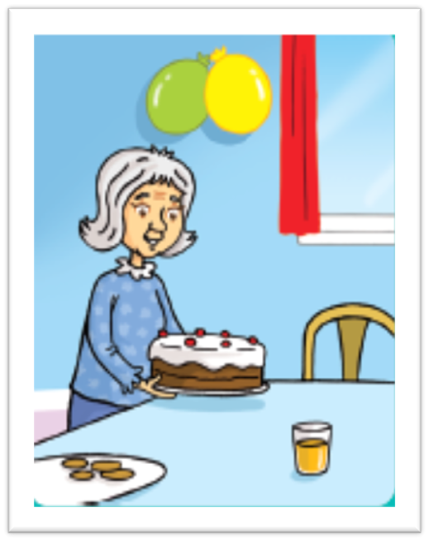
Is she in the kitchen?
No, she isn’t.

Slide 23
Listen and point

Slide 24
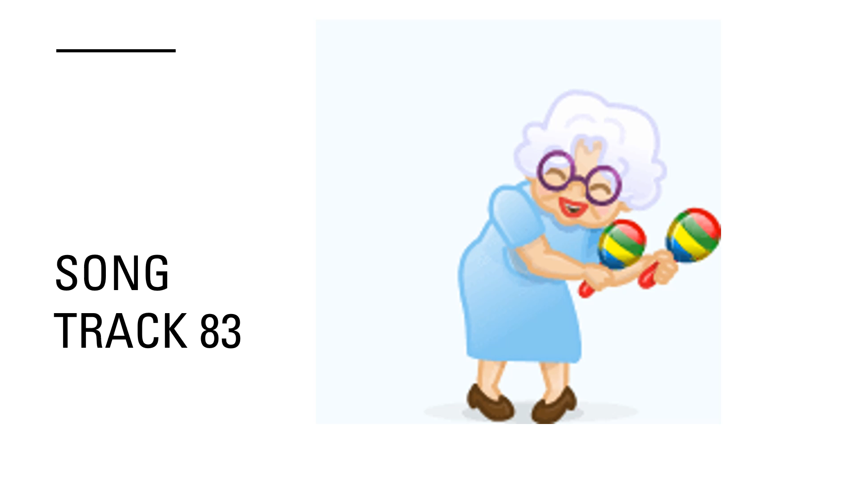

Slide 25
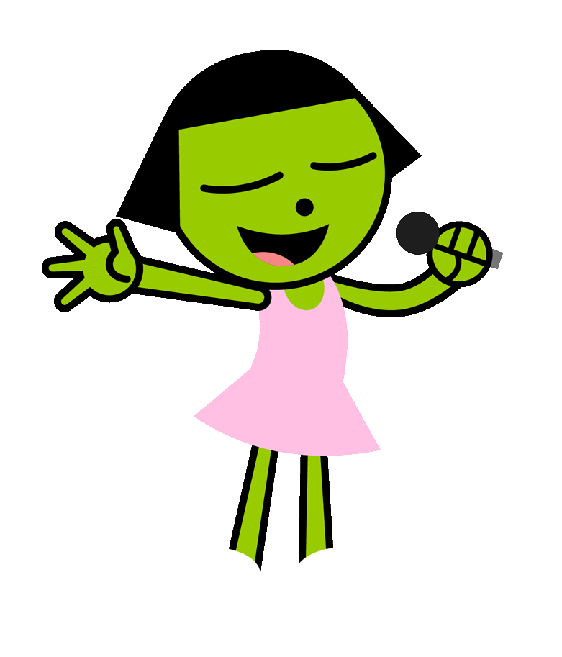
Listen and sing

Slide 27

Write

Slide 28
Where is
in
Yes
is

Slide 30
Workbook time!!!

Slide 32


