Slide 1

Grade 2
Unit starter
Lesson 2

Slide 2


Slide 3


Slide 4


Slide 5
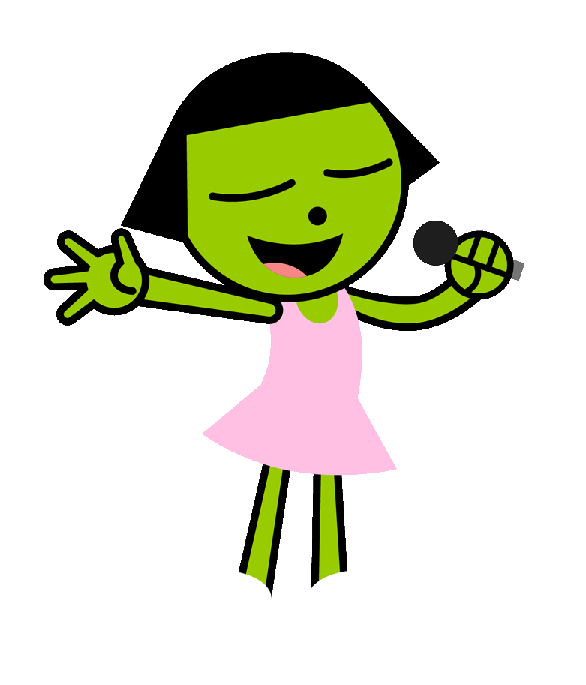
Listen and sing

Slide 6


Slide 7

Listen and repeat

Slide 8


Slide 9
Listen and sing

Slide 10
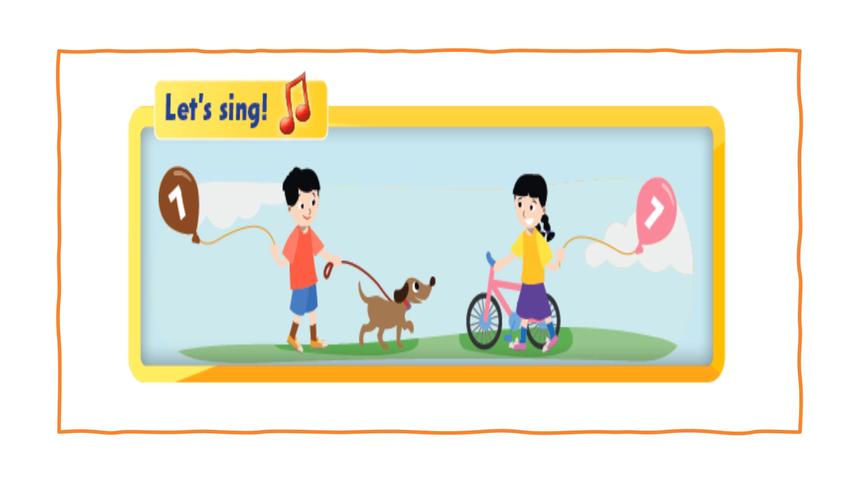

Slide 11
Ask and answer

Slide 12

Work in groups

Slide 13
Look and say

Slide 14
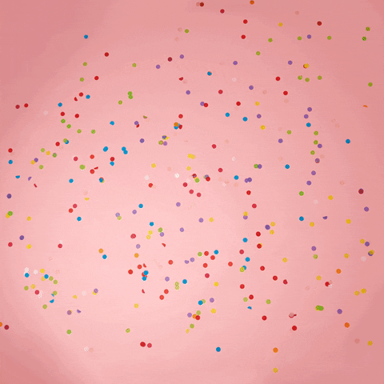
It’s play time!

Slide 15
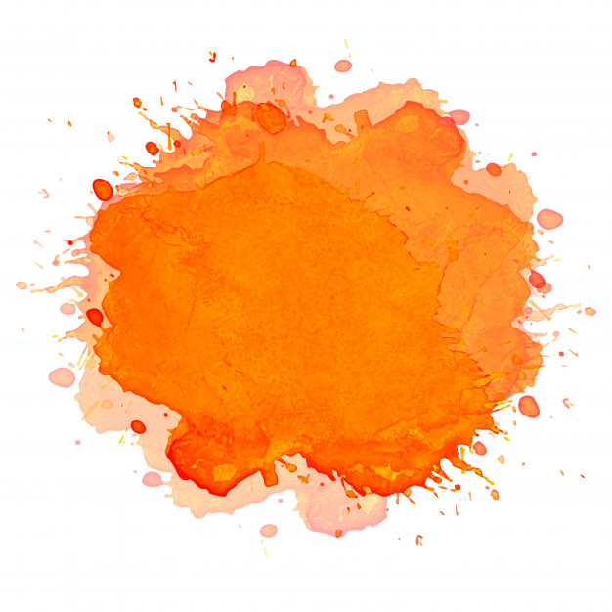
What’s the color?
purple
orange
blue
red

Slide 16

What’s the color?
red
yellow
black
green

Slide 17
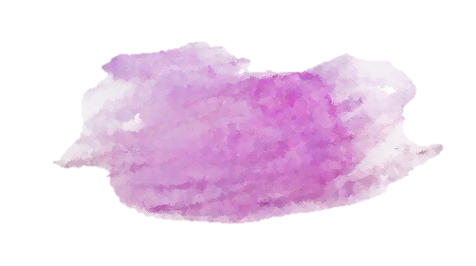
What’s the color?
green
purple
orange
black

Slide 18

What’s the color?
blue
red
yellow
purple

Slide 19

What’s the color?
green
red
blue
black

Slide 21
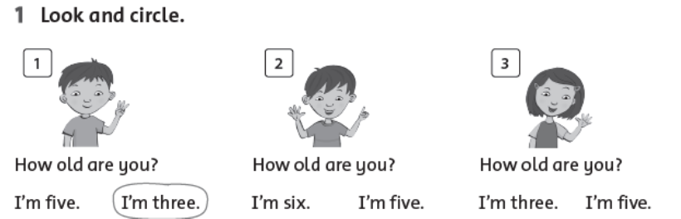
Look and circle

Slide 22

Workbook time!!!

Slide 23
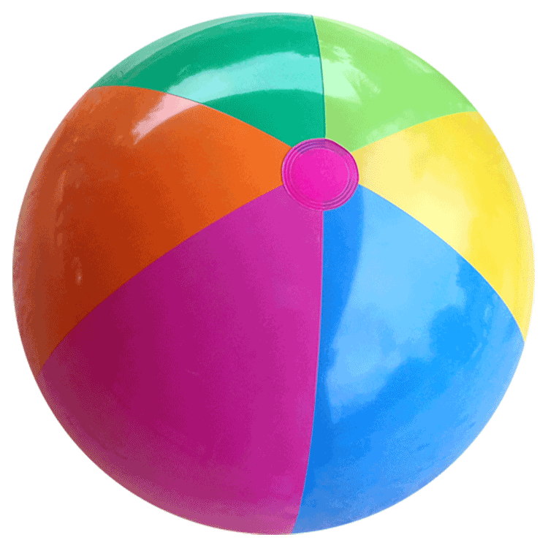
Pass the ball game

Slide 24


Slide 25


