Slide 1
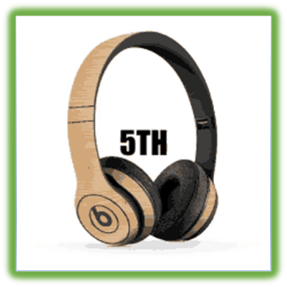
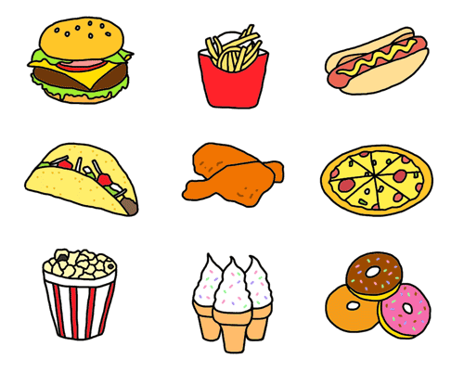
UNIT 3
The food here is great
Lesson 2

Slide 4
WATCH THE VIDEO CLIP

Slide 6
PERFORMANCE TIME

Slide 7
LISTEN AND POINT

Slide 9
WORK IN PAIRS

Slide 10
Read, circle, and say.
1. She drink / is drinking / drinks a glass of water now.
2. The family sit / is sitting / sits by the door today.
3. They usually sit/ are sitting / sits by the window.
4. He never have / is having / has soup for dinner.
5. She have / is having / has soup today.

Slide 11
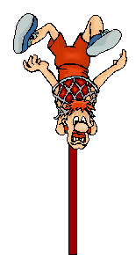
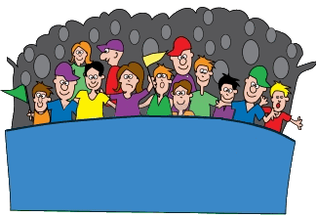
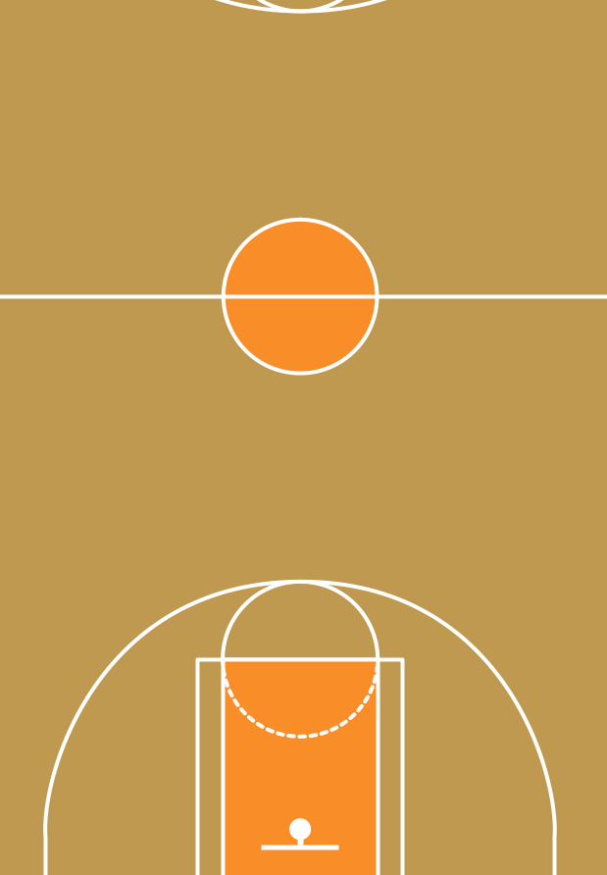
SIPMLE PRESENT vs PRESENT CONTINUOUS

Slide 12
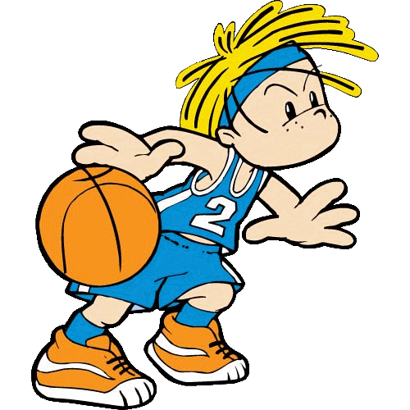
He ... a big bottle of milk every day.
drinks
is drinking

Slide 13
The family ... by the window today.
sits
is sitting

Slide 14
She never ... Pho for dinner.
has
is having

Slide 15
They ... jeans doday.
wear
are wearing

Slide 16
I ... to school now.
walk
am walking

Slide 17
We usually ... soup for breakfast.
have
are having

Slide 18
Write: has, playing, having (x2), play, share, have.
At break time, I usually ¹play with my friends, Tam and Anh. Anh isn't at school today, so I'm ²______ with Tam.
We're ³______ fun today. At lunchtime, I always ⁴_____ some rice and an apple. But there aren't any apples, so today I'm ⁵______ a banana. Anh usually ⁶____ salad and cookies. Sometimes she ⁷_____ her cookies with us. She's a kind girl.
playing
having
have
having
has
shares

Slide 19
WORKBOOK TIME

Slide 20
GOODBYE!!!

