Slide 1
GRADE 5
UNIT TWO
Our vacation
Lesson 2

Slide 4
WATCH THE VIDEO CLIP

Slide 6
PERFORMANCE TIME

Slide 7
Listen and repeat.

Slide 8
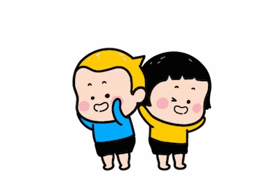
GAME TIME

Slide 9
BE GOING TO
WHAT ARE THEY GOING TO DO?
WHAT IS GOING TO HAPPEN?

Slide 10
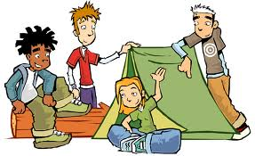
What are they going to do?
click
here
They ____ going to ____
camping.
are
go

Slide 11
What are you going to do?
click
here
I ____ going to ____
a picture.
am
take

Slide 12
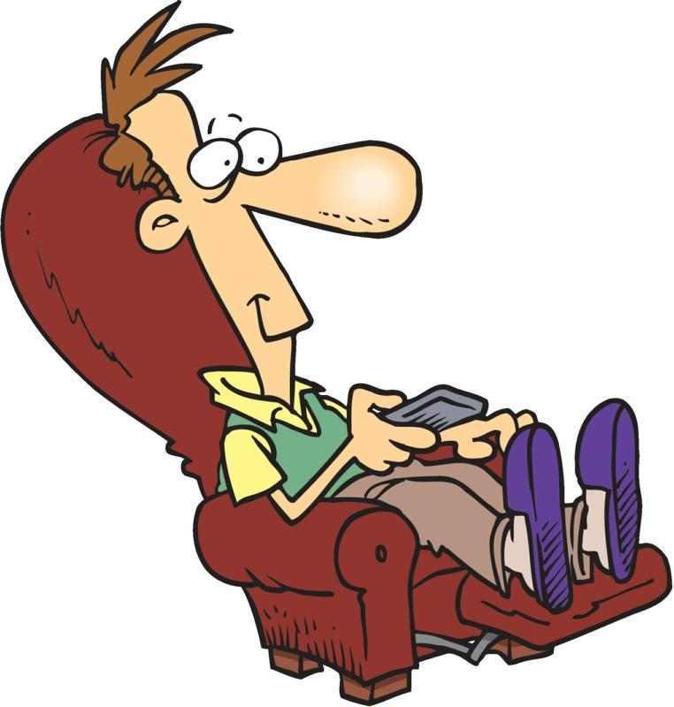
What is he going to do?
click
here
He ____ going to ____
TV.
is
watch

Slide 13
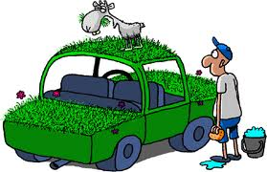
What is Tom going to do?
click
here
Tom ____ going to _______
his car.
is
wash

Slide 14
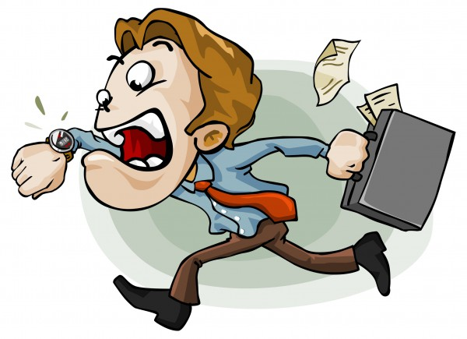
What is going to happen?
click
here
He ____ going to ____
late for work.
is
be

Slide 15
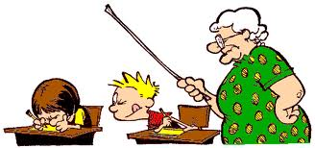
What is Calvin going to do?
click
here
He ____ going to _______
in his English test.
is
cheat

Slide 16
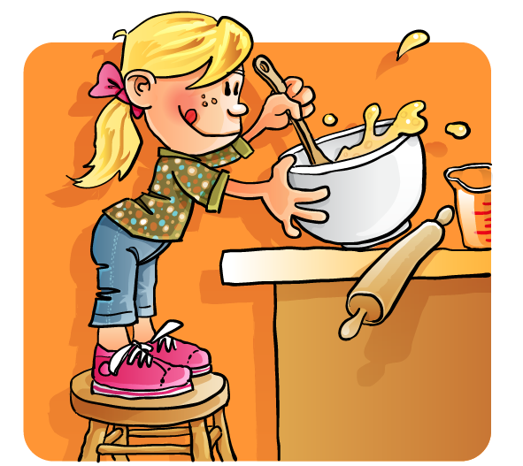
What are you going to do?
click
here
I ___ going to ______
a cake.
am
make

Slide 17
What is going to happen?
click
here
It ____ going to _____ .
is
rain

Slide 18
What is she going to do?
click
here
She ____ going to ____
a short story.
is
write

Slide 19
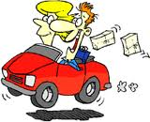
What are you going to do?
click
here
We ____ going to ____
to Spain tomorrow.
are
drive

Slide 20
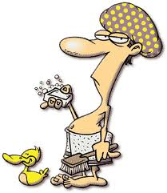
What are you going to do?
click
here
I ____ going to _______
a shower.
am
have

Slide 21
WORK IN PAIRS

Slide 22
Read and circle.
1. We is / are going to go on vacation next week.
2. I'm / 're going to take my shampoo on vacation.
3. Mom and Dad am / are going to buy soap and toothpaste tomorrow.
4. Trung is/ are going to put sunscreen on when he goes to beach.

Slide 23
WORK IN PAIRS

Slide 24
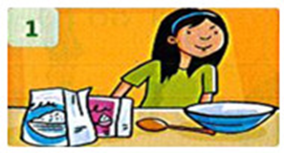
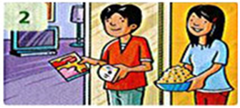
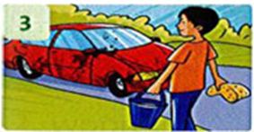
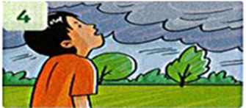
Write: 'm, 's, 're
 | She 's going to make a cake.
 | They ____ going to watch a DVD.
 | I __ going to wash the car.
 | It ___ going to brain.
‘re
‘m
‘s

Slide 25
WORKBOOK TIME

Slide 26
GOODBYE!!!

