Slide 1
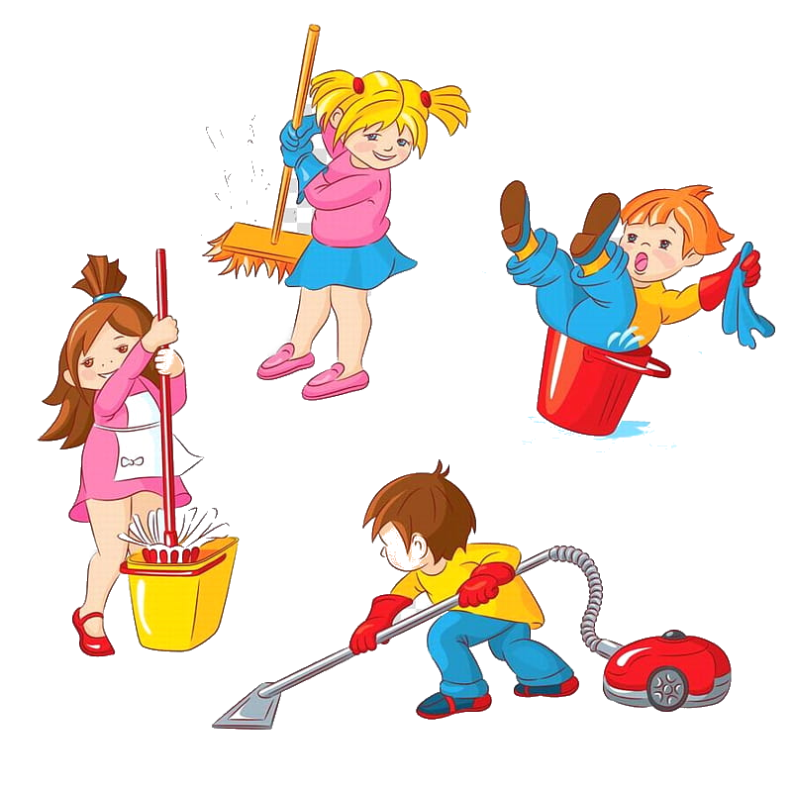
Unit 1: Clean up!
Friday, October 1st, 2021
Grade 3
Lesson Three: Song

Slide 2
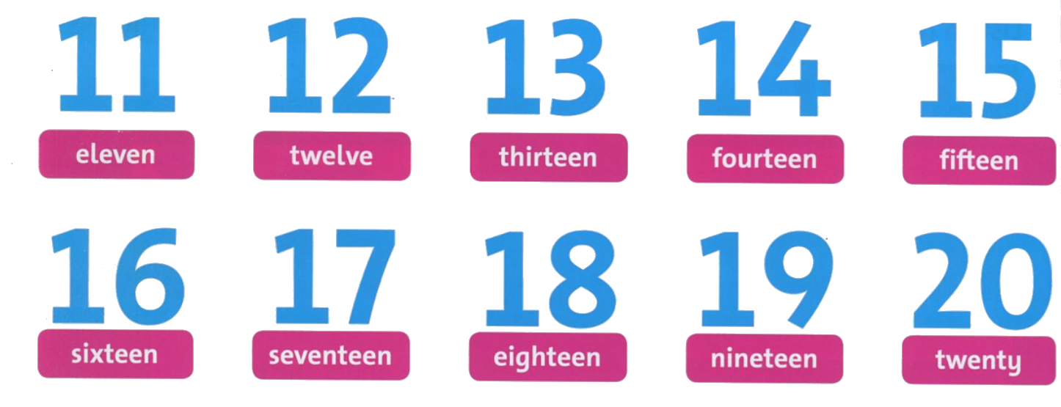
Listen and point

Slide 3
Listen and point
Let’s learn to sing! Point to the lines of the song in your book while it’s playing.

Slide 4
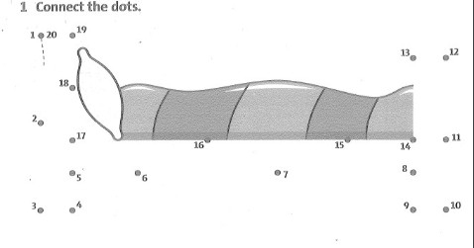

Slide 5
welve
ixteen
eventeen
hirteen
ighteen
ourteen
ineteen
ifteen
wenty

Slide 6
Goodbye~!

