Slide 1
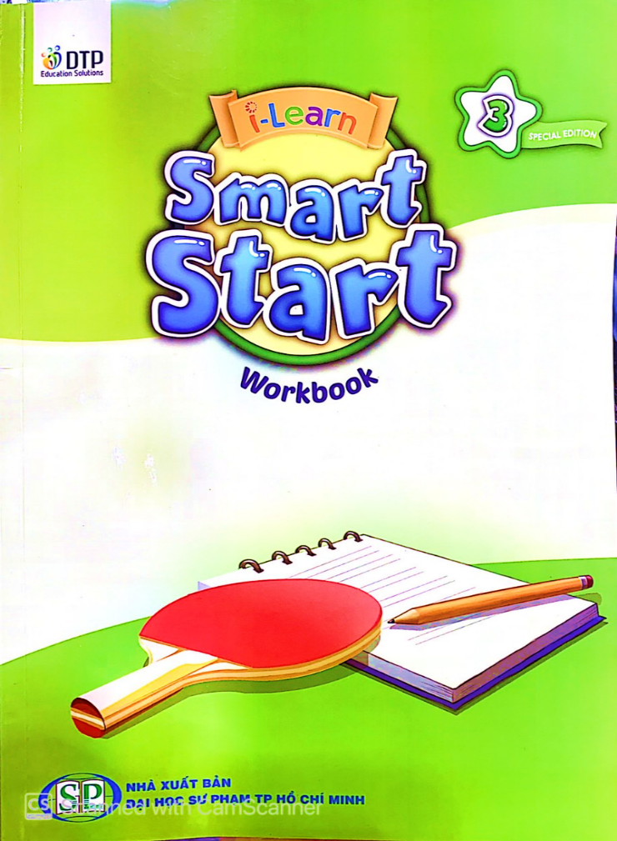
Thursday, December 30th, 2021
GRADE 3 WORKBOOK Theme 5 lesson 6

Slide 2
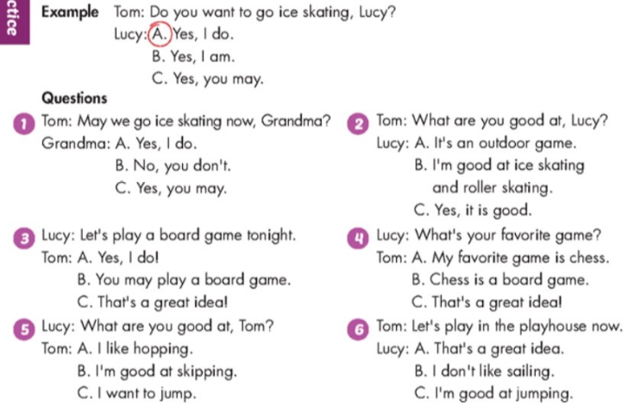
Workbook/60

Slide 3
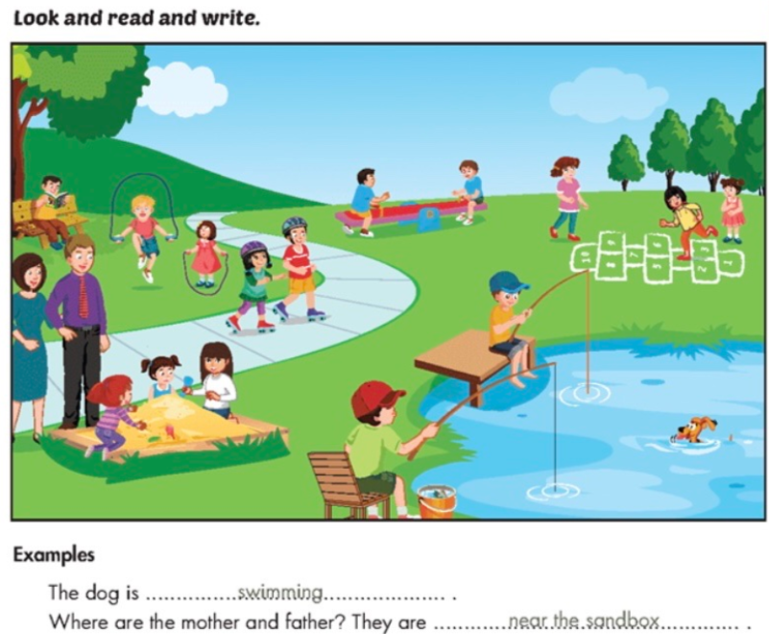
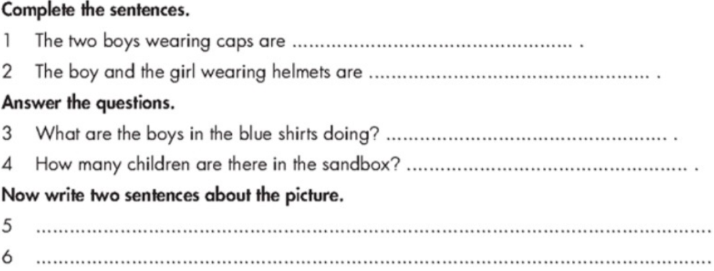
Workbook/61
fishing
roller skating
They are playing
on the seesaw.
Three children.
Three girls are playing hopscotch.
A boy is reading under a three.

Slide 4
Các em gửi bài làm trang 60,61 sách Workbook vào zalo cho cô.

