Slide 2
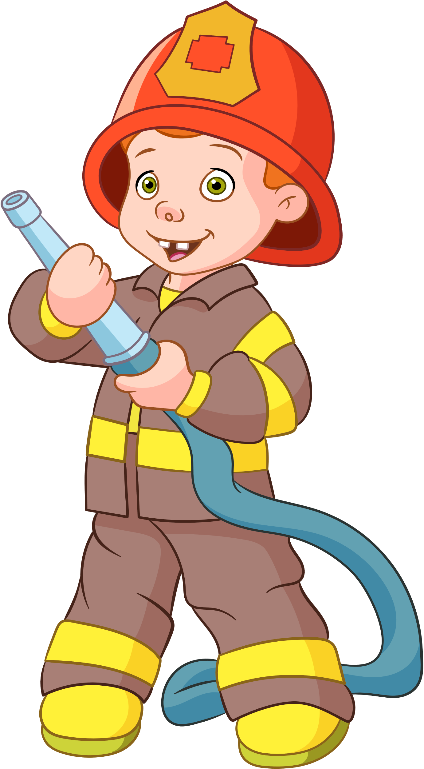
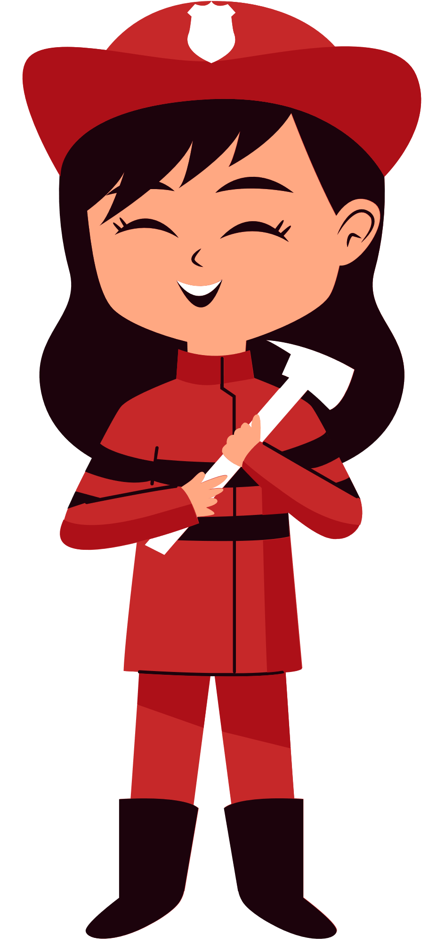
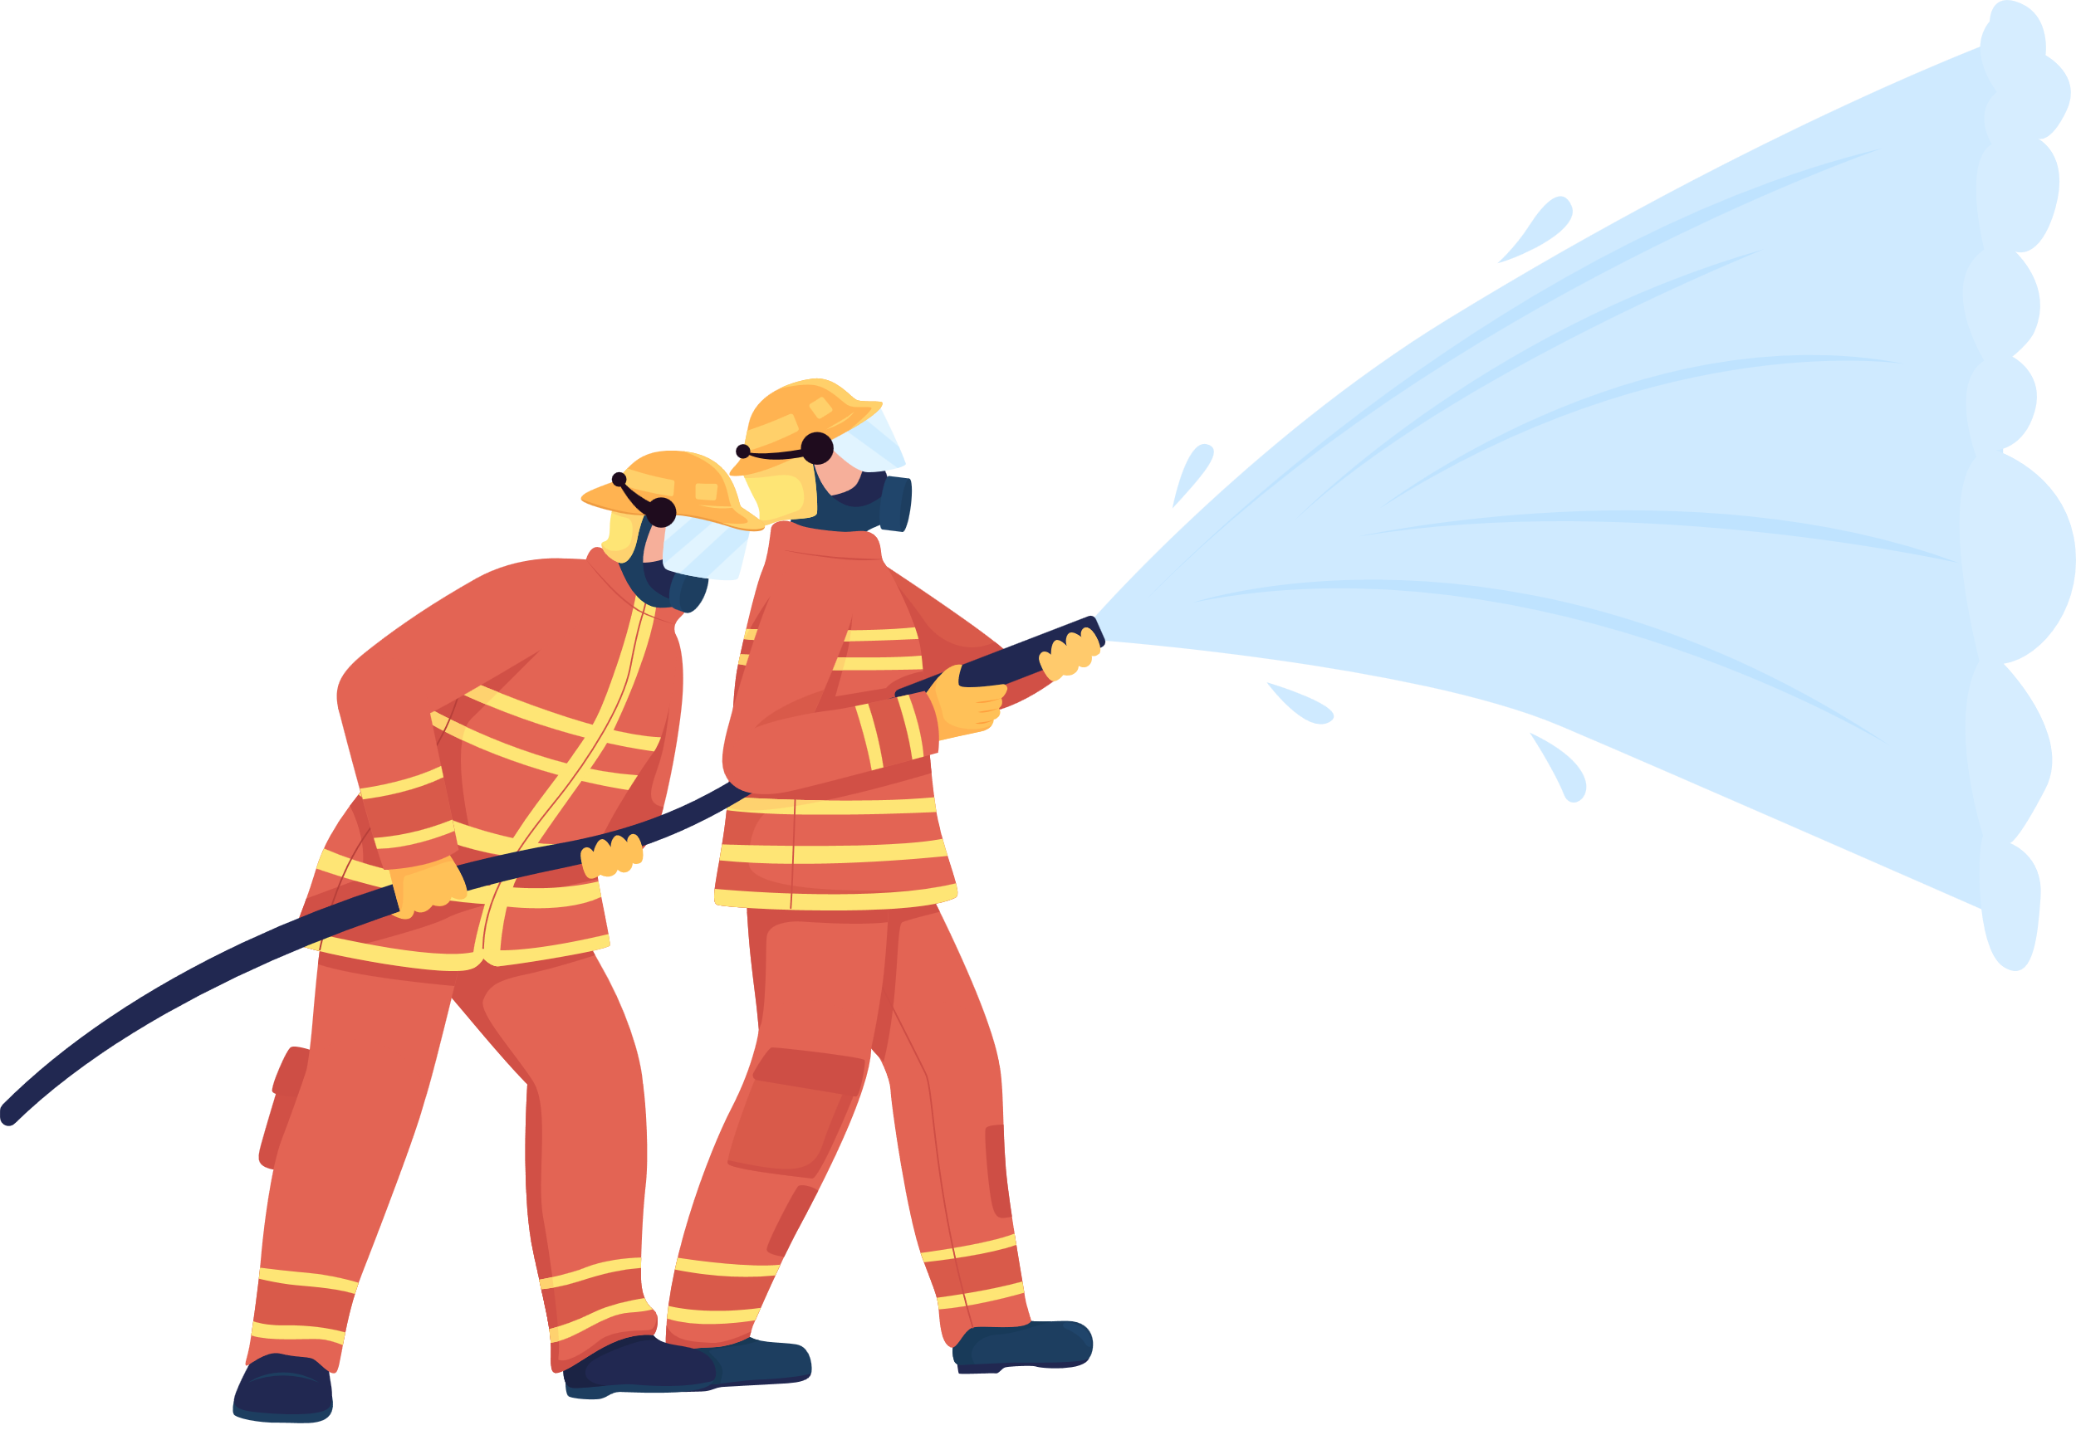
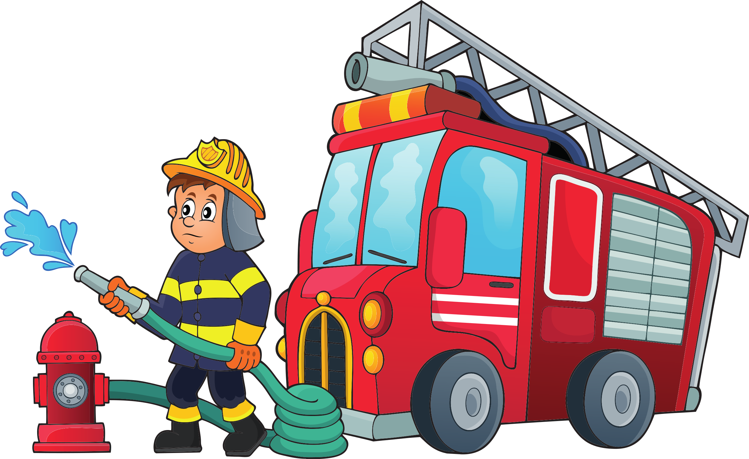
Unit 1
They're firefighters!
Lesson 1 - Words

Slide 3
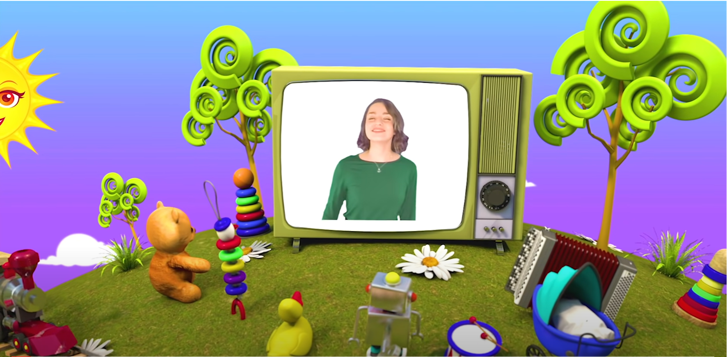
HELLO SONG
Notes:
https://www.youtube.com/watch?v=pqDEwPi7vxg

Slide 4
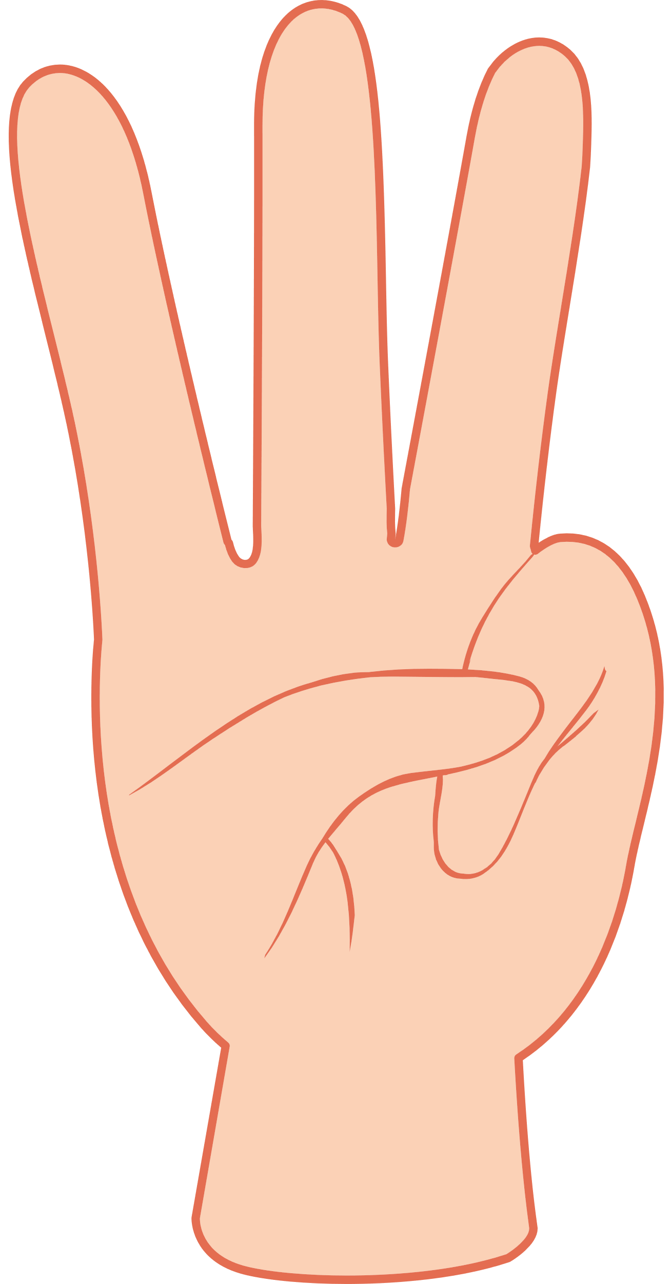

Slide 5
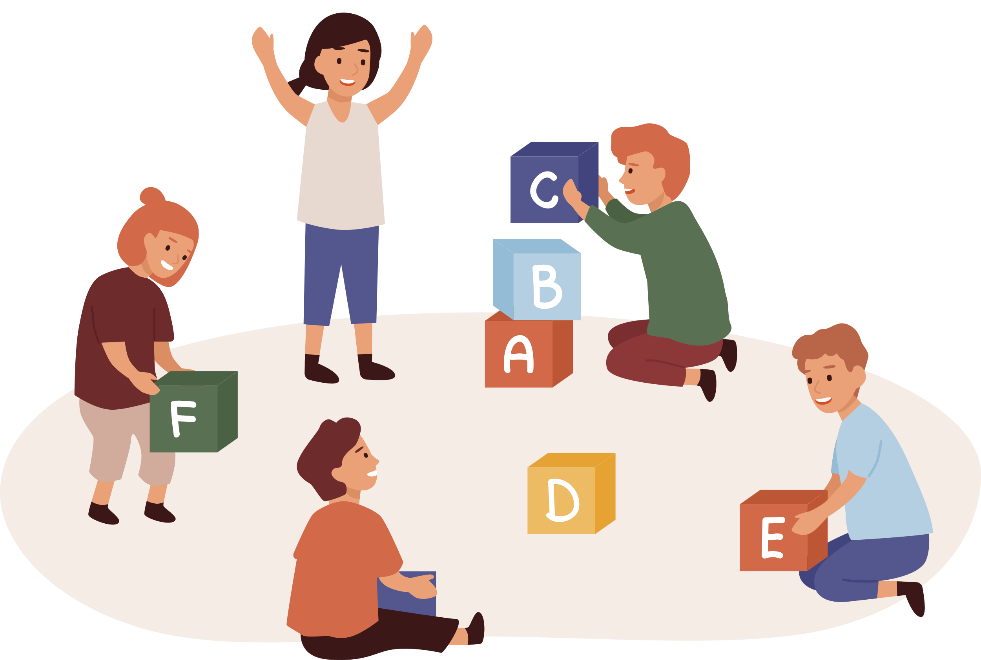
Game: SIMON SAYS
Notes:
* Game: “Simon says...”
Ask the students to stand at their desks. Explain that you are going to give instructions. If the instruction begins with the words Simon says… students must do as you say. If not, they must stand still and wait for the next instruction. Any student who gets this wrong is out of the game and sits down.
Model the activity, e.g., Simon says stand up. Simon says open your book. Intermittently, introduce an instruction that doesn’t start with Simon says and see if any students follow the instruction.
Continue the game until there is one winner or a group of winners, if you prefer.
Call some volunteers to say the commands.
Praise the winner.

Slide 6
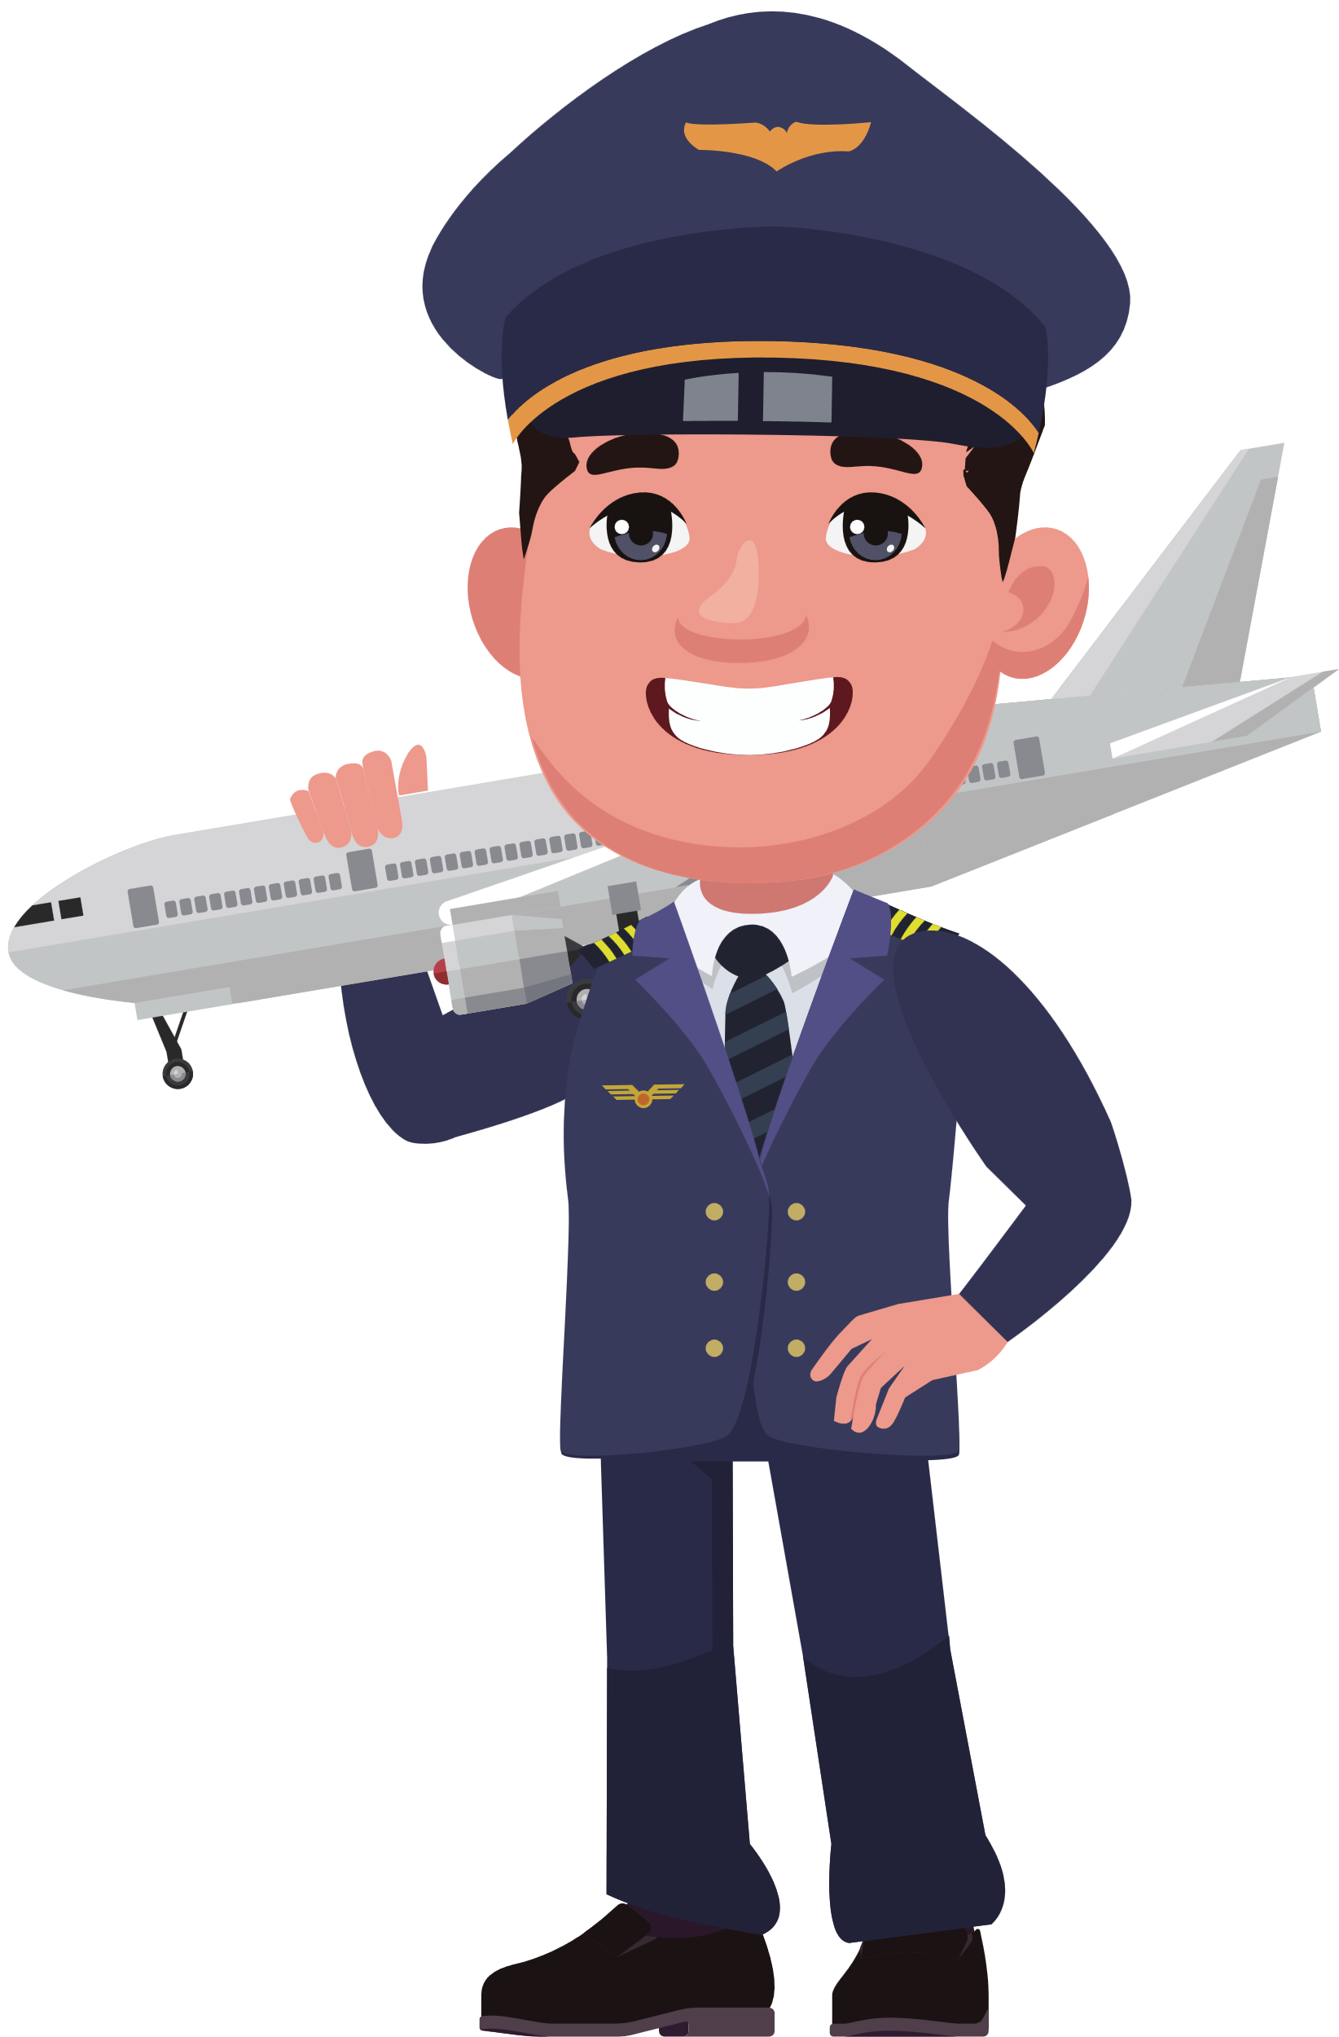
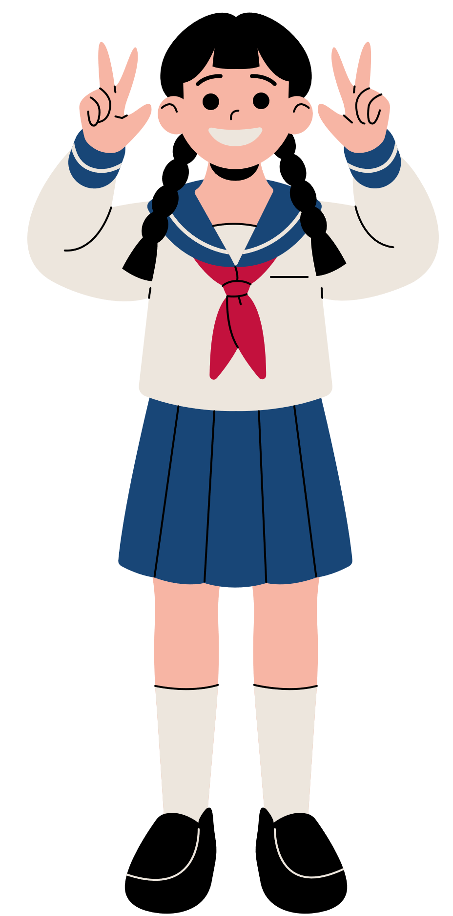
Good job!

Slide 7
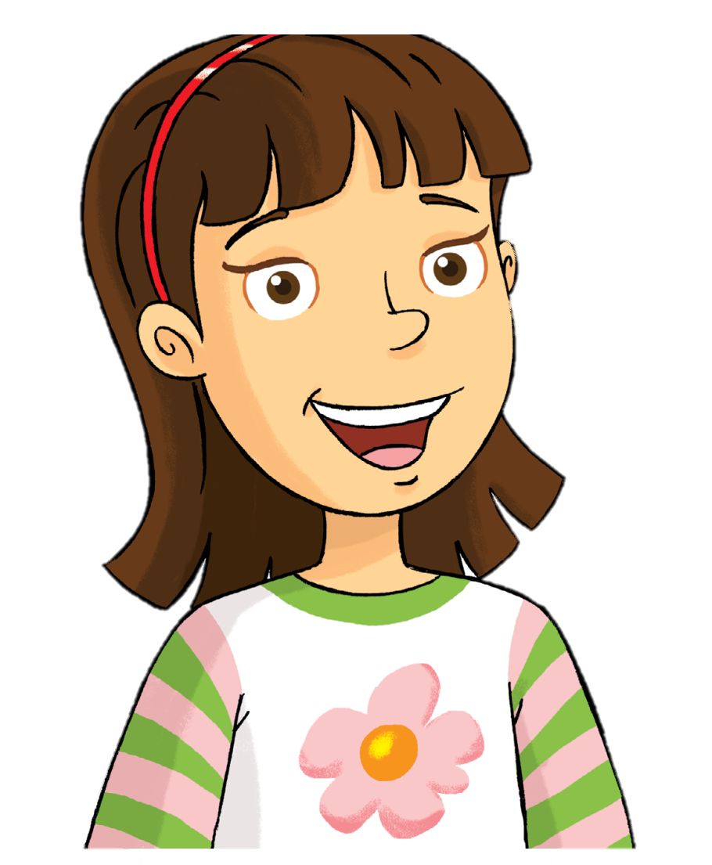
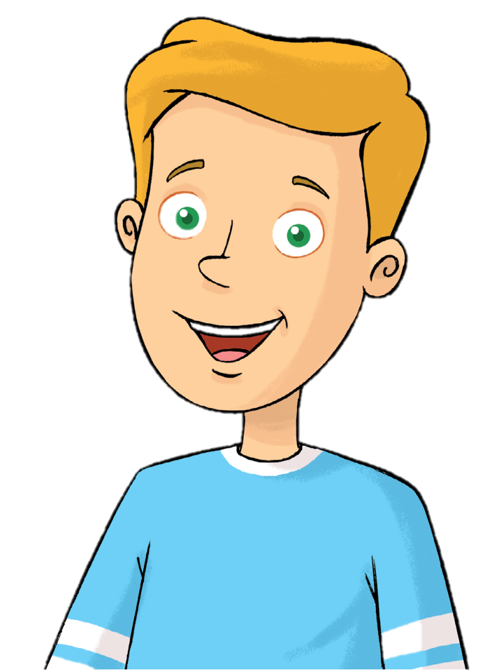
Look and Say.
Rosy
Tim

Slide 8
Look and Listen.
doctor

Slide 9
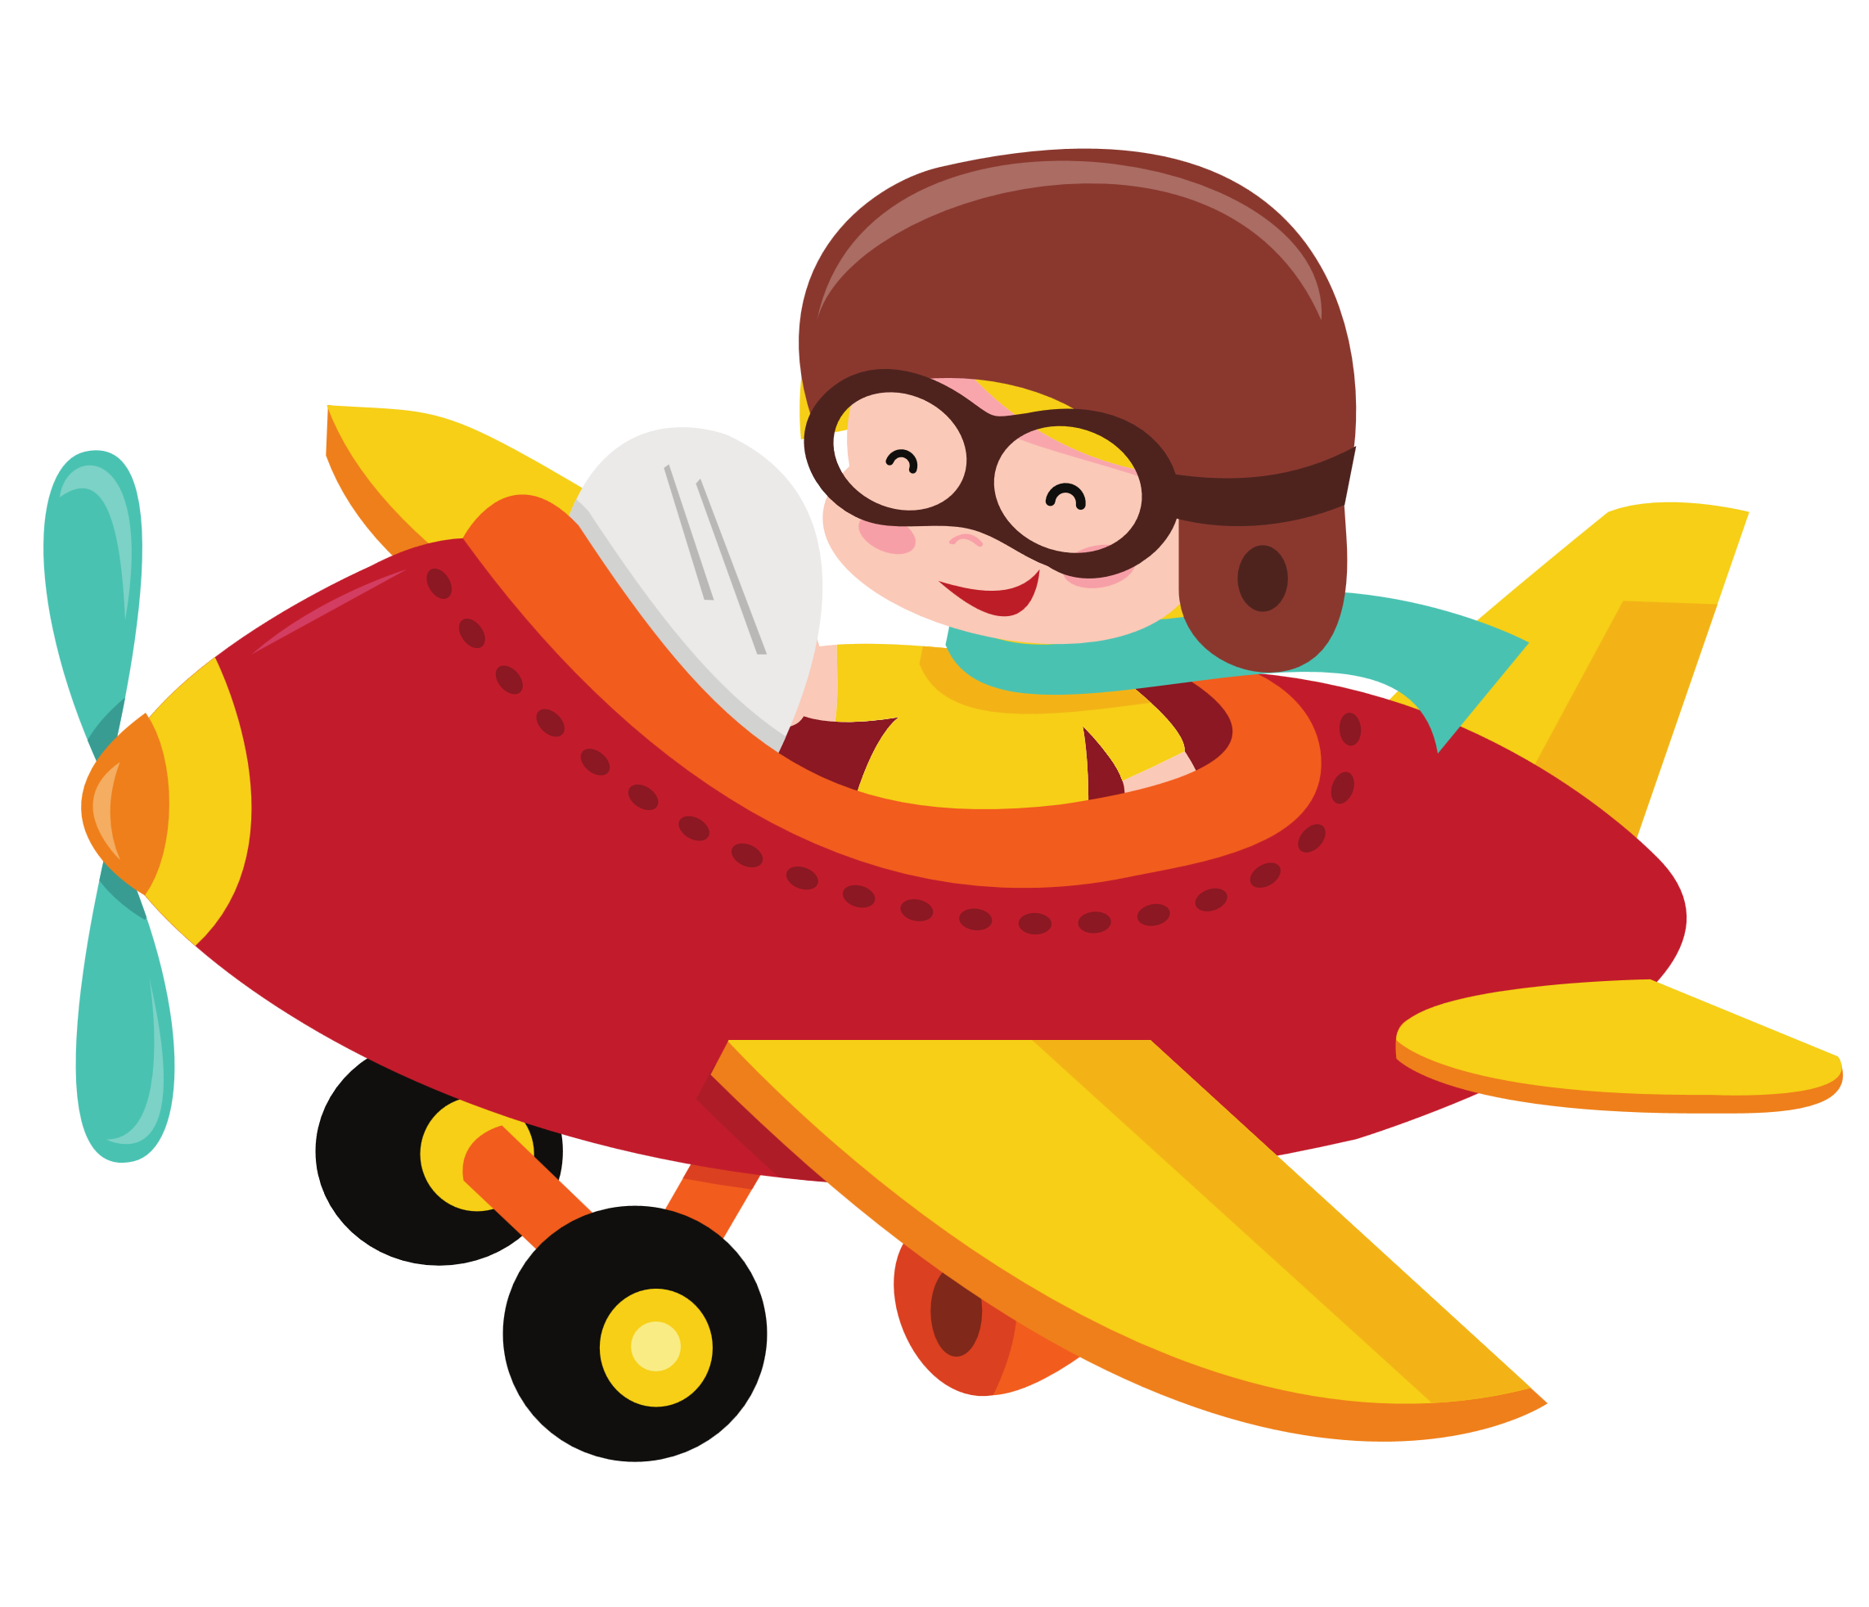
Look and Listen.
pilot

Slide 10
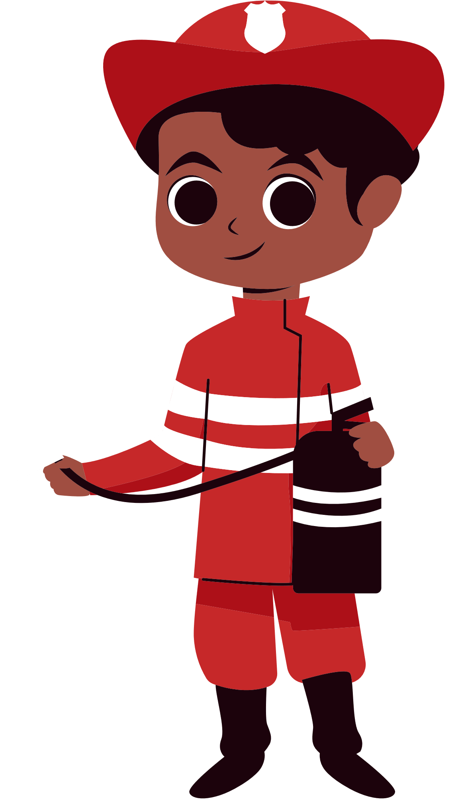
Look and Listen.
firefighter

Slide 11
Look and Listen.
student

Slide 12
Look and Listen.
teacher

Slide 13
Listen, Point and Repeat.
doctor
pilot
firefighter
student
teacher

Slide 14
Good job!

Slide 15
Listen and Chant.
doctor
pilot
firefighter
student
teacher

Slide 16
Good job!

Slide 17
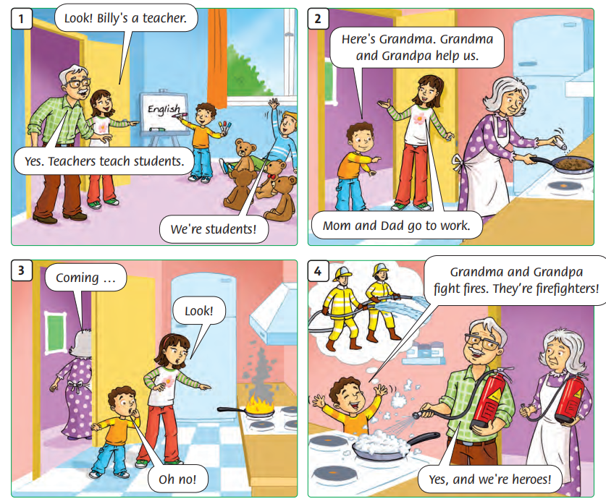
Look and
Answer.
Notes:
Ask “ Who’s this?”

Slide 18
Look and
Answer.
Notes:
Ask “ What’s happening?”

Slide 19
Look and
Answer.
Notes:
Ask “ What’s happening?”

Slide 20
Look and
Answer.
Notes:
Ask “ What’s happening?”

Slide 21
Look and
Answer.
Notes:
Ask “ What’s happening?”

Slide 22
Listen
and
Point.
Notes:
Ask comprehension questions, e.g. Are Tim and the teddy bears pilots? Is Grandma a student? Who are heroes?

Slide 23
Listen
and
Repeat.

Slide 24
Circle the job words.

Slide 25
Good job!

Slide 26
Game: Mystery Bag
Notes:
* Game: “Mysterious bag”
Put the things related to the jobs into a bag.
Explain how the game is played.
Call each student to put his/her hand in the bag and try to identify the job by touching the things.
Encourage students to say the name of the jobs.
The student who names the correct job is the winner.
Praise the winner.

Slide 27
Good job!

Slide 28
Homework
Learn new words by heart.
Do the exercises in Workbook p.10.
Prepare for the next lesson
(Unit 1 - Lesson 2/Part 1).

Slide 29
Unit 1
They're firefighters!
Lesson 2 – Grammar - Period 1

Slide 30
HELLO SONG
Notes:
https://www.youtube.com/watch?v=pqDEwPi7vxg

Slide 32
Look and Say.
doctor

Slide 33
Look and Say.
pilot

Slide 34
Look and Say.
firefighter

Slide 35
Look and Say.
student

Slide 36
Look and Say.
teacher

Slide 37
Listen and Chant.
doctor
pilot
firefighter
student
teacher

Slide 38
Good job!

Slide 39
Game: GUESS THE WORD
Notes:
*Game: “Guess the word”
Picture cards
Divide the class into four groups.
Write a word on the board with several or all letters missing.
Have each team take turns calling out a letter.
Add the missing letters to the word if correctly guessed.
Give that team one point if it’s a correct guess.
Continue until the students guess the word correctly.
The group that gets the most points win. Praise the winner.
Ask students to read all words aloud.
Check students’ pronunciation.

Slide 40
Good job!

Slide 41
Look and
Answer.
teacher
student
firefighter
Notes:
Ask students about jobs words in the story. Ask them to write them on their mini board.

Slide 42
Listen
and
Repeat.

Slide 43
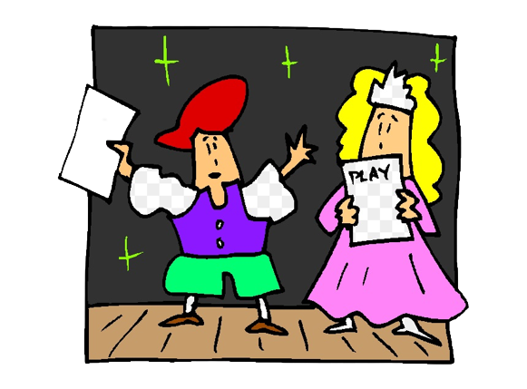
Groupwork: ROLE-PLAY

Slide 44
Good job!

Slide 45
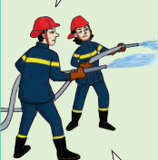
Listen and Say.
We’re firefighters.
We fight fires.
Notes:
Ask the children to listen and repeat.

Slide 46
Listen and Point.
We’re = We are
Notes:
Focus on the grammar box. On the board write we are and then the contracted forms we’re.

Slide 47
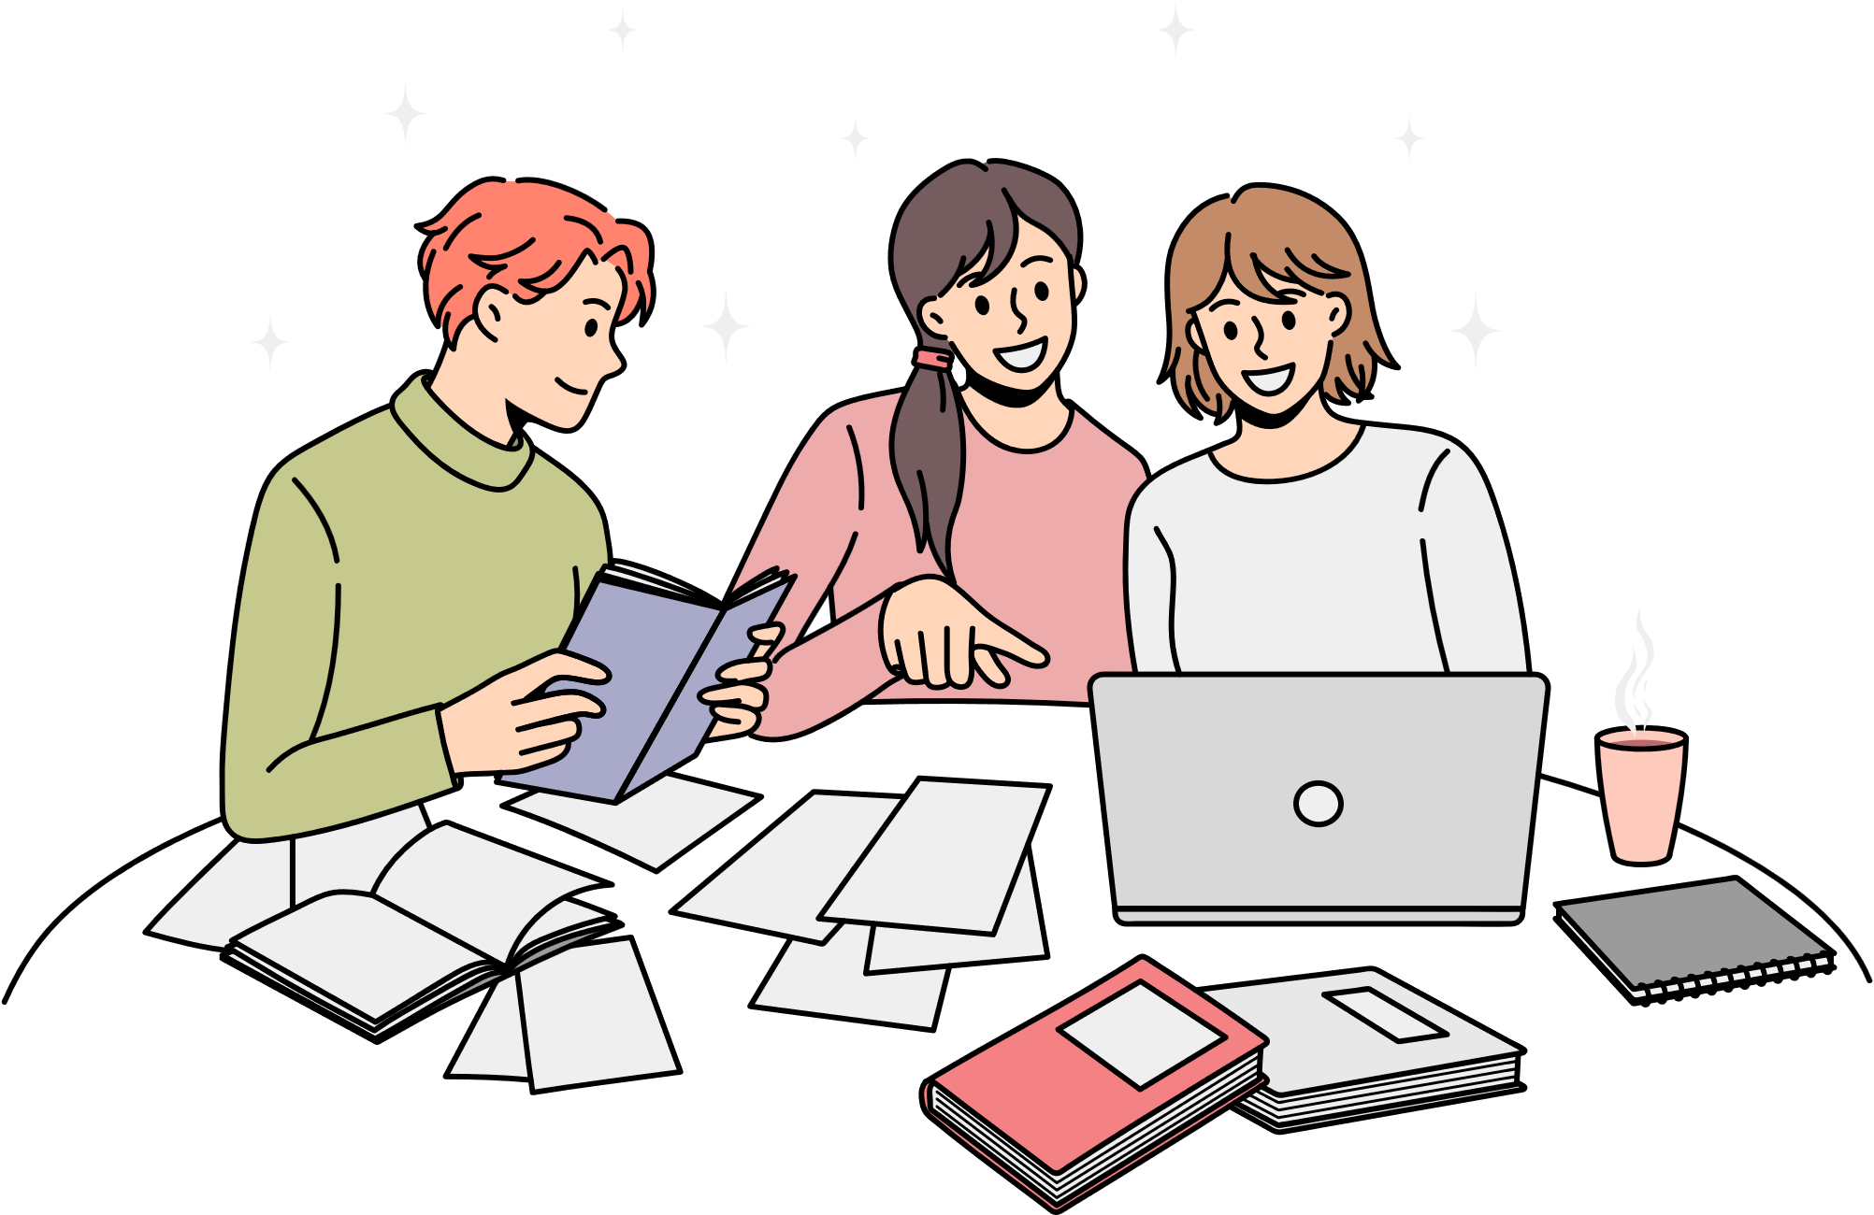
Look and Answer.
We ……………………………..
We sing.
We study.
We read books.
We write in our notebooks.
Notes:
Ask “What do students do?”
Elicit answers from the students.

Slide 48
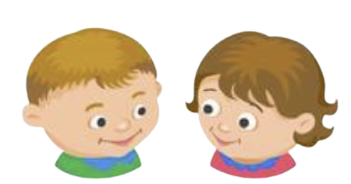
Work in Pairs.
We …………………………….
We sing.
We study.
We read books.
We write in our notebooks.
Notes:
Ask students to work in pairs, ask and answer the questions.

Slide 49
Good job!

Slide 50
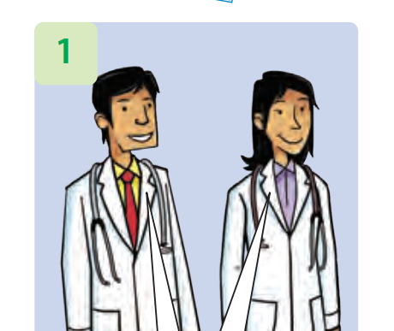
Write.
We help people.
____________________
We’re doctors.
Notes:
Ask “ What’s happening?”

Slide 51
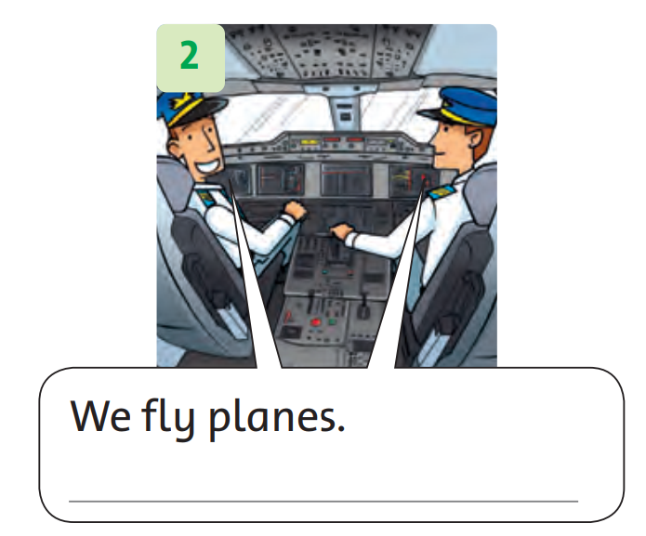
Write.
We’re pilots.
Notes:
Ask “ What’s happening?”

Slide 52
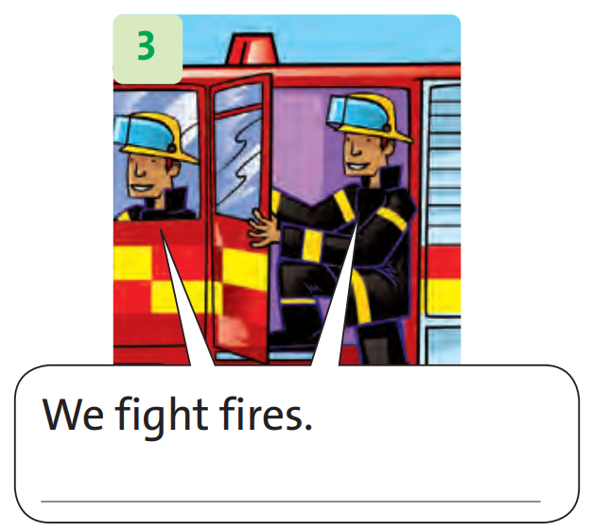
Write.
We’re firefighters.
Notes:
Ask “ What’s happening?”

Slide 53
Good job!

Slide 54
Game: MINGLE
Notes:
* Mingle
Ask students to prepare some photos of people (from magazines or newspapers).
Ask students to look at the picture and speech bubble.
Have a student demonstrate the sentence for the class. E.g., We’re students.
Have students move around with their photos while listening to music and talk about their photos.
Tell students to use other vocabulary on the page.
Call some students to perform in front of the class with their photos.
Check students’ speaking skills.

Slide 55
Good job!

Slide 56
Homework
Do the exercises in Workbook p.11.
Prepare for the next lesson
(Unit 1 - Lesson 2/Part 2).

Slide 57
Our Winners!
Peter
Eric
Julie
Notes:
Replace photos and names with your students’ information.

Slide 58
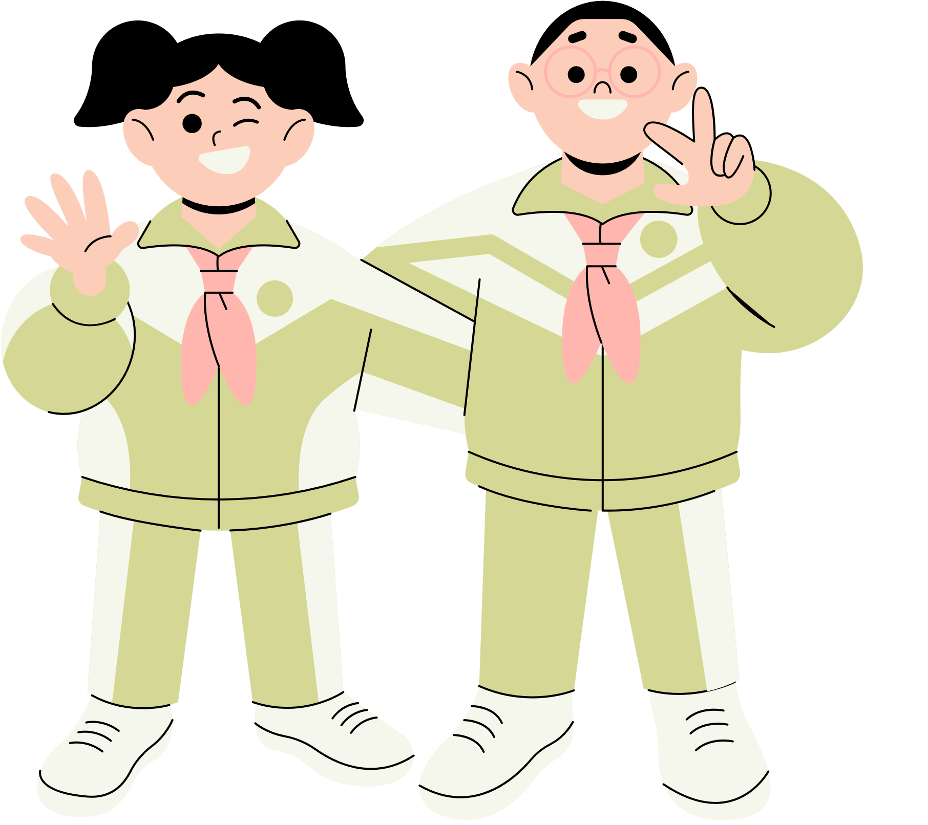
Thank You!
See You Next Time.
Notes:
https://www.youtube.com/watch?v=SRyFiVeNjWs

