Slide 1





THE COMMITTEE OF PEOPLE OF DISTRICT 12
DEPARTMENT OF EDUCATION AND TRAINING
WELCOME TO ENGLISH CLASS
NGUYỄN THỊ MINH KHAI PRIMARY SCHOOL
Starter: Back togther!
LESSON 1
Teacher: Trần Thị Thanh Loan

Slide 2



Slide 3
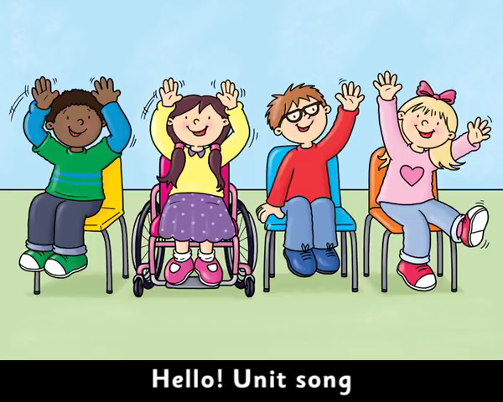

Slide 4


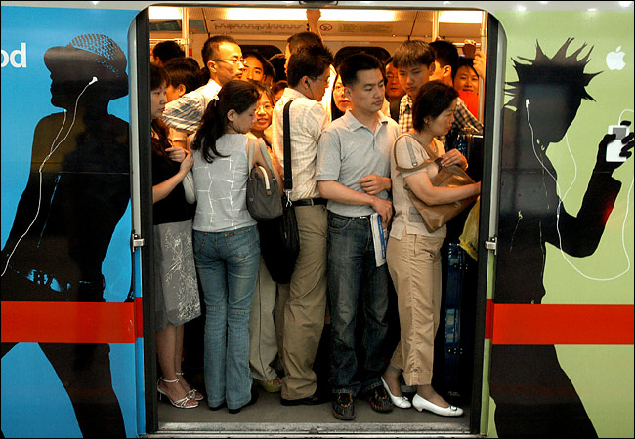
0
ORDINAL
NUMBERS
by HERBER

Slide 5


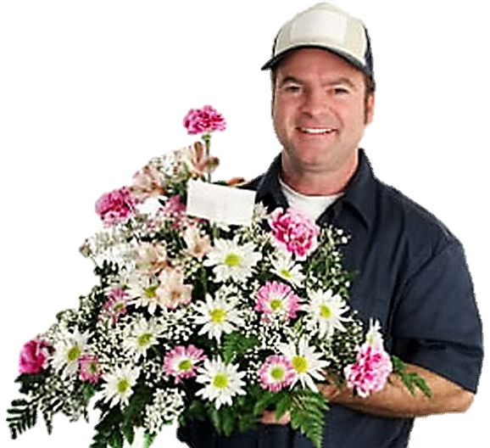
Help me, please! I’m going to the third floor
11
12
9
10
7
8
5
6
3
4
1
2

Slide 6
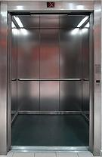
3 rd
third
Thank you!

Slide 7

I’m going to the fifth floor
11
12
9
10
7
8
5
6
3
4
1
2

Slide 8

5 th
fifth
Thank you!

Slide 9

I’m going to the ninth floor
11
12
9
10
7
8
5
6
3
4
1
2

Slide 10
9 th
ninth
Thank you!

Slide 11
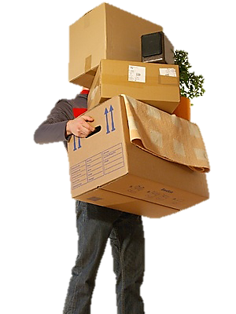
I’m going to the second floor
11
12
9
10
7
8
5
6
3
4
1
2

Slide 12
2 nd
second
Thank you!

Slide 13
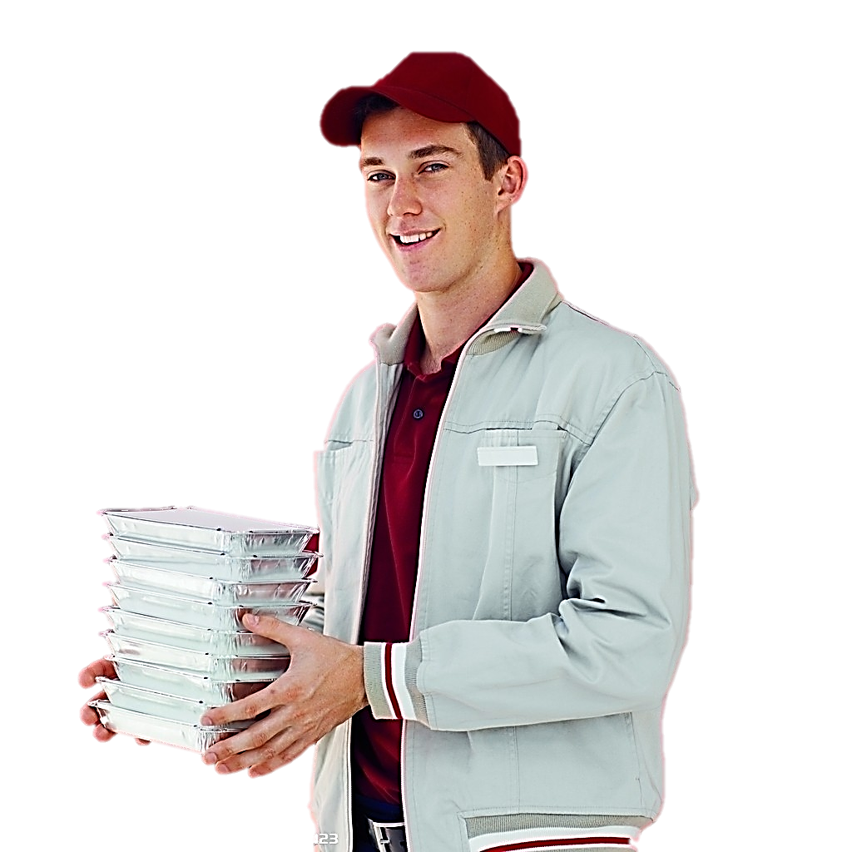
I’m going to the first floor
11
12
9
10
7
8
5
6
3
4
1
2

Slide 14
1 st
first
Thank you!

Slide 15

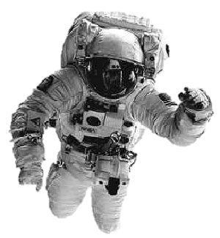
What floor are we on?
?

Slide 16

LISTEN AND POINT

Slide 17


Slide 18

LISTEN AND SING

Slide 20

WATCH THE VIDEO CLIP

Slide 21


Slide 22
WATCH THE VIDEO CLIP
ANSWER THESE QUESTIONS:
Where are they?
What are they doing?
How many people are there?

Slide 24

GROUPWORK

Slide 25

PERFORMANCE TIME

Slide 26
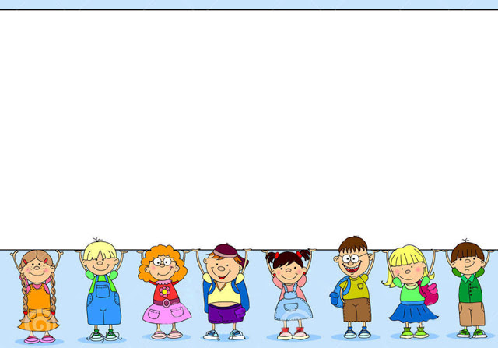
Choose the correct word.
Make a sentence with Verb + ing then.

Slide 27

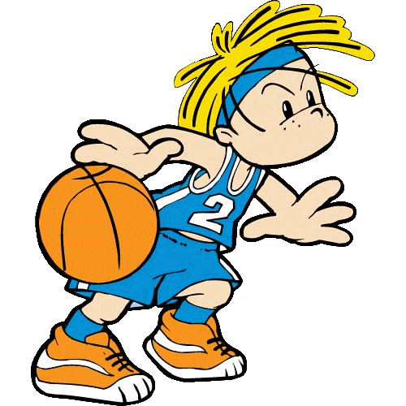






Slide 28
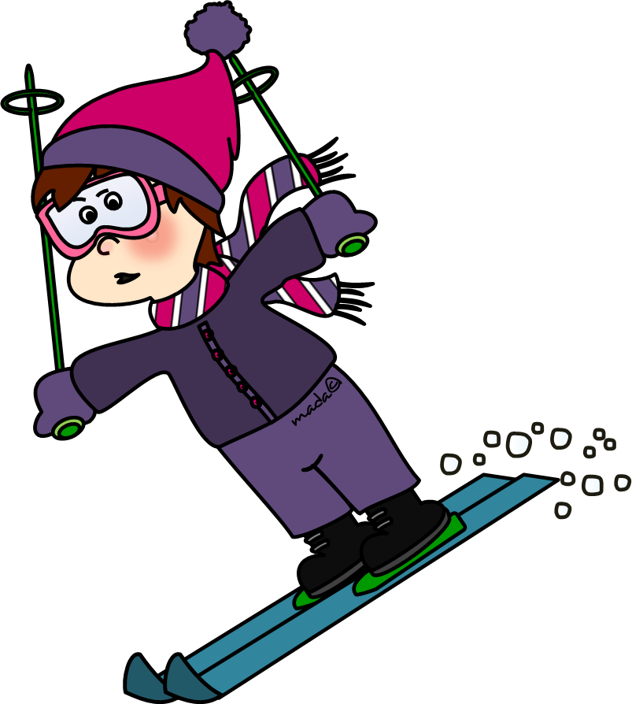



Slide 29




Slide 30



Slide 31



Slide 32
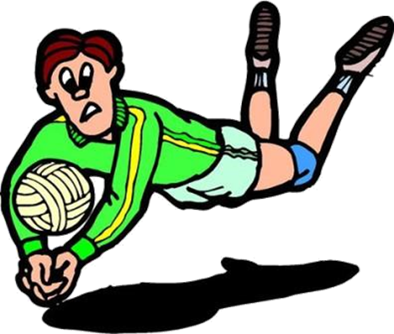


Slide 33
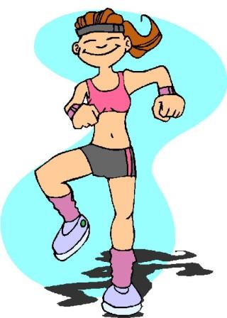


Slide 34
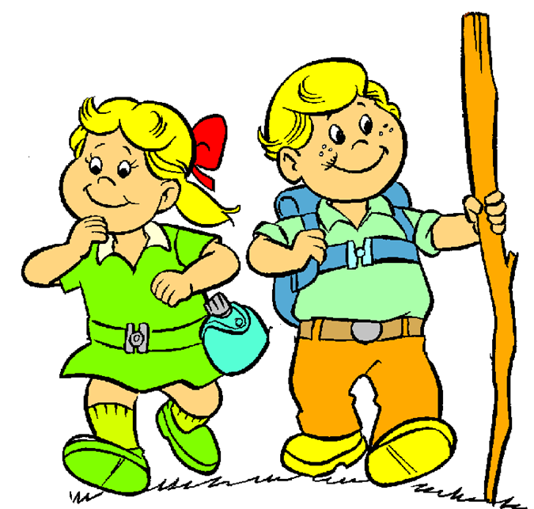


Slide 35
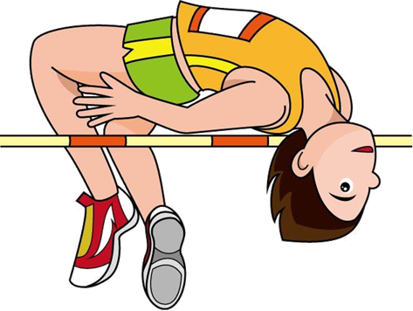


Slide 36
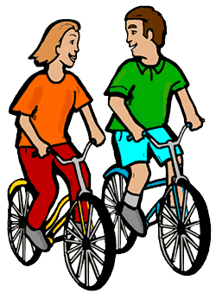


Slide 37



Slide 38



Slide 39

WORKBOOK TIME

Slide 40

GOODBYE!!!

Slide 41


