Slide 1
PEOPLE’S COMMITTEE OF DISTRICT 3 DEPARTMENT OF EDUCATION AND TRAINING

Slide 2
PEOPLE’S COMMITTEE OF DISTRICT 3 NGUYỄN THI PRIMARY SCHOOL
SUBJECT: ENGLISH
Teacher:Võ Thị Mỹ Phượng
District 3, September 27th , 2021.

Slide 3
Unit 1: The Ancient Mayans!
Lesson 1: Words.

Slide 4
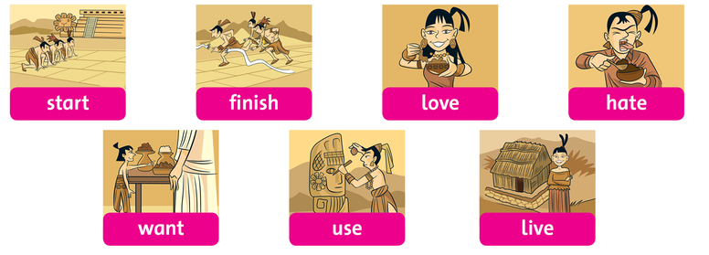
Listen and repeat.
Listen and point.

Slide 5
What’s the word’s meaning?
Start
= To begin doing some thing.
Finish
= to complete something or come to the end of an activity.
love
= to like something very much.

Slide 6
Hate
= to dislike someone or something very much.
Want
= to need something.
Use
= to put something into your service
for a purpose
Live
= to have interesting life

Slide 8
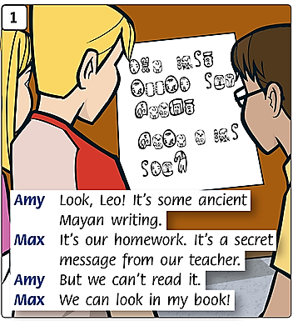

Slide 9
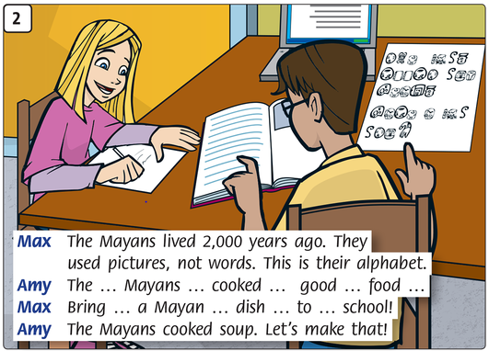

Slide 10
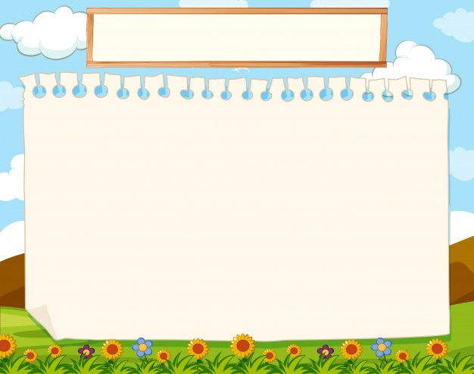
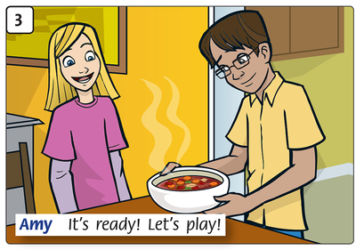

Slide 11
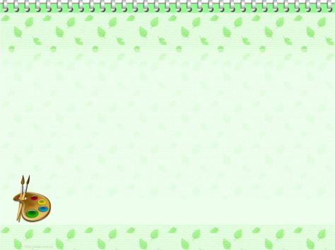
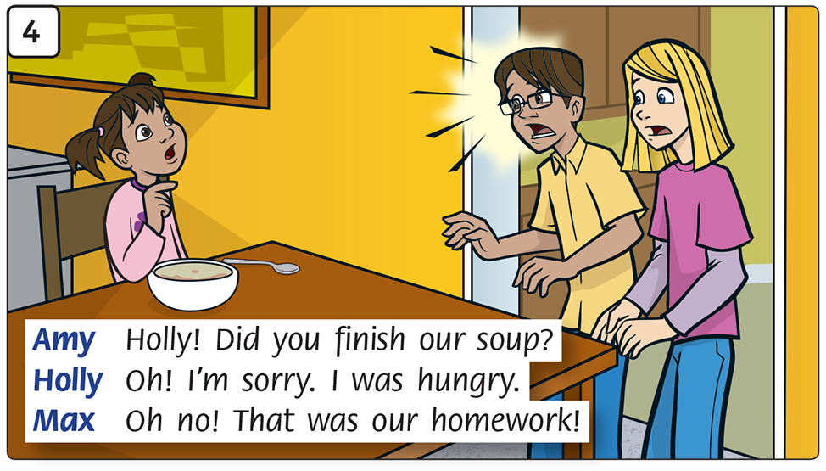

Slide 12
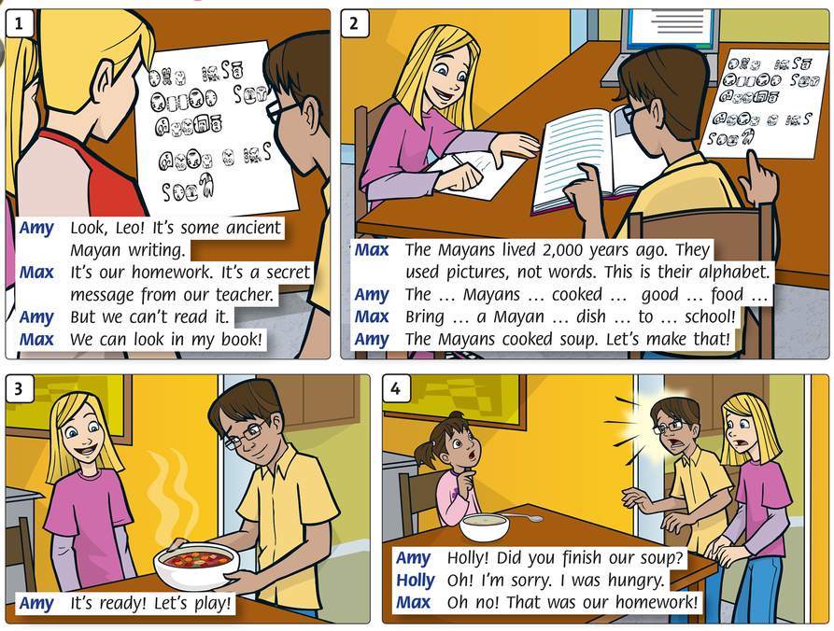

Slide 13
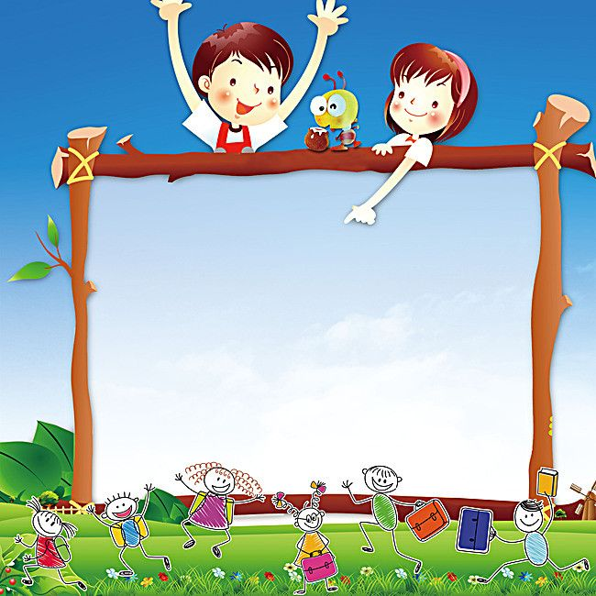
Home work
Study by your heart
New words
Try to read the story.

Slide 14
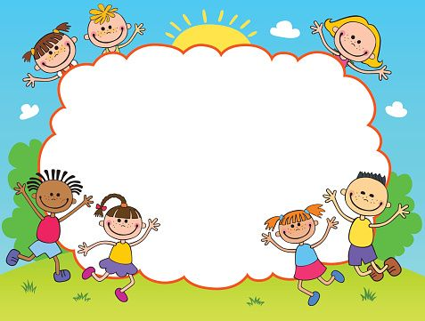

Slide 15
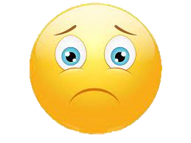
Stick in the box, please!
Very satisfied
Satisfied
Not satisfied

Slide 16
PEOPLE’S COMMITTEE OF DISTRICT 3 NGUYỄN THI PRIMARY SCHOOL
Thanks for your watching.
Teacher:Võ Thị Mỹ Phượng
Nguyễn Thi primary school’s website
https://thnguyenthiq3.hcm.edu.vn

