Slide 1
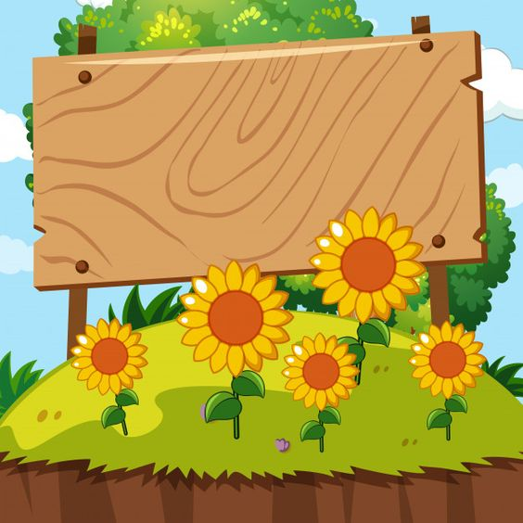

PEOPLE’S COMMITTEE OF DISTRICT 3 DEPARTMENT OF EDUCATION AND TRAINING

Slide 2


PEOPLE’S COMMITTEE OF DISTRICT 3 NGUYỄN THI PRIMARY SCHOOL
SUBJECT: ENGLISH
Teacher : Võ Thị Mỹ Phượng
District 3, September 29th , 2021.

Slide 3

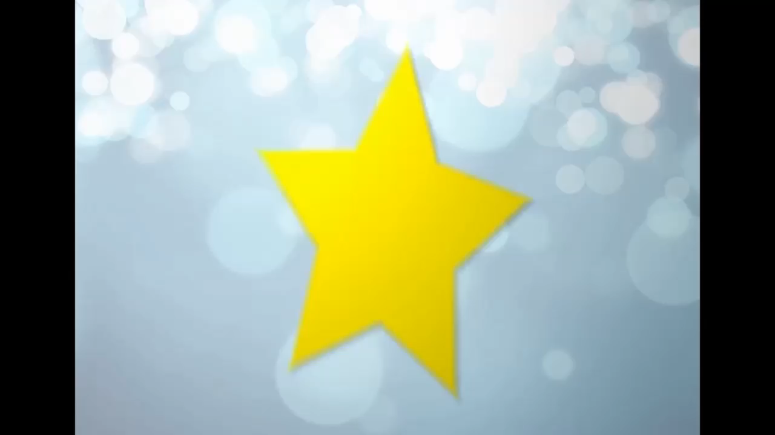

Slide 4
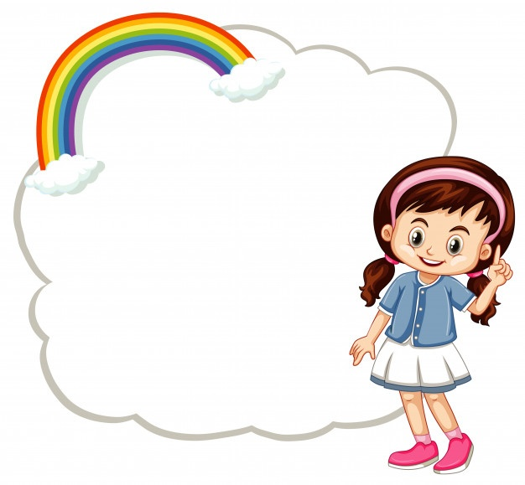

Unit 1: The Ancient Mayans!!
Lesson 2 & 3: Grammar & song.

Slide 5


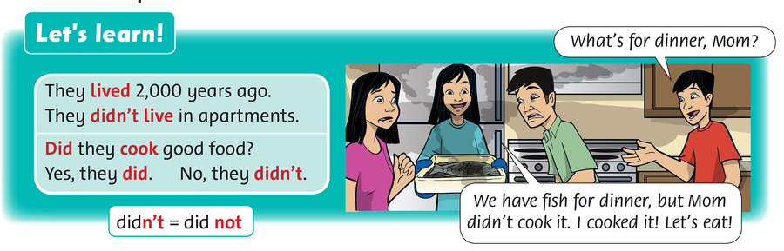

Slide 6
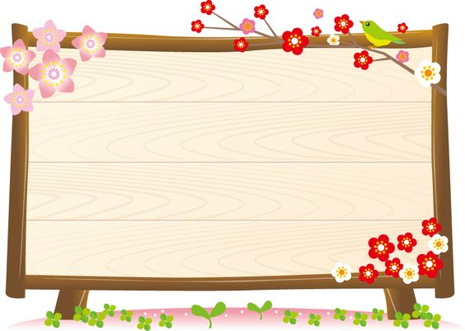
Simple past:
Simple past
Future
Simple present
They lived 2.000 years ago.
Affirmations
Simple past
They didn’t live in apartments.
Negative
Did they cook good food?
Question
=>Yes, they did./No,they didn’t.

Slide 7

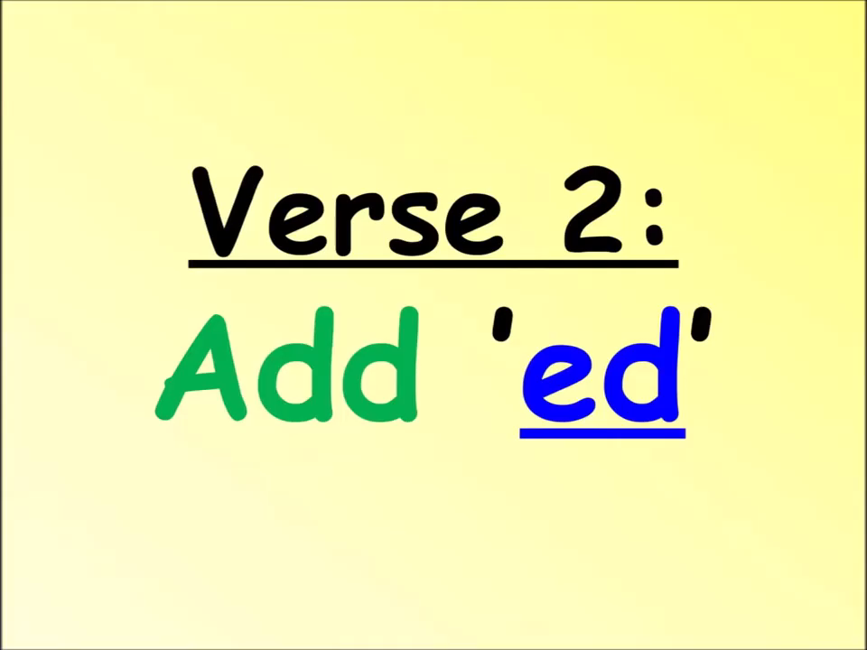

Slide 8

Affirmations
Negative
Question
start
started
didn’t start
Did…… start…. ?
Examples:
We started at 4 PM.
We didn’t start at 5 PM.
Did we start at 5 PM?
finish
love
hate

Slide 9

Affirmations
Negative
Question
want
use
live

Slide 10
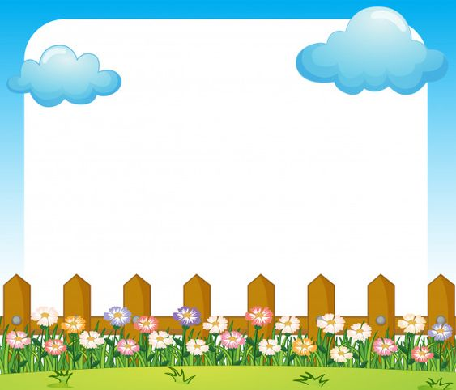
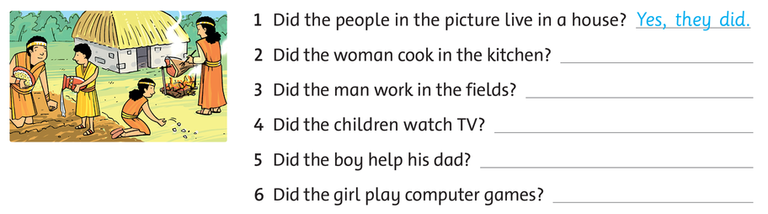
Write the answer.

Slide 11

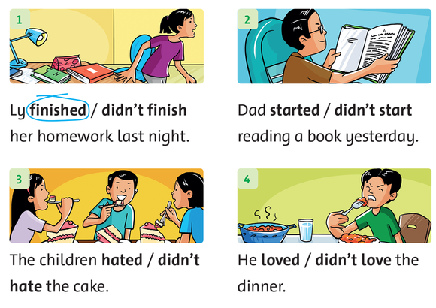
Read and circle.

Slide 12

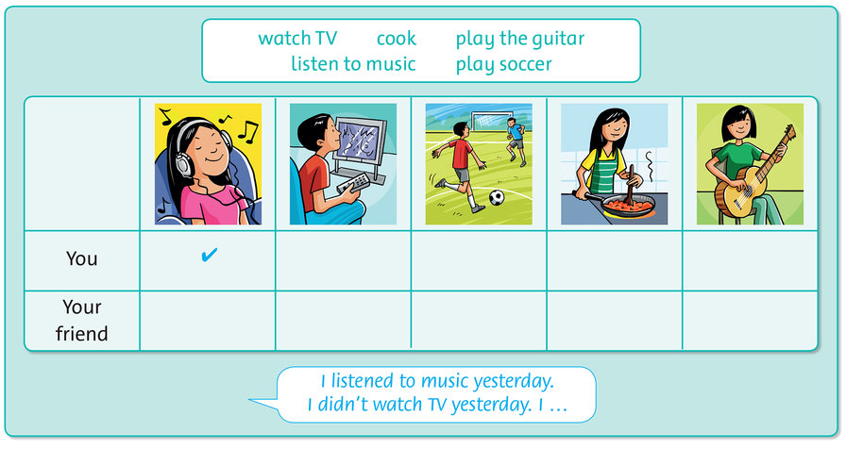
Look and say . Write tick or cross.

Slide 13
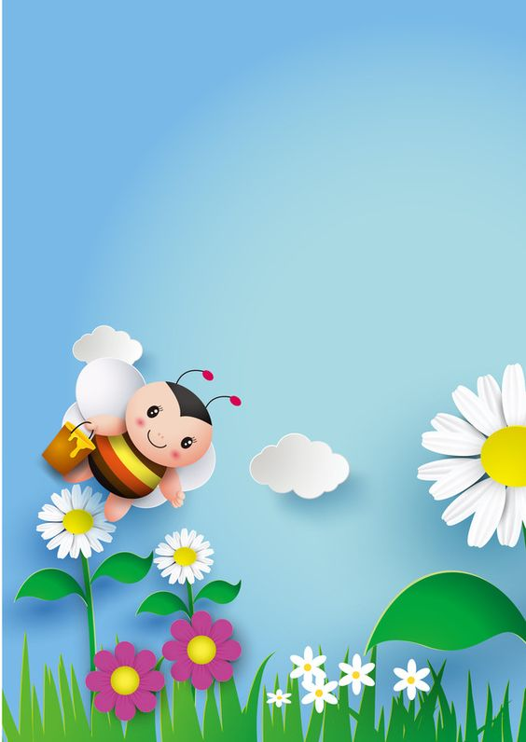
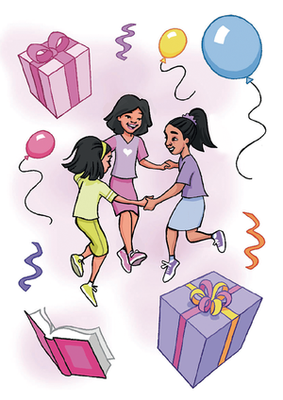
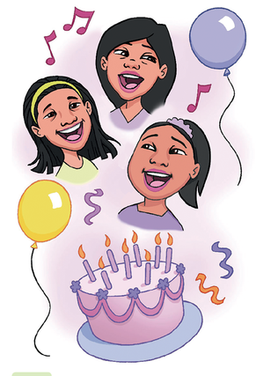
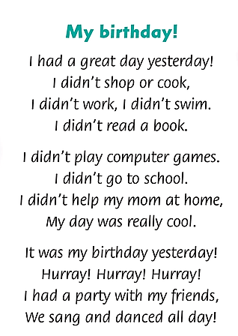

Slide 14
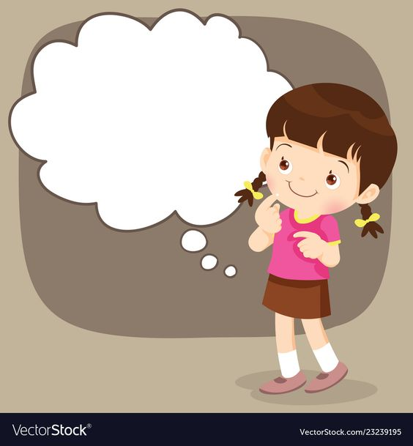
Homework
Finish your workbook pages 9&10.
Study by your heart sructures and “simple past tense”.

Slide 15




Stick in the box, please!
Very satisfied
Satisfied
Not satisfied

Slide 16

PEOPLE’S COMMITTEE OF DISTRICT 3 NGUYỄN THI PRIMARY SCHOOL
Thanks for your watching.
Teacher:Võ Thị Mỹ Phượng
Nguyễn Thi primary school’s website
https://thnguyenthiq3.hcm.edu.vn

