Slide 1
ỦY BAN NHÂN DÂN QUẬN 3 PHÒNG GIÁO DỤC VÀ ĐÀO TẠO

Slide 2
ỦY BAN NHÂN DÂN QUẬN 3 TRƯỜNG TIỂU HỌC NGUYỄN THI
MÔN TIẾNG ANH LỚP 3
Giáo viên thực hiện: Lê Toàn Thắng
Năm học 2021 - 2022

Slide 3
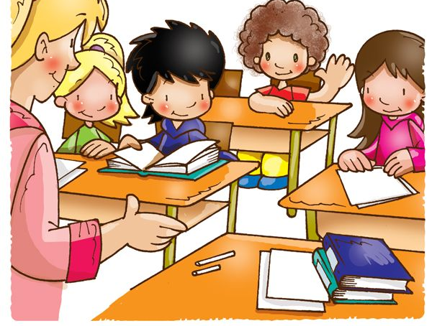
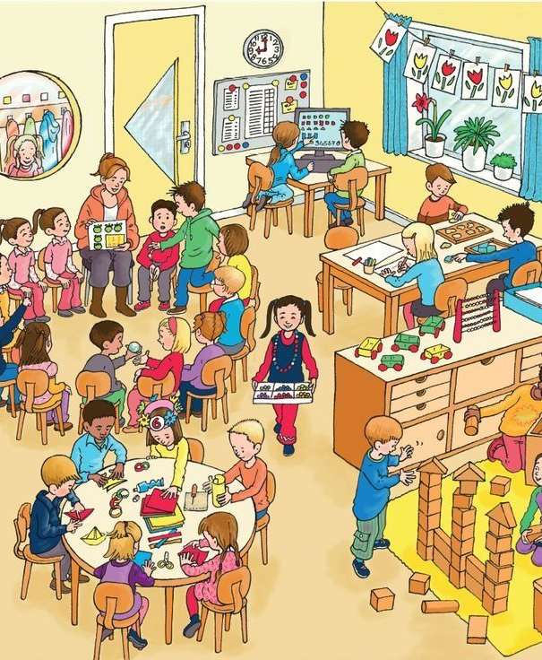
Unit 2: Our new things
Grade 3
Lesson Three: Song

Slide 4
Hello everyone!

Slide 5
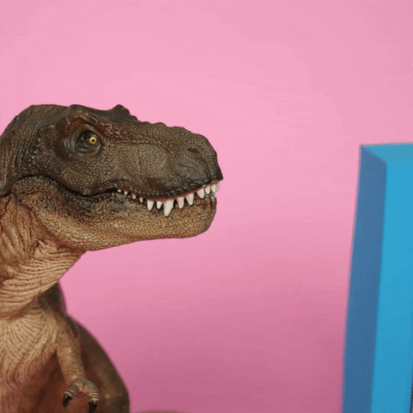
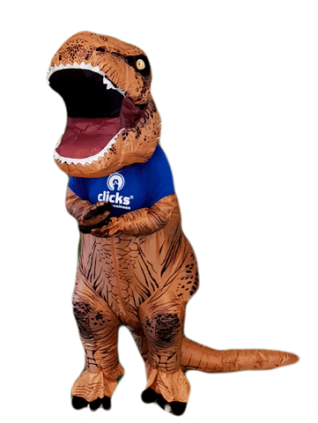
It’s time for a game!

Slide 6
That is a computer.
That is a board.
This is a board.
Those are tables.

Slide 7
These are computers.
This is a coat hook.
That is a pencil case.
Those are boards.

Slide 8
This is a coat hook.
These are tables
This is a pencil case.
This is a board.

Slide 9
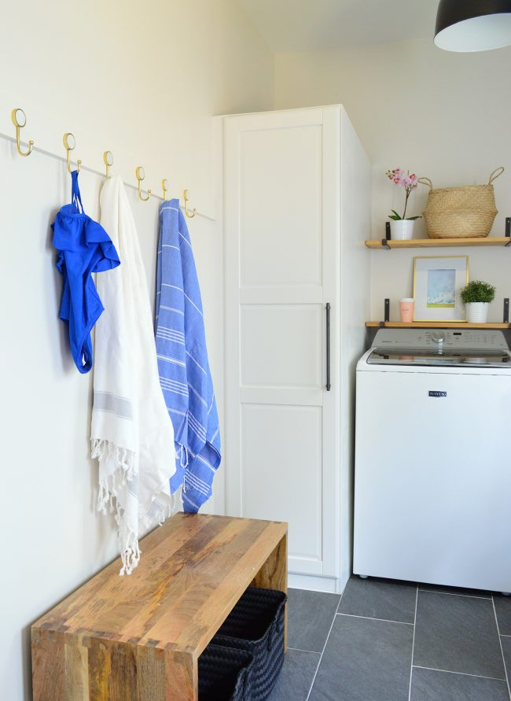
This is a computer.
These are tables
This is a coat hook.
Those are coat hooks.

Slide 10
This is a table.
That is a coat hook.
Those are tables.
Those are pencil cases.

Slide 11
Listen and point

Slide 13
Listen and repeat
This Photo by Unknown Author is licensed under CC BY-SA

Slide 15
Listen and point

Slide 17
Listen and repeat
This Photo by Unknown Author is licensed under CC BY-SA

Slide 19
GROUPWORK: Sing and do

Slide 20
Performance time

Slide 21
Tasks: Worktime!
Finish the works in your workbook!

Slide 22
Goodbye~!

Slide 23
How do you feel this lesson ?
Fantastic
Good
Ok

Slide 24
ỦY BAN NHÂN DÂN QUẬN 3 TRƯỜNG TIỂU HỌC NGUYỄN THI
XIN CHÂN THÀNH CÁM ƠN
Giáo viên thực hiện: Lê Toàn Thắng
Trang website của trường Nguyễn Thi https://thnguyenthiq3.hcm.edu.vn

