Slide 1
ỦY BAN NHÂN DÂN QUẬN 3 PHÒNG GIÁO DỤC VÀ ĐÀO TẠO

Slide 2
ỦY BAN NHÂN DÂN QUẬN 3 TRƯỜNG TIỂU HỌC NGUYỄN THI
MÔN TIẾNG ANH LỚP 3
Giáo viên thực hiện: Lê Toàn Thắng
Năm học 2021 - 2022

Slide 3
Unit starter:
Grade 3
Lesson Four
This Photo by Unknown Author is licensed under CC BY-SA-NC

Slide 4
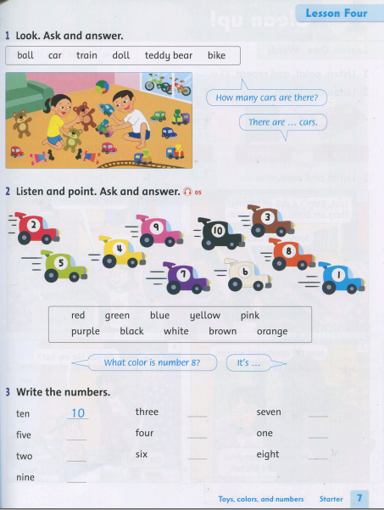

Slide 5
Starter: Welcome back! Lesson 4 + New words: 1/ Ball: trái banh, trái bóng 2/ Car: xe hơi 3/ Train: xe lửa 4/ Doll: búp bê 5/ Teddy bear: gấu bông 6/ Bike: xe đạp

Slide 6
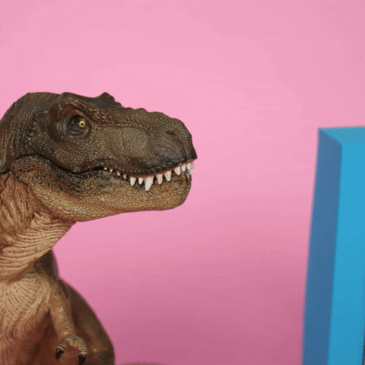
It’s time for a game!

Slide 7
It is round.
You use it in sport.
You kick it.
Nothing here.
ball

Slide 8
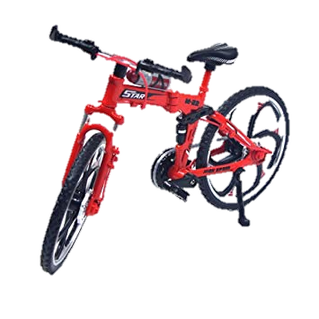
It has 2 wheels.
Nothing here.
b _ _ _
bike

Slide 9
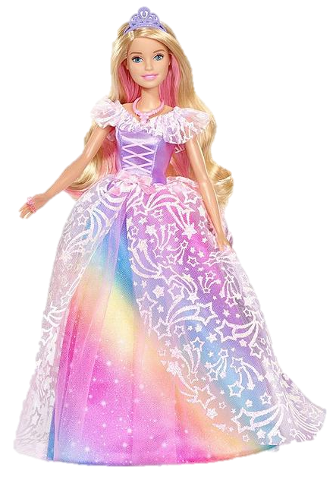
It can be hard or soft.
Nothing here.
doll
It has hair.
You play with it.

Slide 10
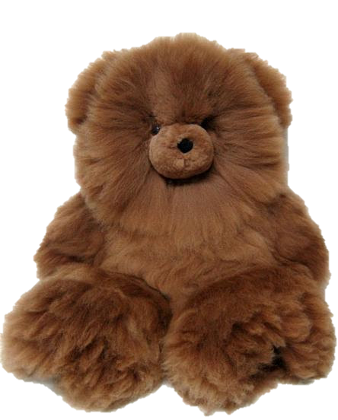
Nothing here.
It is very soft.
Its name has 2 words.
It has hands but no finger.
teddy bear

Slide 11
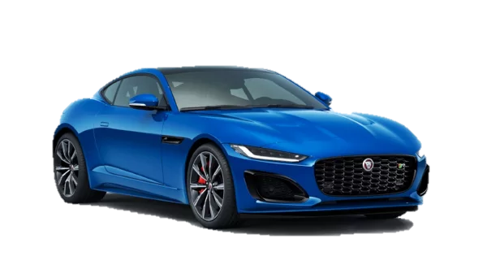
It has 4 wheels.
Nothing here.
It can carry up to 7 people.
car

Slide 12
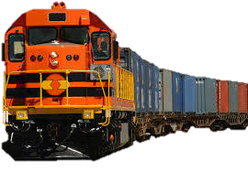
It is very long.
Nothing here.
It is very noisy.
train

Slide 13
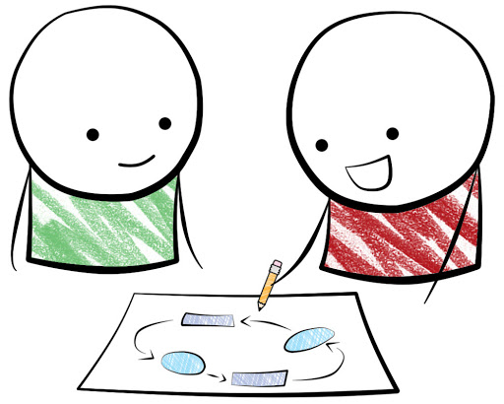
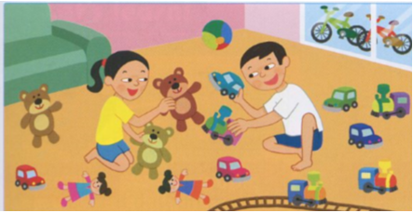
Look. Ask and answer.
ball / car / train / doll / teddy bear / bike
PAIR WORK
EXAMPLE:
+ How many cars are there?
There are … cars.

Slide 15
Listen and point

Slide 16
Ask and answer
PAIR WORK
EXAMPLE:
+ What color is number 8?
It's …

Slide 17
Write the numbers.
ten | 10 | three |  | seven
five |  | four |  | one
two |  | six |  | eight
nine

Slide 18
Write the numbers.
ten | 10 | three | 3 | seven | 7
five | 5 | four | 4 | one | 1
two | 2 | six | 6 | eight | 8
nine | 9

Slide 19
Tasks: Worktime!
Finish the works in your workbook!

Slide 20
1. Take out your pencil cases.
2. Tell your friends how many school things you have
Tasks

Slide 21
Goodbye~!

Slide 22
How do you feel this lesson ?
Fantastic
Good
Ok

Slide 23
ỦY BAN NHÂN DÂN QUẬN 3 TRƯỜNG TIỂU HỌC NGUYỄN THI
XIN CHÂN THÀNH CÁM ƠN
Giáo viên thực hiện: Lê Toàn Thắng
Trang website của trường Nguyễn Thi https://thnguyenthiq3.hcm.edu.vn

