Slide 1
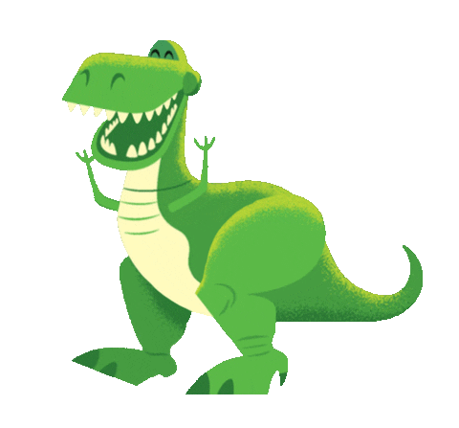
GRADE 5
UNIT FIVE
The dinosaur museum
Lesson 2 – Grammar 1

Slide 2
WATCH THE VIDEO CLIP

Slide 4
GROUPWORK

Slide 6
Past Simple
Irregular verbs

Slide 7
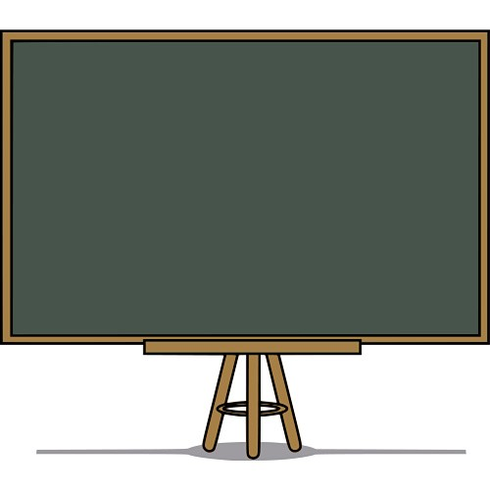
Irregular verbs make the past form in different ways.
Ex: go - went
eat - ate
take - took

Slide 8
Negative sentences
Subject + didn’t + infinitive
Ex: You didn’t buy tickets for the concert.

Slide 9
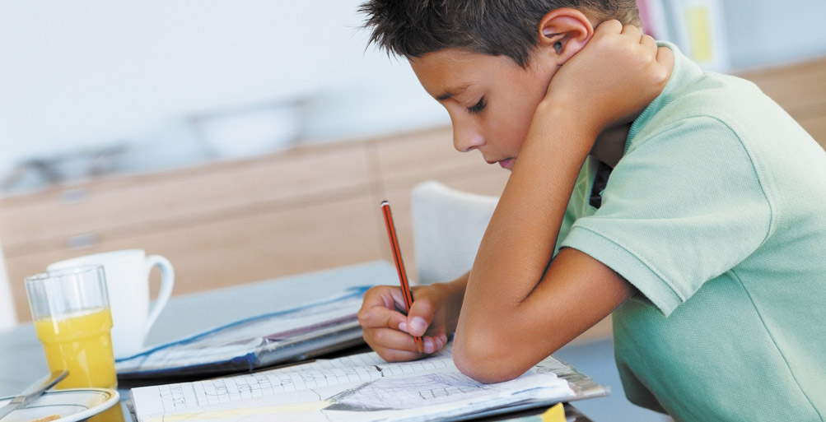
Make a sentence. Follow the model.
❐
Michael / do / his homework
Michael did his homework yesterday.

Slide 10
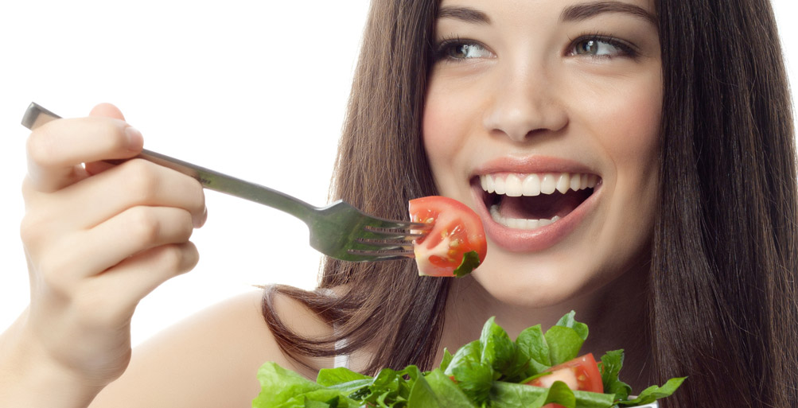
x
Ann / eat / pizza
Ann didn’t eat pizza yesterday evening.

Slide 11
❐
they / win / the game
They won the game last Sunday.

Slide 12
x
Sue / catch / the bus to work
Sue didn’t catch the bus to work two days ago.

Slide 13
❐
they / go / to the beach
They went to the beach last month.

Slide 14
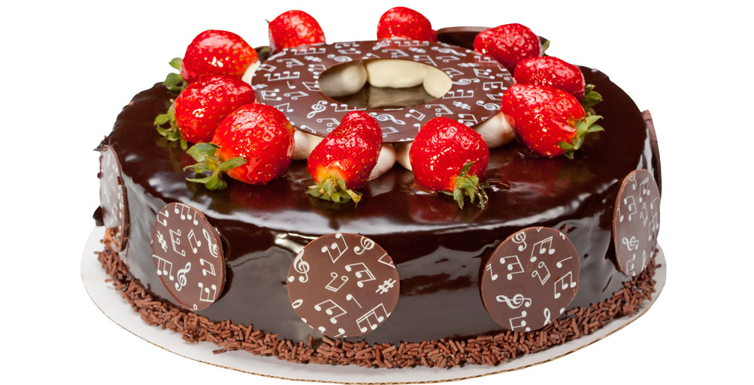
x
I / make / an apple pie
I didn’t make an apple pie three days ago.

Slide 15
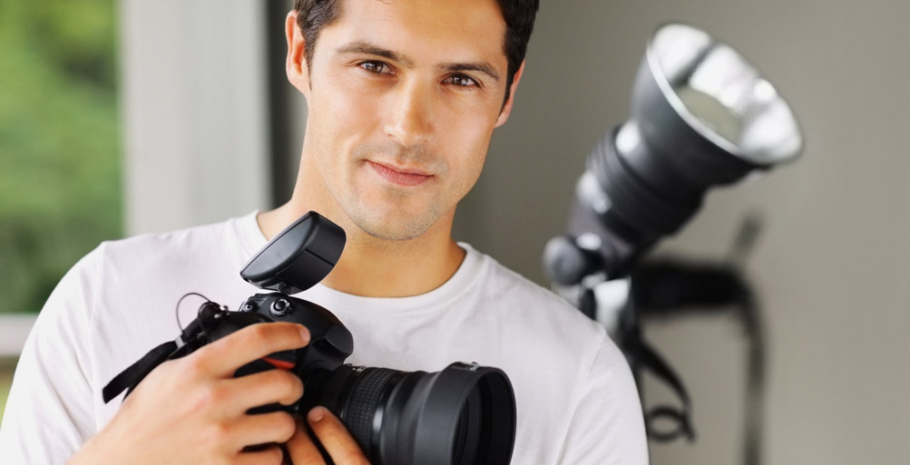
❐
Peter/ buy / a new camera
Peter bought a new camere last week.

Slide 16
x
Maggie / drink / water
Maggie didn’t drink water this morning.

Slide 17
didn’t buy
didn’t eat
saw

Slide 18
didn’t go
didn’t learn
played
didn’t wear
wore

Slide 19
WORKBOOK TIME

Slide 21
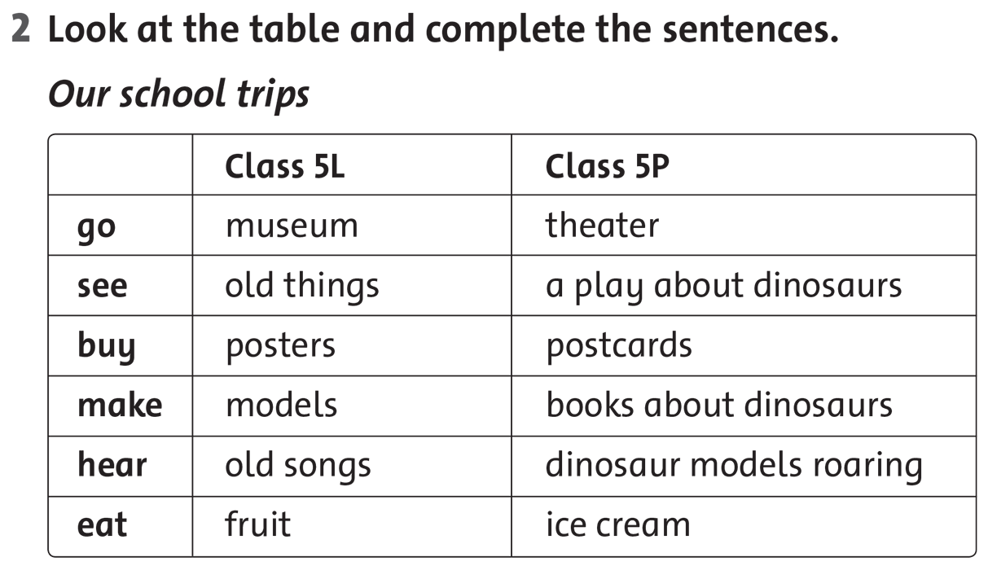

Slide 22
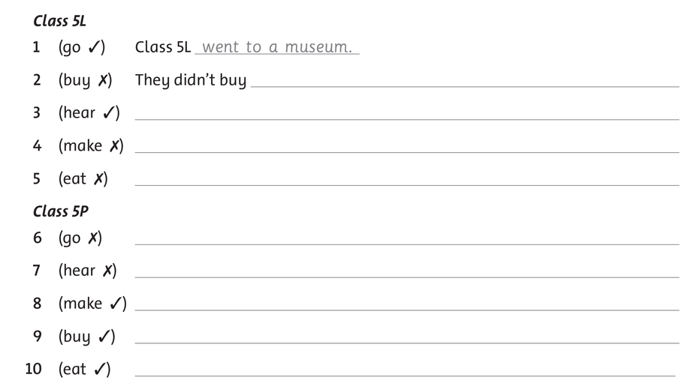

Slide 23
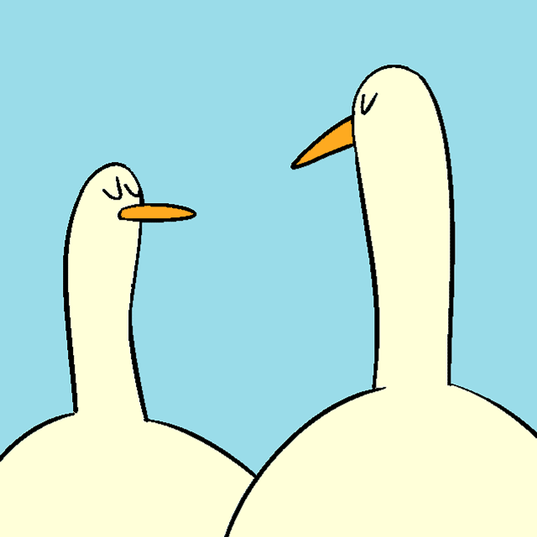
GOODBYE!!!

