Slide 1
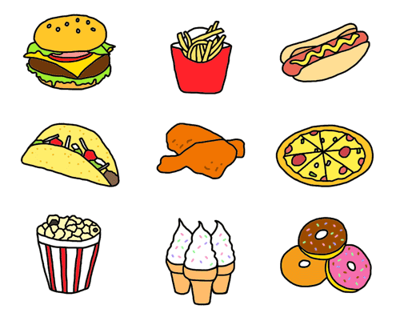
UNIT 3
The food here is great
Lesson 6

Slide 2
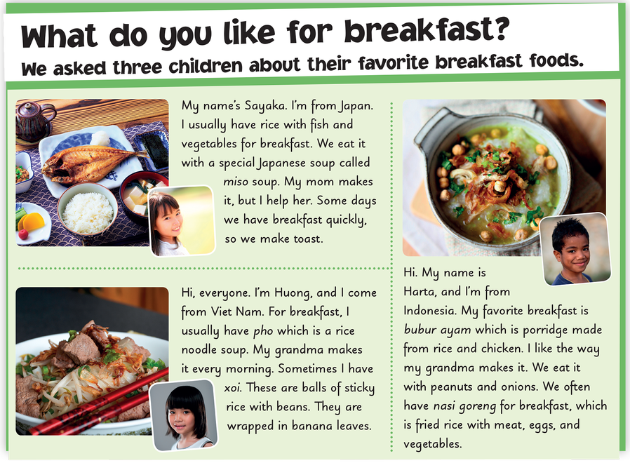

Slide 3
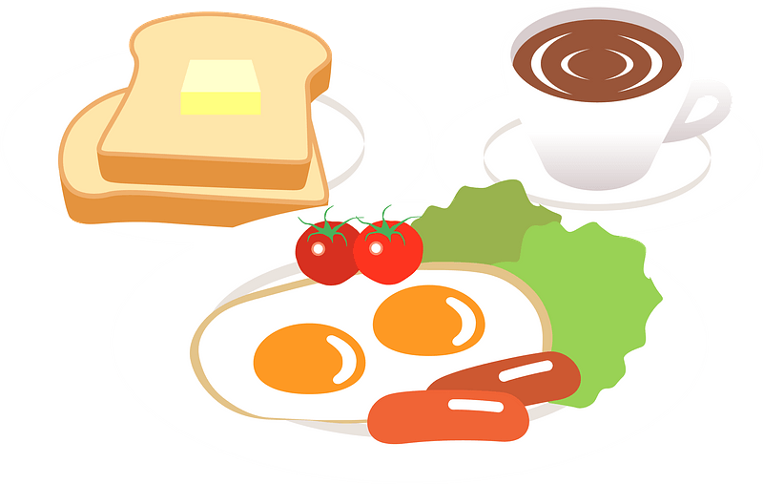
BREAKFAST
QUIZ
START

Slide 4
dinner
This is a meal in a day.
You can eat with your family in the evening.
START

Slide 5
salad
This dish is very good for your health.
There are many kinds of vegetables in it.
START

Slide 6
breakfast
We have this meal in the morning.
START

Slide 7
pizza
This is a kind of fast food.
It’s round. You need to cut it into pieces when you eat.
START

Slide 8
pho
This is Vietnamese noodles soup. It’s very famous and yummy.
START

Slide 9
water
We need this kind of drink every day.
It has no smell, no colors.
START

Slide 10
coffee
This drink is brown or dark brown.
You can add sugar, milk or ice when you have it.
START

Slide 11
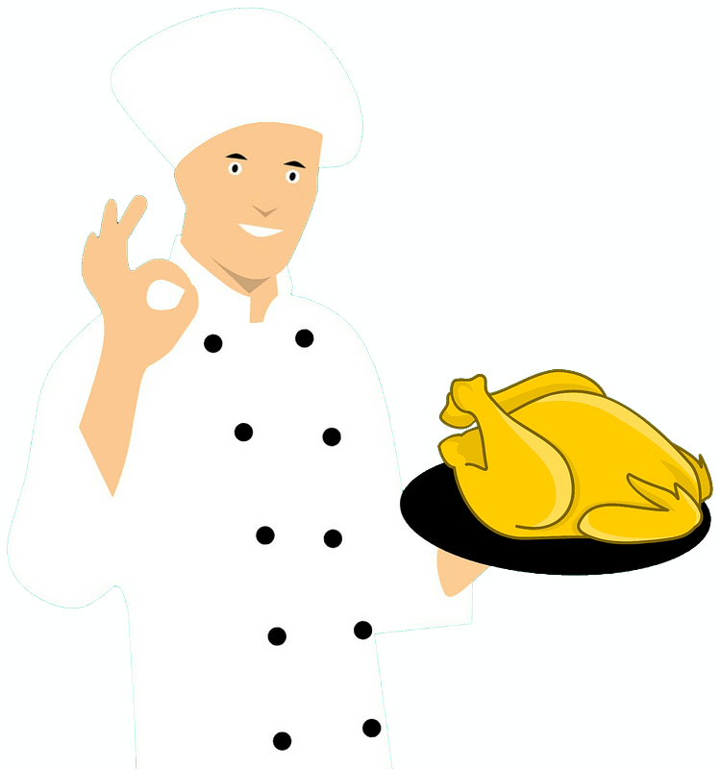
Well done!

Slide 12
3
2

Slide 14
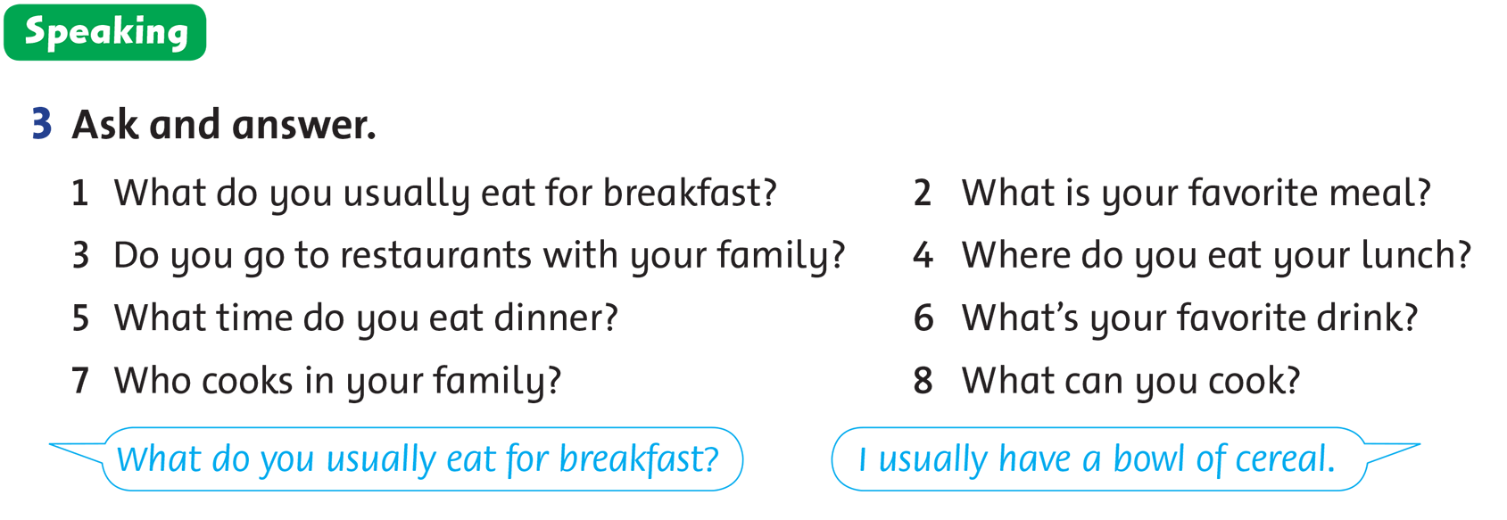

Slide 15
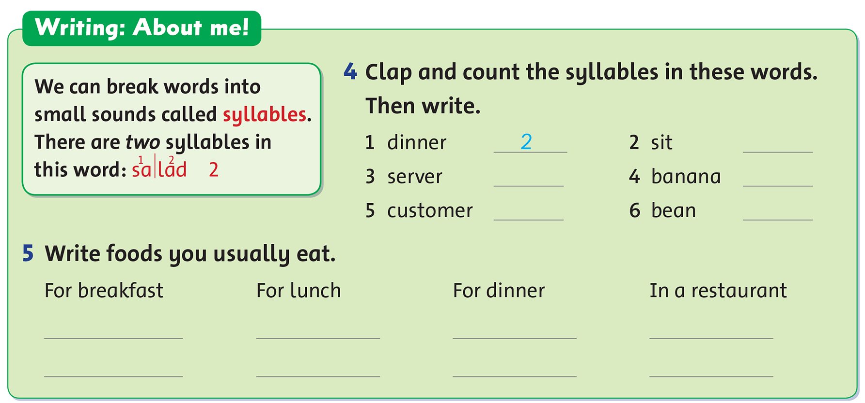

Slide 16
WORKBOOK TIME

Slide 17
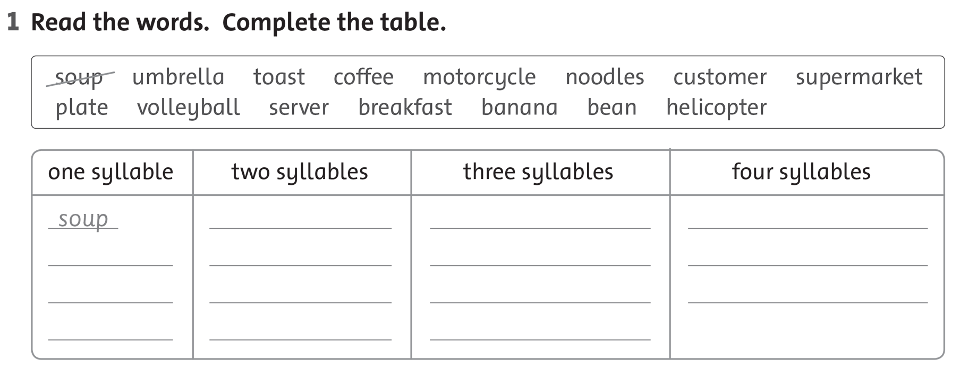

Slide 19
GOODBYE!!!

