Slide 1
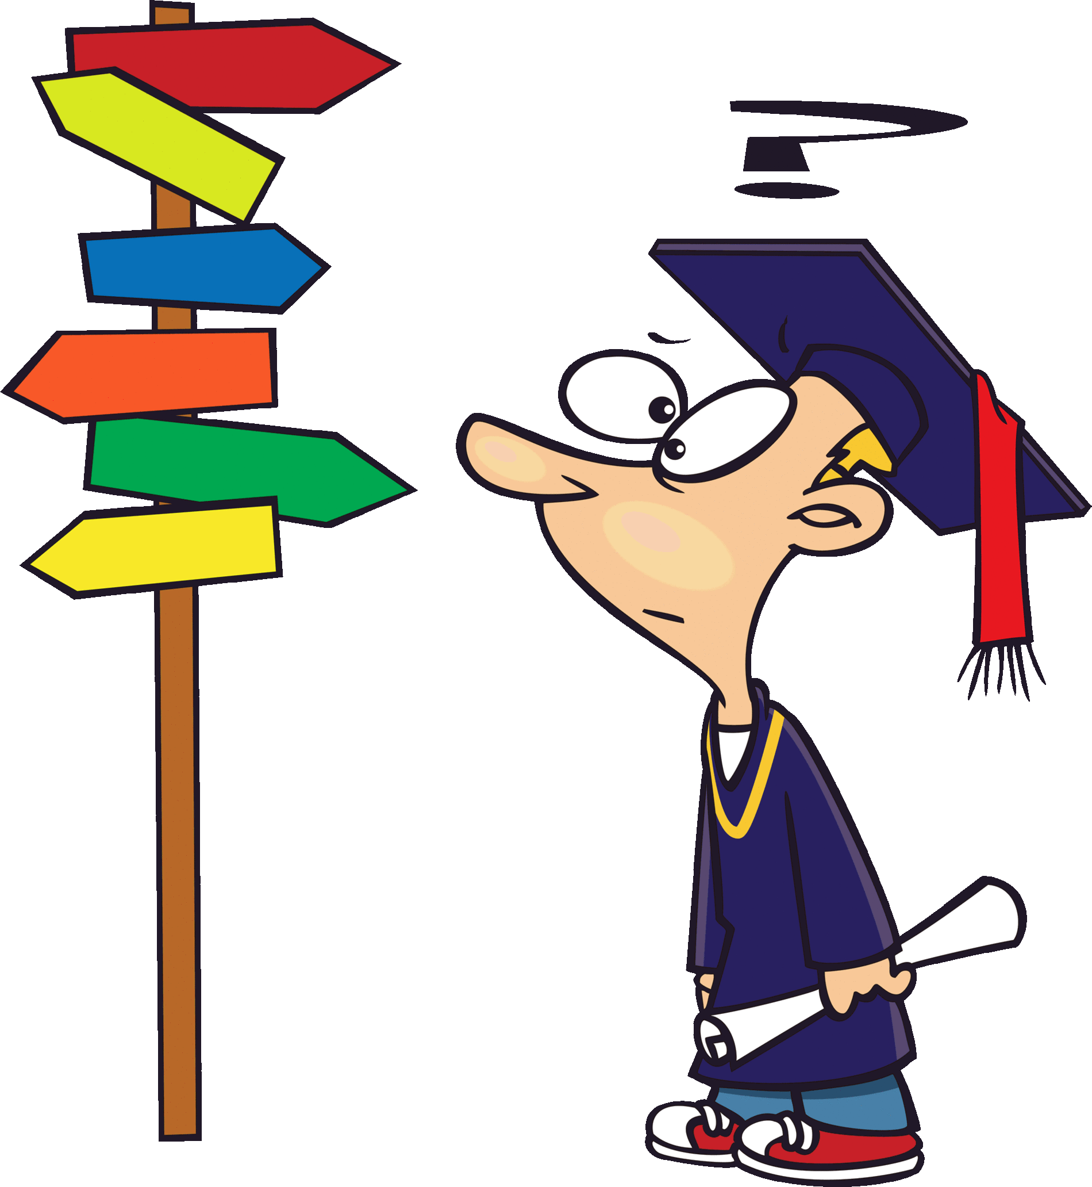
Unit 7
GO BACK TO THE TRAFFIC LIGHTS.
LESSON 1 - WORDS

Slide 4
WATCH THE VIDEO CLIP

Slide 6
LISTEN AND POINT

Slide 7
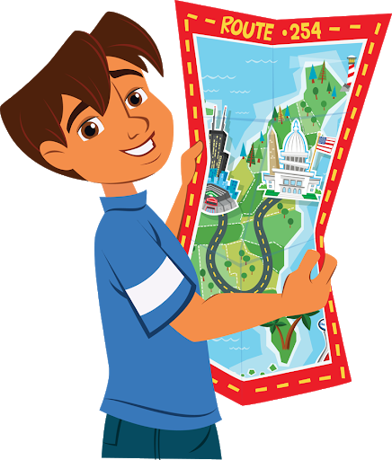
read a map

Slide 8
turn left

Slide 9
go back

Slide 10
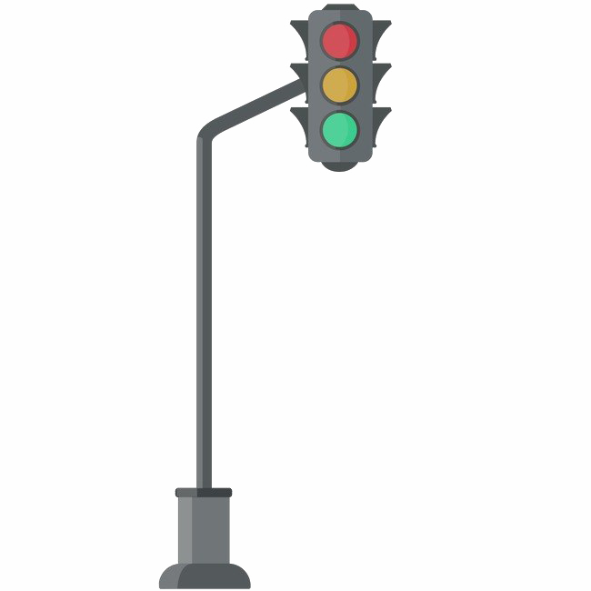
traffic lights

Slide 11
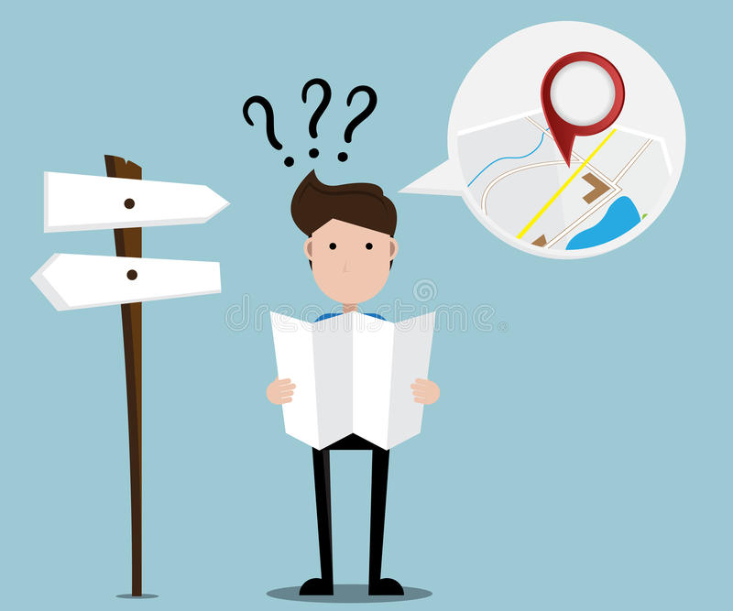
lost

Slide 12
turn right

Slide 13
go straight

Slide 14
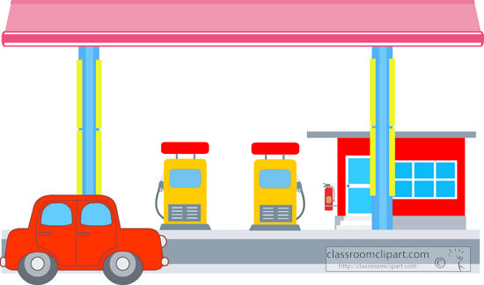
gas station

Slide 15
LISTEN AND REPEAT

Slide 16
read a map

Slide 17
turn left

Slide 18
go back

Slide 19
traffic lights

Slide 20
lost

Slide 21
turn right

Slide 22
go straight

Slide 23
gas station

Slide 24
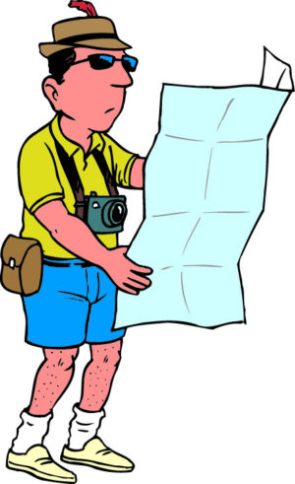
LOOK AND CHOOSE
turn left
read a map
turn right
read a map
Great!

Slide 25
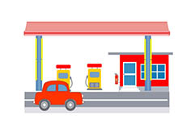
LOOK AND CHOOSE
lost
gas station
traffic lights
gas station
Great!

Slide 26
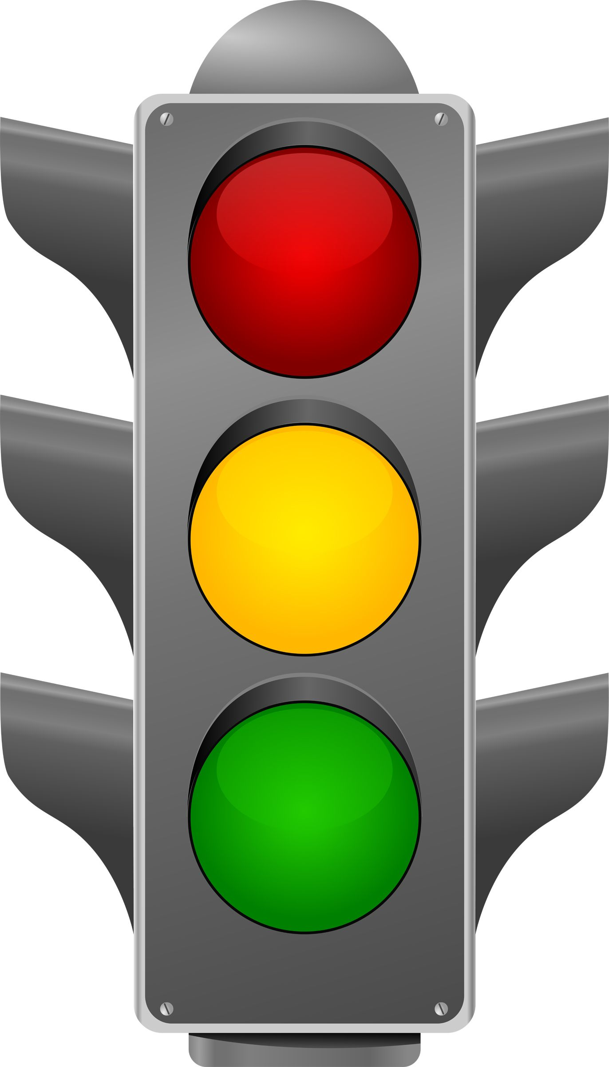
LOOK AND CHOOSE
go straight
go back
traffic lights
Great!
traffic lights

Slide 27
LOOK AND CHOOSE
go back
go straight
go across
go back
Great!

Slide 28
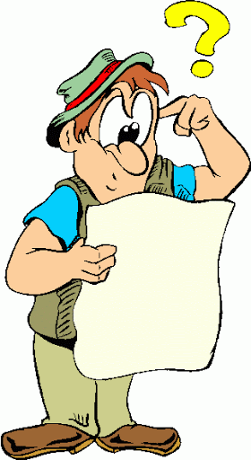
LOOK AND CHOOSE
go back
go straight
lost
Great!
lost

Slide 29
LOOK AND CHOOSE
turn left
go straight
turn right
go straight
Great!

Slide 30
LOOK AND CHOOSE
turn left
turn right
go back
turn left
Great!

Slide 31
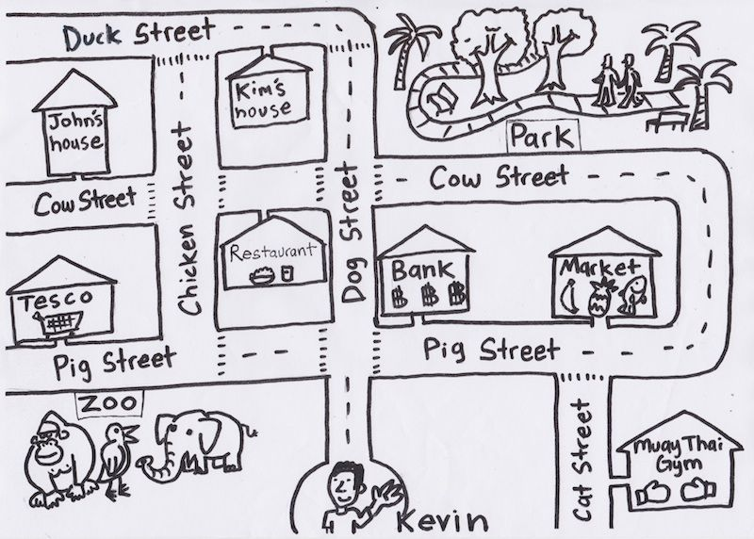
Help Kevin get to …

Slide 32
WATCH THE VIDEO CLIP
ANSWER THESE QUESTIONS:
Where are they?
What are they doing?
How many people are there?

Slide 34
GROUPWORK

Slide 35
PERFORMANCE TIME

Slide 36
WORKBOOK TIME

Slide 37
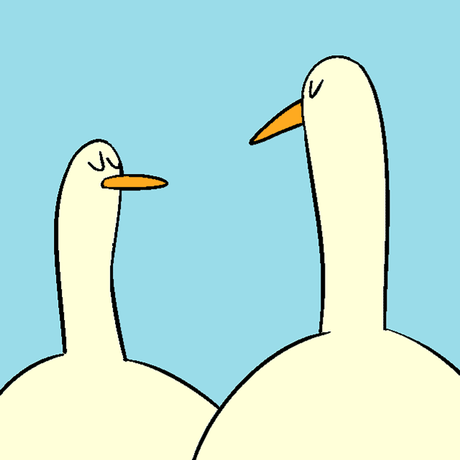
GOODBYE!!!

