Slide 2
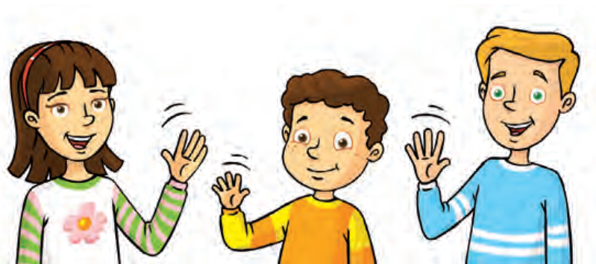
Starter Unit
Welcome back!
Lesson 1 - Grammar

Slide 4
Let’s say Hello!
Notes:
Ask students to sing along the music.

Slide 5
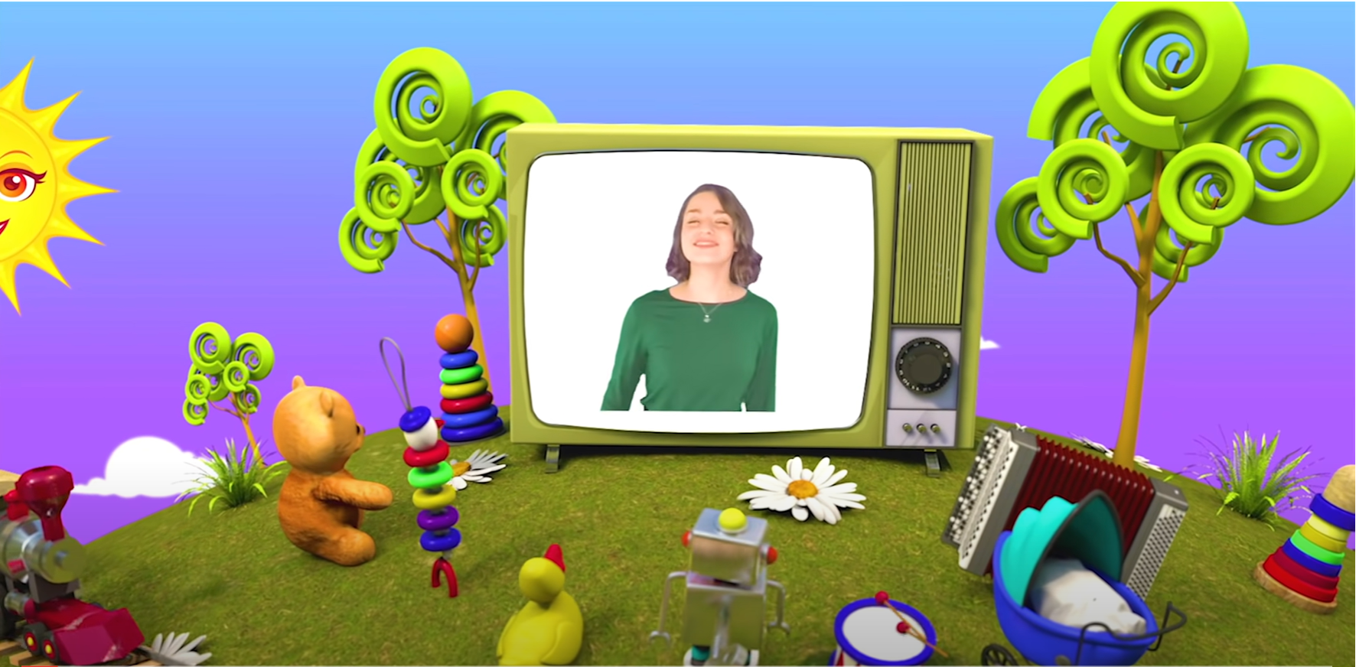
HELLO SONG
Notes:
https://www.youtube.com/watch?v=pqDEwPi7vxg

Slide 6
Good job!

Slide 7
Let’s sing Welcome Song!
Notes:
Song Actions
Welcome back to all our friends – wave
Fun and learning never end! – punch the air Welcome back. It’s a happy day. – wave and smile A day for learning, – mime opening a book A day for play! – jump in the air

Slide 8
Sing and Do!
Notes:
Song Actions
Welcome back to all our friends – wave
Fun and learning never end! – punch the air Welcome back. It’s a happy day. – wave and smile A day for learning, – mime opening a book A day for play! – jump in the air

Slide 9
Sing and Do in groups.
Notes:
Ask students to sing in groups.

Slide 10
Live on Stage

Slide 11
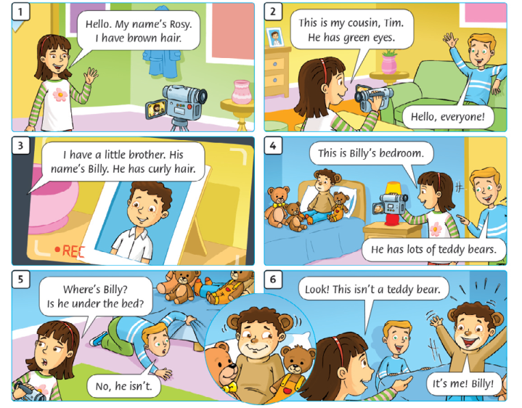
Look and Answer.
What’s happening in the story?
What is Rosy’s video about?
What’s on Billy’s bed?
Is Billy in his bedroom?
Notes:
Ask students to open their books, look at the pictures and answer the questions.

Slide 12
Listen
and
Point.
4
Notes:
Ask children to turn to the story on page 4 of their books.

Slide 13
Listen
and
Repeat.
4
Notes:
Play Track 2, pausing for children to repeat each line.

Slide 14
Listen and Do the actions.
4
Notes:
As a class, decide on actions for the story. Play the recording again for children to mime the actions as they listen.
Story actions
Picture 1: Rosy waves to her video camera.
Picture 2: Rosy holds the camera up to film Tim. Tim waves. Picture 3: Rosy holds the camera low to film Billy’s photo. Picture 4: Rosy and Tim walk into Billy’s bedroom, filming. Picture 5: Tim bends down to look under the bed. Rosy looks around for Billy, while Billy “hides” on the bed.
Picture 6: Billy jumps up with a big smile. Rosy and Tim are happy and surprised.

Slide 15
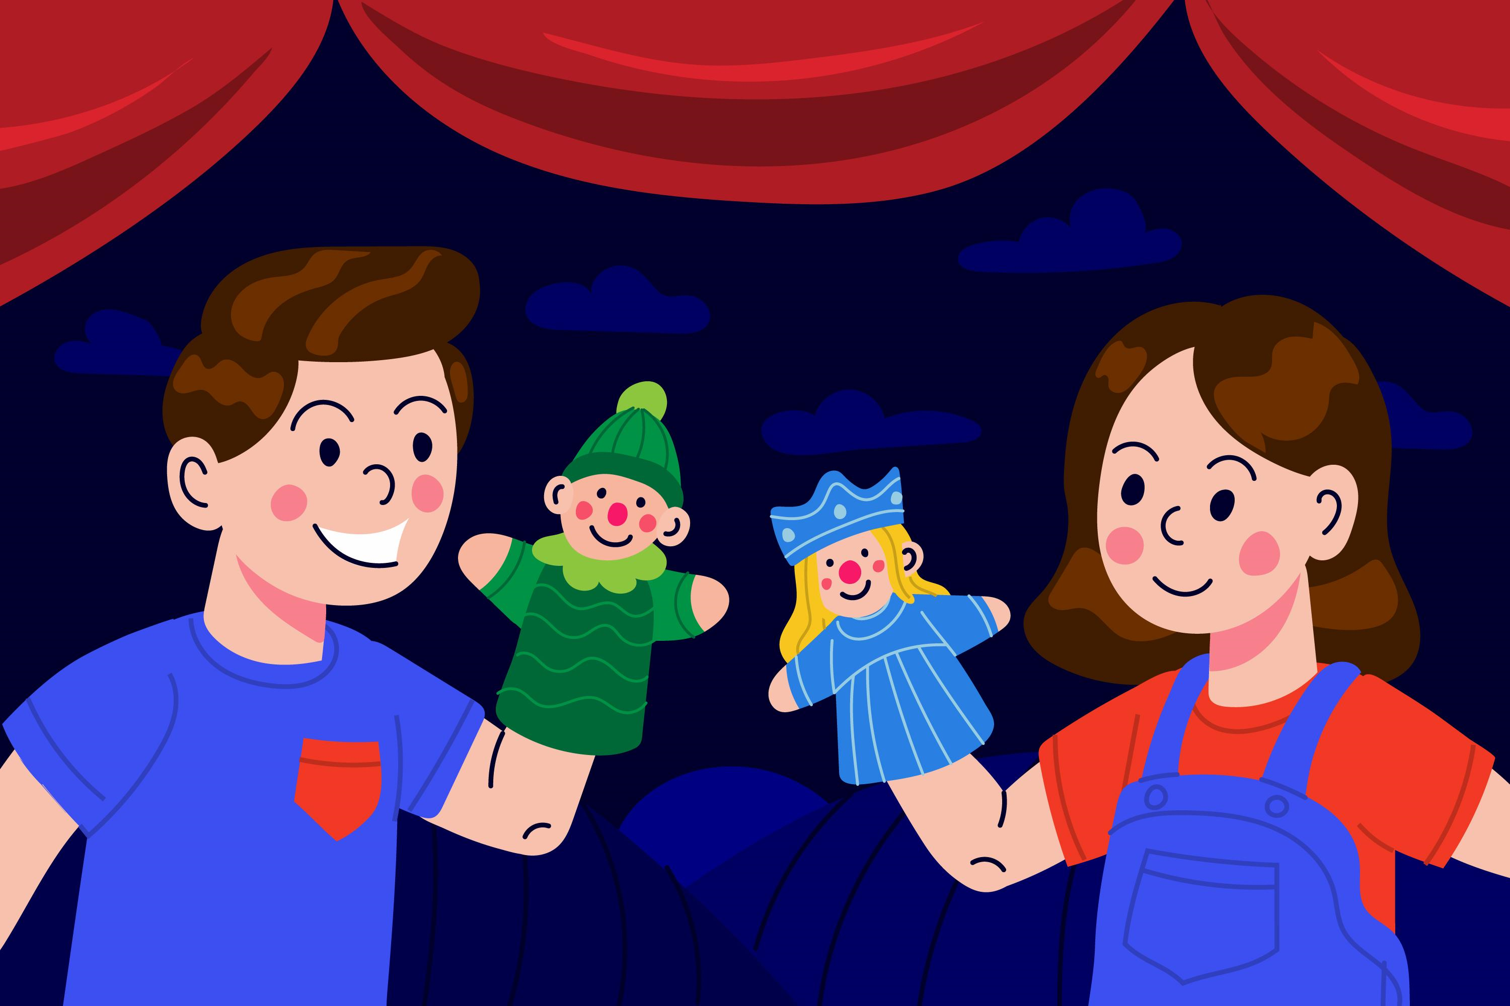
Story Actions
Notes:
Put the class into groups of three to play Rosy, Tim, and Billy. If the class doesn’t divide exactly, some children can act out two parts. They practice acting out the story in their groups.

Slide 16
Good job!

Slide 17
GAME: Snap!
Notes:
Ask two students to share one book. Listen to the teacher and try to snap the correct ones ad fast as they can, they shout them out.

Slide 18
Good job!

Slide 19
Homework
Do the exercises in Workbook p.4.
Prepare for the next lesson
(Starter Unit - Lesson 2).

Slide 20
Our Winners!
Peter
Eric
Julie
Notes:
Replace photos and names with your students’ information.

Slide 21
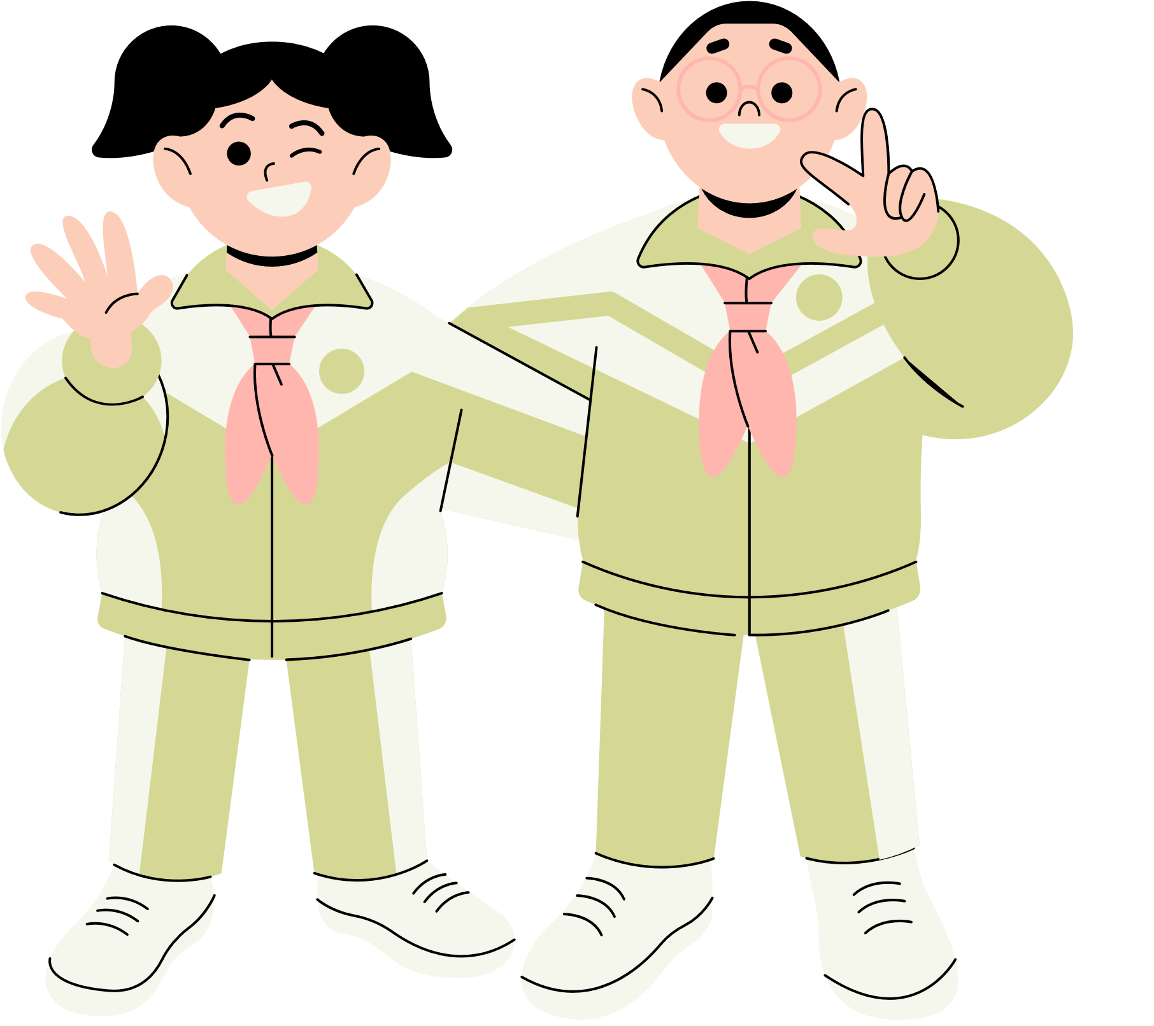
Thank You!
See You Next Time.
Notes:
https://www.youtube.com/watch?v=SRyFiVeNjWs

