Slide 1
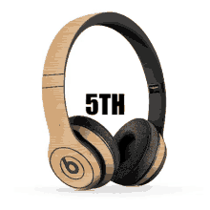
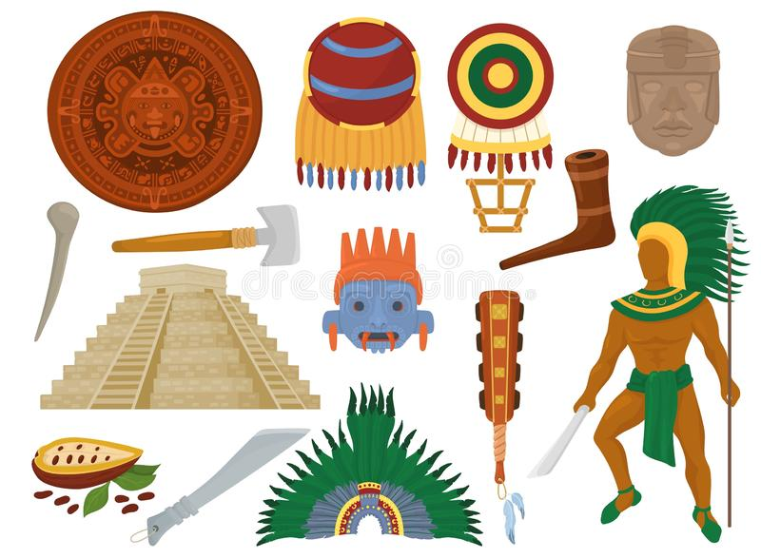
UNIT 1
The ancient Mayans
LESSON 5

Slide 5
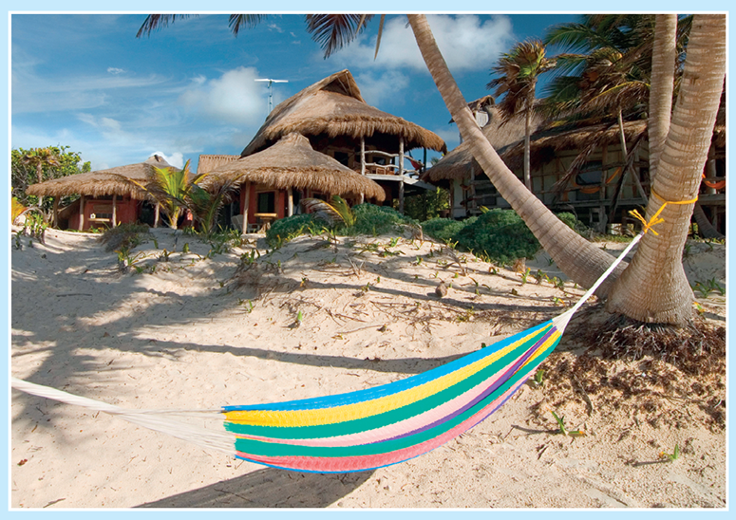
What is it?

Slide 6
Look at the text below. Who made hammocks?

Slide 7
WORK IN PAIRS

Slide 8
HAMMOCKS
Thousands of years ago, the Mayans used the bark from hamack trees to make a special kind of bed. These beds were hammocks. People used them to sit on or to sleep in. They were light and easy to carry. The Mayans often moved from place to place, and they didn’t want to carry heavy things.
The Mayans lived in rainforests. The weather was hot and there were lots of bugs, so it was difficult to sleep. Hammocks were perfect beds for the Mayans, because they weren’t on the ground.
At first, only people in hot countries had hammocks, but then a man called Christopher Columbus took hammocks to Europe. Soon, sailors on ships started to sleep in hammocks, because they were soft and comfortable.
Today, Mayan people in Central America still make hammocks, and people all over the world buy them to use in their backyards or homes.
Look around in Viet Nam and it is easy to see people reading, sleeping, and drinking in hammocks. They are everywhere — in people's houses, in cafes, and at the beach. Does your family have a hammock?

Slide 9
LISTEN AND POINT

Slide 10
HAMMOCKS
Thousands of years ago, the Mayans used the bark from hamack trees to make a special kind of bed. These beds were hammocks. People used them to sit on or to sleep in. They were light and easy to carry. The Mayans often moved from place to place, and they didn’t want to carry heavy things.
The Mayans lived in rainforests. The weather was hot and there were lots of bugs, so it was difficult to sleep. Hammocks were perfect beds for the Mayans, because they weren’t on the ground.
At first, only people in hot countries had hammocks, but then a man called Christopher Columbus took hammocks to Europe. Soon, sailors on ships started to sleep in hammocks, because they were soft and comfortable.
Today, Mayan people in Central America still make hammocks, and people all over the world buy them to use in their backyards or homes.
Look around in Viet Nam and it is easy to see people reading, sleeping, and drinking in hammocks. They are everywhere — in people's houses, in cafes, and at the beach. Does your family have a hammock?

Slide 11
Answer the questions

Slide 12
Underline these words in the text. Guess their meanings and then check them in the dictionary. heavy, light, soft, easy, difficult

Slide 13
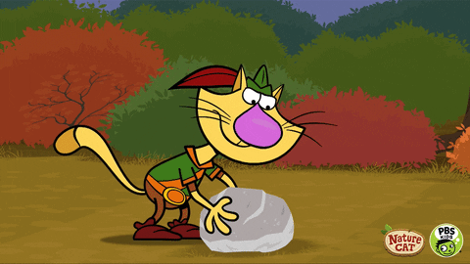
heavy

Slide 14
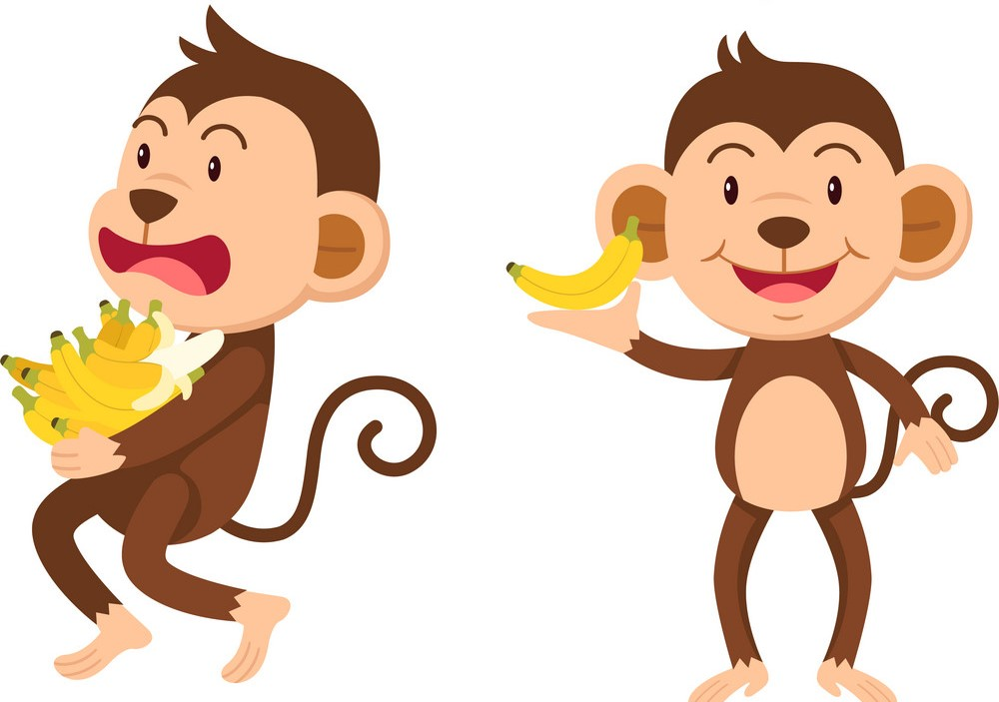
light

Slide 15
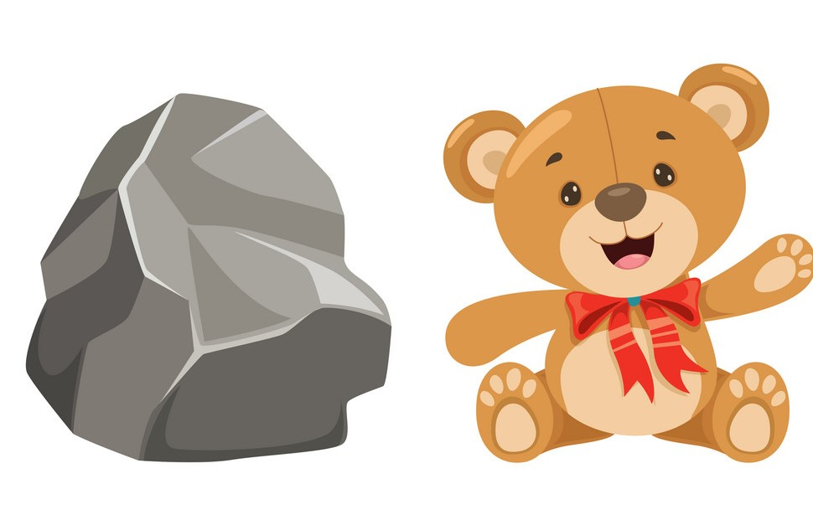
soft

Slide 16
easy

Slide 17
difficult

Slide 18
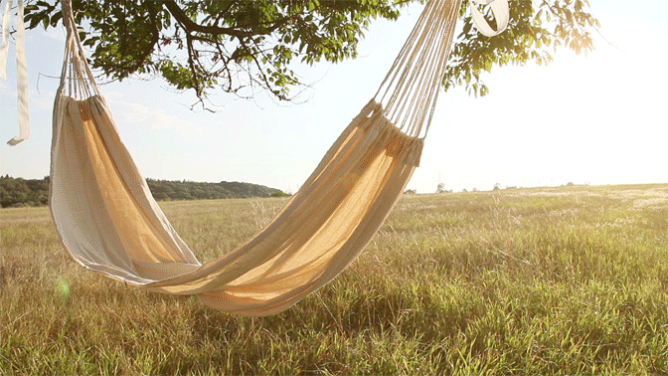
hammock

Slide 19
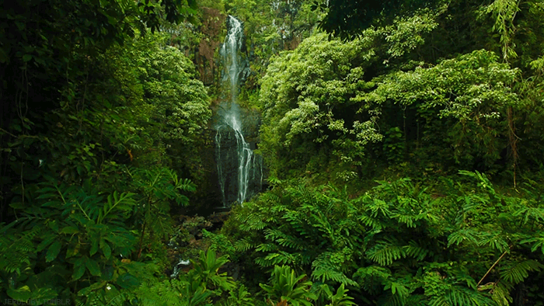
rainforest

Slide 20
Open your book and read again

Slide 21
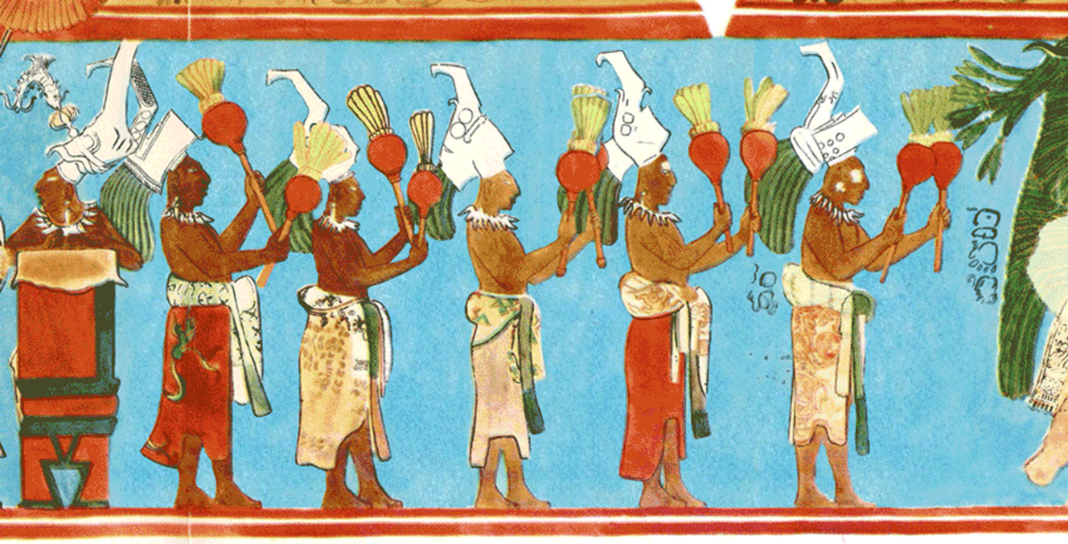
GAMETIME

Slide 22
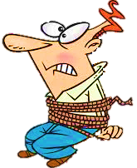
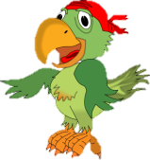
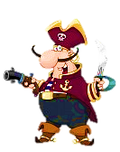
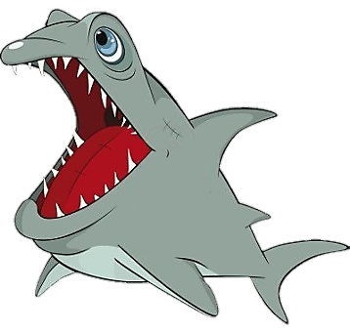

Slide 23
Click on the right option to save Peter
light
heavy
NEXT
The hammocks weren’t. They were ________ .
light

Slide 24
Thousands
Hundreds
NEXT
Thousands
___________ of years ago, the Mayans used the bark of hamack tres to make a special kind of bed .

Slide 25
light
heavy
NEXT
The Mayans didn’t want to carry ________ things.
heavy

Slide 26
cities
rainforests
NEXT
The Mayans lived in the _____________ .
rainforests

Slide 27
cold
hot
NEXT
At first, only people in _______ countries had hammocks.
hot

Slide 28
Asia
Europe
NEXT
Christopher Columbus took hammocks to ___________ .
Europe

Slide 29
easy
difficult
END
easy
Now, it is _______ to see people Reading in hammocks around Vietnam.

Slide 30
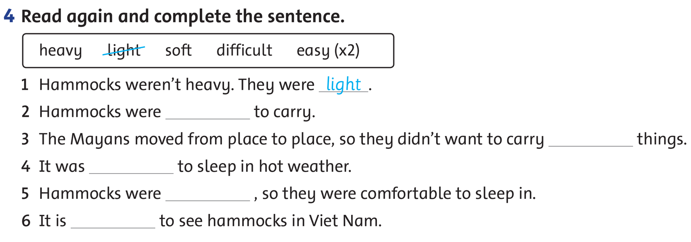

Slide 31
WORKBOOK TIME

Slide 34
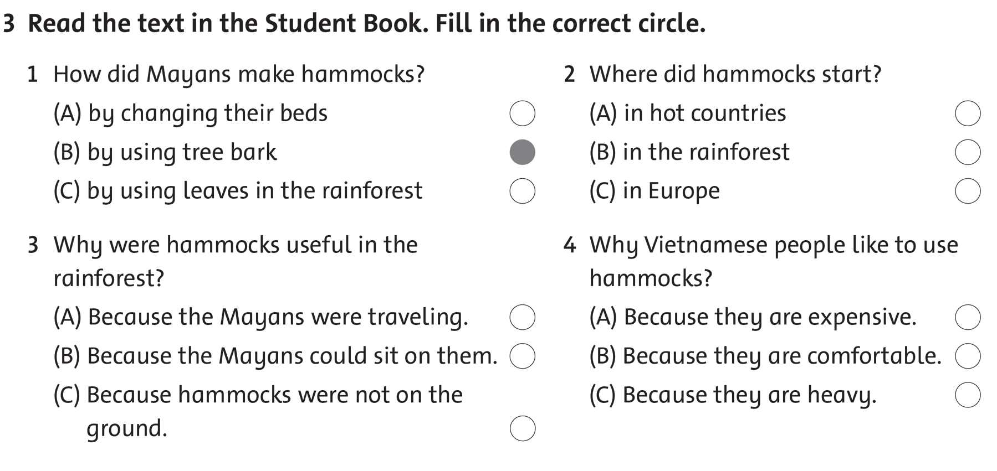

Slide 35
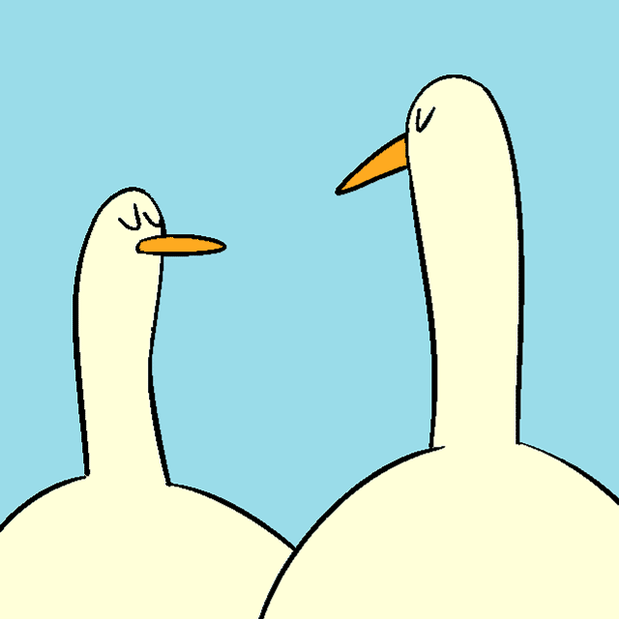
GOODBYE!!!

