Slide 1
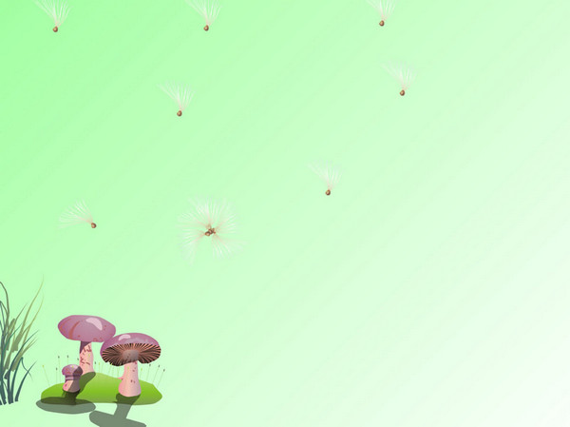
Unit 8 The best bed! Lesson 4
Tan Nhut 6 Primary School
Teacher: Huynh Thi Diem Huong

Slide 2
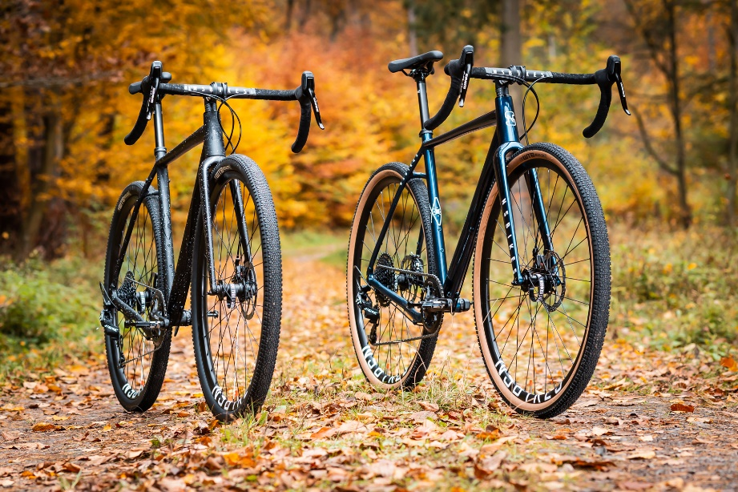
Review
s says /s/
bikes
laughs
it’s

Slide 3
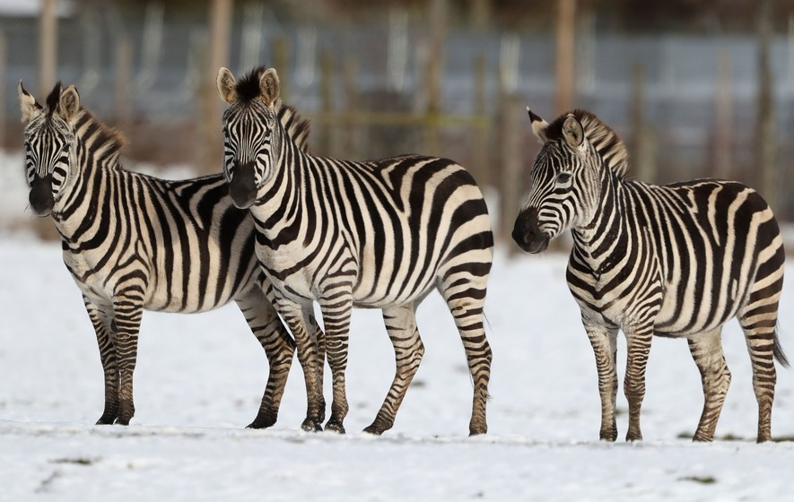
Review
s says /z/
zebras
he’s
plays

Slide 4
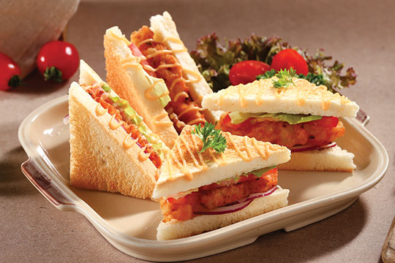
Review
s says /iz/
sandwiches
watches
foxes

Slide 5

city

Slide 6
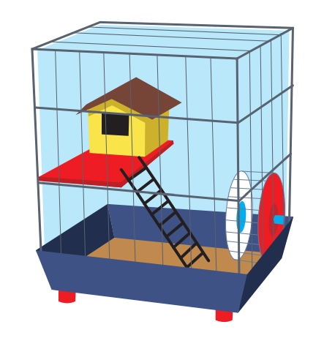
cage

Slide 7
city
cage
/s/
/dʒ/

Slide 8
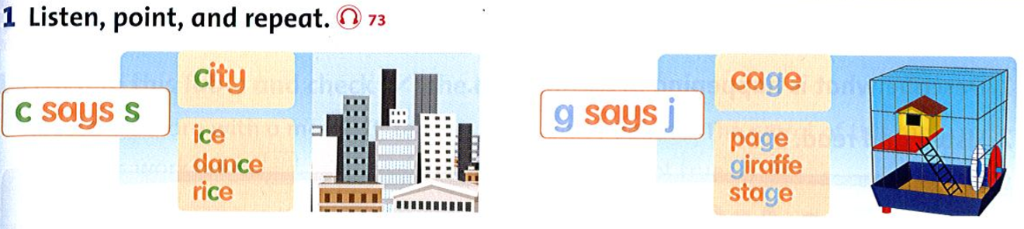


Slide 9
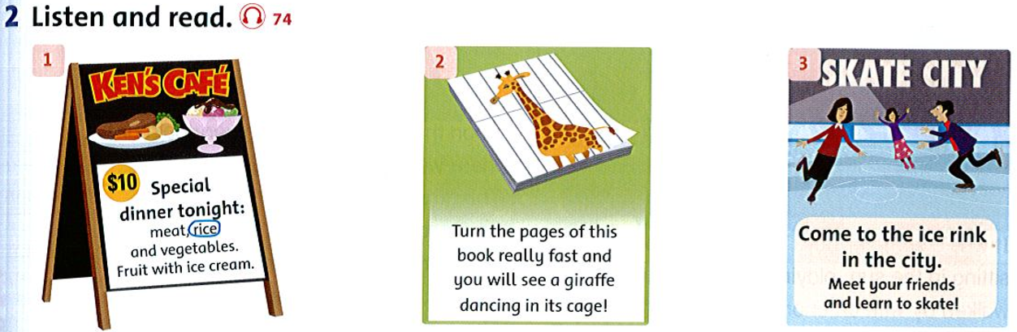

Slide 10
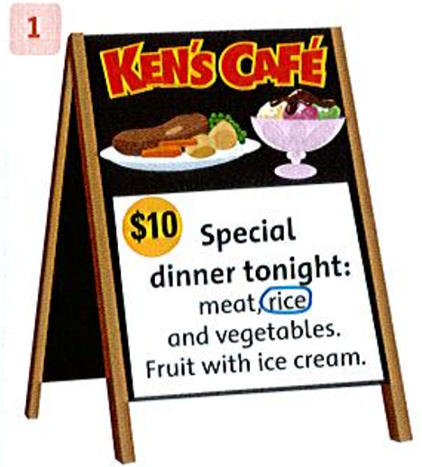
3. Read again. Circle the words with c saying s and underline the words with g sayings j.

Slide 11
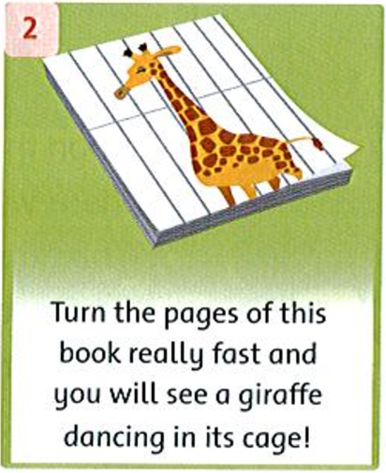
3. Read again. Circle the words with c saying s and underline the words with g sayings j.

Slide 12
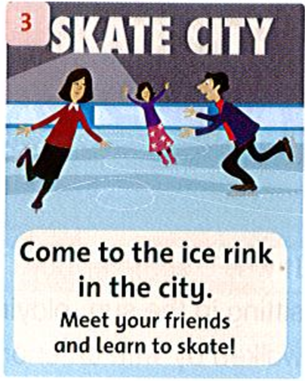
3. Read again. Circle the words with c saying s and underline the words with g sayings j.

Slide 13
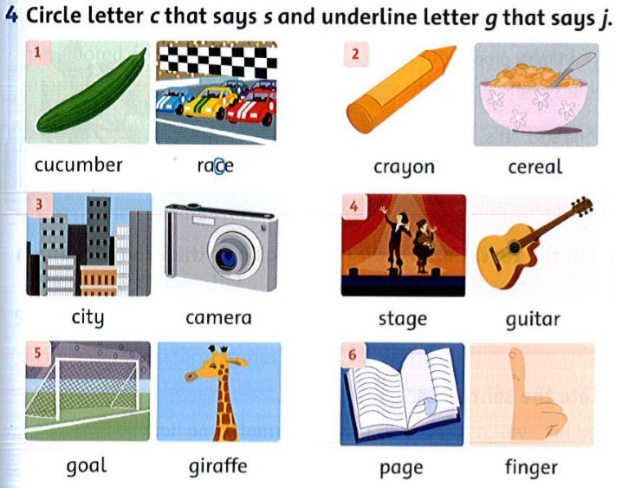

Slide 14
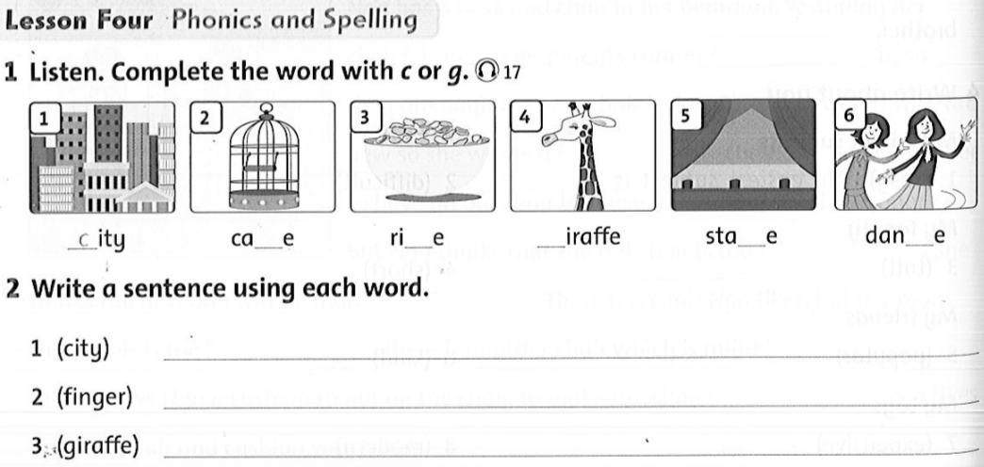
g
c
g
g
c
I like living in the city.
There are ten fingers on my hands.
My favorite animal is giraffe.

Slide 15


