Slide 1
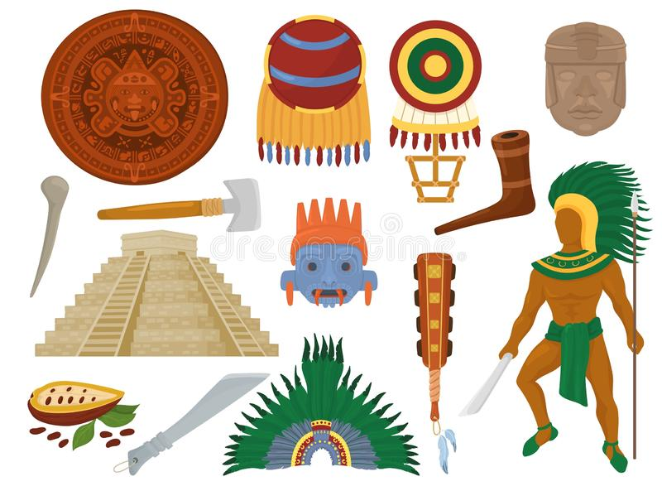
UNIT 1
The ancient Mayans
LESSON 6

Slide 4
PAST SIMPLE
GAME
Choose the right option.

Slide 5
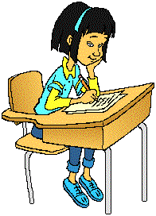
Yesterday Jane . … homework.
GREAT
do
did
does

Slide 6
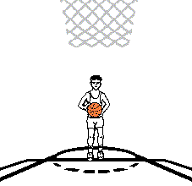
My brother… basketball last Sunday.
GREAT
played
play
playing

Slide 7
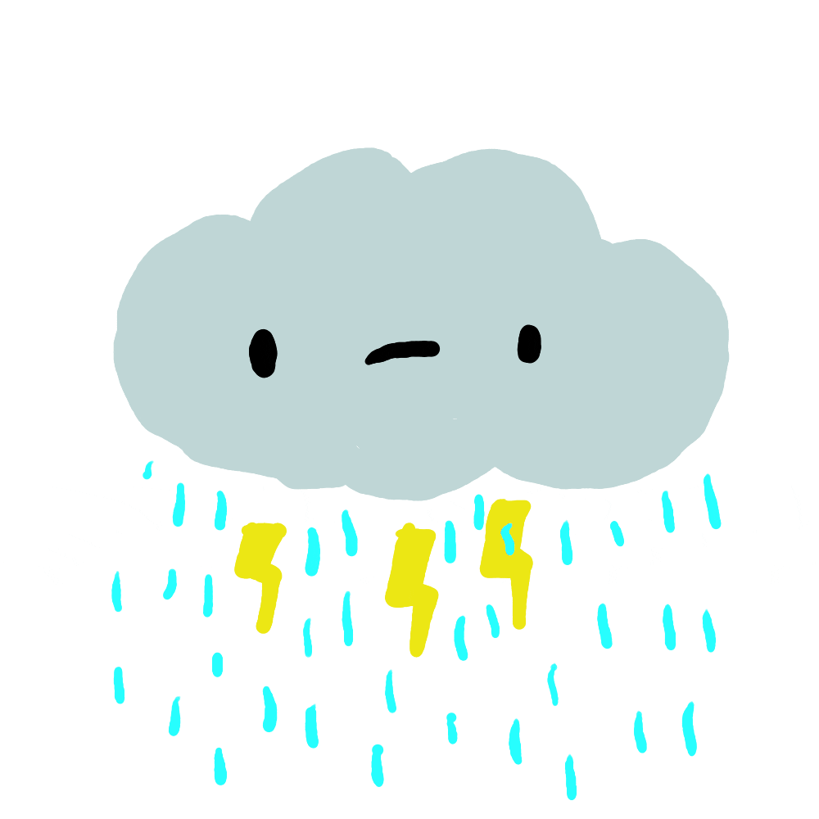
It … a lot yesterday morning.
GREAT
raining
rains
rained

Slide 8
John … with his toy plane yesterday.
GREAT
plays
played
play

Slide 9
The dog… after the cat.
GREAT
use
used
using

Slide 10
My dad … for three hours last night.
GREAT
worked
works
work

Slide 11
Lucy … reading a bok yesterday.
GREAT
flown
flew
fly

Slide 12
Listen and write the numbers.
3
2
4

Slide 13
WORK IN PAIRS

Slide 14
Speaking Look at the pictures and say.
have difficult homework have a math lesson play basketball have an English lesson work for three hours not know the answers start to rain not have his homework
3
2
4

Slide 15
LISTEN AND SING

Slide 17
Writing: About me! Remember! In each paragraph, there is one topic.

Slide 18
Match the topic to the paragraphs.
Underline things that are different from you.
1. House 2. Food 3. Children | a. Food b. ________ c._________ | In my country, Viet Nam, a lot of food is made from rice, meat, and vegetables. Food is important, especially at festivals Like Tet. We also have great street food! Houses in Viet Nam are often tall and thin and sometimes brightly-colored. A normal house might have two floors. Children, parents, and grandparents often live in the same house. In cities, more and more people are living in apartments. Children in Viet Nam normally go to school from early in the morning. There are some schools that have two school days in one day. Some children study in the morning, and then other children study in the afternoon.
House
Children

Slide 19
WORKBOOK TIME

Slide 20
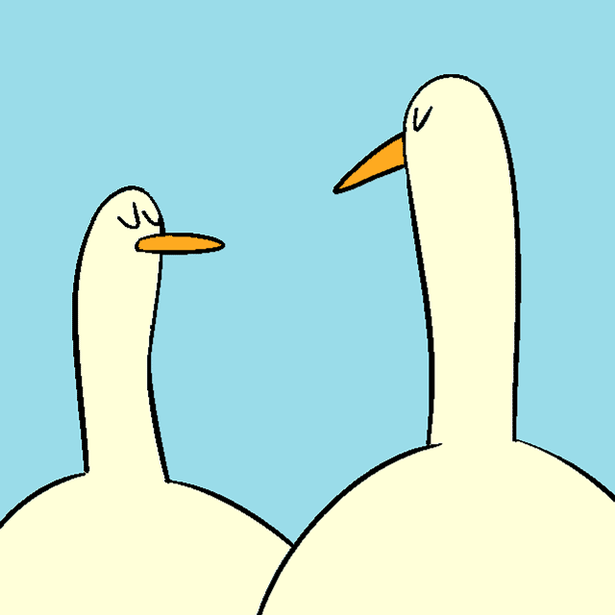
GOODBYE!!!

