Slide 1
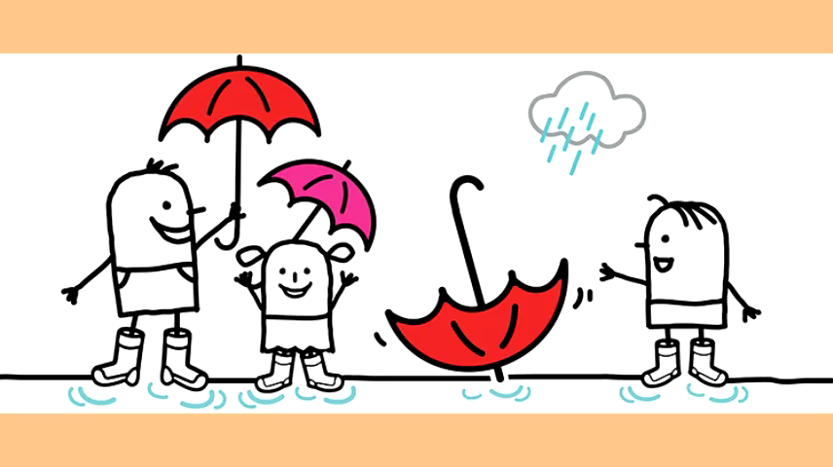

Slide 2


Listen and point

Slide 3
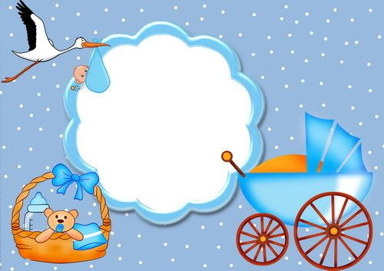


car

Slide 4

park

Slide 5

shark

Slide 6

star

Slide 7

scarf

Slide 8
UNSCRAMBLE.

Slide 9


s r f c a
scarf
NEXT

Slide 10

r t a s
star
NEXT

Slide 11

h r s a k
shark
NEXT

Slide 12

r k p a
park
NEXT

Slide 13

r c a
car
NEXT

Slide 14
Listen and point

Slide 15

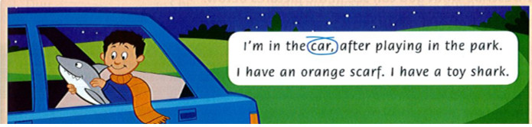
Read the chant again. Circle the words with 'ar'.

Slide 16
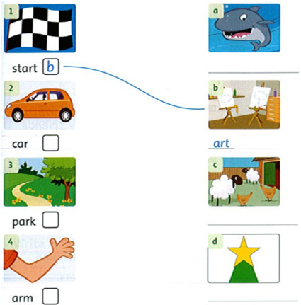
Match the words that rhyme Write: farm / star / art / shark
shark
farm
star

Slide 17
