Slide 1
GRADE 4
UNIT 3
MY THINGS!
LESSON 5

Slide 2
Listen and point

Slide 3
posters

Slide 4
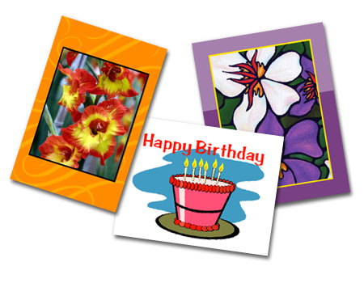
postcards

Slide 5
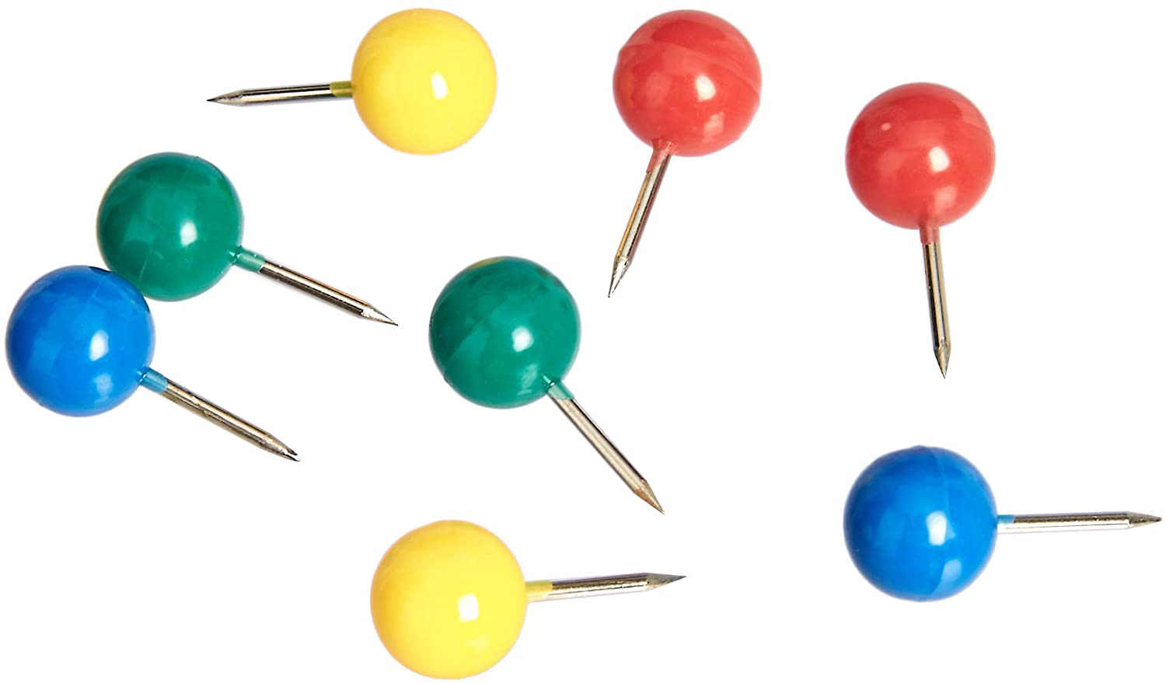
pins

Slide 6
shells

Slide 7
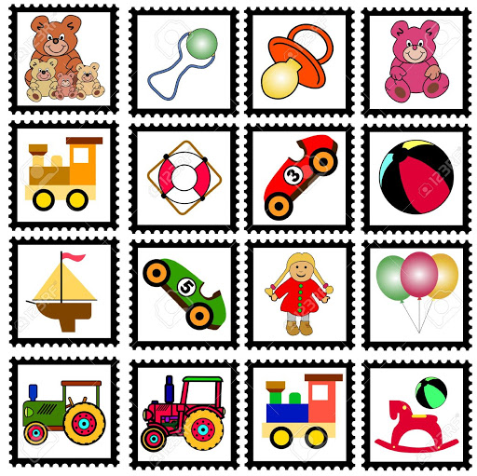
collection

