Slide 1
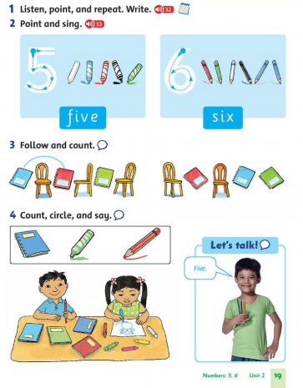
Thursday, November 25th 2021 Unit 2 :What this? Lesson 4

Slide 2
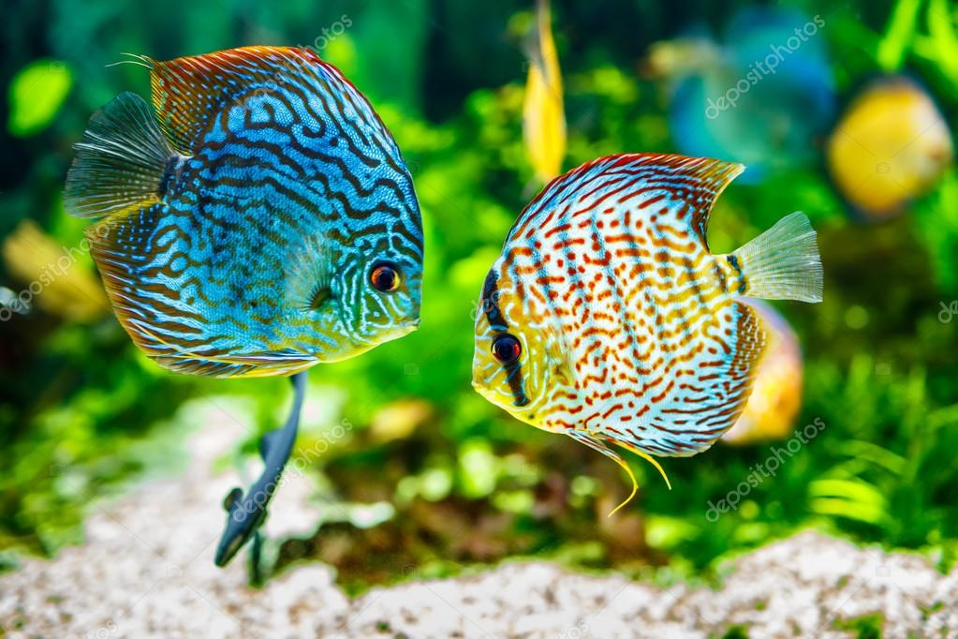
2_TWO

Slide 3
1_ONE

Slide 4
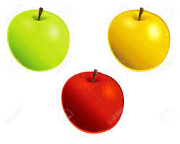
3_ three

Slide 5
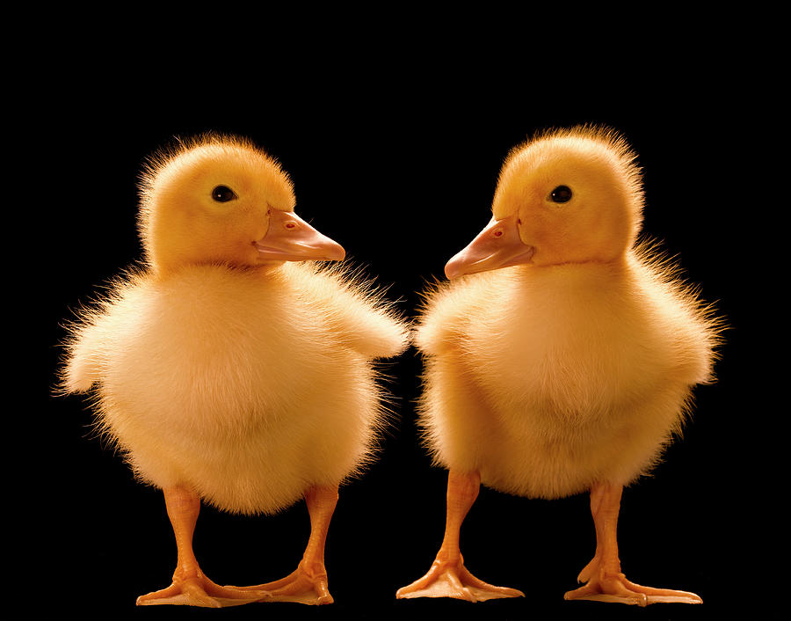
2_TWO

Slide 6
1_ONE

Slide 7
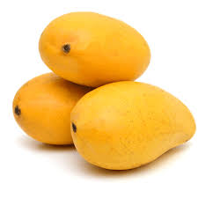
3_ three

Slide 8
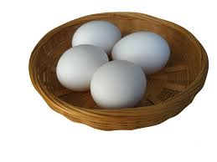
4_four

Slide 9
3_ three

Slide 10
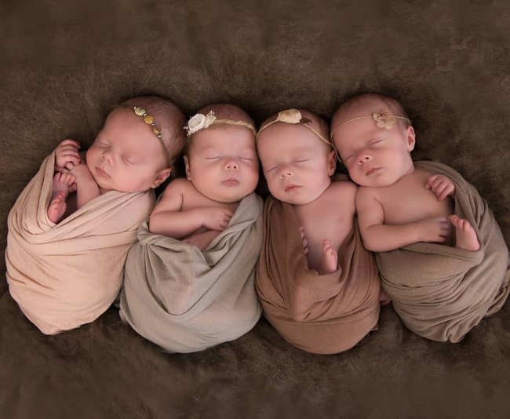
4_four

Slide 11
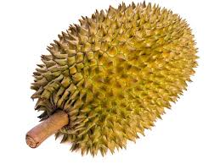
1_ONE

Slide 12
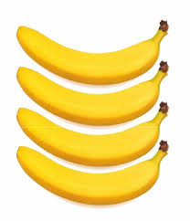
4_four

Slide 13
4_four

Slide 14
3_ three

Slide 15
6_six

Slide 16
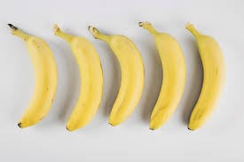
5 _ five

Slide 17
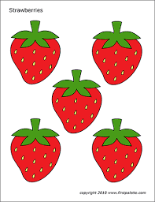
5 _ five

Slide 18
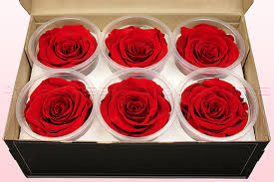
6_six

Slide 19
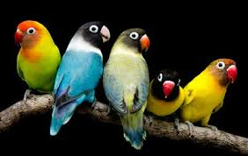
5 _ five

Slide 20
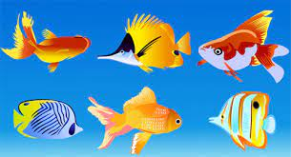
6_six

Slide 21
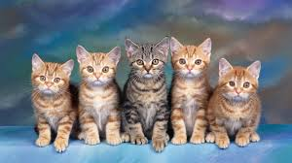
5 _ five

Slide 22
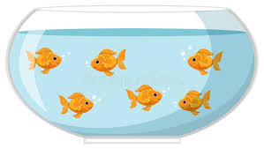
6_six

