Slide 1
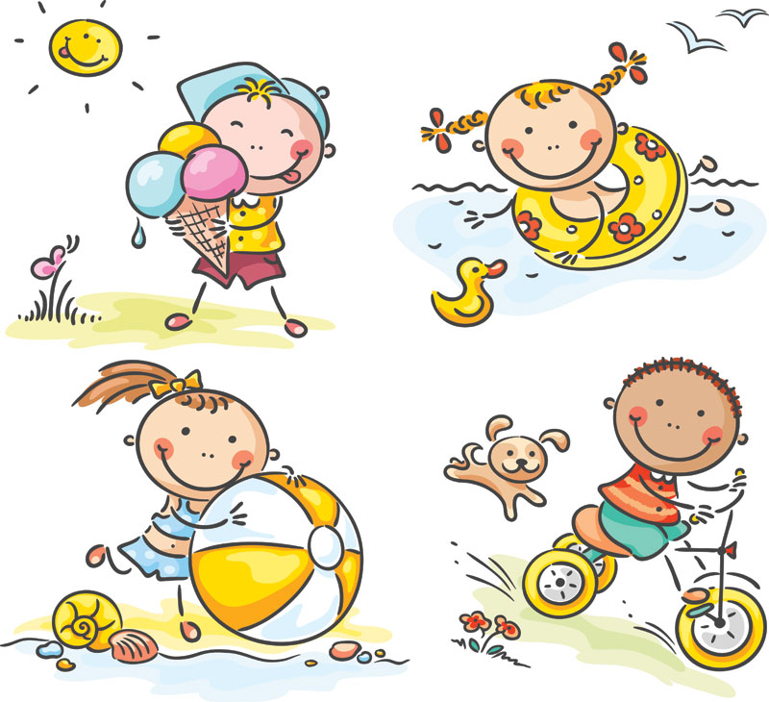
GRADE 4
UNIT TWO
My weekend
Lesson 1

Slide 3
Listen and point

Slide 4
read comics

Slide 5
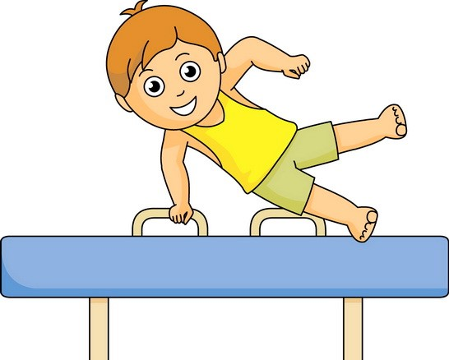
do gymnastics

Slide 6
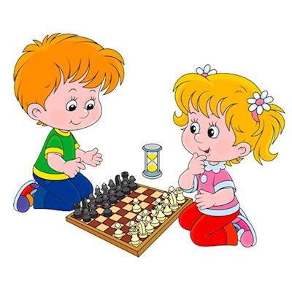
play chess

Slide 7
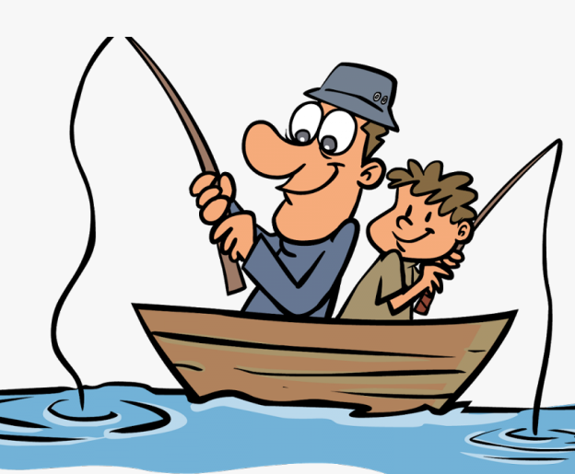
fish

Slide 8
play basketball

Slide 9
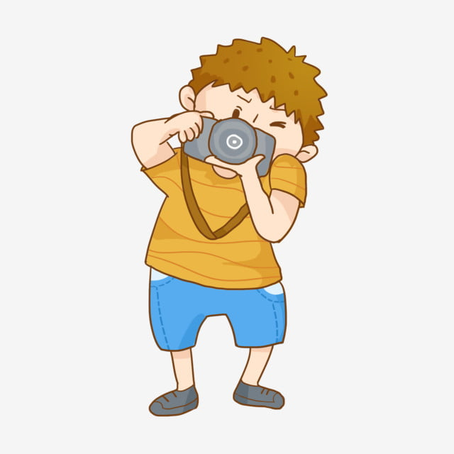
take photos

Slide 10
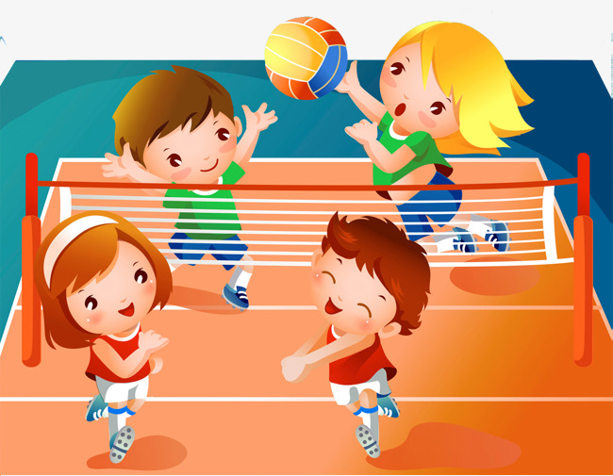
play volleyball

Slide 11
Pair work: answer these questions
Where are they?
What are they doing?

Slide 12
Homework :
Học thuộc từ vựng sach student book trang 14
Chép mỗi từ 20 lần

