Slide 1
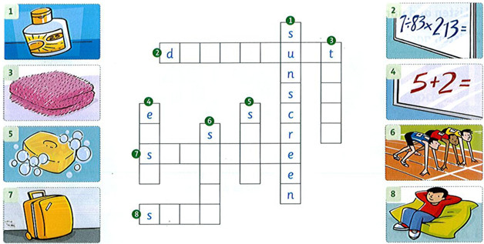
Wednesday , November 10th 2021 Review 1
1. Complete the crossword.

Slide 2
2. Write the correct words.
toothbrush, sunscreen, towel, shampoo, toothpaste, suitcase.
Holly is going to go to Florida on vacation. She's putting all her things in her ¹suicase. She's going to take her ²_____ to use after swimming. She's going to take her ³­­­______ and ⁴_____ to brush her teeth. She's going to take some ⁵______ to wash her hair. She's going to take some ⁶______because the sun is very hot in Florida.

Slide 3
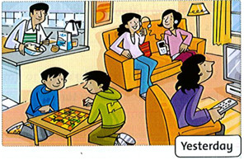
3. Look and read. Circle.
1. Mom listened / didn't listen to music yesterday.
2. The girls played / didn't play a game.
3. Dad cooked / didn't cook dinner.
4. The boys played / didn't play a game.
5. Mom watched / didn't watch TV.
6. The girls listened / didn't listen to music.

