Slide 1
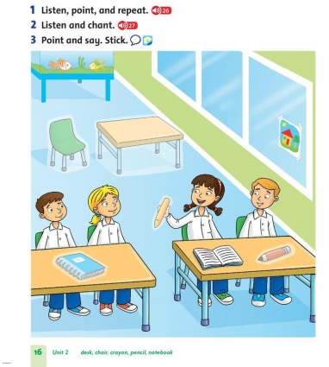
Tuesday, November 9th 2021 Unit 1 :What color is it? Lesson 6

Slide 2
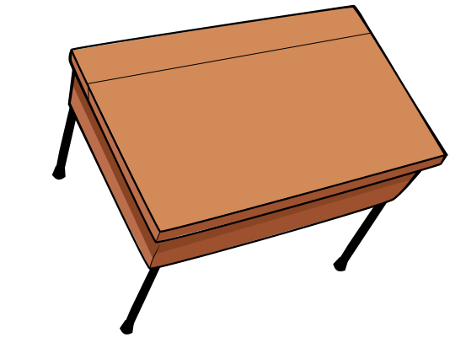
desk

Slide 3
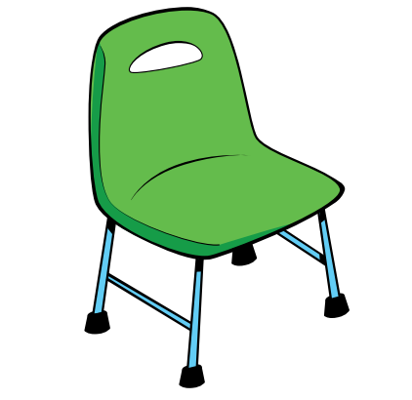
chair

Slide 4

crayon

Slide 5
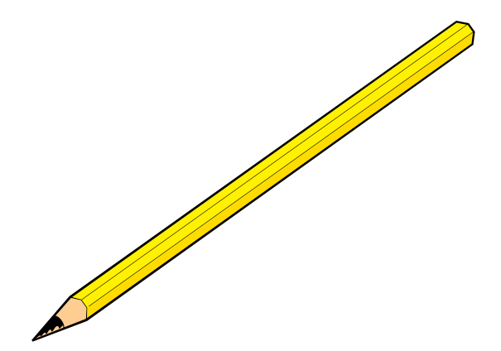
pencil

Slide 6
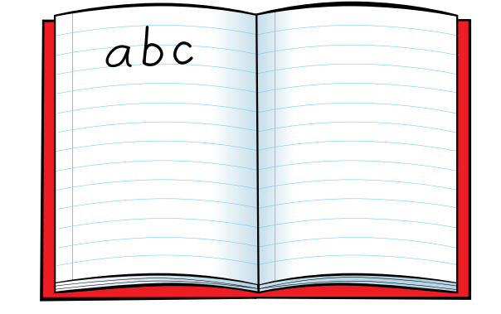
notebook

