Slide 1
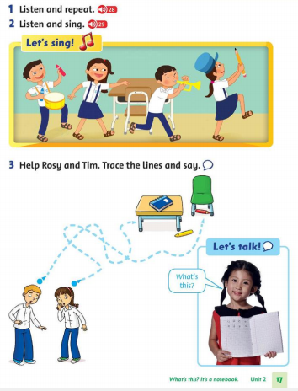
Thursday, November 18th 2021 Unit 2: What this? Lesson 2

Slide 2
What’s this? It’s a …

Slide 3
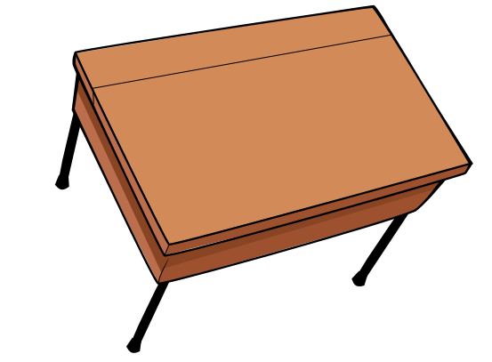
desk

Slide 4
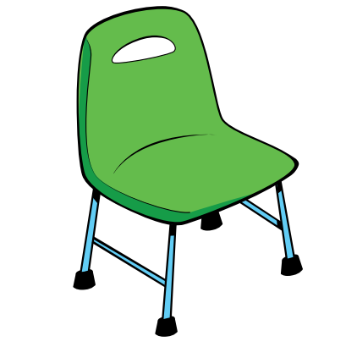
chair

Slide 5
crayon

Slide 6
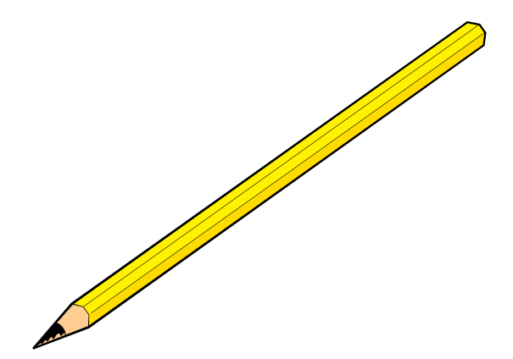
pencil

Slide 7
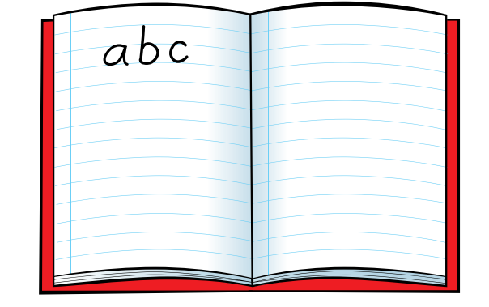
notebook

