Slide 1
GRADE 4
Unit Starter My Family
LESSON 3

Slide 3
Let’s play a game about numbers.

Slide 4
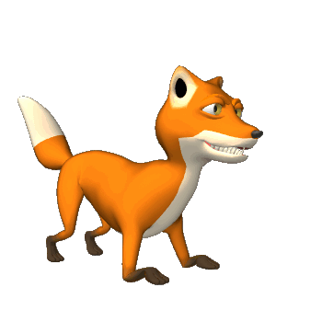
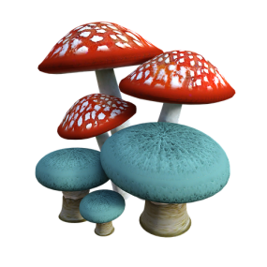
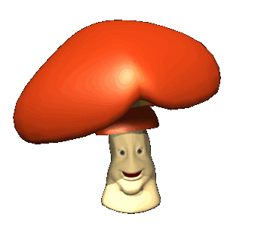
Click the numbers, listen and repeat. ( Nghe và chọn số )
80
60
10
40
20
100
50
90
70
30
NEXT

Slide 5
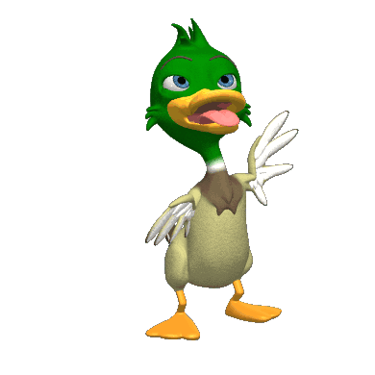
Listen to the number and choose it.
10
20
30
40
50
60
70
80
90
100
CLICK
NEXT

Slide 6
Listen to the number and choose it.
10
20
30
40
50
60
70
80
90
100
CLICK
NEXT

Slide 7
Listen to the number and choose it.
10
20
30
40
50
60
70
80
90
100
CLICK
NEXT

Slide 8
Listen to the number and choose it.
10
20
30
40
50
60
70
80
90
100
CLICK
NEXT

Slide 9
Listen to the number and choose it.
10
20
30
40
50
60
70
80
90
100
CLICK
NEXT

Slide 10
Listen to the number and choose it.
10
20
30
40
50
60
70
80
90
100
CLICK
NEXT

Slide 11
Look and match : Nối số và chữ cho trùng khớp

Slide 12
- Ôn lại từ vựng về : gia đình, tháng, số thứ tự từ 10 – 100 - ôn lại ngữ pháp

Slide 14
Write the answer
Dấu cộng ( Plus ) – Dấu trừ ( Minus ) ten + fifty = seventy + ten = 3. twenty + twenty = 4. sixty-three + thirty-one = 5. Twenty + fifteen = 6. Thirty + twenty-five = 7. Seventeen + thirty = 8. sixty – thirteen = 9. eighty – forty-five = 10. thirty-five + twenty =

Slide 15
Simple past
Was or Were? - Complete the sentences with was or were. ( Hoàn thành câu sau sử dụng was / were )
1. I _____ happy.
2. You ____ angry.
3. She ______ in London last week.
4. He ______ on holiday.
5. It _____ cold.
6. We ______ at school.
7. You _____ at the cinema.
8. They _____ at home.
9. The cat ____ on the roof.
10. The children _____in the garden.

Slide 16
Comparative ( so sánh hơn )
Chọn câu đáp án đúng trong những câu sau đây :
1. My dad’s funny/funnier than your dad!
2. Physics is badder/worse than chemistry.
3. Australia is far/further hotter than Ireland.
4. It is strange but often a coke is more expensive/ expensiver than a beer.
5. Non-smokers usually live more long/longer than smokers.

