Slide 1

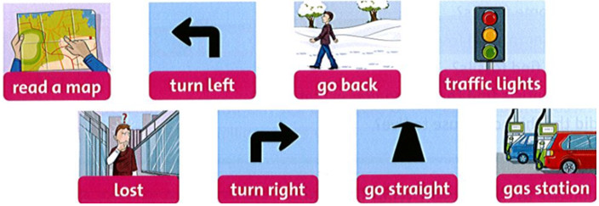
Monday, January 17th 2022 Unit 6 Lesson 1
1. Listen, point, and repeat.

Slide 2
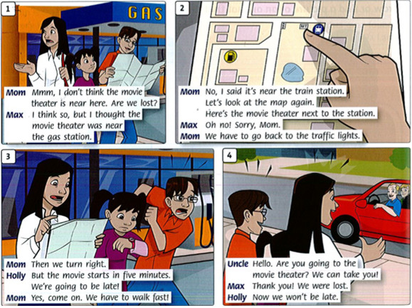
2. Listen and read.

Slide 3
1. Mom: Mmm, I don't thinh the movie theater is near here. Are we lost?
Max: I think so, but I thought the movie theater was near the gas station.
2. Mom: No, I said it's near the strain station. Let's look at the map again.
Here's the movie theater next to the station.
Max: Oh no! Sorry, Mom.
Mom: We have to go back to the traffic lights.
3. Mom: Then we turn right.
Holly: But the movie starts in five minutes. We're going to be late!
Mom: Yes, come on. We have to walk fast!
4. Uncle: Hello. Are you going to the movie theater? We can take you!
Max: Thank you! We were lost.
Holly: Now we won't be late.

