Slide 1
Thursday, January 19th 2022 Fluency Time Lesson 1

Slide 2
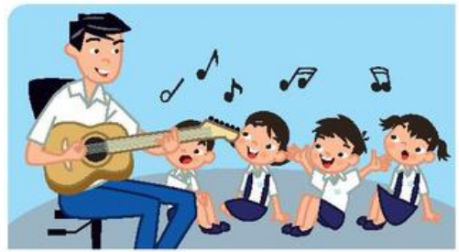
sing

Slide 3
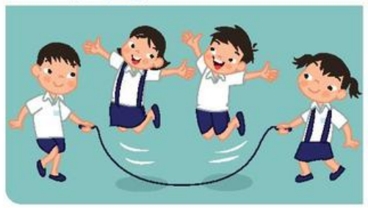
jump

Slide 4
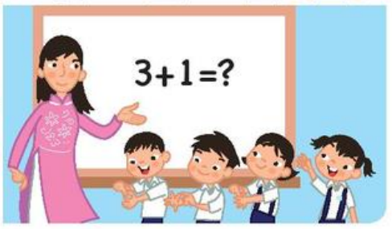
Count to four.

Slide 5
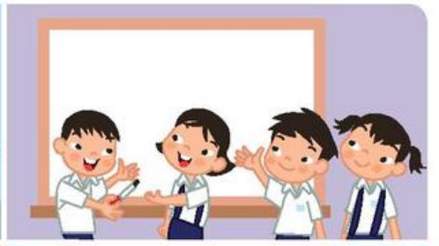
Write your name.

