Slide 2
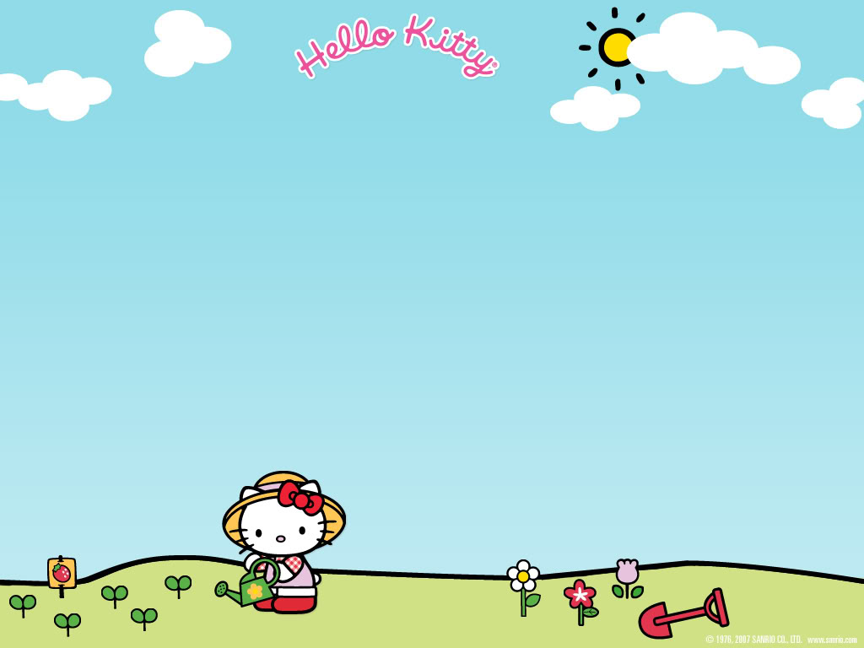
Yen The Primary School
Grade 4

Slide 3
talk about your
What’s your hobby?
I like / I DON’T’ LIKE READING COMICS.

Slide 4
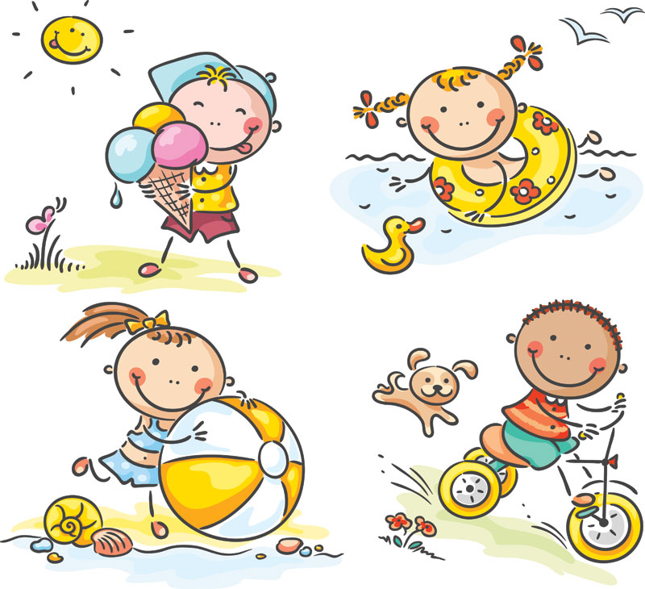
UNIT TWO
My weekend
GRADE 4
Lesson 4

Slide 5
Listen

Slide 6
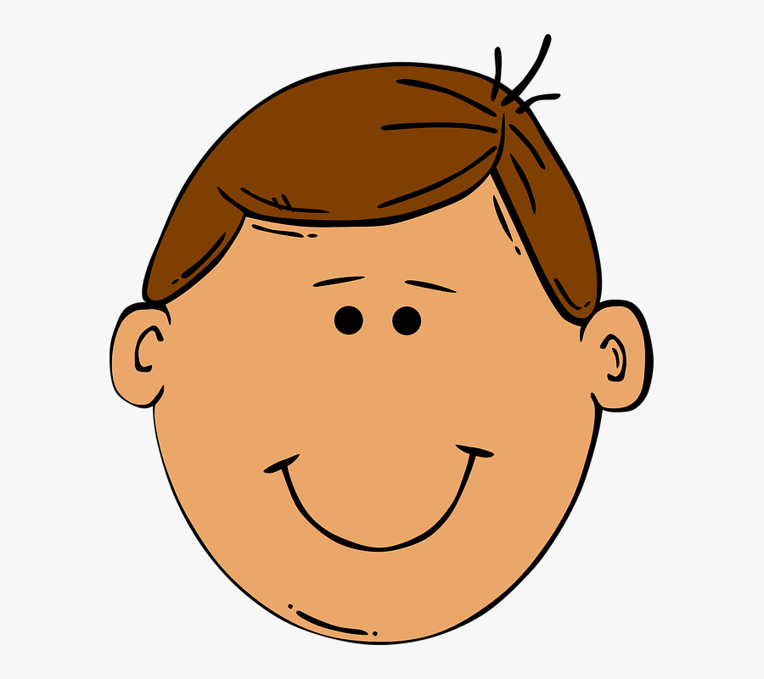
face

Slide 7
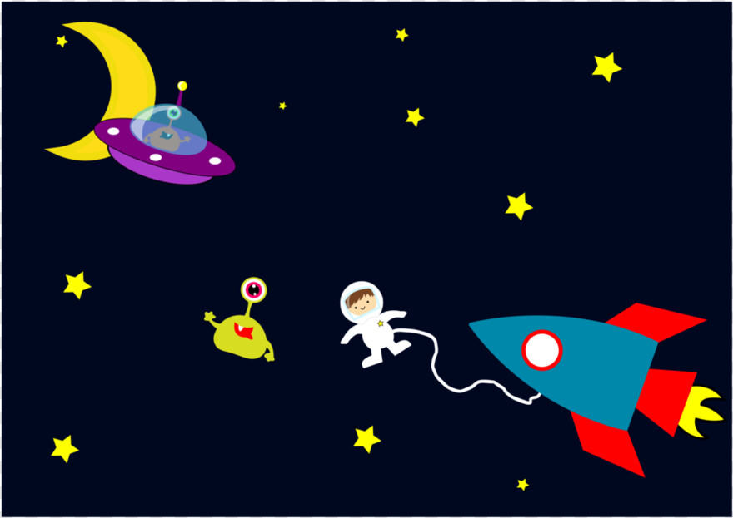
space

Slide 8
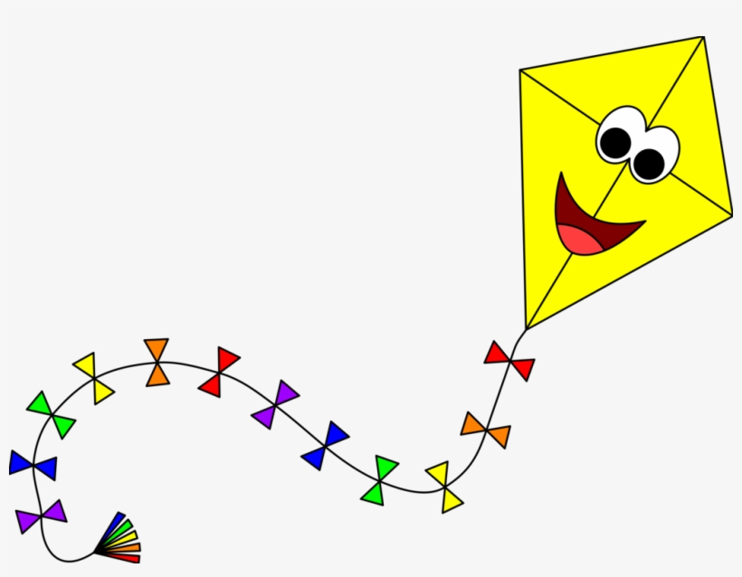
kite

Slide 9
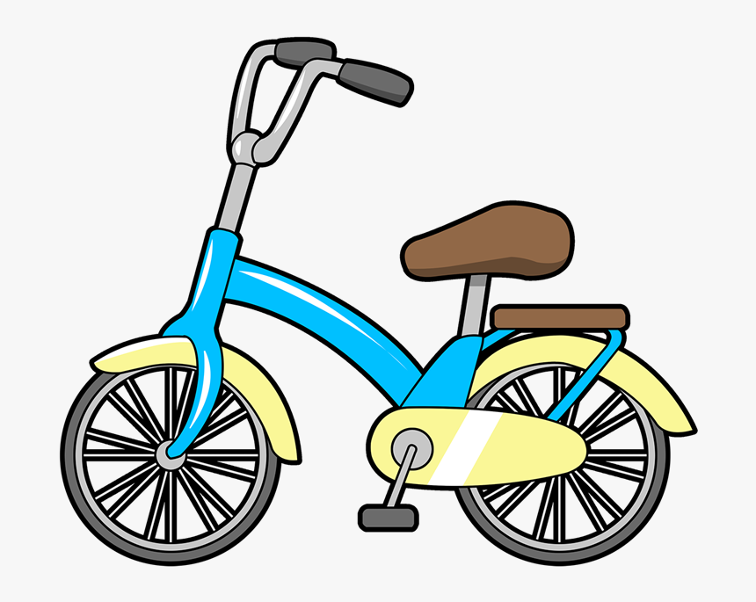
bike

Slide 10
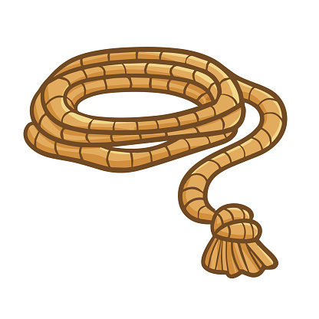
rope

Slide 11
stone

Slide 12
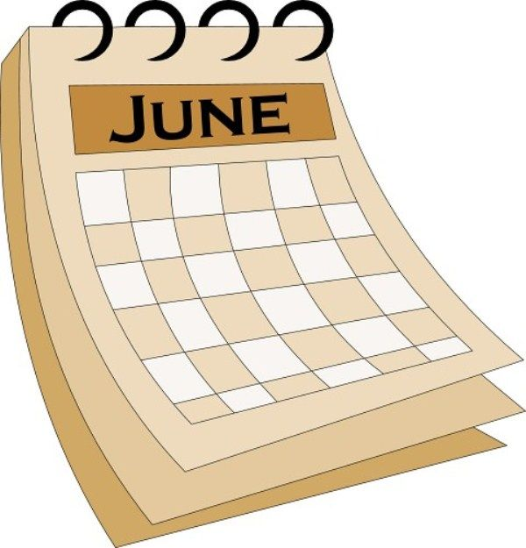
June

Slide 13
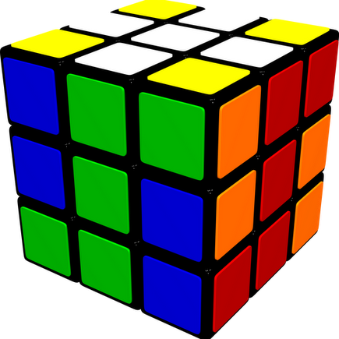
cube

Slide 14
UNIT TWO
My weekend
Lesson 4

Slide 15
Listen and CHANT

Slide 18
Task: Read the chant again. Circle the words from 1.

Slide 19
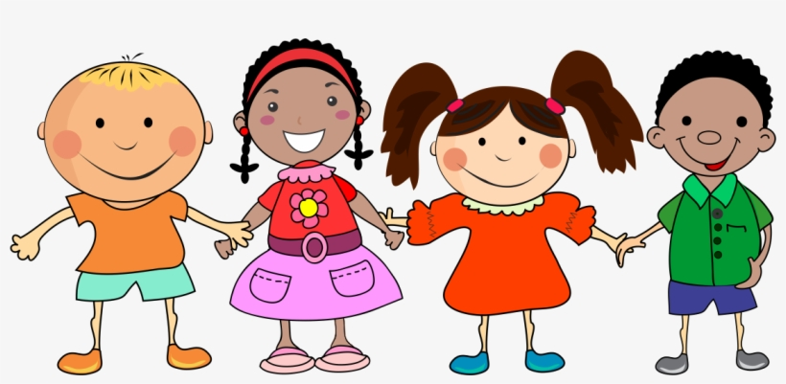
Let’s
play a game.

Slide 20
WORDS
GARDEN

Slide 21
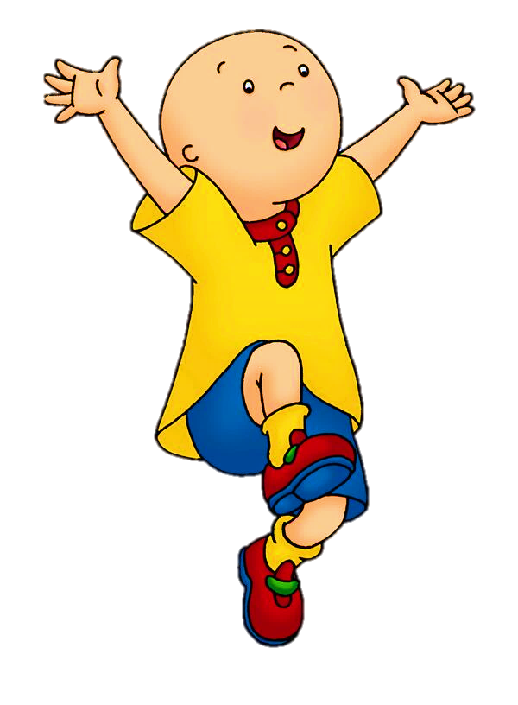
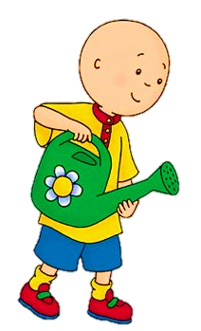
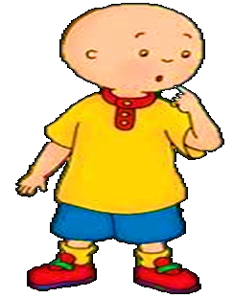
What word is it?
rope
stone
NEXT

Slide 22
What word is it?
bike
kite
NEXT

Slide 23
What word is it?
face
space
NEXT

Slide 24
What word is it?
cube
June
NEXT

Slide 25
What word is it?
stone
rope
NEXT

Slide 26
What word is it?
kite
bike
END

Slide 27
Listen and point

Slide 28
Complete the word.

Slide 29
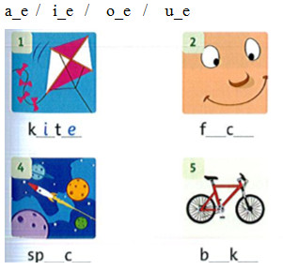
Listen and check.
a e
a e
i e

Slide 30
UNIT TWO
My weekend
GRADE 4
Lesson 5

Slide 31
Listen and point

Slide 32
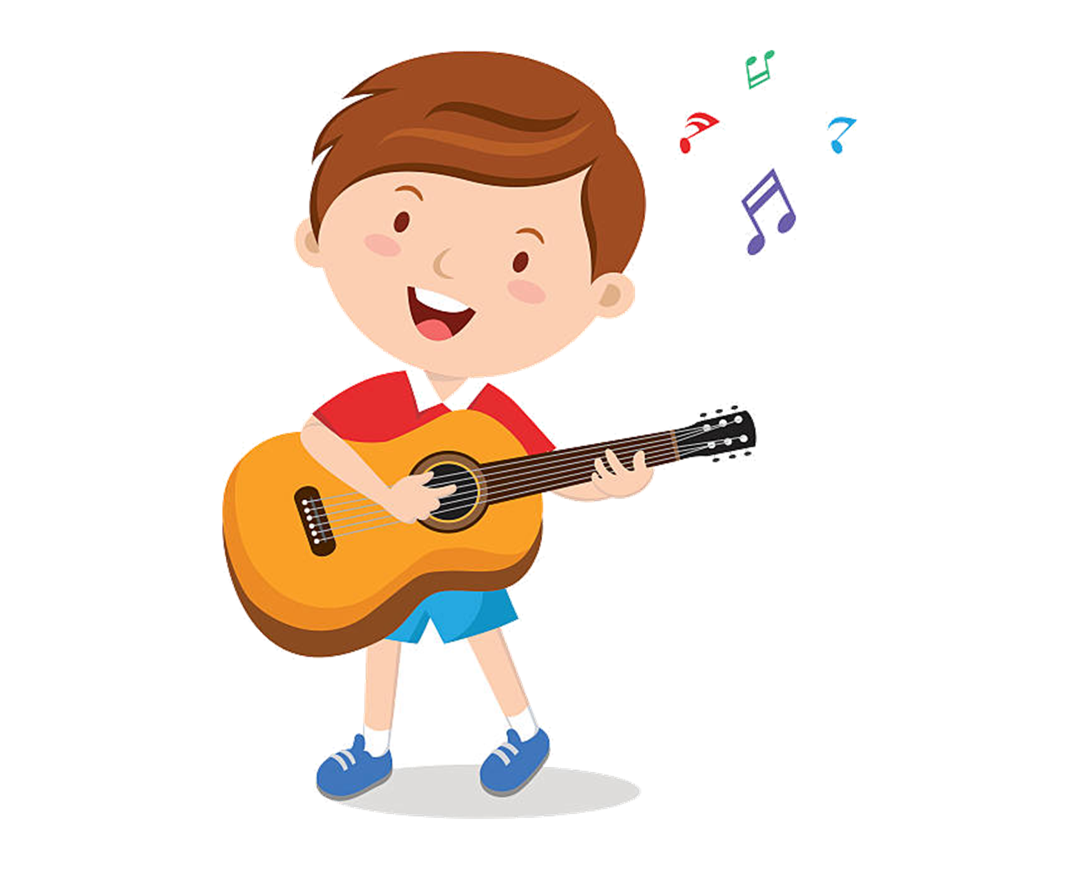
play the guitar

Slide 33
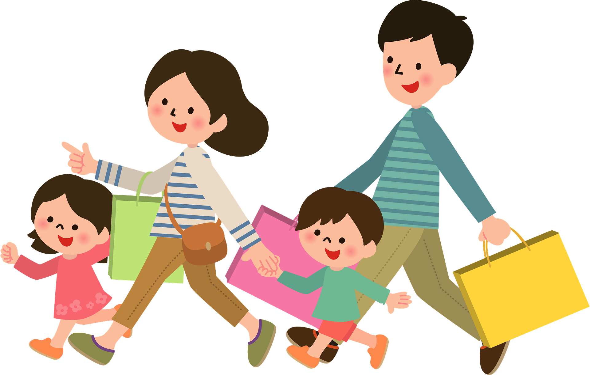
shop

Slide 34
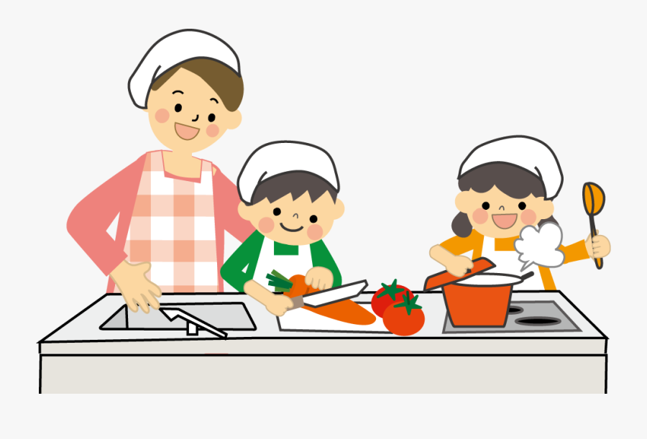
cook

Slide 35
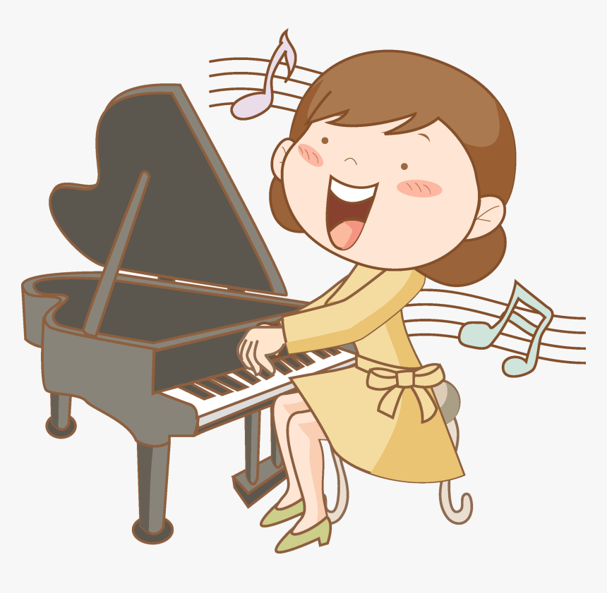
play the piano

Slide 36
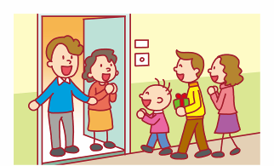
visit family

Slide 37
Listen and point

Slide 39
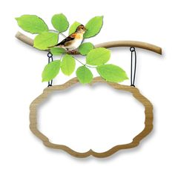
LISTEN TO THE TEXT

Slide 41
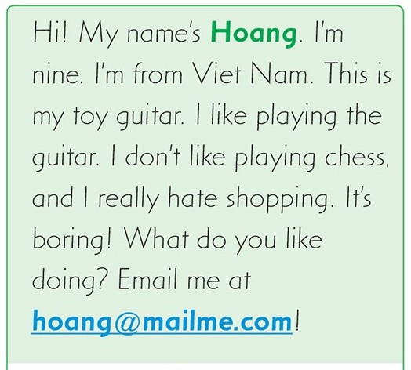
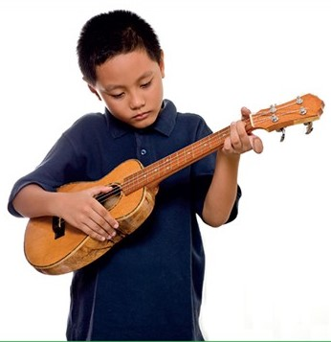

Slide 42
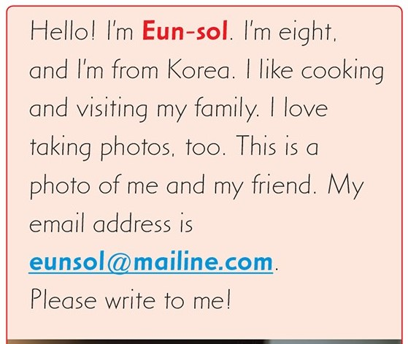
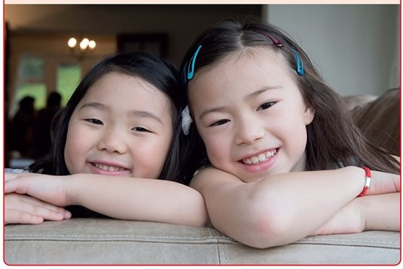

Slide 43
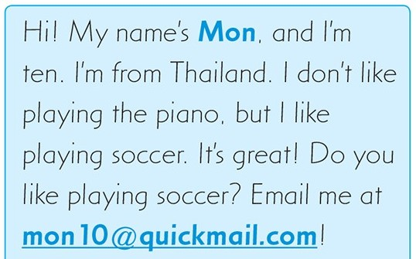
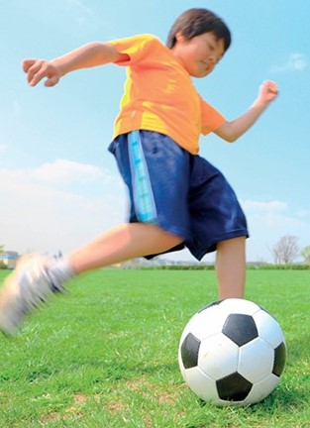

Slide 44
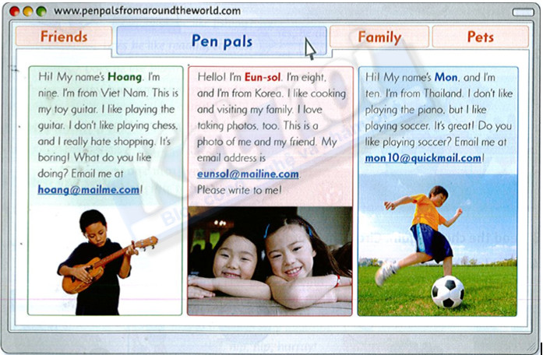
Task: read again

Slide 45
Answer these questions- Exercise 4p18 SB
Does Hoang like playing the guitar? _yes_ 3. Does Eun-sol like cooking? ____ 5. Does Mon like playing soccer? ____ | 2. Does Hoang like shopping? ___ 4. Does Eun-sol like taking photos? ___ 6. Does Mon like playing the piano? ___
No
Yes
Yes
Yes
No

Slide 46
1/Hoang likes playing the guitar.
2/ Eun-sol is from Thailand.
3/ Hoang thinks shopping is boring.
4/ Mon likes playing the piano.

Slide 47
GRADE 4
UNIT TWO
My weekend
Lesson 6

Slide 48
Listen and match. What do they like?
2
3
4

Slide 50
NOW, IT’S YOUR TURN!
What do you like doing?

Slide 51
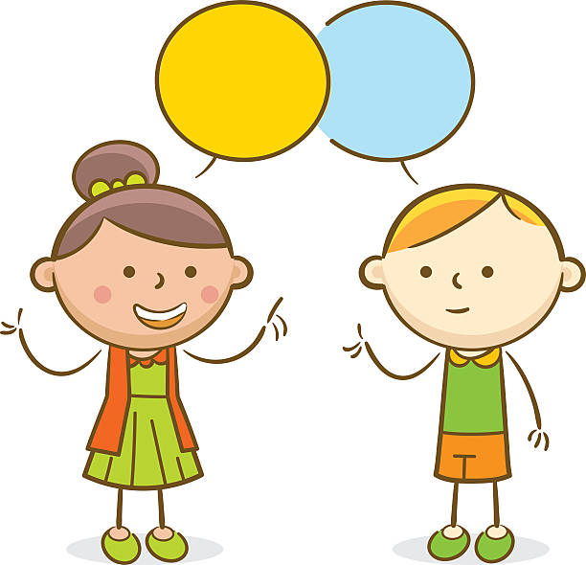
GAME TIME.
Yeah.

Slide 52
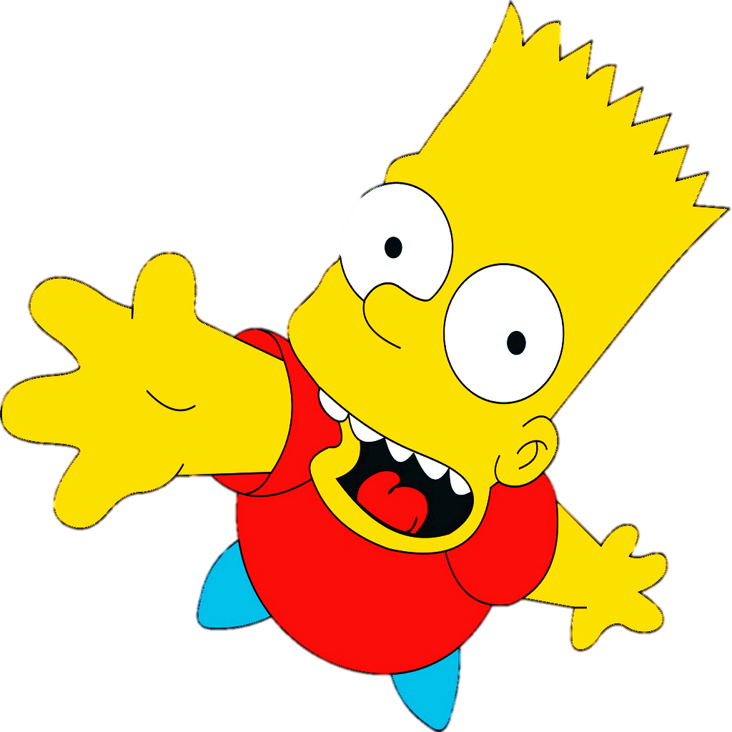
LIKE or DISLIKE

Slide 53
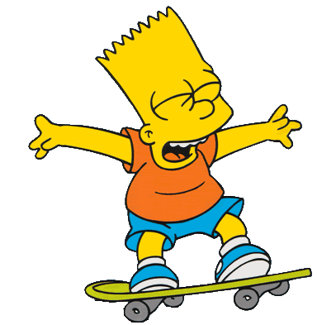
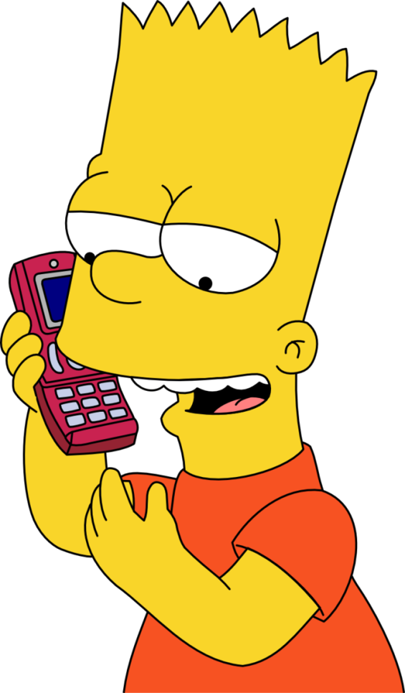
talking on the phone
Bart likes _______________________ .
He doesn’t like ________________________ .
CHECK
NEXT
skating

Slide 54
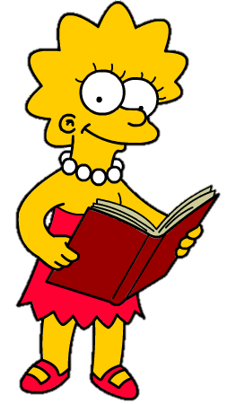
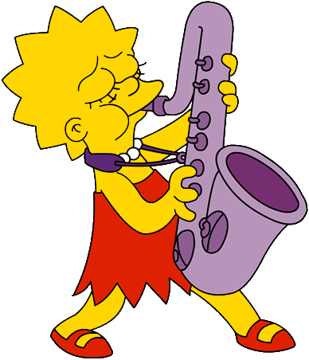
reading books
Lisa likes__________________.
She doesn’t like _________________________ .
CHECK
NEXT
playing the saxophone

Slide 55
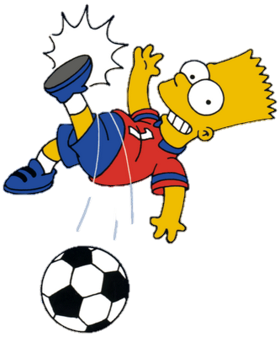
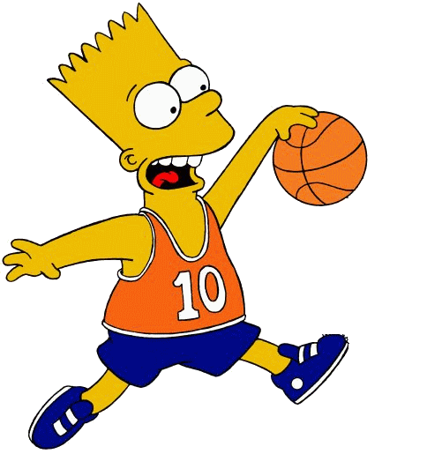
playing soccer
Bart likes ___________________.
He doesn’t like _______________________ .
CHECK
NEXT
playing basketball

Slide 56
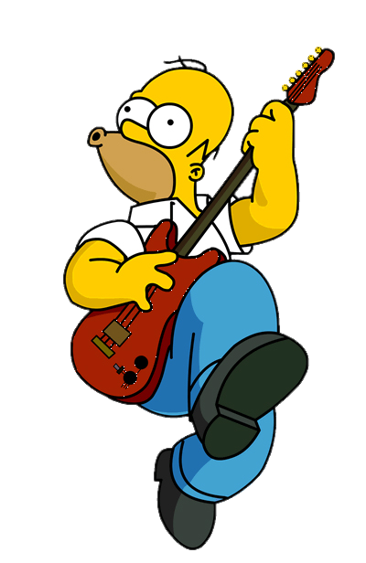
playing the guitar
Homer likes ____________________ .
He doesn’t like ______________________ .
CHECK
NEXT
using the computer

Slide 57
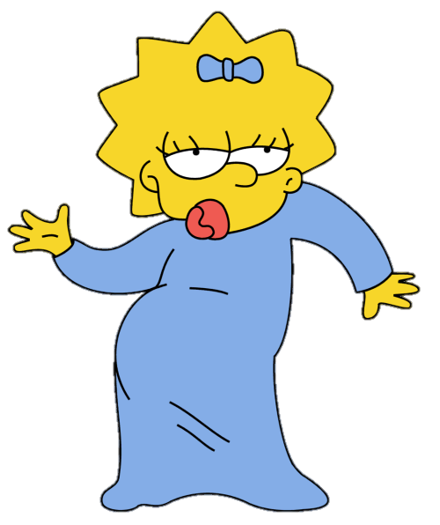
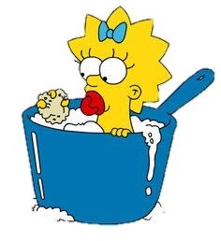
dancing
Maggie likes ________________ .
She doesn’t like ____________________ .
CHECK
NEXT
taking a bath

Slide 58
What does Quang like doing?
Quang likes ………….., ……………… and ………………

Slide 59
Các con nhớ chép bảng này vào vở nhé!

Slide 60
Workbook time!!!

Slide 61
