Slide 1
GRADE 4
UNIT 4
We’re having fun at the beach
LESSON 1

Slide 2
Listen and point

Slide 3
beach

Slide 4
sail

Slide 5
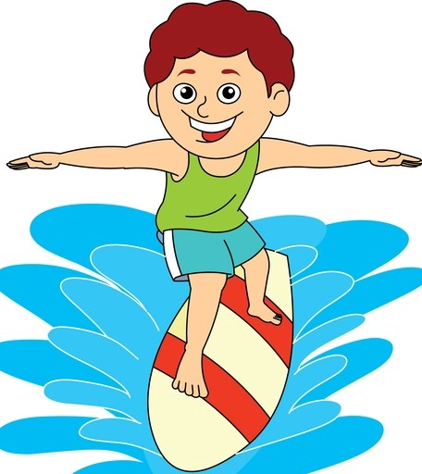
surf

Slide 6
kayak

Slide 7
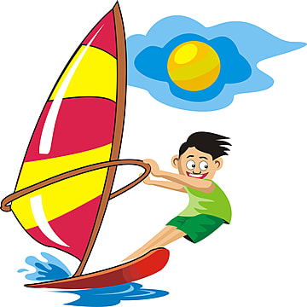
windsurf

Slide 8
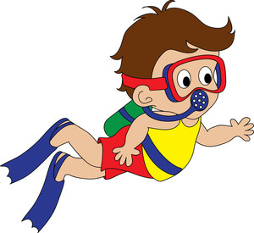
snorkel

Slide 9
waterski

Slide 10
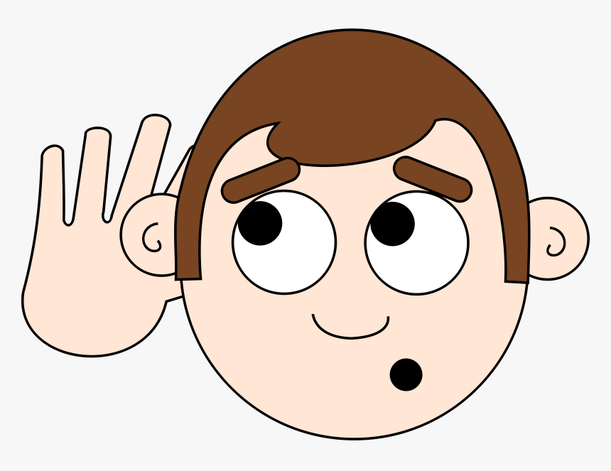
LISTEN and REPEAT

Slide 11
It’s game time.
HIDDEN PICTURE

Slide 12
snorkel
SHOW

Slide 13
sail
SHOW

Slide 14
waterski
SHOW

Slide 15
windsurf
SHOW

Slide 16
kayak
SHOW

Slide 17
surf
SHOW

Slide 18
Tasks: Watch the video and answer these questions
Where are they?
What are they doing?

Slide 20
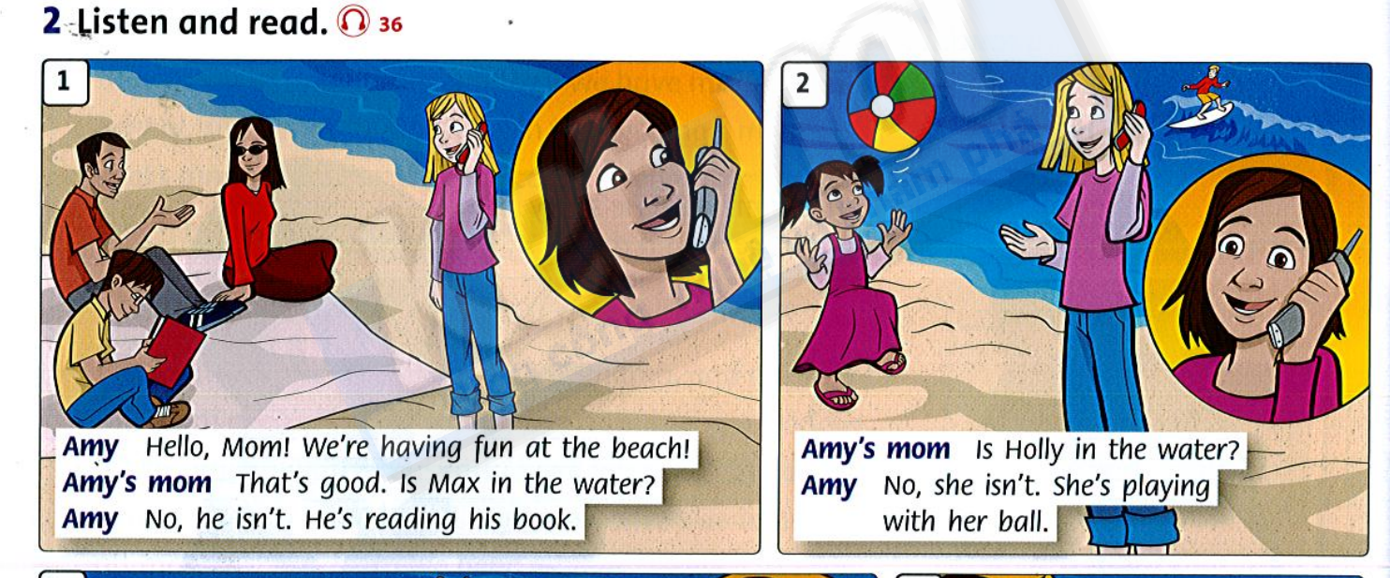

Slide 21
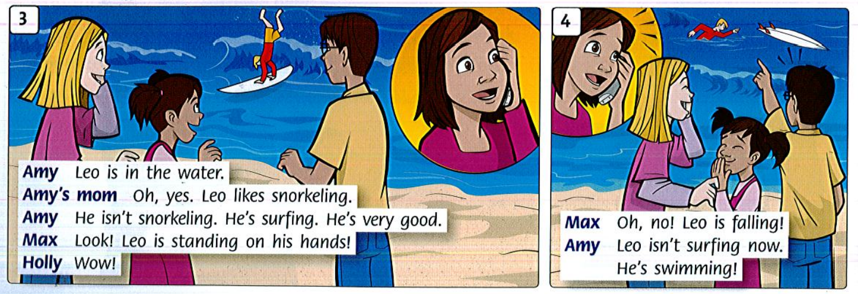

Slide 22
Lesson 2

Slide 23
LISTEN and REPEAT

Slide 25
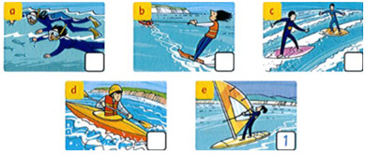
2
3
5
4
1. She's windsurfing.
2. They're snorkeling.
3. She's waterskiing.
4. He's kayaking.
5.They're surfing.
Read and write the number.

Slide 26
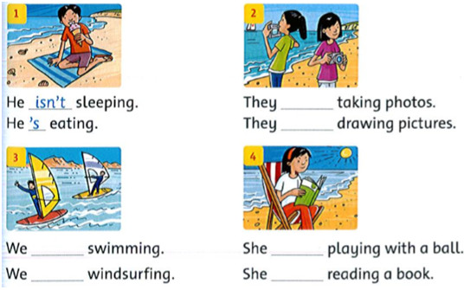
Write
're
aren’t
's
isn't 're aren't
aren’t
isn’t
're
's

Slide 27
Practice .
HIDDEN PICTURE

Slide 28
PRESENT CONTINUOUS
GAME
Choose the right option.

Slide 29
Tom is…
GREAT
waterskiing
surfing
swimming

Slide 30
Lan is…
GREAT
windsurfing
sailing
waterskiing

Slide 31
Thanh is …
GREAT
snorkeling
kayaking
surfing

Slide 32
John and Mark are …
GREAT
windsurfing
sailing
kayaking

Slide 33
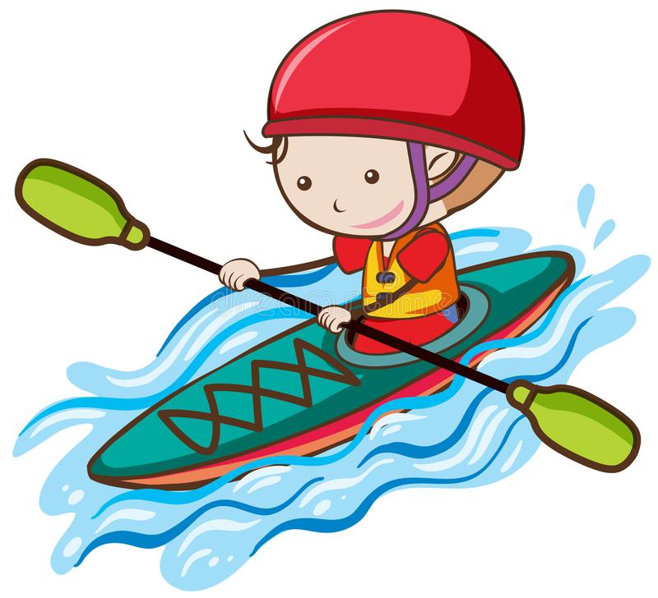
The girl is…
GREAT
sailing
surfing
kayaking

Slide 34
The boy is…
End
snorkeling
windsurfing
kayaking

Slide 35
Lesson 3

Slide 36
Look and say

Slide 37
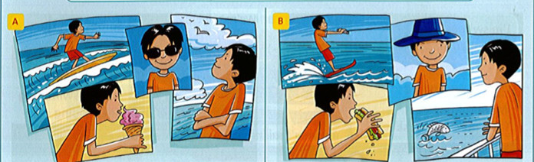
Write about A or B
Example:
A: The boy is eating some ice cream. He isn't…

Slide 38
LISTEN and SING

Slide 40
Lesson 3

Slide 41
It’s game time.

Slide 42
The Present Continuous Journal
What are
they doing?
PLAY

Slide 43
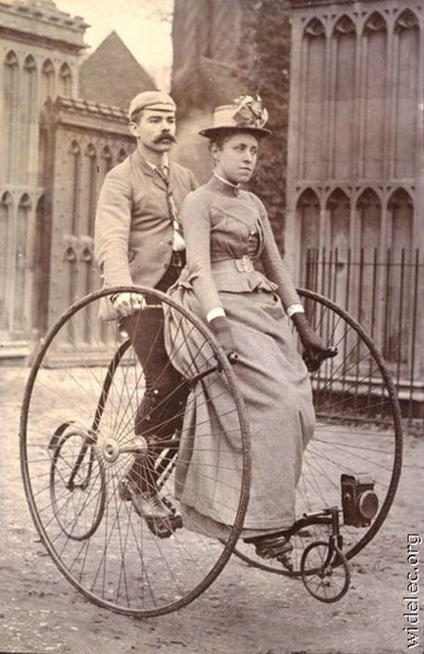
HE
AREN’T
SHE
ARE
CYCLING.
THEY

Slide 44
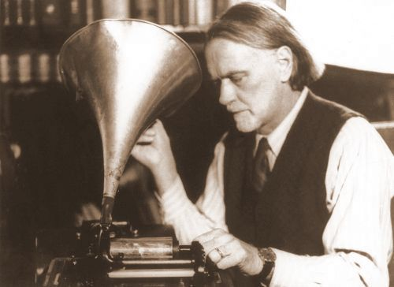
HE
IS
SHE
LISTENING.
ISN’T
THEY

Slide 45
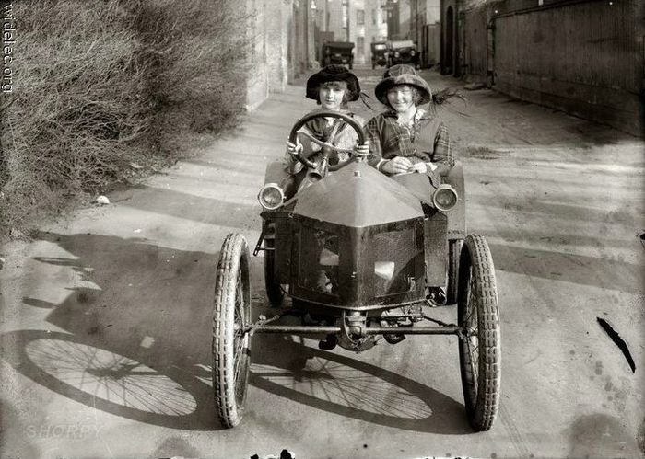
HE
IS
DRIVING.
SHE
ISN’T
THEY

Slide 46
HE
ISN’T
SHE
EATING ICE-CREAM.
IS
THEY

Slide 47
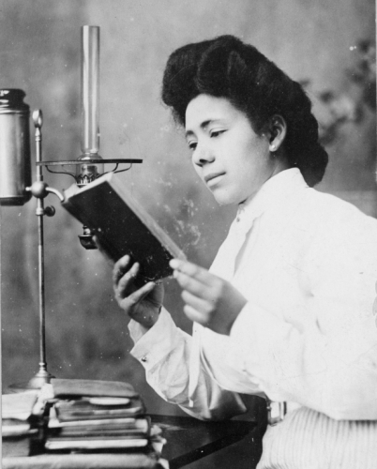
HE
IS
SHE
READING.
ISN’T
THEY

Slide 48
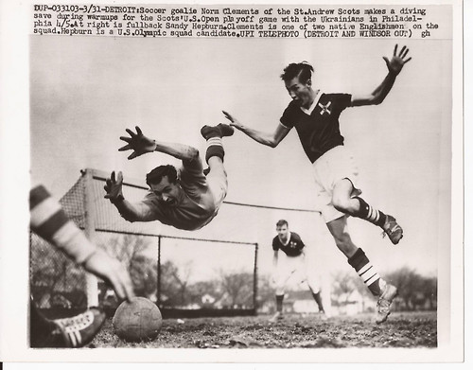
HE
ARE
PLAYING TENNIS.
SHE
AREN’T
THEY

Slide 49
Workbook time!!!

