Slide 1
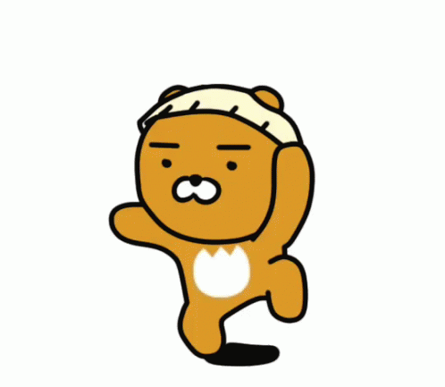
GRADE 4
REVIEW 2

Slide 2
TASK:
Complete the crossword.

Slide 3
c
a
r
d
o
n
o
r
e
l
i
n
k
e
e
e
y
u
r
i
g
u
n
a
i
l
i
g
y

Slide 4
GAME TIME

Slide 5
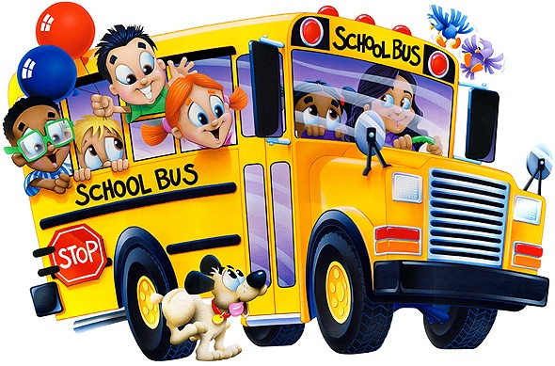
We go to school by bus.
LISTENING PRACTICE
DAILY ROUTINES

Slide 6
Say what Tim does. Then listen and click the right words.
morning
up
early
on
wake
bed
he
late
in
tired
o´clock
wakes
gets
very
Check the sentence here.
He wakes up very early.

Slide 7
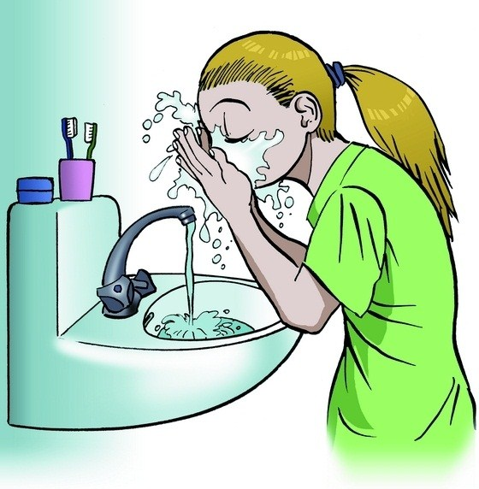
Say what Sue does. Then listen and click the right words.
hands
she
wash
water
clean
teeth
soap
cleans
face
washes
brush
after
his
her
Check the sentence here.
She washes her face.

Slide 8
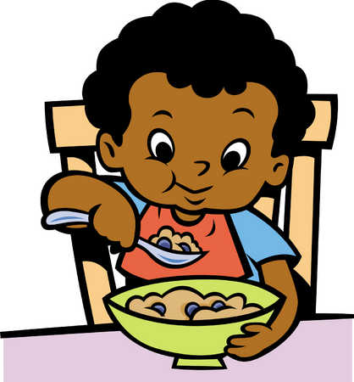
Say what Rob does. Then listen and click the right words.
breakfast
milk
eat
for
have
he
she
eats
has
coffee
tea
makes
cereals
in
Check the sentence here.
He has cereals for breakfast.

Slide 9
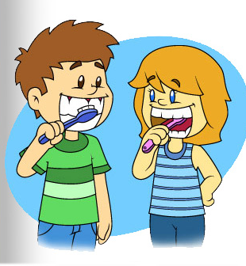
Say what they do. Then listen and click the right words.
brush
after
before
his
breakfast
her
their
they
wash
teeth
my
tooth
brushes
for
Check the sentence here.
They brush their teeth after breakfast.

Slide 10
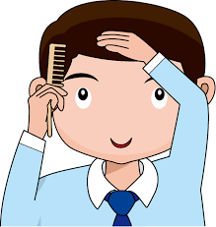
Say what Mike does. Then listen and click the right words.
combs
her
brushes
hare
has
she
washes
his
always
comb
morning
hair
he
after
Check the sentence here.
He always combs his hair.

Slide 11
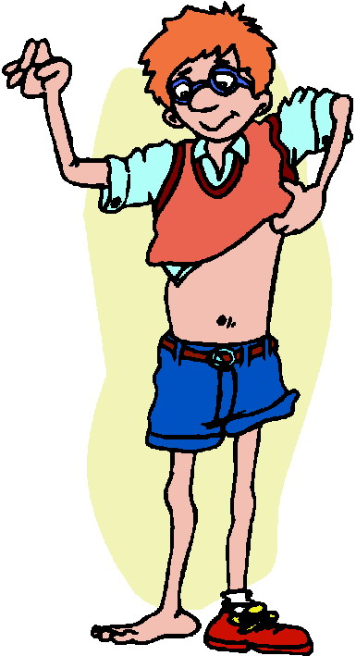
Say what Richard does. Then listen and click the right words.
the
his
clothes
gets
in
shoe
get
dress
dressed
on
after
he
she
bedroom
Check the sentence here.
He gets dressed in the bedroom.

Slide 12
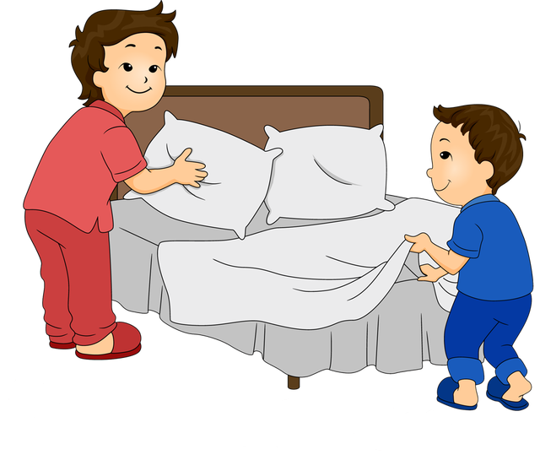
Say what they do. Then listen and click the right words.
their
they
school
makes
make
before
do
to
after
going
the
does
at
bed
Check the sentence here.
They make the bed before going to school.

Slide 13
Say what they do. Then listen and click the right words.
walks
school
walk
always
for
home
leave
to
they
day
car
runs
the
every
Check the sentence here.
They always walk to school every day.

Slide 14
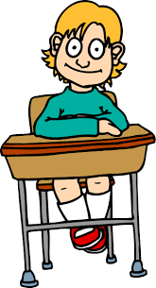
Say when his lessons start. Then listen and click the right words.
starts
o’clock
half
never
nine
lessons
start
to
minutes
past
eight
his
at
quarter
Check the sentence here.
His lessons start at half past eight.

Slide 15
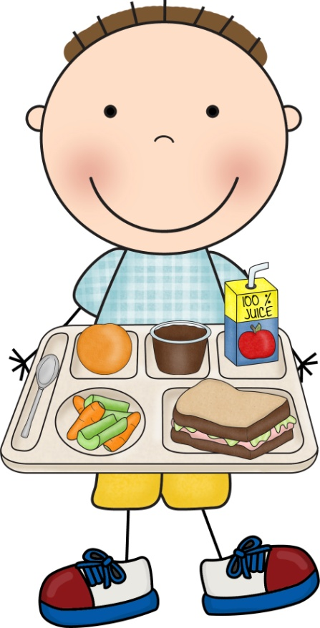
Say what Billy does. Then listen and click the right words.
has
canteen
eat
in
have
food
the
he
dinner
takes
school
her
for
lunch
Check the sentence here.
He has lunch in the school canteen.

Slide 16
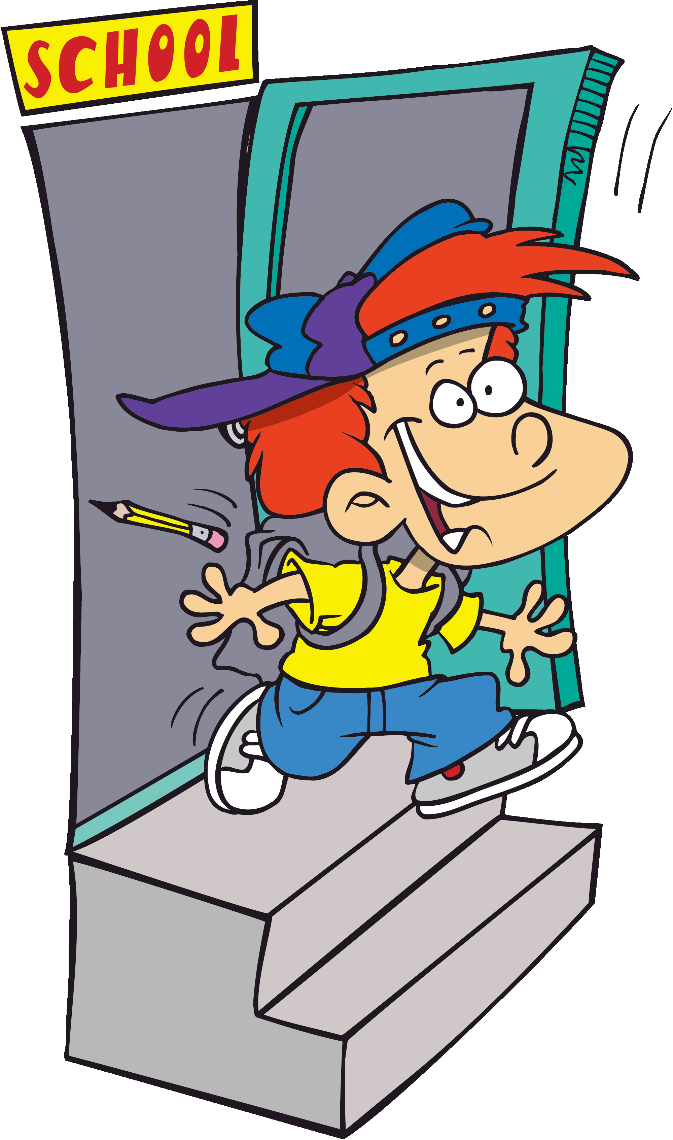
Say what Michael does. Then listen and click the right words.
and
end
for
to
school
goes
home
go
walks
he
leave
his
leaves
begins
Check the sentence here.
He leaves school and goes home.

Slide 17
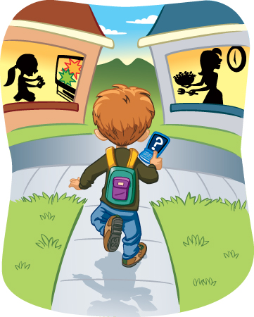
Say what Ryan does. Then listen and click the right words.
a
to
fifteen
he
half
quarter
arrive
arrives
at
past
three
two
home
o’clock
Check the sentence here.
He arrives home at a quarter past two.

Slide 18
Say what Sarah does. Then listen and click the right words.
make
does
study
his
her
makes
write
do
never
homework
she
afternoon
books
plays
Check the sentence here.
She does her homework.

Slide 19
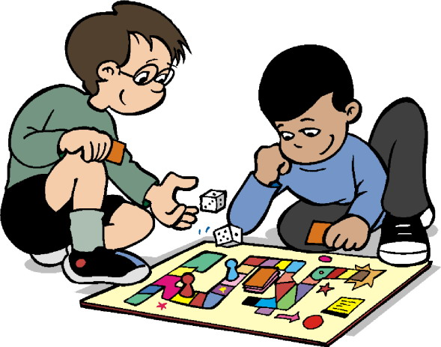
Say what Seth does. Then listen and click the right words.
games
play
board
at
a
with
home
have
plays
his
friend
video
to
he
Check the sentence here.
He plays board games with a friend.

Slide 20
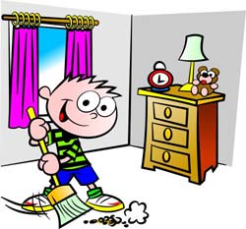
Say what Paul does. Then listen and click the right words.
he
afternoon
clean
room
washes
never
kitchen
in
does
his
she
the
cleans
broom
Check the sentence here.
He cleans his room in the afternoon.

Slide 21
TASK:
Write the correct words.

Slide 22
zebra / kangaroo / camel / crocodile / lizard
Look at the animals! The ¹_lizard_ is sleeping in the sun. The ²_______ is swimming in the water. The ³________ is jumping. Can you see it? The ⁴_______ is running. It's very fast. The ⁵_______ is hungry. It's eating.
crocodile
kangaroo
zebra
camel

Slide 23
TASK:
Read and circle.

Slide 24
1. Dad is / isn't reading a book. 2. The girls are / aren't listening to music. 3. The boys are / aren't playing chess. 4. Mom is / isn't watching TV. 5. Dad is / isn't eating an apple. 6. The boys are / aren't listening to music.

Slide 25
TASK:
Match the question with the answer.

Slide 26
1. Is Duy watching a DVD? _d_ | a. Yes, she is.
2. Are the children playing volleyball? __ | b. No, it isn't
3. Is Lan snorkeling? ___ | c. Yes, I am
4. Are you and your friends surfing? ___ | d. No, he isn't
5. Is the monkey jumping? ___ | e. Yes, we are.
6. Are you eating a sandwich? ___ | f. No, they aren't.
f
a
e
b
c

Slide 27
TASK
Complete the text.

Slide 28
COMPLETE THE TEXT. gets / brushes / plays / walks / catches / has
Thanh gets up at five thirty on Mondays. He ¹ _has_ a shower and then he ²___ dressed. He has breakfast with his family. He always ³______ his teeth after breakfast. He never ⁴______ the bus to school. He always ⁵______ to school with his brother. After school, he ⁶_____ with his friends in the park. Thanh loves the park!
gets
brushes
catches
walks
plays

Slide 29
TASK
Read and complete the word.
ow / ou / oy / oi

Slide 30
oi
ou
oy
oi
ow

Slide 31
Workbook time!!!

