Slide 1




THE COMMITTEE OF PEOPLE OF DISTRICT 12
DEPARTMENT OF EDUCATION AND TRAINING
NGUYEN THI MINH KHAI PRIMARY SCHOOL
Unit 2: What’s this ?
Lesson 5: Sounds and Letters
Teacher: Tran Thi Thanh Loan

Slide 2
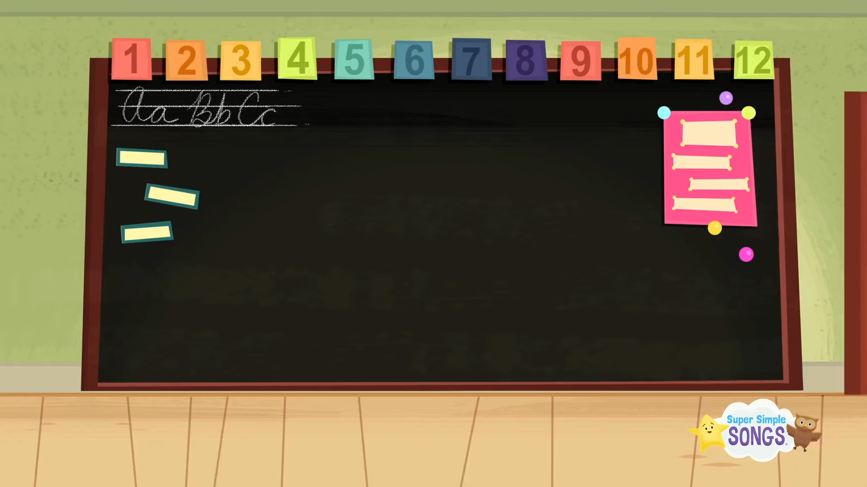
bbbbcvvgggpooggg

Slide 3
UNIT 2 : WHAT’S THIS ?
Lesson 5: Sounds and Letters
( P. 20 )

Slide 4
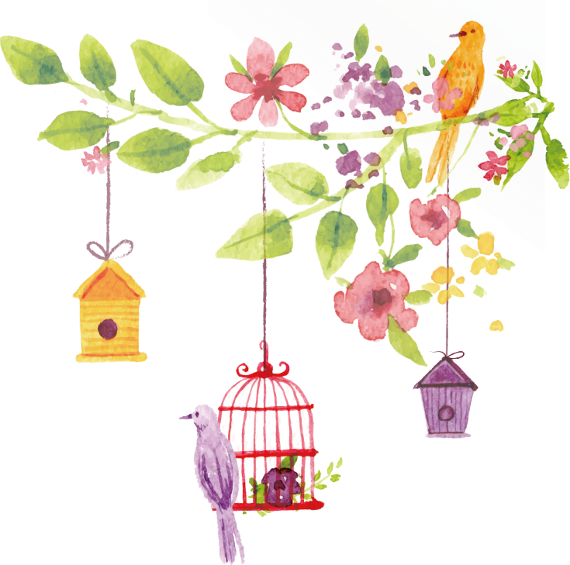


REVIEW

Slide 5

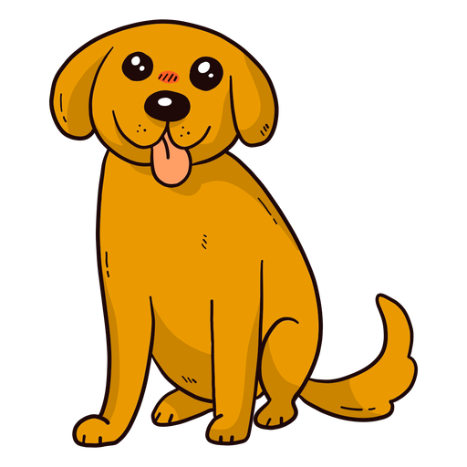
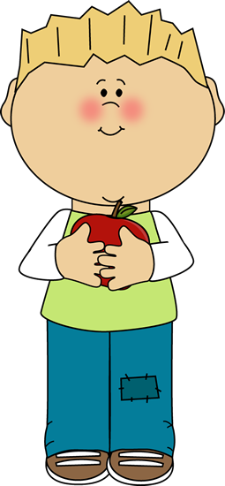


Matching
Bb
Aa
Cc
Dd
Ee

Slide 6
Aa
Bb
Cc
Dd
Ee

Slide 7


What’s next?
Aa
Bb
Cc
Dd
Ee

Slide 8


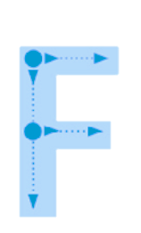
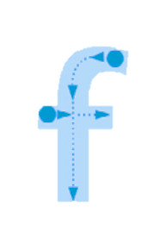
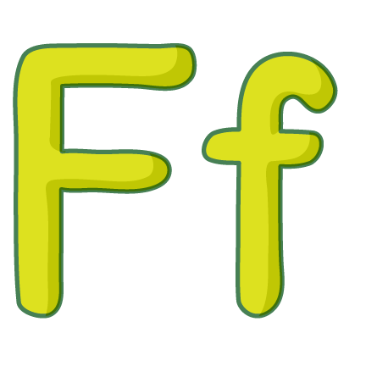


Notes:
- Show the uppercase F and lowercase f.
- Say the sound /f/.
- Draw dotted outlines of the uppercase F and lowercase f on the board.
- Ask different students to come to the board and connect the dots.

Slide 9


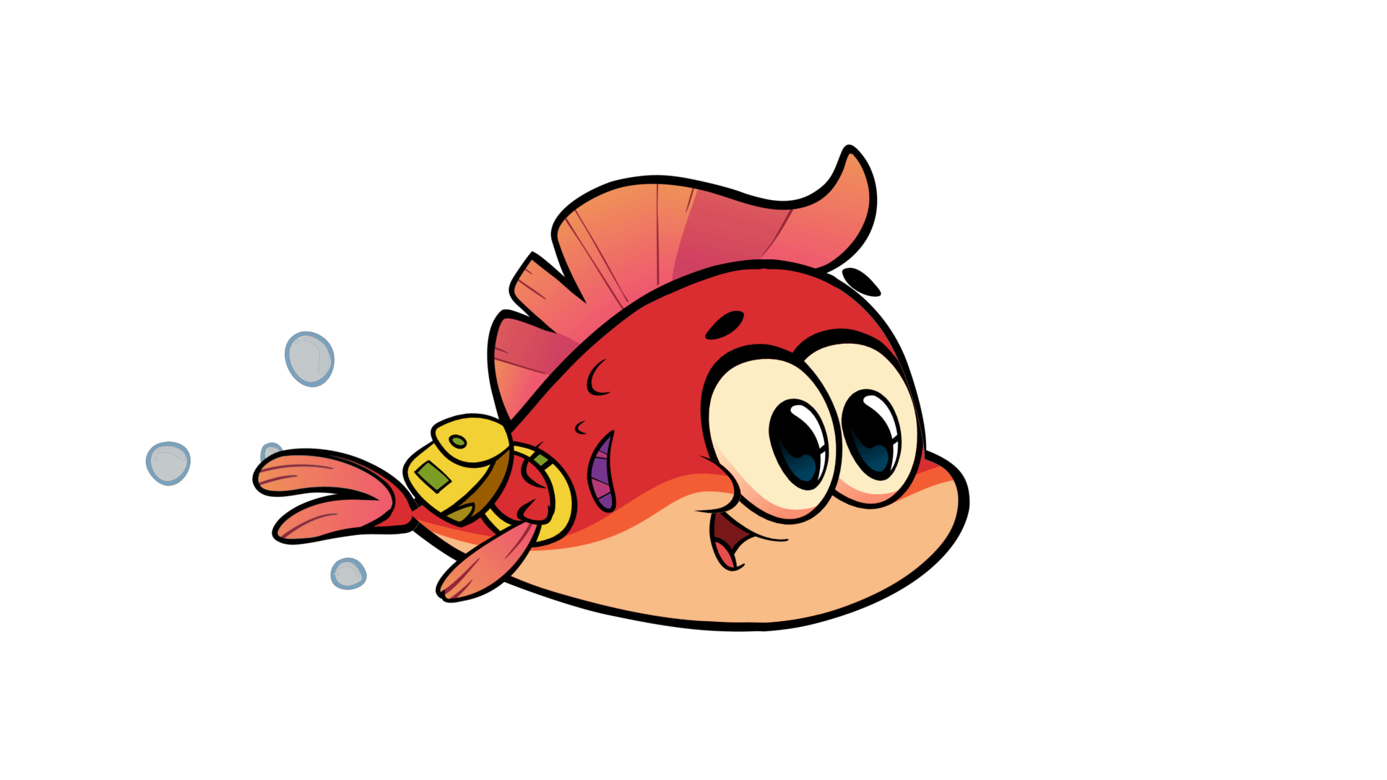

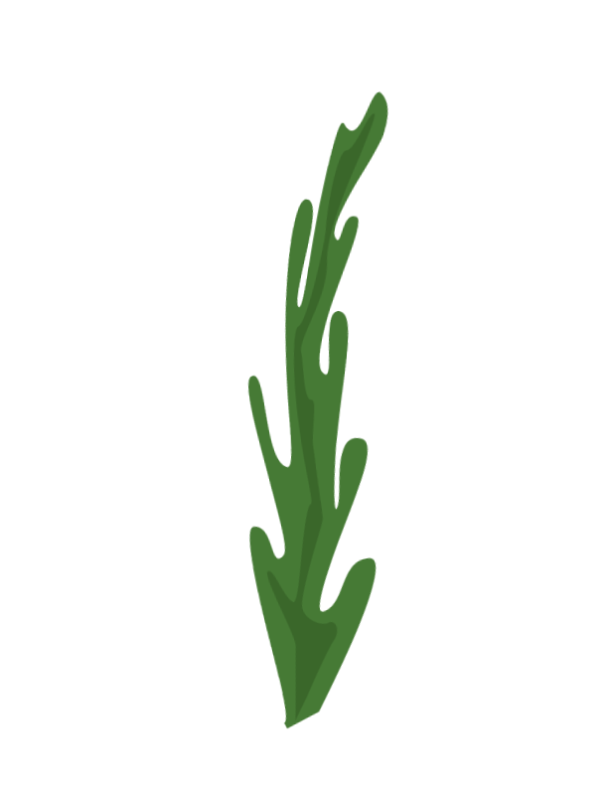
f
Notes:
Listen, point, and repeat. Write. Track 34
- Play track 34, listen and point
- Play again, ask students to listen and point
- Play again, ask students to listen and repeat
- Model the writing activity

Slide 10


f
Notes:
Below level: Practice tracing the letters F and f in the air in different ways; big, small, quickly, slowly, on the desk, on the board. Have fun with this activity and encourage children to say the sound /f/ each time.
At level:
- Write fish and farm on the board. Write the letter f in dotted lines under both words.
- Hold up Phonics card 11 (fish) and 12 (farm) one at a time. Invite a child to come to the front of the class and trace the letter f under the correct word – either with their finger or a pen.
- Draw a new dotted letter f and repeat with as many children as possible.
Above level:
- Follow the ‘At level’ activity as described above.
- Add other words and dotted letters from previous lessons to the board.
- Continue the activity as before, by showing a phonics picture card and inviting children to trace the corresponding letter.

Slide 11

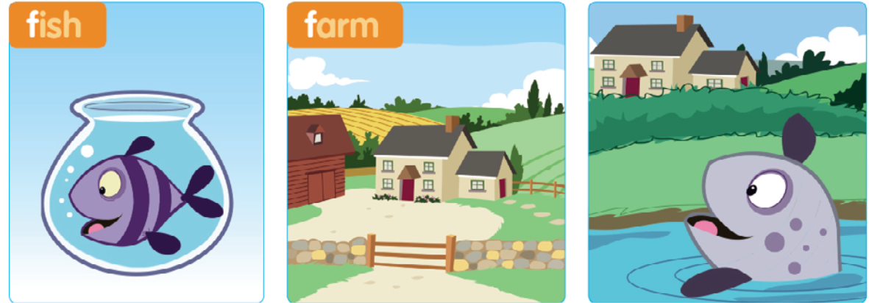
A fish, fish, fish
At the farm, farm, farm
A fish, fish, fish
At the farm, farm, farm
/ f /, / f /, /f /
/ f /, / f /, / f /
A fish, fish, fish
At the farm, farm, farm
Notes:
Listen and chant: track 35
- Point to the picture and say: “A fish at the farm.”
- Play the recording, ask students to listen to the chant.
- Put Phonics cards 11-12 on the board.
- Play the chant again
- Students point to the cards.
- Play the chant again, pause for students to repeat.

Slide 12
A fish, fish, fish
At the farm, farm, farm
A fish, fish, fish
At the farm, farm, farm
/ f /, / f /, / f /
/ f /, / f /, / f /
A fish, fish, fish
At the farm, farm, farm
Notes:
Listen and chant: track 35
- Point to the picture and say: “A fish at the farm.”
- Play the recording, ask students to listen to the chant.
- Put Phonics cards 11-12 on the board.
- Play the chant again
- Students point to the cards.
- Play the chant again, pause for students to repeat.

Slide 13
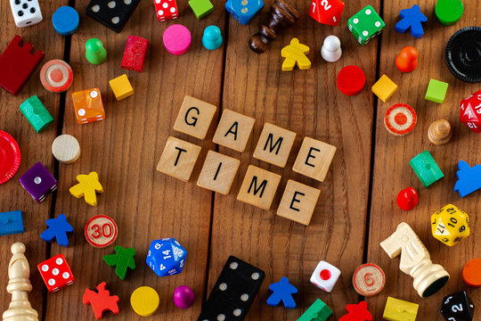

Slide 14

WHAT IS IN THE CLOCK?
START

Slide 15



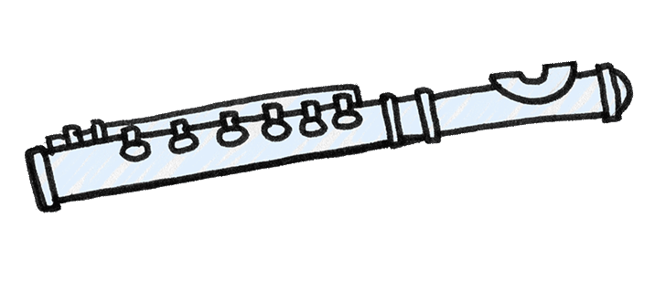
START
CHECK

Slide 16
START
CHECK

Slide 17

START
CHECK

Slide 18
START
CHECK

Slide 19

START
CHECK

Slide 20
START
CHECK

Slide 21


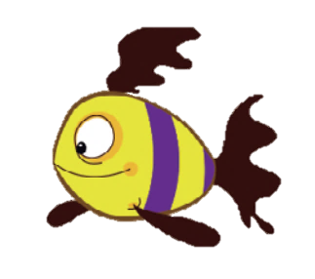
Notes:
Stick and say.
- Point to the picture and elicit the words: fish, egg, farm and elephant
- Point to the letters, say /f/ – fish, then /e/ – egg, then
/f/ – farm, and finally /e/ – elephant.
- Encourage students to say the sounds and words with you.
- Say: Let’s stick! Hold up the F sticker. Say the sound /f/.
- Say Now your turn!
- Ask students to connect and say.

Slide 22





Slide 23

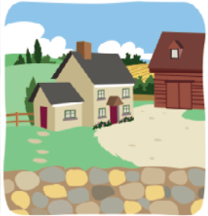

Slide 24



Slide 25

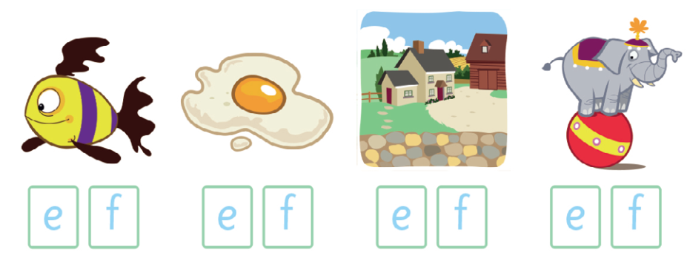

Slide 26
Notes:
Listen and chant: track 35
- Point to the picture and say: “A fish at the farm.”
- Play the recording, ask students to listen to the chant.
- Put Phonics cards 11-12 on the board.
- Play the chant again
- Students point to the cards.
- Play the chant again, pause for students to repeat.

Slide 27




How do you feel ?

Slide 28
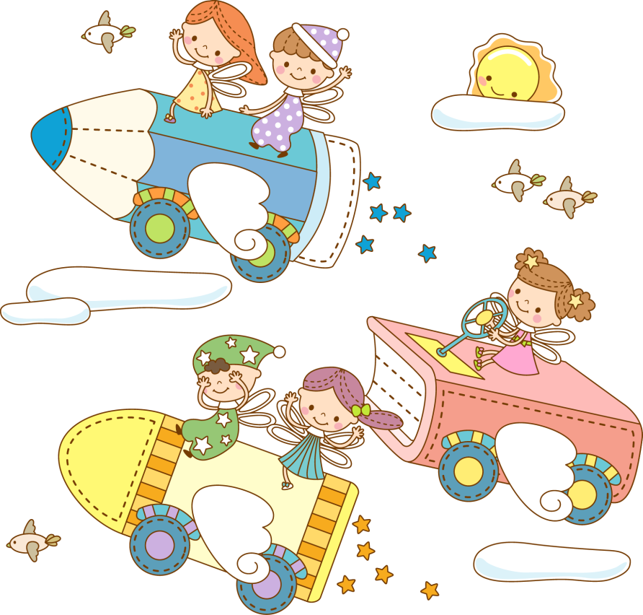

Goodbye !

