Slide 1
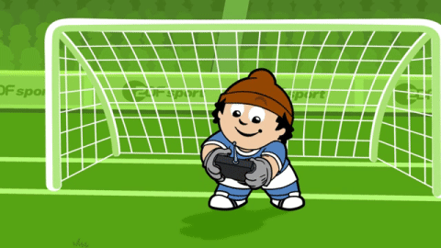
THE COMMITTEE OF PEOPLE OF DISTRICT 12
DEPARTMENT OF EDUCATION AND TRAINING
NGUYEN THI MINH KHAI PRIMARY SCHOOL
UNIT 6: WHOSE JACKET IS THIS ?
Lesson 4: Phonics
Teacher: Tran Thi Thanh Loan

Slide 4
LISTEN AND SING

Slide 6
LISTEN AND POINT

Slide 8
LISTEN AND REPEAT

Slide 10
WORK IN PAIRS

Slide 11
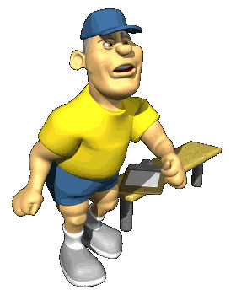
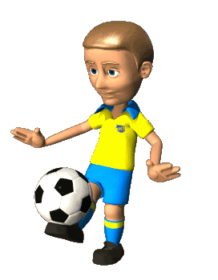
“ll” or “rr”
NEXT

Slide 12
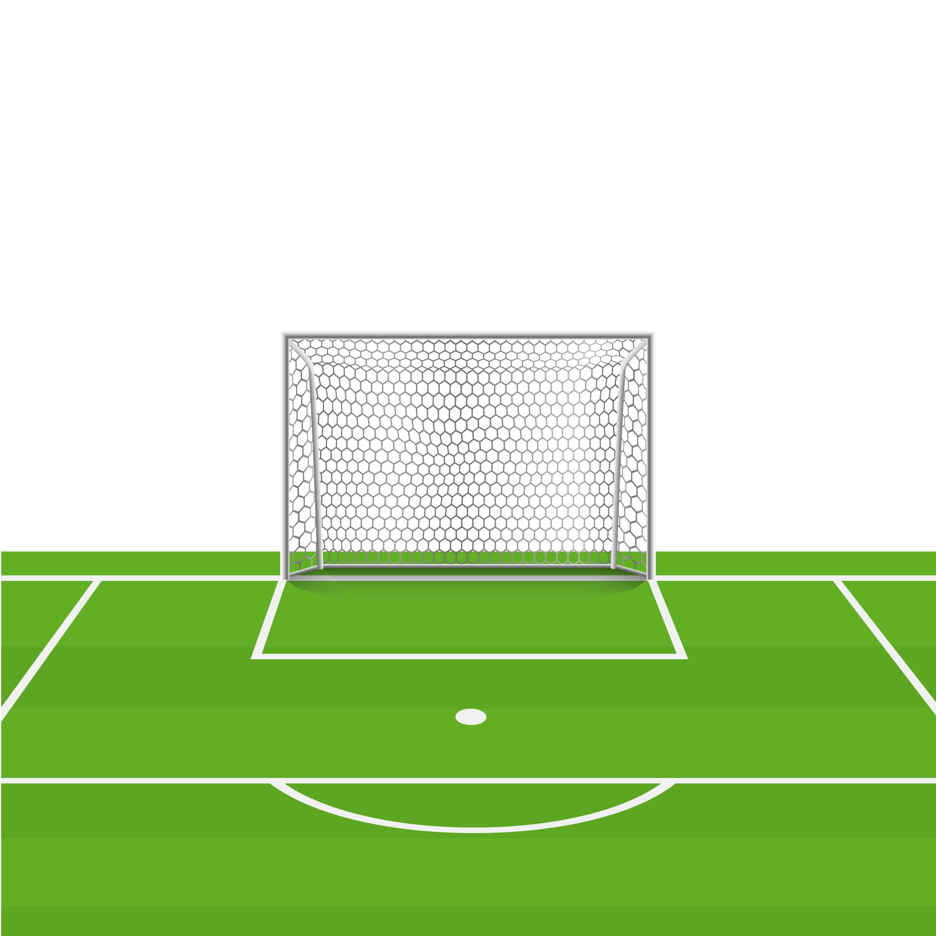
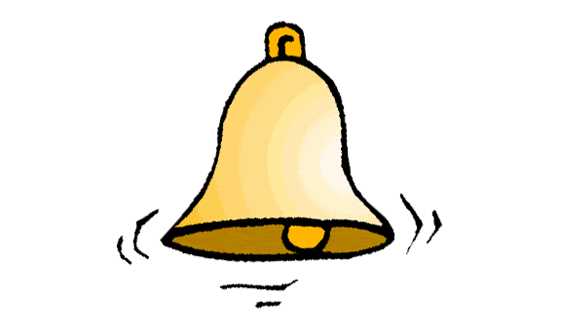
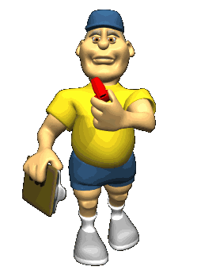
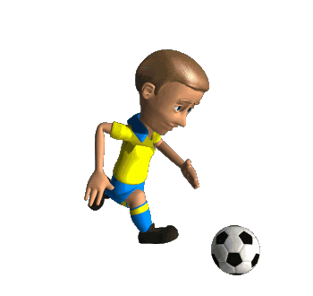
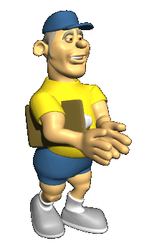
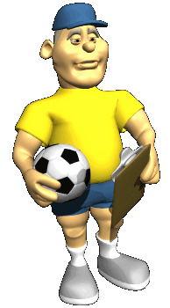
Choose the correct answer.
NEXT
rr
ll

Slide 13
Choose the correct answer.
NEXT
rr
ll

Slide 14
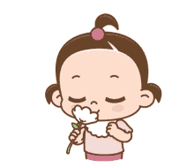
Choose the correct answer.
NEXT
rr
ll

Slide 15
Choose the correct answer.
NEXT
rr
ll

Slide 16
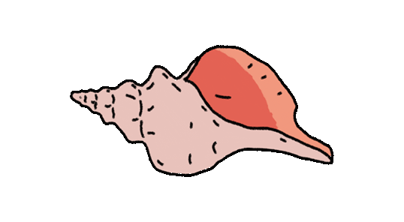
Choose the correct answer.
NEXT
rr
ll

Slide 17
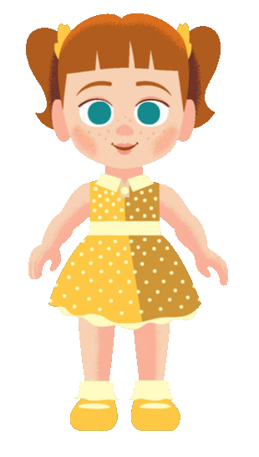
Choose the correct answer.
NEXT
rr
ll

Slide 18
Choose the correct answer.
NEXT
rr
ll

Slide 19
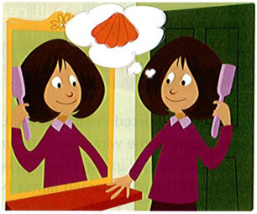
I'm waiting at the door, looking in the mirror, and brushing my hair.
I'm going to beach with my friend today!
I'm going to take my doll. Her name is Carrie.
We have a picnic: sandwiches, cheese, carrots, and cherries. We're going to look for shells and smell the ocean air. Oh! I can hear the doorbell.
My friend is here.
LISTEN AND READ

Slide 20
I'm waiting at the door, looking in the mirror, and brushing my hair.
I'm going to beach with my friend today!
I'm going to take my doll. Her name is Carrie.
We have a picnic: sandwiches, cheese, carrots, and cherries. We're going to look for shells and smell the ocean air. Oh! I can hear the doorbell.
My friend is here.
READ AGAIN. CIRCLE THE WORDS WITH "LL" AND UNDERLINE THE WORDS WITH "RR".

Slide 21
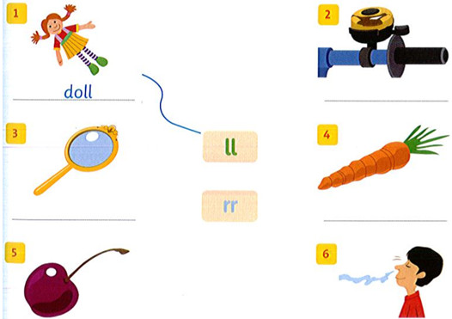
Match and write.
bell
mirror
carrot
cherry
smell

Slide 22
WORKBOOK TIME

Slide 23
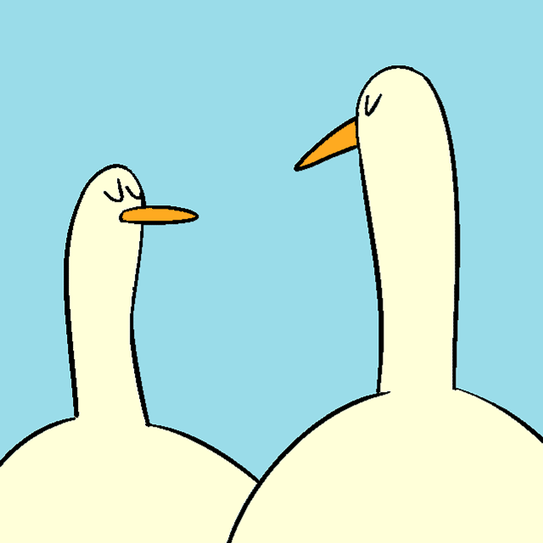
GOODBYE!!!

