Slide 1

Unit 7: Numbers
Lesson 2.1: Vocabulary & Phonics
Page: 46

Slide 2
Objectives
By the end of this lesson, students will be able to gain the following:
Phonics: /ɪ/
Vocabulary:
insect, ink
Skills:
Recognize the letter I/i and make the /ɪ/ sound.

Slide 3

WARM UP

Slide 4

It’s 1.
YES
NO

Slide 5

It’s two.
YES
NO

Slide 6

It’s three.
YES
NO

Slide 7

It’s time to learn …

Slide 8

Phonics
/ɪ/

Slide 9
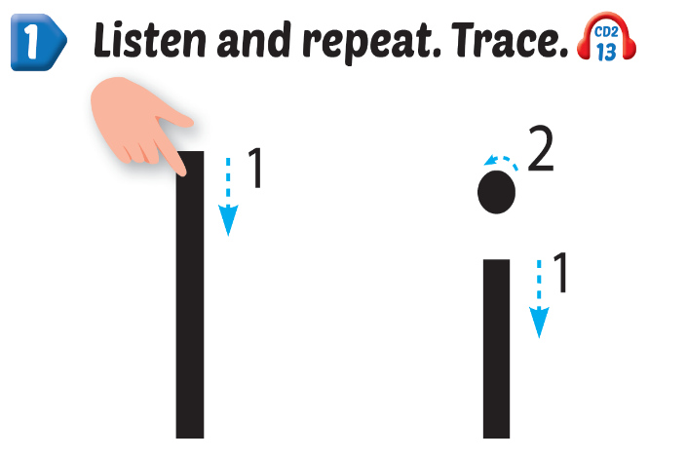
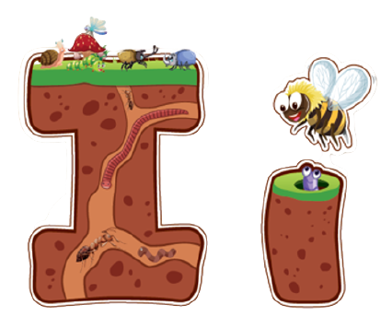
Click Alphabet to hear the sound
Notes:
Click vào hình A. 1. Listen and point. Repeat để cho cả audio full chạy

Slide 10
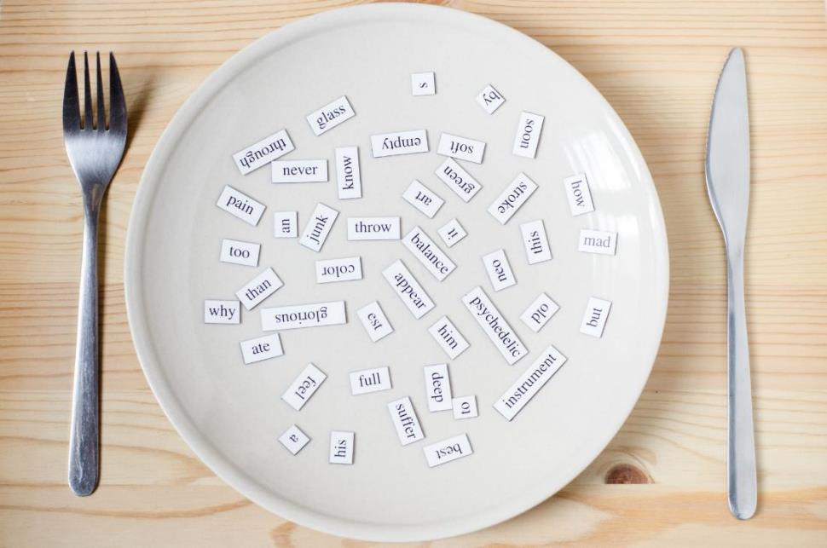
New words
insect, ink

Slide 11
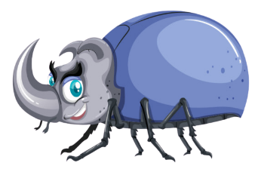
i
i
insect
/ˈɪnsekt/
côn trùng
Notes:
Click vào hình A. 1. Listen and point. Repeat để cho cả audio full chạy

Slide 12

i
i
ink
/ɪŋk/
mực
Notes:
Click vào hình A. 1. Listen and point. Repeat để cho cả audio full chạy

Slide 13


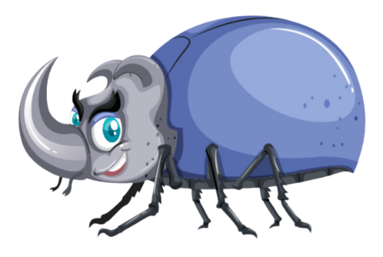


Notes:
Click vào hình A. 1. Listen and point. Repeat để cho cả audio full chạy

Slide 14
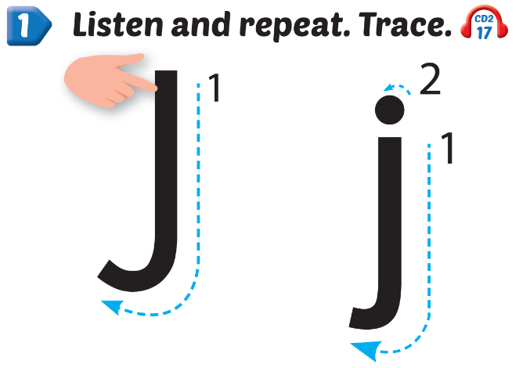
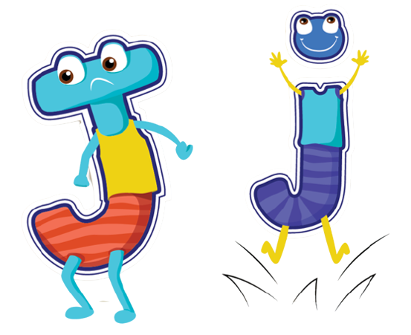
Click Alphabet to hear the sound
Notes:
Click vào hình A. 1. Listen and point. Repeat để cho cả audio full chạy

Slide 15
New words
jump, juice

Slide 16

jump
j
j
/dʒʌmp/
nhảy
Notes:
Click vào hình A. 1. Listen and point. Repeat để cho cả audio full chạy

Slide 17

juice
j
j
/dʒuːs/
nước ép
Notes:
Click vào hình A. 1. Listen and point. Repeat để cho cả audio full chạy

Slide 18





Notes:
Click vào hình A. 1. Listen and point. Repeat để cho cả audio full chạy

Slide 19
Structure
Everybody, jump.

Slide 20




Everybody, jump ,
j, j, .
Everybody, jump ,
j, j, j.

Slide 21

Practice

Slide 22



Slide 23
It’s time to play …

Slide 24


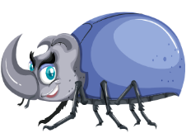
Listen and match

Slide 25
Fill the missing letters
i n
i n e c
k
s
t

Slide 26
Read and choose
ink

Slide 27
Read and choose
insect

Slide 28
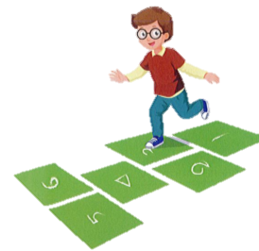

Choose the picture beginning with the sound “i”

Slide 29
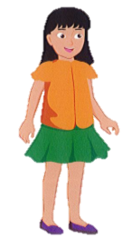
Choose the word beginning with the sound “i”

Slide 30

Further Practice

Slide 31

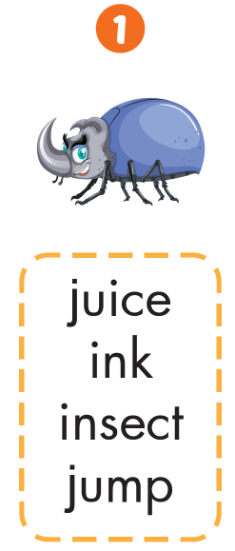



Slide 32

CONSOLIDATION

Slide 33
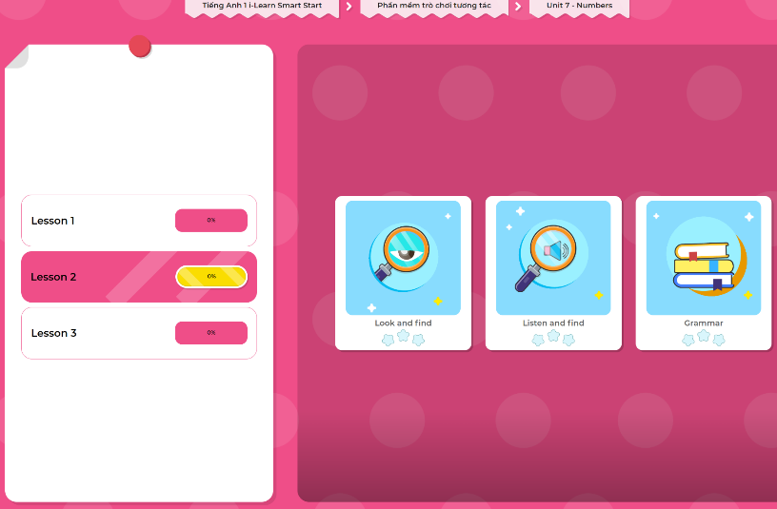
Extra Practice
DHA App
LET’S PLAY!
Click here to play the games

Slide 34

WRAP-UP

Slide 35
Today’s lesson
Phonics
/ɪ/
Vocabulary
insect, ink

Slide 36
Homework
Practice vocabularies and phonics. Make sentences using them.
Practice the vocabulary and phonics in Tiếng Anh 1 i-Learn Smart Start Notebook (page 44)
Do the exercises in Tiếng Anh 1 i-Learn Smart Start Workbook (page 44)
Play the consolidation games in Tiếng Anh 1 i-Learn Smart Start DHA App on www.eduhome.com.vn
Prepare the next lesson (page 47)

Slide 37

Enjoy your day!

