Slide 1
Let’s find Mom!
Unit 3
Lesson Three - Song

Slide 2

Hello song

Slide 3






Give me FIVE

Slide 4

Game

Slide 5
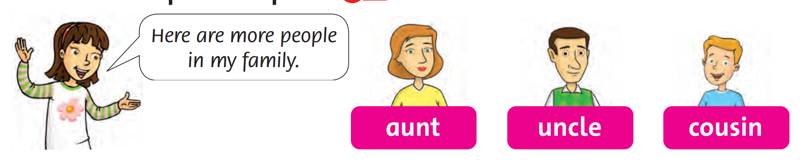

Listen and Point

Slide 6
Listen and Repeat

Slide 7
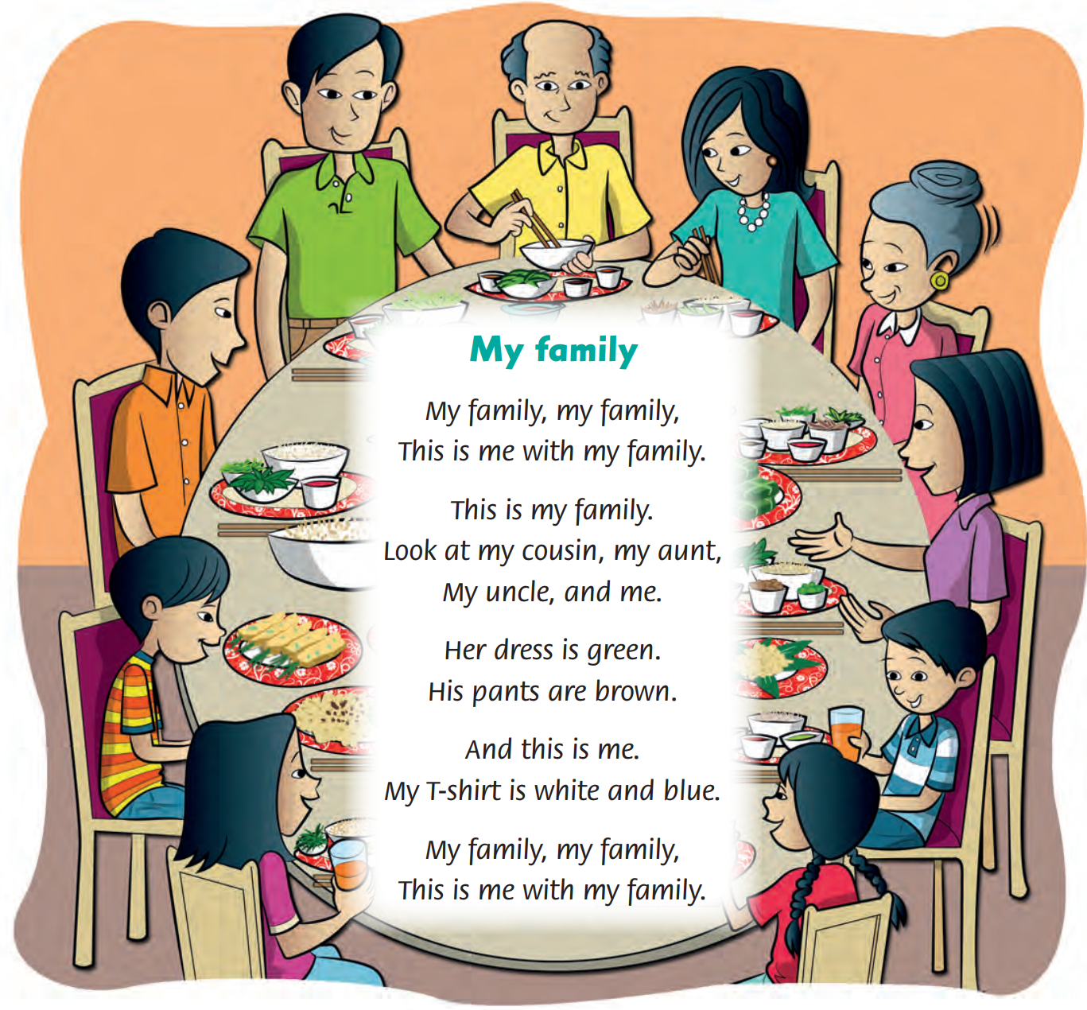
Look and Answer

Slide 8
Listen and Point

Slide 9
Listen and Repeat

Slide 10
Listen and Sing

Slide 11

Sing in groups

Slide 12

Live on stage

Slide 13

Good job!

Slide 14

Homework

Slide 15



Goodbye!
Tieng Anh 3 Family and Friends National Edition

