Slide 1
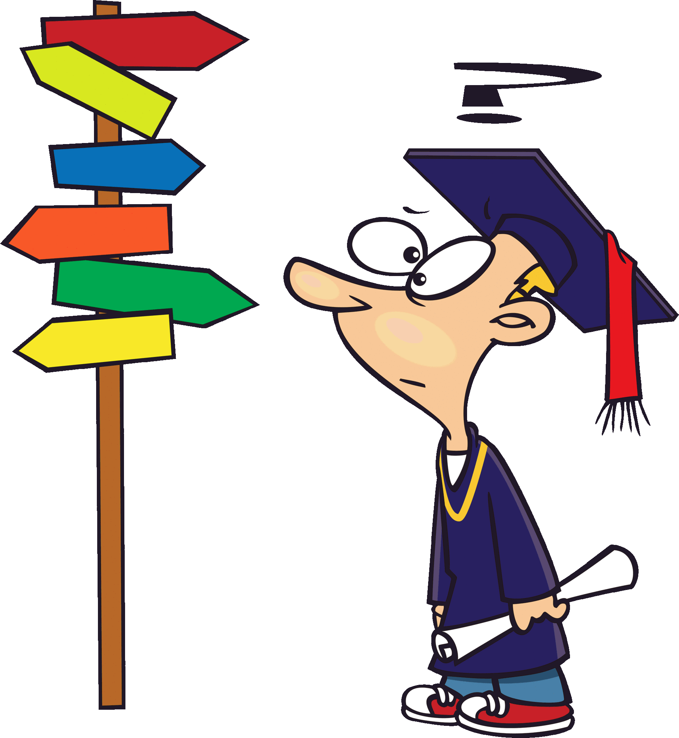
THE COMMITTEE OF PEOPLE OF DISTRICT 12
DEPARTMENT OF EDUCATION AND TRAINING
NGUYEN THI MINH KHAI PRIMARY SCHOOL
Unit 7
GO BACK TO THE TRAFFIC LIGHTS.
LESSON 2 - GRAMMAR
Teacher: Tran Thi Thanh Loan

Slide 4
WATCH THE VIDEO CLIP

Slide 6
GROUPWORK

Slide 7
PERFORMANCE TIME

Slide 8
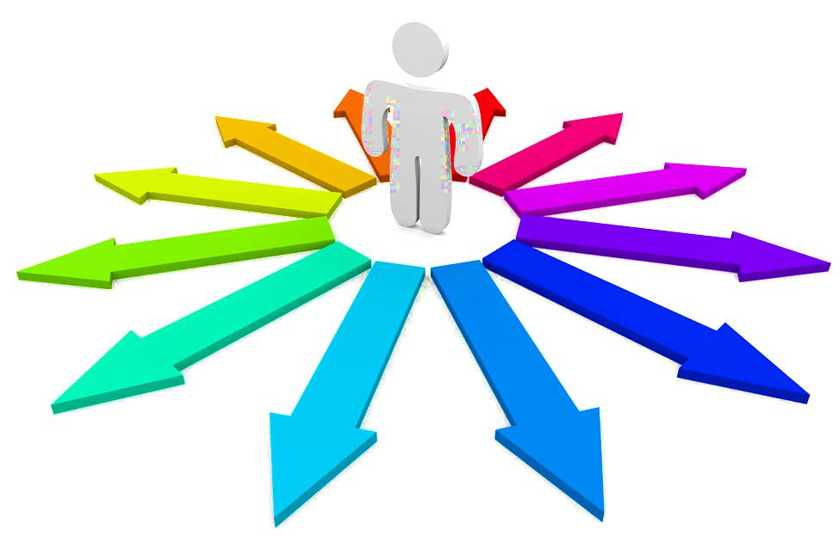
Where’s
Giving directions

Slide 9
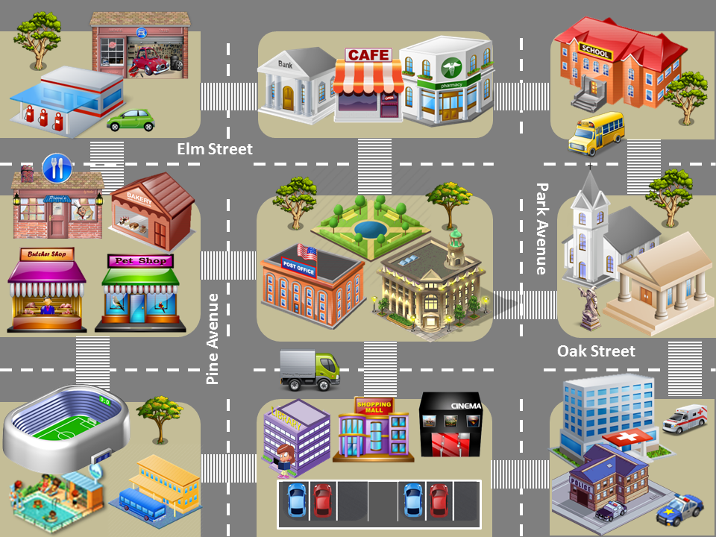
GAS STATION
Hill Road
MUSEUM
Lake Road
Go straight on Elm Street, pass the park, turn right on Park Avenue and turn left on Oak Street. Stop on the left, across from the hospital and next to the church.
CHECK
NEXT

Slide 10
SCHOOL
Hill Road
Lake Road
STADIUM
Go straight on Oak Street, pass the post office and the city hall, turn left on Park Avenue and turn right on Elm Street. Stop on the left, across from the church.
CHECK
NEXT

Slide 11
PHARMACY
Hill Road
Lake Road
SWIMMING POOL
Go straight on Elm Street, pass the café and the bank, turn left on Pine Street and turn right on Oak Street. Pass the pet shop and the buthcer shop. Turn left on Hill Road. Stop on the left next to the stadium.
CHECK
NEXT

Slide 12
GARAGE
Hill Road
Lake Road
HOSPITAL
Go straight on Oak Street, pass the cinema and the shopping mall, turn right on the corner of the post office, go straight on Pine Avenue, and cross Elm Street. It’s on the left across from the bank behind the gas station.
CHECK
NEXT

Slide 13
RESTAURANT
Hill Road
Lake Road
POLICE STATION
Go straight on Elm Street, turn right on Pine Avenue, turn left on Oak Street and turn right on Park Avenue. It’s next to the hospital across from the car park.
CHECK
NEXT

Slide 14
SCHOOL
Hill Road
Lake Road
BUS STATION
Go straight on Lake Road. Turn right on the corner of the museum. Go straight on Oak Street. Cross Park Avenue and pass the town hall and the post office. Turn left on Pine Avenue. Pass the library. It’s across from the car park.
CHECK
EXIT

Slide 15
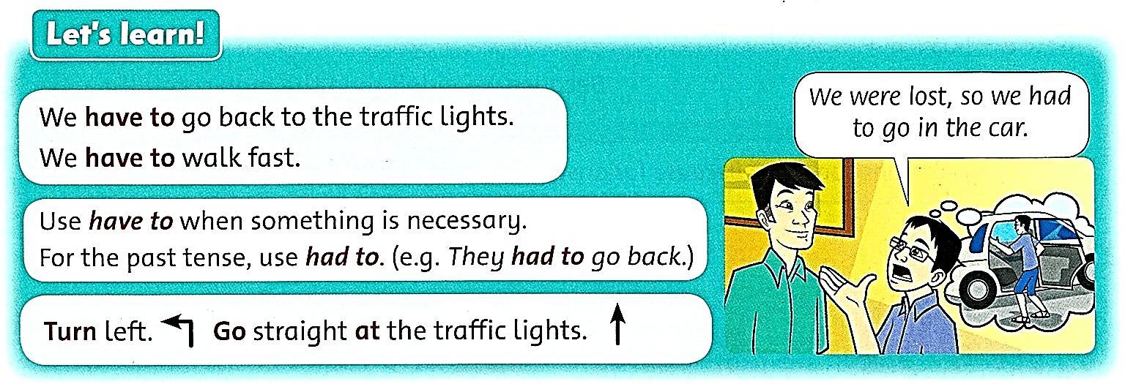
Listen and repeat.

Slide 16
Use have to when something is necessary.
We have to go back to the traffic lights.
We have to walk fast.

Slide 17
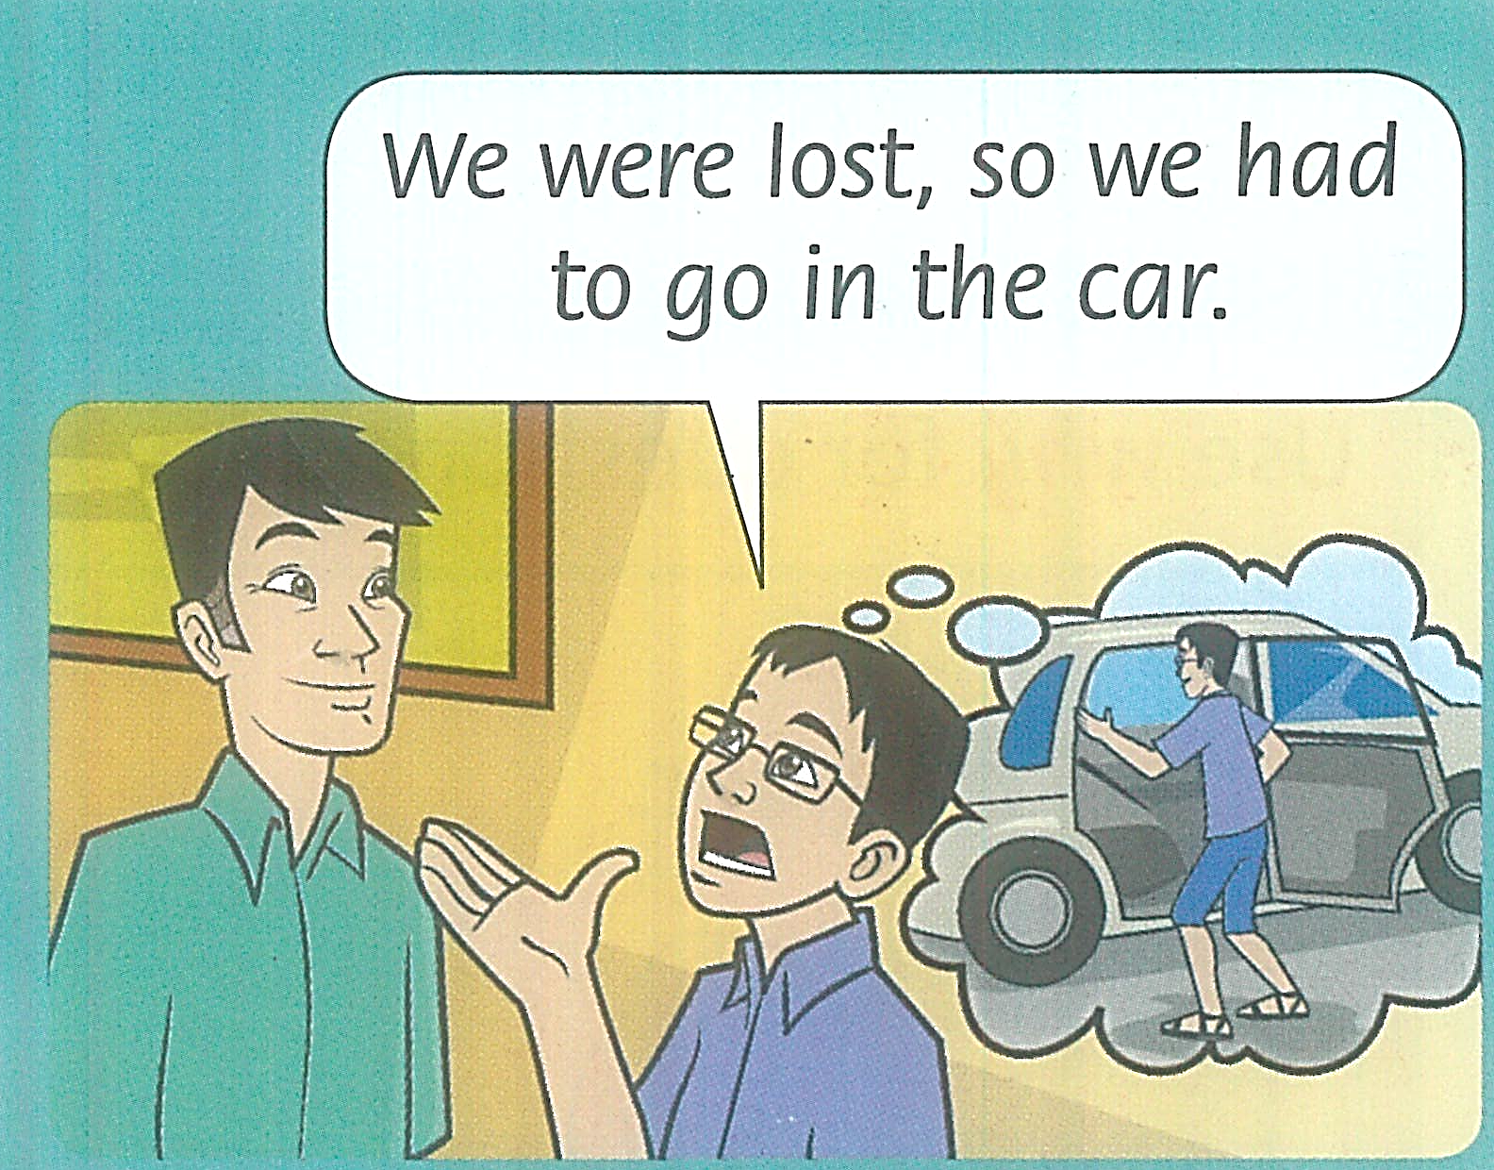
For the past, use had to.

Slide 18
We don’t need a subject when giving directions.
Turn left.
Go straight at the traffic lights.

Slide 19
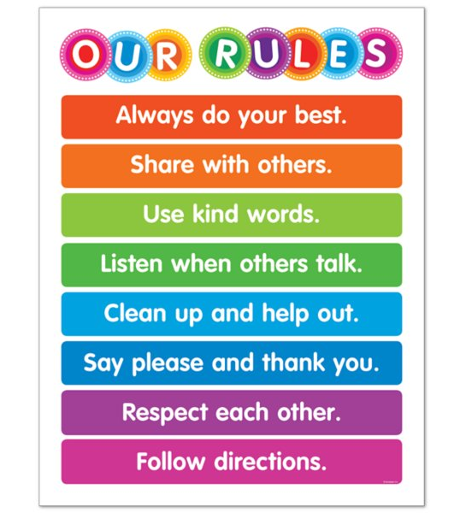
What do the students in Sarah’s class have to do?

Slide 20
Complete the sentences.
We’re late! We ____________________.
They’re lost. They ____________________ again.
The traffic light is red. He ____________________.
I’m at the movie theater already. I _____________.
have to walk fast

Slide 21
Complete the sentences.
We’re late! We ____________________.
They’re lost. They ____________________ again.
The traffic light is red. He ____________________.
I’m at the movie theater already. I _____________.
have to walk fast
have to read the map
has to stop
have to wait

Slide 22
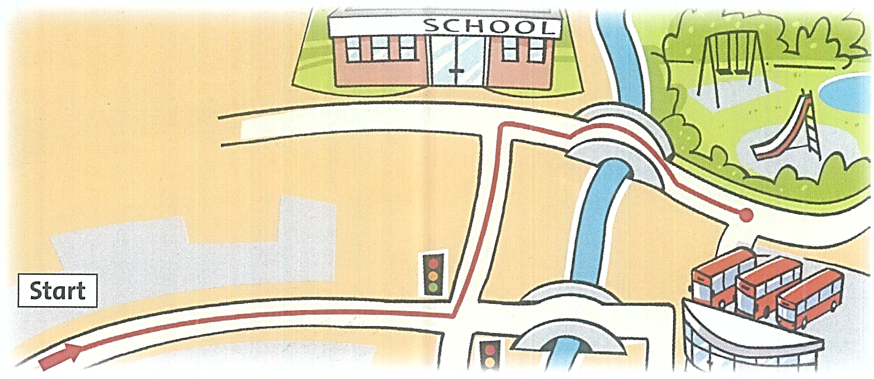
Write directions to the park.
Go ________________.
Turn ________________ at the traffic lights.
Turn ________________ at the school.
Go ________________ the bridge.
The park is ________________ the bus station.
straight

Slide 23
Write directions to the park.
Go ________________.
Turn ________________ at the traffic lights.
Turn ________________ at the school.
Go ________________ the bridge.
The park is ________________ the bus station.
straight
left
right
over
in front of

Slide 24
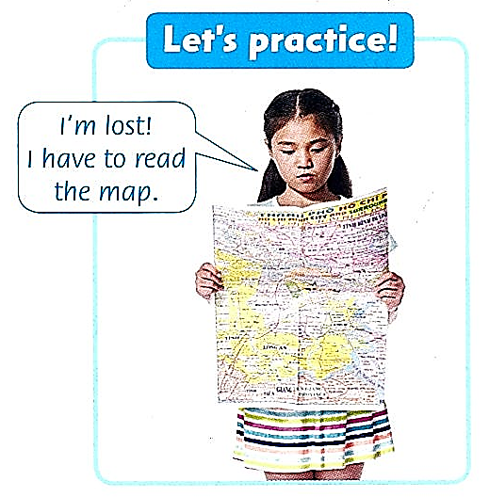

Slide 25
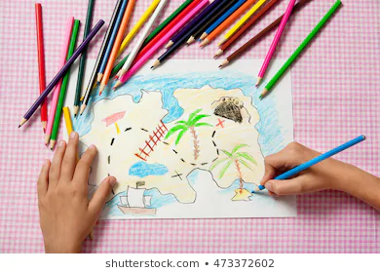
Let’s draw a map from your home to school!

Slide 26
True or False?
You have to go straight.

Slide 27
True or False?
You have to turn right.

Slide 28
True or False?
You have to stop and wait.

Slide 29
WORKBOOK TIME

Slide 30
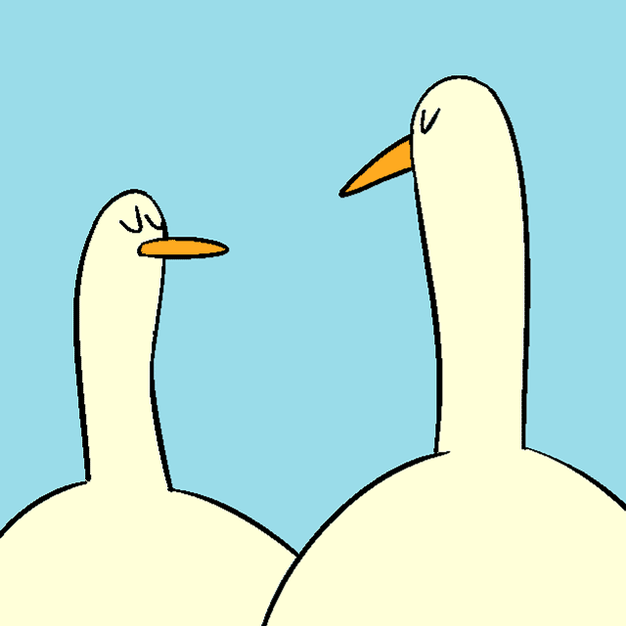
GOODBYE!!!

